Slide 1
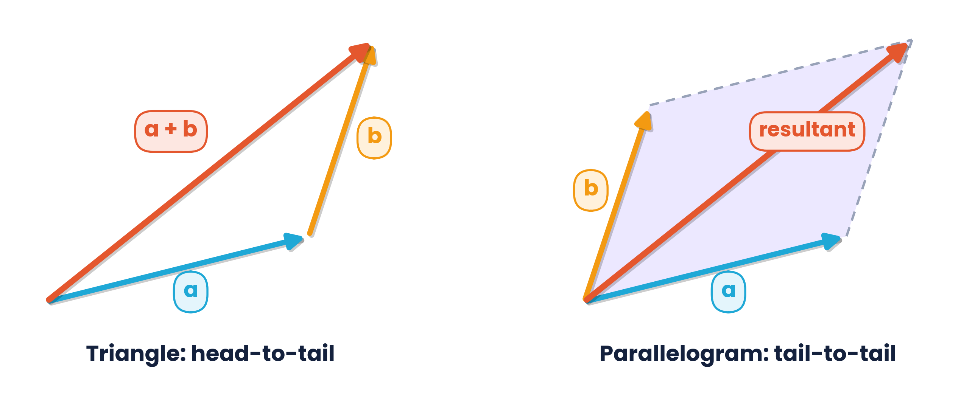
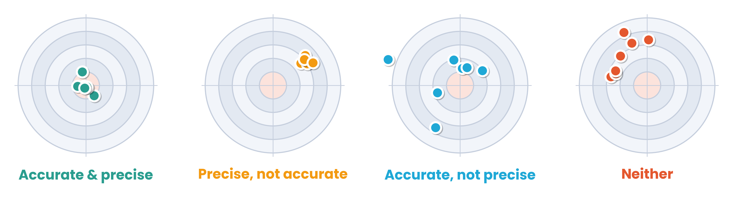
CAMBRIDGE AS & A LEVEL · PHYSICS 9702 · TOPIC 1
Physical Quantities
and Units
SI units · prefixes · uncertainties · vectors · exam practice
Syllabus 1.1 – 1.4 | Exams 2025 – 2027
WA
Waseem Ahmad
Head of Science & IB Physics Lead Teacher
Presidential School, Jizzakh · Cambridge Examiner
Author, Orange Publication · www.examspath.com

Slide 2
CAMBRIDGE INTERNATIONAL 9702 · 2025 – 2027
00
The AS & A Level Physics course
Papers, routes, topics and assessment objectives
Topic 1 · Physical quantities and units | Cambridge International AS Level Physics 9702
2

Slide 3
ASSESSMENT OVERVIEW
Five papers, two stages
Paper 1
Paper 2
Paper 3
Paper 4
Paper 5
Multiple choice
AS structured questions
Advanced practical skills
A Level structured questions
Planning, analysis & evaluation
1 h 15 min · 40 marks
1 h 15 min · 60 marks
2 h · 40 marks
2 h · 100 marks
1 h 15 min · 30 marks
31% AS · 15.5% A Level
46% AS · 23% A Level
23% AS · 11.5% A Level
38.5% A Level
11.5% A Level
AS LEVEL
A LEVEL ONLY
Three routes:
AS only (Papers 1, 2, 3) · staged A Level (AS in Year 1, then Papers 4 and 5) · full A Level in one series. AS grades a–e; A Level grades A*–E.
Topic 1 · Physical quantities and units | Cambridge International AS Level Physics 9702
3

Slide 4
CONTENT OVERVIEW
What you will study
AS LEVEL · TOPICS 1–11
A LEVEL · TOPICS 12–25
1
Physical quantities and units
12
Motion in a circle
19
Capacitance
2
Kinematics
13
Gravitational fields
20
Magnetic fields
3
Dynamics
4
Forces, density and pressure
14
Temperature
21
Alternating currents
5
Work, energy and power
15
Ideal gases
22
Quantum physics
6
Deformation of solids
7
Waves
16
Thermodynamics
23
Nuclear physics
8
Superposition
Oscillations
Medical physics
17
24
9
Electricity
10
D.C. circuits
18
Electric fields
25
Astronomy and cosmology
11
Particle physics
Topic 1 · Physical quantities and units | Cambridge International AS Level Physics 9702
4

Slide 5
HOW MARKS ARE AWARDED
Assessment objectives
AO1
40%
AO2
40%
AO3
20%
Knowledge and understanding
Handling, applying and evaluating information
Experimental skills and investigations
Phenomena, laws, definitions, vocabulary, units and apparatus
Calculations, graphs, patterns, explanations, new situations, problem solving
Planning, recording, analysing and evaluating — Papers 3 and 5 only
Topic 1 · Physical quantities and units | Cambridge International AS Level Physics 9702
5

Slide 6
SYLLABUS 1.1 – 1.4 · PHYSICAL QUANTITIES AND UNITS
What the syllabus asks you to do
1
LO 1.1.1
2
LO 1.1.2
3
LO 1.2.1
4
LO 1.2.2
Every physical quantity = numerical magnitude × unit
Make reasonable estimates of physical quantities
Recall SI base quantities: kg, m, s, A, K
Express derived units in SI base units
5
LO 1.2.3
6
LO 1.2.4
7
LO 1.3.1
8
LO 1.3.2
Use base units to check homogeneity of equations
Recall and use prefixes from pico to tera
Explain systematic (incl. zero) and random errors
Distinguish between precision and accuracy
9
LO 1.3.3
10
LO 1.4.1
11
LO 1.4.2
12
LO 1.4.3
Combine absolute and percentage uncertainties
Distinguish scalars and vectors, with examples
Add and subtract coplanar vectors
Represent a vector as two perpendicular components
Topic 1 · Physical quantities and units | Cambridge International AS Level Physics 9702
6

Slide 7
TOPIC 1 · PHYSICAL QUANTITIES AND UNITS
Lesson roadmap
01
02
03
04
Physical quantities
SI units
Prefixes
Uncertainties
Magnitude, unit and estimates
Base units, derived units, homogeneity
Powers of ten, pico to tera
Errors, precision, combining
05
06
07
08
Measurement
Scalars & vectors
Past paper practice
Doubts & exam tips
Instruments, micrometer, vernier, CRO
Adding, subtracting, resolving
MCQs and structured questions
Misconceptions and technique
Topic 1 · Physical quantities and units | Cambridge International AS Level Physics 9702
7

Slide 8
LEARNING OUTCOMES 1.1.1 – 1.1.2
01
Physical quantities
Magnitude, unit and reasonable estimates
Topic 1 · Physical quantities and units | Cambridge International AS Level Physics 9702
8

Slide 9
1.1.1 · MAGNITUDE AND UNIT
A physical quantity = number × unit
l
=
3.2
×
m
“3.2” alone means nothing — 3.2 m, 3.2 km and 3.2 mm are very different lengths.
symbol (italic)
numerical magnitude
unit
Quantity symbols
Unit symbols
Table & graph labels
written in italics: m, v, F, I, T
upright, no plural, no full stops: 5 kg, not 5 kgs.
quantity / unit, e.g. I / mA, t / s
Topic 1 · Physical quantities and units | Cambridge International AS Level Physics 9702
9

Slide 10
1.1.2 · ORDERS OF MAGNITUDE
Reasonable estimates you should know
70 kg
0.1 kg
2 m
1.5 m s⁻¹
mass of an adult
mass of an apple
height of a door
walking speed
300 m s⁻¹
10⁵ Pa
10⁻²⁷ kg
60 W
speed of sound in air
atmospheric pressure
mass of a hydrogen atom
power of a light bulb
1000 kg
10⁻¹⁰ m
1.5 × 10¹¹ m
3 × 10⁷ s
mass of a car
diameter of an atom
Earth–Sun distance
seconds in a year
Estimate the kinetic energy of a sprinter:
Eₖ = ½mv² ≈ ½ × 70 × 10² ≈ 3500 J, so about 10³ – 10⁴ J. Keep 1 s.f. and check the power of ten.
Topic 1 · Physical quantities and units | Cambridge International AS Level Physics 9702
10

Slide 11
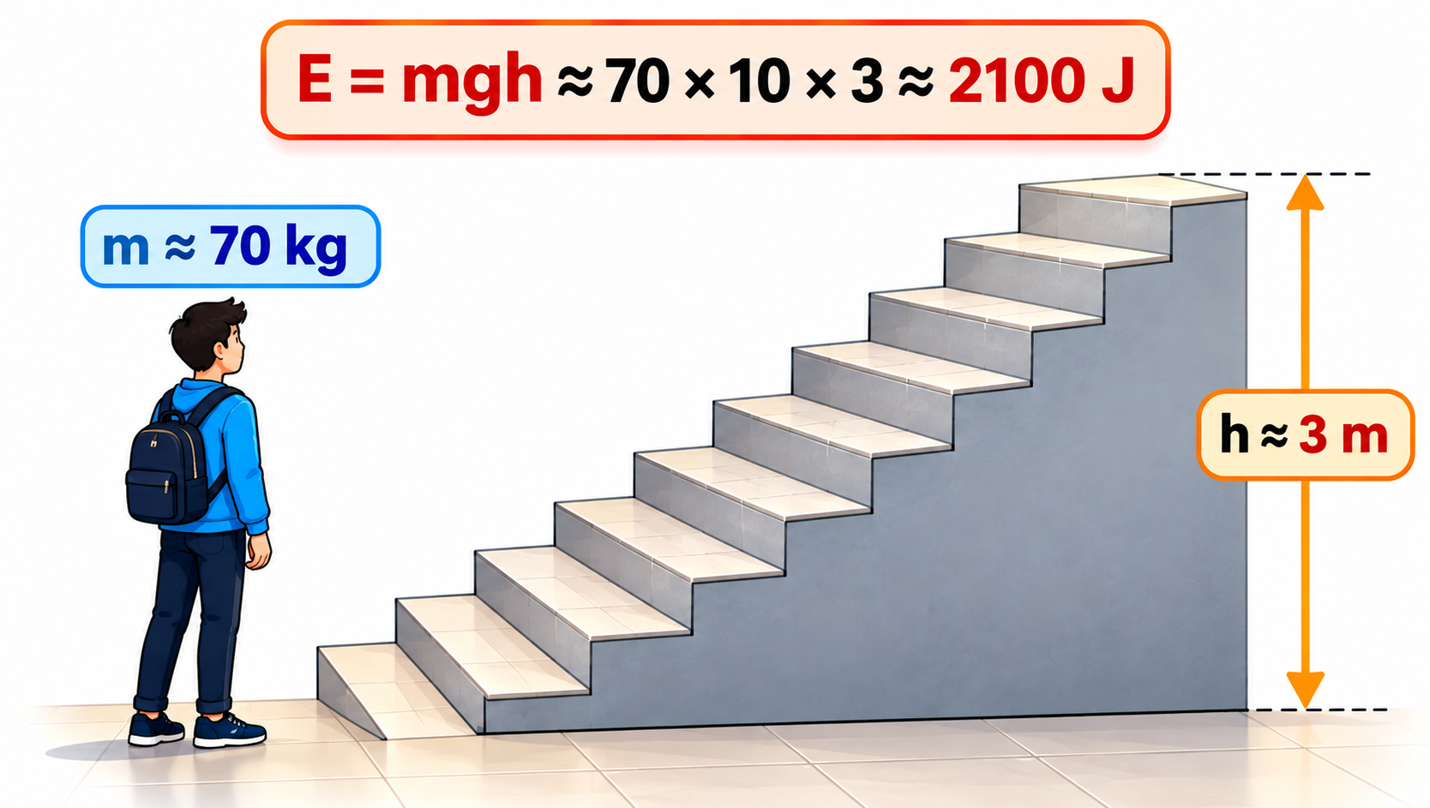
1.1.2 · MAKING AN ESTIMATE
Worked estimate · Climbing the stairs
Estimate the energy an adult needs to climb a flight of stairs.
1
Mass of an adult ≈ 70 kg
2
Height of one flight ≈ 3 m
3
Energy gained = mgh ≈ 70 × 10 × 3
4
E ≈ 2100 J, i.e. about 2 × 10³ J
Exam tip:
mark schemes accept a range for estimates; g ≈ 10 m s⁻² is fine. Many values (c, e, mₑ) are on the data sheet — check there first.
Topic 1 · Physical quantities and units | Cambridge International AS Level Physics 9702
11

Slide 12
LEARNING OUTCOMES 1.2.1 – 1.2.3
02
SI units
Base quantities, derived units and homogeneity
Topic 1 · Physical quantities and units | Cambridge International AS Level Physics 9702
12

Slide 13
1.2.1 · RECALL THE FIVE BASE UNITS
The SI base quantities
kg
m
s
A
K
mass
length
time
current
temperature
kilogram
metre
second
ampere
kelvin
Also a base quantity
Common mistake
Amount of substance, unit mol — used later in Topic 15 (ideal gases).
Newton, joule, volt, coulomb and ohm are NOT base units — they are derived. Charge is derived from current: 1 C = 1 A s.
Topic 1 · Physical quantities and units | Cambridge International AS Level Physics 9702
13

Slide 14
1.2.2 · BUILD UNITS FROM DEFINING EQUATIONS
Derived units in SI base units
Quantity | Defining equation | SI base units
velocity | v = s / t | m s⁻¹
acceleration | a = Δv / t | m s⁻²
force (N) | F = ma | kg m s⁻²
energy / work (J) | W = Fs | kg m² s⁻²
power (W) | P = W / t | kg m² s⁻³
pressure (Pa) | p = F / A | kg m⁻¹ s⁻²
charge (C) | Q = It | A s
p.d. (V) | V = W / Q | kg m² s⁻³ A⁻¹
resistance (Ω) | R = V / I | kg m² s⁻³ A⁻²
Worked example
Express the volt in SI base units.
1
V = W / Q
2
W: kg m² s⁻²; Q: A s
3
V = kg m² s⁻² ÷ (A s)
4
V = kg m² s⁻³ A⁻¹
Topic 1 · Physical quantities and units | Cambridge International AS Level Physics 9702
14

Slide 15
1.2.3 · BOTH SIDES MUST HAVE THE SAME BASE UNITS
Homogeneity: checking an equation with base units
Check s = ut + ½at²
Check v = √(T / μ)
1
Left side: s → m
Wave speed on a string: T = tension (N), μ = mass per unit length (kg m⁻¹)
2
ut → (m s⁻¹)(s) = m
1
T / μ → kg m s⁻² ÷ kg m⁻¹ = m² s⁻²
3
½at² → (m s⁻²)(s²) = m (½ has no unit)
2
√(m² s⁻²) = m s⁻¹ = unit of v ✓
4
Every term is m ⇒ the equation is homogeneous
Homogeneous does not mean correct
Base units cannot check pure numbers (½, 2π), and a term could be missing or wrong. s = ut + at² is homogeneous but physically wrong.
Topic 1 · Physical quantities and units | Cambridge International AS Level Physics 9702
15

Slide 16
1.2.3 · HOMOGENEITY
Worked example · Speed of sound in a gas
The speed of sound in a gas is v = √(γp / ρ), where p is pressure and ρ is density. Show that the constant γ has no units.
1
Rearrange: γ = v²ρ / p
Method
Make the unknown the subject
Replace every quantity by its base units
Simplify powers carefully
Both sides must match
2
v² → m² s⁻²; ρ → kg m⁻³; p → kg m⁻¹ s⁻²
3
γ → (m² s⁻² × kg m⁻³) ÷ (kg m⁻¹ s⁻²) = kg m⁻¹ s⁻² ÷ kg m⁻¹ s⁻²
4
All units cancel, so γ has no units ✓
Topic 1 · Physical quantities and units | Cambridge International AS Level Physics 9702
16

Slide 17
1.2.3 · USING BASE UNITS TO FIND K
Worked example · Finding an unknown power
A sphere of radius r moves at speed v through air of density ρ. The resistive force is F = Br²ρvᵏ, where B and k are constants without units. Use base units to find k.
1
F → kg m s⁻²; r² → m²; ρ → kg m⁻³; vᵏ → mᵏ s⁻ᵏ
Tip
Match the powers of each base unit separately (kg, m, s). Use one to find k and another to check it.
2
Right side: m² × kg m⁻³ × mᵏ s⁻ᵏ = kg m⁽ᵏ⁻¹⁾ s⁻ᵏ
3
Compare powers of s: −k = −2 → k = 2
4
Check with m: k − 1 = 1 ✓ so F = Br²ρv²
Topic 1 · Physical quantities and units | Cambridge International AS Level Physics 9702
17

Slide 18
LEARNING OUTCOME 1.2.4
03
Prefixes
Decimal multiples and submultiples from pico to tera
Topic 1 · Physical quantities and units | Cambridge International AS Level Physics 9702
18

Slide 19
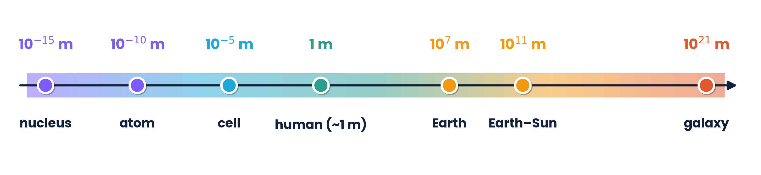
1.2.4 · PHYSICS SPANS A HUGE RANGE OF SIZES
Powers of ten
10⁻¹⁰ m
10²¹ m
31
diameter of an atom
width of a galaxy
powers of ten between them
Topic 1 · Physical quantities and units | Cambridge International AS Level Physics 9702
19

Slide 20
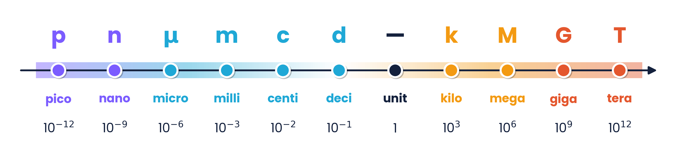
1.2.4 · RECALL AND USE
Prefixes from pico to tera
4.7 μF
650 nm
2.4 GHz
3 MW
= 4.7 × 10⁻⁶ F
= 6.5 × 10⁻⁷ m
= 2.4 × 10⁹ Hz
= 3 × 10⁶ W
Topic 1 · Physical quantities and units | Cambridge International AS Level Physics 9702
20

Slide 21
1.2.4 · SQUARE OR CUBE THE CONVERSION FACTOR
Converting area and volume units
1 cm = 10⁻² m
1 cm² = 10⁻⁴ m²
1 cm³ = 10⁻⁶ m³
1 mm = 10⁻³ m
1 mm² = 10⁻⁶ m²
1 mm³ = 10⁻⁹ m³
Example
Trap
A wire has cross-sectional area 0.20 mm² = 0.20 × 10⁻⁶ m² = 2.0 × 10⁻⁷ m².
Writing 1 cm² = 10⁻² m² is the most common unit error in resistivity and density questions.
Topic 1 · Physical quantities and units | Cambridge International AS Level Physics 9702
21

Slide 22
LEARNING OUTCOMES 1.3.1 – 1.3.3
04
Errors and uncertainties
Systematic and random errors · precision and accuracy · combining uncertainties
Topic 1 · Physical quantities and units | Cambridge International AS Level Physics 9702
22

Slide 23
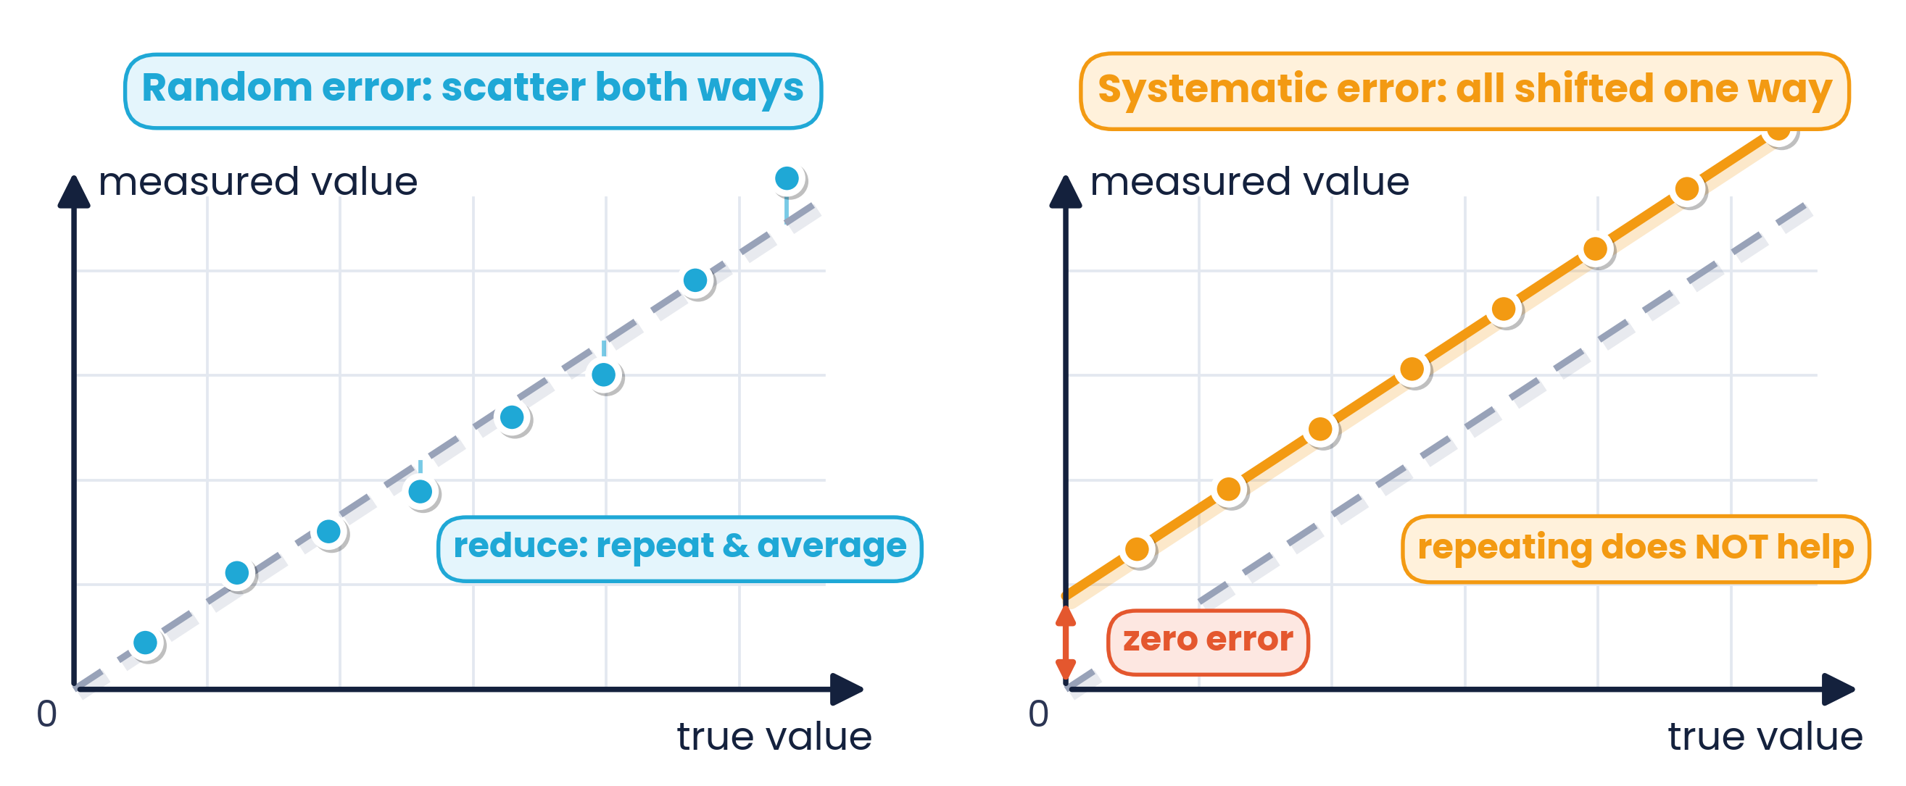
1.3.1 · WHAT CAUSES THEM AND HOW TO REDUCE THEM
Systematic and random errors
Random error
Systematic error
Readings scatter unpredictably either side of the true value (reaction time, parallax, fluctuations). Reduce by repeating readings and averaging, or plotting a graph.
All readings shifted by the same amount or proportion in one direction (zero error, miscalibrated meter). Repeating does not help — correct the reading or recalibrate.
Topic 1 · Physical quantities and units | Cambridge International AS Level Physics 9702
23

Slide 24
1.3.1 · RECOGNISE THEM IN PRACTICAL WORK
Examples of each type of error
Random errors
Systematic errors
Parallax when reading a thermometer or ruler
Human reaction time starting / stopping a stopwatch
Fluctuating digital balance or meter readings
Effect: readings scattered about the true value → lower precision
A ruler with a worn end — always reads too long
Zero error: voltmeter needle not at zero
Stopwatch started late every time
Effect: precise but not accurate; averaging does not remove it
Topic 1 · Physical quantities and units | Cambridge International AS Level Physics 9702
24

Slide 25
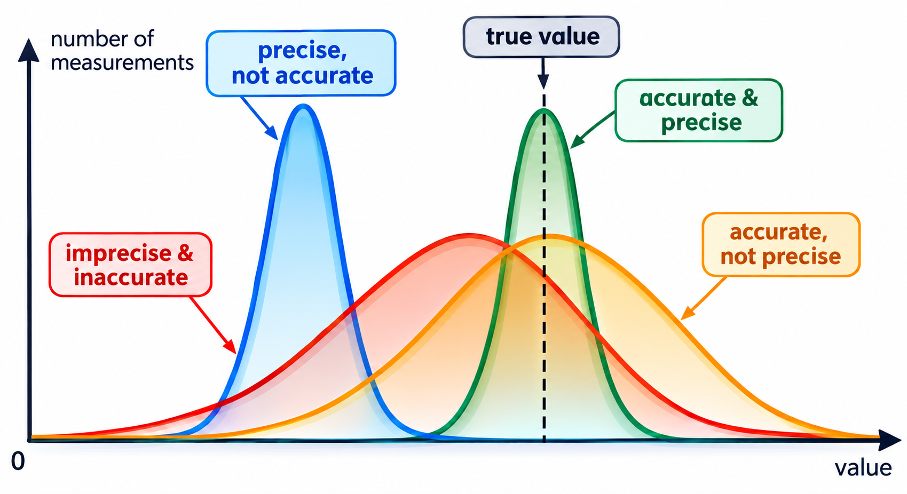
1.3.2 · SPREAD VS POSITION OF THE PEAK
Precision and accuracy on a distribution
Narrow peak = precise (small random error)
Peak at the true value = accurate
A systematic error moves the whole peak sideways
A random error widens the peak
Exam tip: a single reading cannot be ‘precise’ — many decimal places means high resolution
Topic 1 · Physical quantities and units | Cambridge International AS Level Physics 9702
25

Slide 26
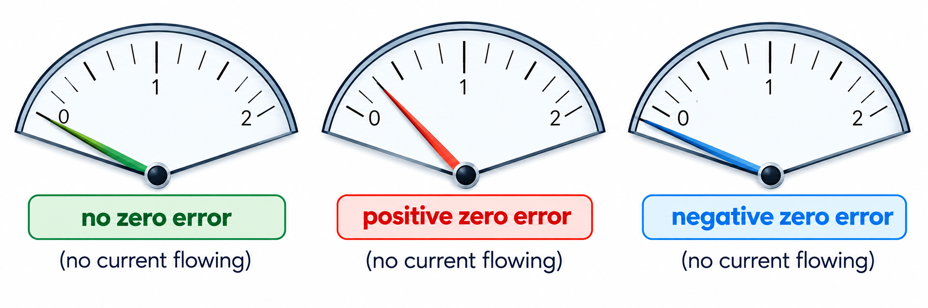
1.3.1 · A SYSTEMATIC ERROR TO CORRECT
Zero error
Correction
Signs
correct = observed − zero error
Micrometer reads 3.25 mm with a +0.02 mm zero error → 3.25 − 0.02 = 3.23 mm
Positive: reads more than the true value
Negative: reads less — subtracting it adds on
Check calipers, micrometers and meters first
Topic 1 · Physical quantities and units | Cambridge International AS Level Physics 9702
26

Slide 27
1.3.2 · TWO DIFFERENT IDEAS
Precision vs accuracy
Accuracy
Precision
How close a measurement (or the mean) is to the true value. Affected by systematic error.
How close repeated measurements are to each other (small spread). Affected by random error.
Topic 1 · Physical quantities and units | Cambridge International AS Level Physics 9702
27

Slide 28
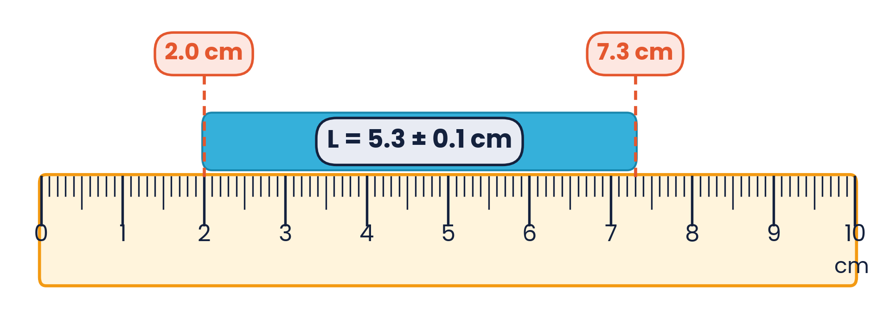
1.3.3 · EXPRESSING UNCERTAINTY
Absolute, fractional and percentage uncertainty
absolute
Δx
same unit as x
fractional
Δx / x
no unit
percentage
(Δx / x) × 100%
no unit
Estimating the uncertainty in a reading
Reading on an analogue scale: ± half the smallest division
A length measured between two marks: at least ± 1 smallest division
Repeated readings: ± half the range = ± ½(largest − smallest)
Digital readings: ± 1 in the last digit, unless stated otherwise
Topic 1 · Physical quantities and units | Cambridge International AS Level Physics 9702
28

Slide 29
1.3.3 · THREE RULES
Combining uncertainties
Add or subtract
Multiply or divide
Powers
x = a ± b
x = ab or a / b
x = aⁿ
Δx = Δa + Δb
%x = %a + %b
%x = n × %a
Add the ABSOLUTE uncertainties
Add the PERCENTAGE uncertainties
Multiply the percentage by the power
Subtraction trap:
(45.3 ± 0.1) cm − (23.7 ± 0.1) cm = 21.6 ± 0.2 cm. Uncertainties always ADD — never subtract them. Constants such as π or ½ carry no uncertainty.
Topic 1 · Physical quantities and units | Cambridge International AS Level Physics 9702
29

Slide 30
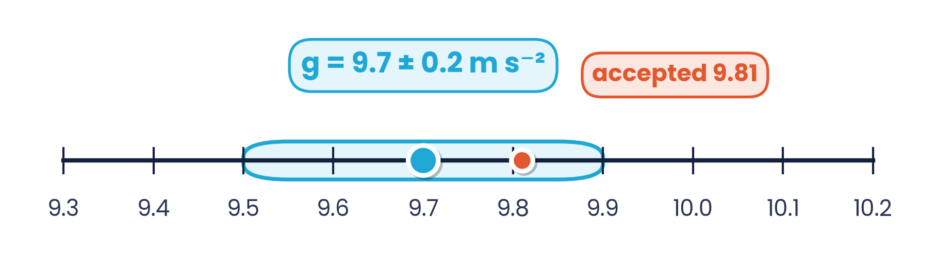
1.3.3 · PERCENTAGE UNCERTAINTIES
Worked example · Uncertainty in g from a pendulum
g = 4π²l / T². l = 0.800 ± 0.002 m and T = 1.80 ± 0.02 s. Calculate g and its absolute uncertainty.
1
g = 4π² × 0.800 / 1.80² = 9.748 m s⁻²
2
%l = 0.002 / 0.800 × 100% = 0.25%
3
%T = 0.02 / 1.80 × 100% = 1.11%; T is squared → 2 × 1.11% = 2.22%
4
%g = 0.25% + 2.22% = 2.5% → Δg = 0.025 × 9.748 = 0.24 m s⁻²
The accepted value 9.81 m s⁻² lies inside 9.5 – 9.9 m s⁻², so the result agrees within its uncertainty.
5
g = 9.7 ± 0.2 m s⁻² (uncertainty to 1 s.f.; value to the same decimal place)
Topic 1 · Physical quantities and units | Cambridge International AS Level Physics 9702
30

Slide 31
1.3.3 · MEAN AND HALF THE RANGE
Worked example · Repeated readings
Five readings of the period of a pendulum are 2.63 s, 2.56 s, 2.42 s, 2.71 s and 2.80 s. Find the mean and its uncertainty.
1
Mean T = (2.63 + 2.56 + 2.42 + 2.71 + 2.80) / 5 = 13.12 / 5 = 2.624 s
Why half the range?
It is the Cambridge-preferred estimate for repeated readings. Some textbooks use the mean absolute deviation (0.11 s here, ≈ 4%) — both show how spread out the data are.
2
Range = 2.80 − 2.42 = 0.38 s
3
Uncertainty = ½ × range = 0.19 s ≈ 0.2 s
4
T = 2.6 ± 0.2 s (percentage uncertainty ≈ 7%)
Topic 1 · Physical quantities and units | Cambridge International AS Level Physics 9702
31

Slide 32
1.3.3 · APPLYING THE RULES
Worked examples · Adding, multiplying and dividing
Subtracting
Multiplying
Dividing
1
Tyre: d₁ = 55.0 ± 0.5 cm, inner d₂ = 21.0 ± 0.7 cm
1
Rectangle: 25.0 ± 0.5 cm by 10.0 ± 0.3 cm
1
Car: s = 50.0 ± 0.1 m, t = 5.00 ± 0.05 s
2
d₁ − d₂ = 34.0 cm
2
Area = 250.0 cm²
2
v = 50.0 / 5.00 = 10.0 m s⁻¹
3
Δ = 0.5 + 0.7 = 1.2 cm
3
% = 2% + 3% = 5% → Δ = 12.5 cm²
3
% = 0.2% + 1.0% = 1.2% → Δ = 0.12 m s⁻¹
4
d₁ − d₂ = 34.0 ± 1.2 cm
4
A = 250 ± 13 cm²
4
v = 10.0 ± 0.1 m s⁻¹
Topic 1 · Physical quantities and units | Cambridge International AS Level Physics 9702
32

Slide 33
1.3.3 · MULTIPLY THE PERCENTAGE BY THE POWER
Worked examples · Powers and roots
Power: volume of a sphere
Root: √B with B = 3.0 ± 0.1
1
r = 2.50 ± 0.02 cm; V = 4/3 πr³
1
√B = √3.0 = 1.73
2
V = 4/3 × π × 2.50³ = 65.5 cm³
2
%B = 0.1 / 3.0 × 100% = 3.33%
3
%r = 0.8% → %V = 3 × 0.8% = 2.4%
3
A square root is a power of ½ → %√B = 1.67%
4
ΔV = 0.024 × 65.5 = 1.6 cm³ → V = 65.5 ± 1.6 cm³
4
Δ = 0.0167 × 1.73 = 0.03 → √B = 1.73 ± 0.03
Topic 1 · Physical quantities and units | Cambridge International AS Level Physics 9702
33

Slide 34
PRACTICAL SKILLS FOR PAPERS 3 AND 5
05
Measurement techniques
Instruments, resolution, micrometer, vernier and the oscilloscope
Topic 1 · Physical quantities and units | Cambridge International AS Level Physics 9702
34

Slide 35
MEASUREMENT TECHNIQUES · RESOLUTION
Choosing an instrument: resolution
Quantity | Instrument | Typical resolution
length | metre rule | 1 mm
length | vernier calipers | 0.1 mm (some 0.02 mm)
length | micrometer screw gauge | 0.01 mm
mass | top-pan balance | 0.01 g
angle | protractor | 1°
time | stopwatch | 0.01 s
temperature | thermometer | 1 °C (digital 0.1 °C)
p.d. | voltmeter | 0.01 V – 0.1 V
current | ammeter | 1 mA – 0.1 A
Resolution
The smallest change in a quantity that causes a change in the instrument's reading.
A digital thermometer (0.1 °C) has a higher resolution than a mercury thermometer (1 °C).
Pick the instrument whose resolution makes the percentage uncertainty small.
Topic 1 · Physical quantities and units | Cambridge International AS Level Physics 9702
35

Slide 36
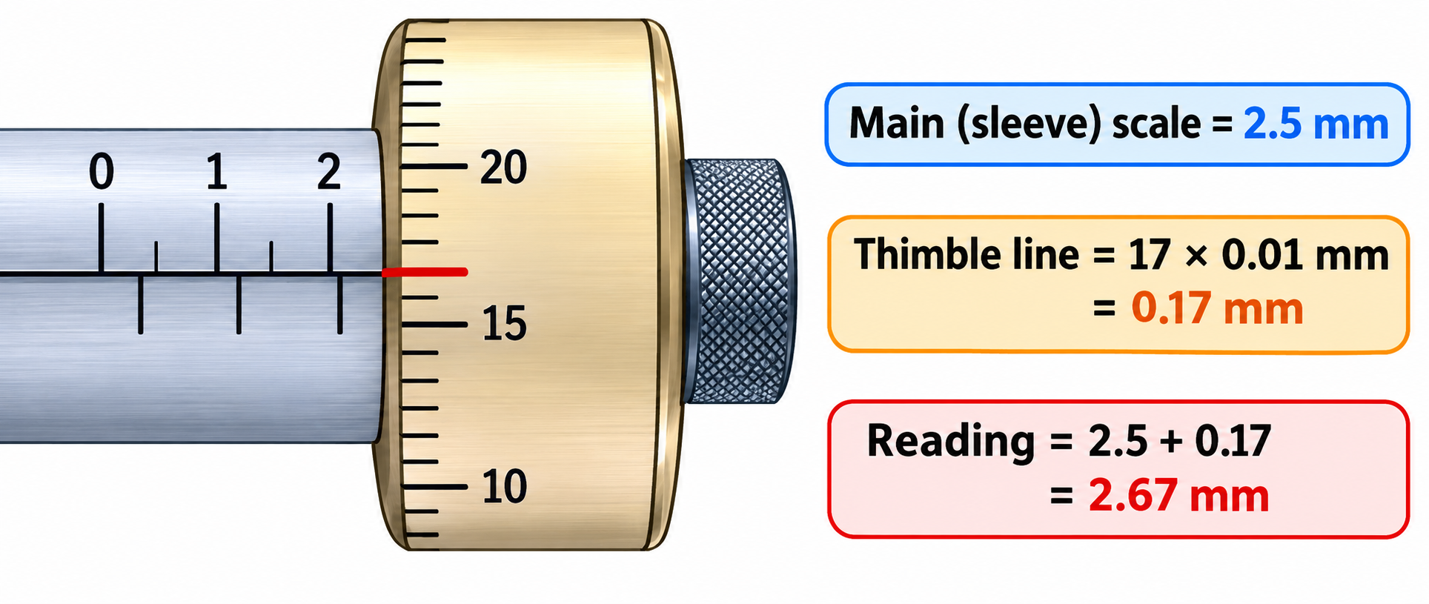
MEASUREMENT TECHNIQUES · RESOLUTION 0.01 MM
Reading a micrometer screw gauge
1
Read the sleeve scale: each division is 0.5 mm → 2.5 mm
2
Read the thimble line level with the datum: 17 × 0.01 mm = 0.17 mm
3
Add: 2.5 + 0.17 = 2.67 mm; check the zero error first
Topic 1 · Physical quantities and units | Cambridge International AS Level Physics 9702
36

Slide 37
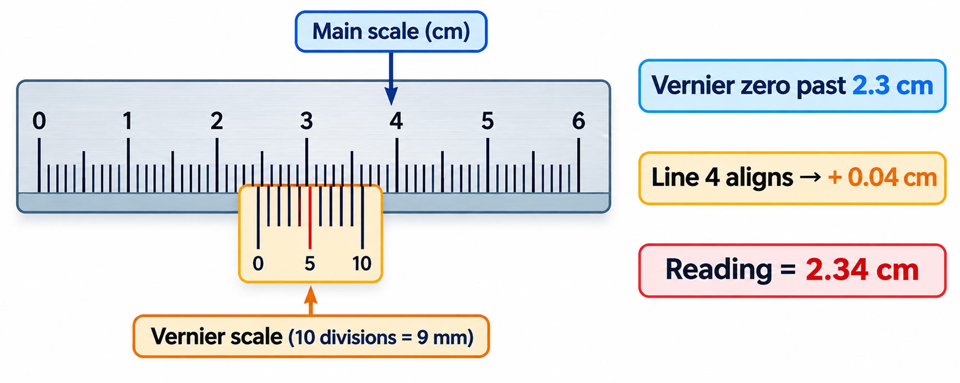
MEASUREMENT TECHNIQUES · RESOLUTION 0.1 MM
Reading vernier calipers
1
Read the main scale just before the vernier zero: 2.3 cm
2
Find the vernier line that lines up exactly with a main-scale line: line 4 → 0.04 cm
3
Add: 2.3 + 0.04 = 2.34 cm. Calipers also measure internal widths and depths
Topic 1 · Physical quantities and units | Cambridge International AS Level Physics 9702
37

Slide 38
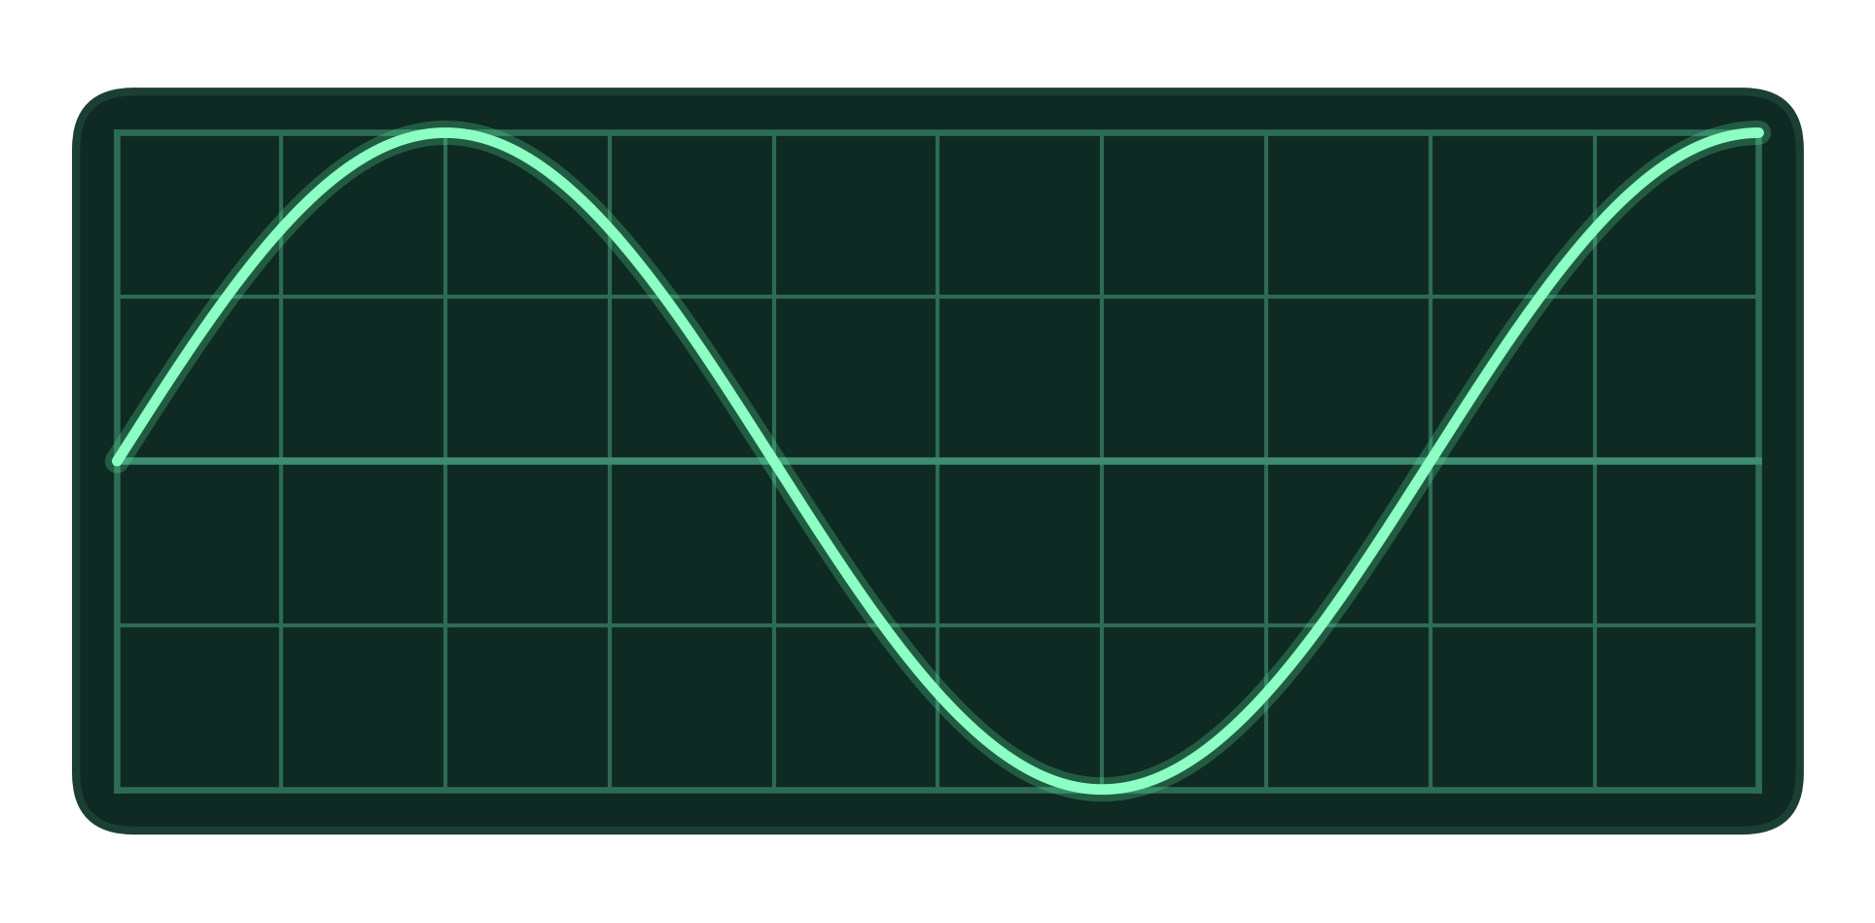
MEASUREMENT TECHNIQUES · TIME-BASE AND Y-GAIN
The cathode-ray oscilloscope (CRO)
Time-base (x-axis)
time per division, e.g. 2.0 ms div⁻¹
T = (number of divisions for one cycle) × time-base
f = 1 / T
Y-gain (y-axis)
Displays a p.d. against time.
A.C. → a wave; D.C. → a horizontal line; time-base off → a vertical line whose length shows the peak-to-peak p.d.
volts per division, e.g. 1.5 V div⁻¹
V₀ = (divisions from centre to peak) × y-gain
Use as many cycles as possible to reduce uncertainty
Topic 1 · Physical quantities and units | Cambridge International AS Level Physics 9702
38

Slide 39
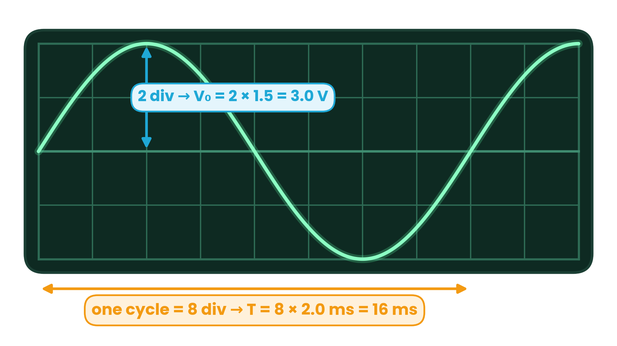
MEASUREMENT TECHNIQUES · PERIOD, FREQUENCY, PEAK P.D.
Worked example · Reading a CRO trace
Time-base 2.0 ms per division; y-gain 1.5 V per division. Find T, f and V₀.
1
One cycle spans 8 divisions
2
T = 8 × 2.0 ms = 16 ms
3
f = 1 / T = 1 / 0.016 s = 63 Hz
4
V₀ = 2 div × 1.5 V div⁻¹ = 3.0 V
Topic 1 · Physical quantities and units | Cambridge International AS Level Physics 9702
39

Slide 40
LEARNING OUTCOMES 1.4.1 – 1.4.3
06
Scalars and vectors
Adding, subtracting and resolving coplanar vectors
Topic 1 · Physical quantities and units | Cambridge International AS Level Physics 9702
40

Slide 41
1.4.1 · MAGNITUDE ONLY, OR MAGNITUDE AND DIRECTION
Scalars and vectors
SCALARS
VECTORS
magnitude only
magnitude and direction
distance
speed
displacement
velocity
mass
time
acceleration
force / weight
energy / work
power
momentum
electric field strength
temperature
density
gravitational field strength
magnetic flux density
pressure
charge
Topic 1 · Physical quantities and units | Cambridge International AS Level Physics 9702
41

Slide 42
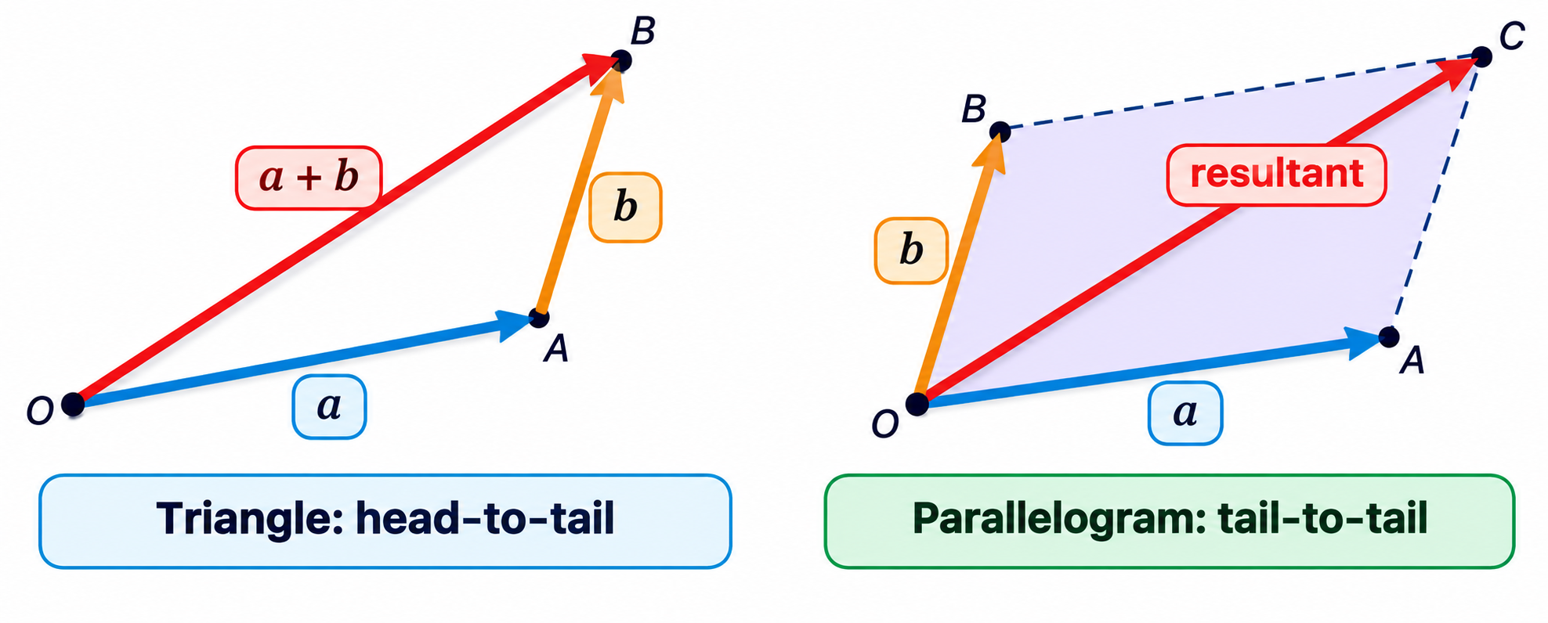
1.4.2 · TRIANGLE AND PARALLELOGRAM RULES
Adding vectors
Rules
Draw vectors to scale, head-to-tail; the resultant joins the first tail to the last head
Or place them tail-to-tail; the diagonal of the parallelogram is the resultant
State the scale and measure both length and angle
Resultant of 3 N and 4 N lies between 1 N and 7 N
Coplanar forces in equilibrium form a closed triangle — the resultant is zero (used again in Topic 4).
Topic 1 · Physical quantities and units | Cambridge International AS Level Physics 9702
42

Slide 43
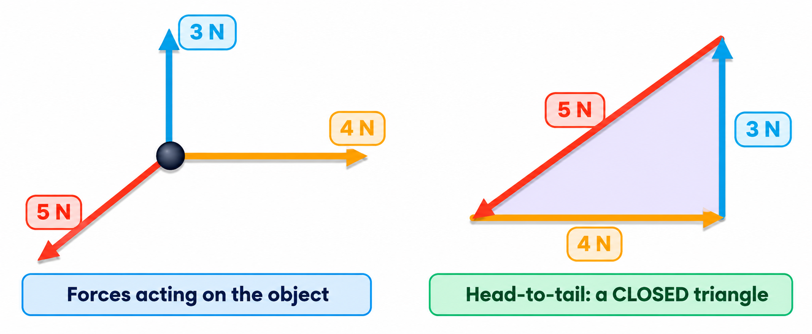
1.4.2 · A CLOSED VECTOR TRIANGLE
Coplanar forces in equilibrium
If three coplanar forces on an object are in equilibrium,
drawn head-to-tail they form a closed triangle — the resultant force is zero. 3 N, 4 N and 5 N form a right-angled triangle.
Topic 1 · Physical quantities and units | Cambridge International AS Level Physics 9702
43

Slide 44
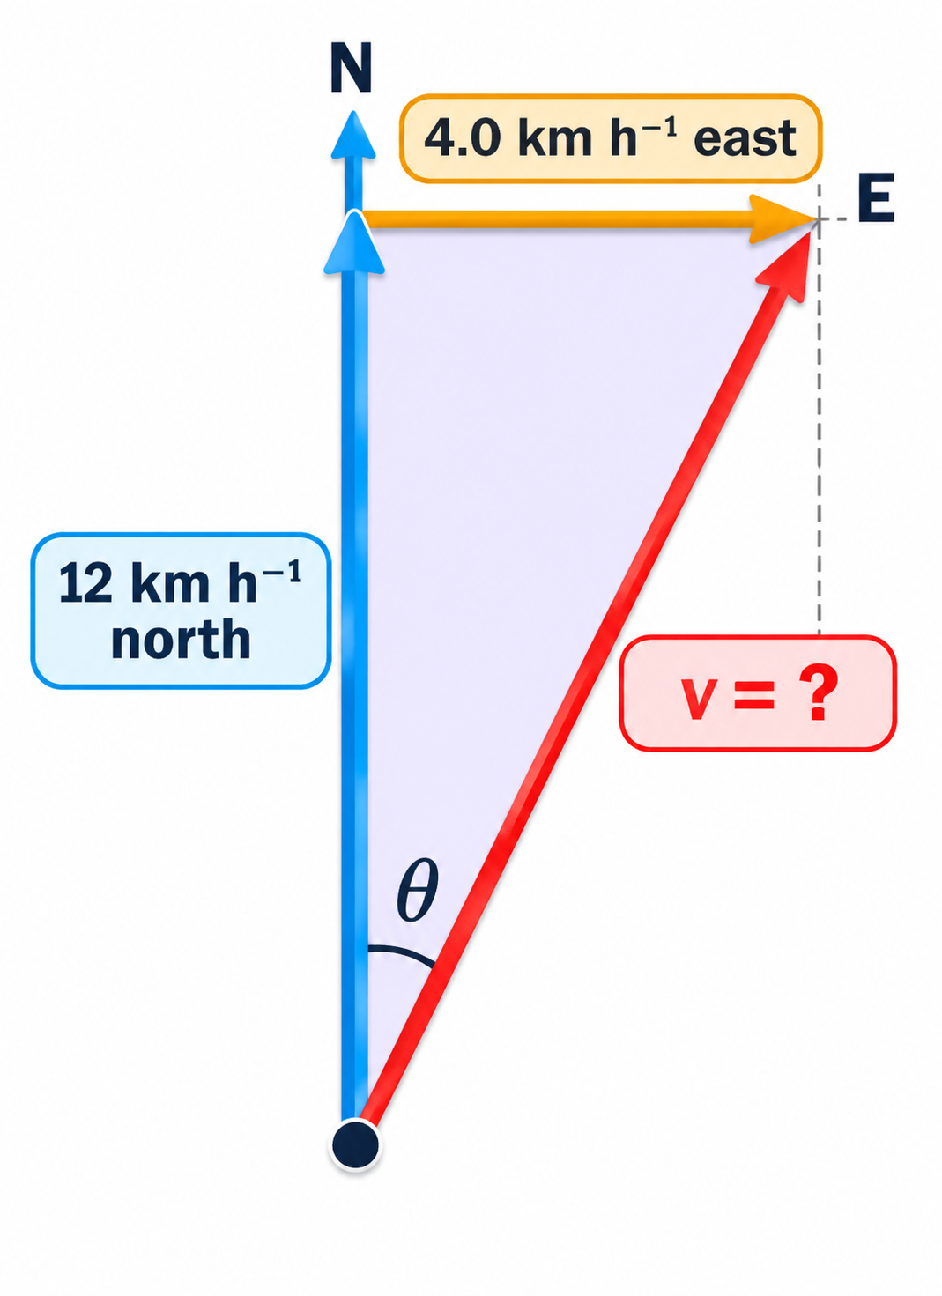
1.4.2 · SCALE DRAWING AND CALCULATION
Worked example · Ship in a current
A ship travels due north at 12 km h⁻¹ relative to the water. A current flows at 4.0 km h⁻¹ towards the east. Determine the velocity of the ship by (a) scale drawing, (b) calculation.
(a) Scale drawing
(b) Calculation
Scale 1 cm : 2 km h⁻¹
Draw 6.0 cm north, then 2.0 cm east
Measure resultant ≈ 6.3 cm → 12.6 km h⁻¹
Protractor: ≈ 18° east of north
v = √(12² + 4.0²)
v = √160 = 12.6 km h⁻¹
tan θ = 4.0 / 12 → θ = 18°
v = 13 km h⁻¹ at 18° east of north
Topic 1 · Physical quantities and units | Cambridge International AS Level Physics 9702
44

Slide 45
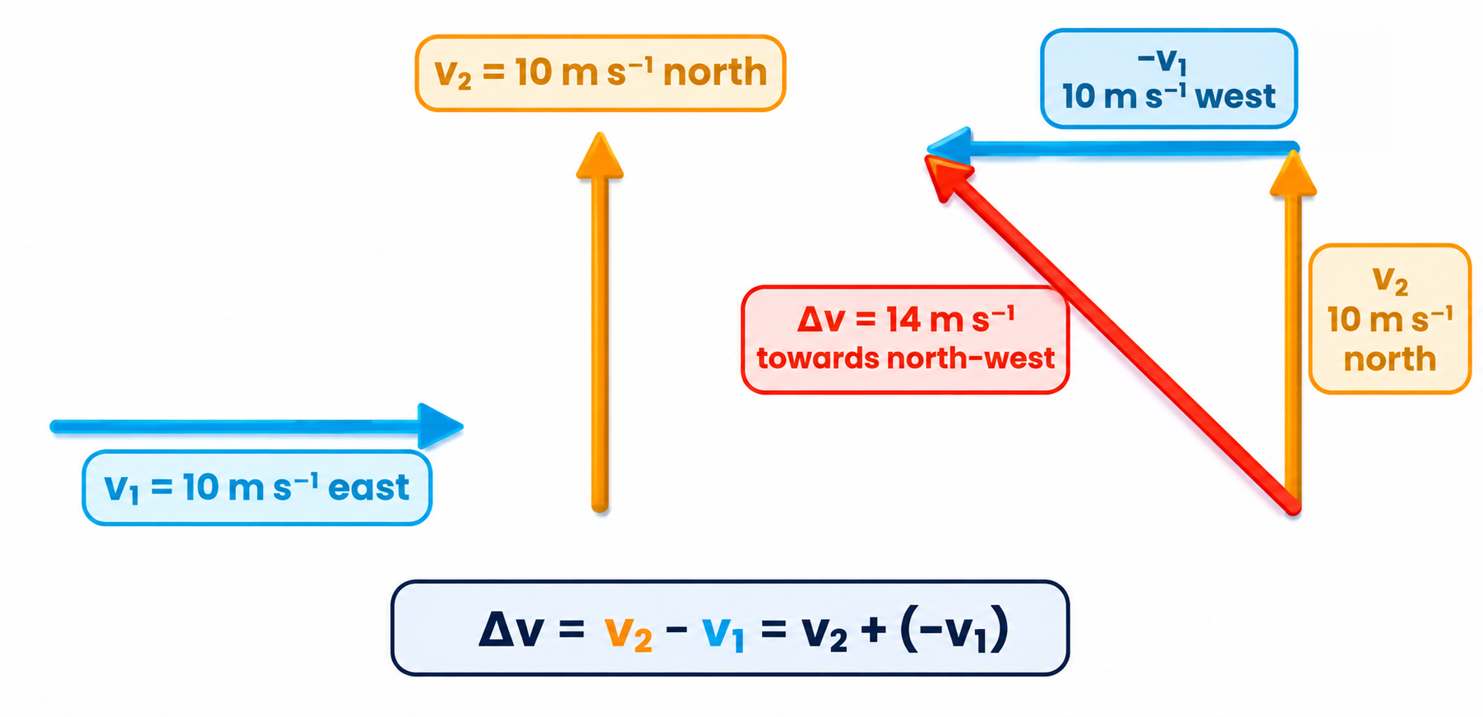
1.4.2 · ΔV = V₂ − V₁ = V₂ + (−V₁)
Subtracting vectors: change in velocity
Method:
reverse v₁ to get −v₁, then add it head-to-tail to v₂.
Key point:
the speed is unchanged (10 m s⁻¹), yet Δv = √(10² + 10²) = 14 m s⁻¹ — so the car accelerated.
Topic 1 · Physical quantities and units | Cambridge International AS Level Physics 9702
45

Slide 46
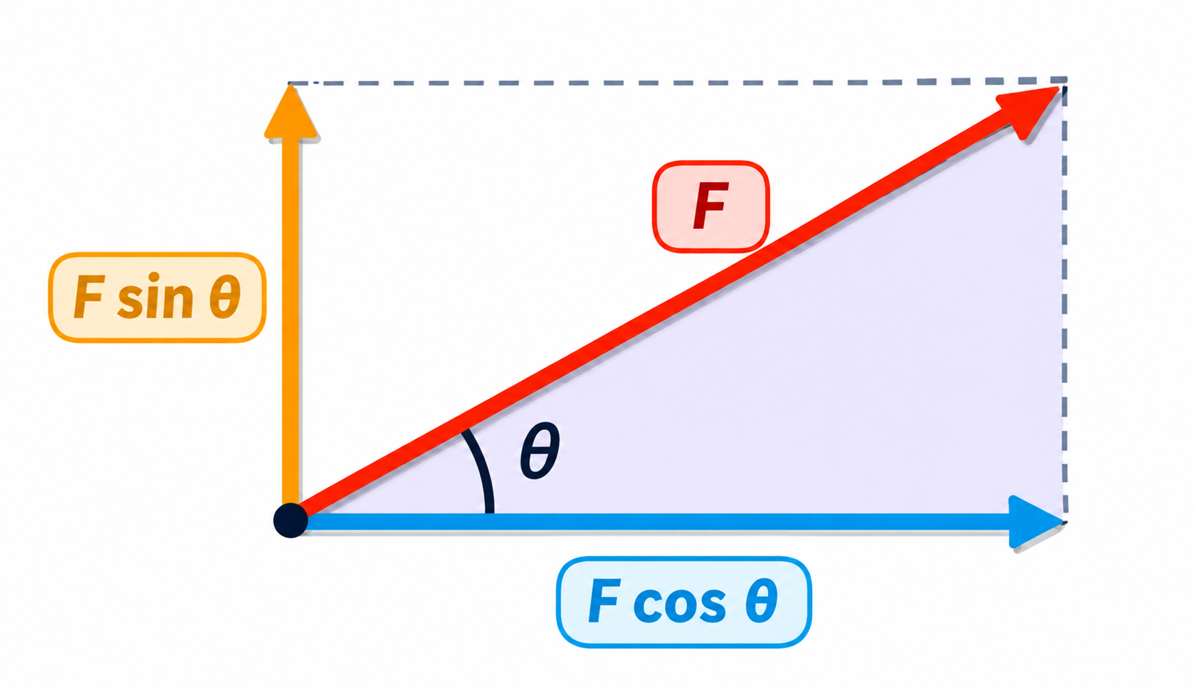
1.4.3 · TWO PERPENDICULAR COMPONENTS
Resolving a vector into components
Adjacent to θ: F cos θ
Opposite θ: F sin θ
Example: 50 N at 30° above horizontal
horizontal = 50 cos 30° = 43.3 N; vertical = 50 sin 30° = 25.0 N
Check:
(F cos θ)² + (F sin θ)² = F². The two components together replace F — never add them to F as extra forces.
Topic 1 · Physical quantities and units | Cambridge International AS Level Physics 9702
46

Slide 47
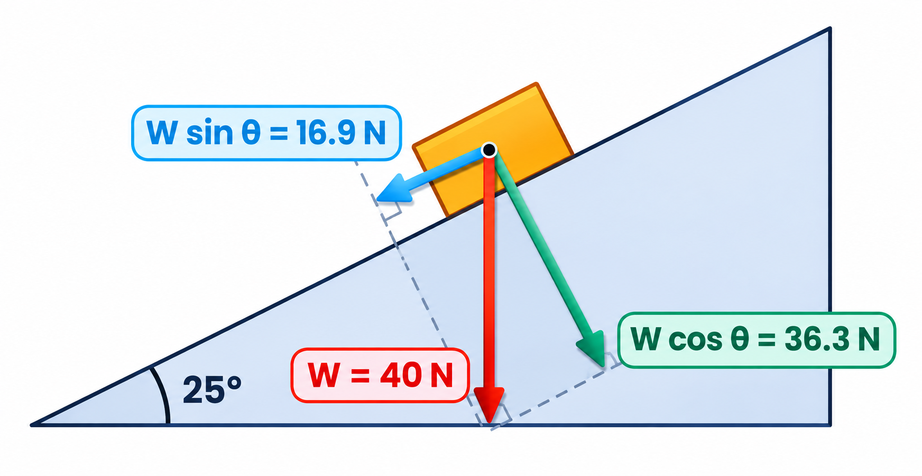
1.4.3 · WEIGHT ALONG AND PERPENDICULAR TO THE SLOPE
Resolving on an inclined plane
A box of weight 40 N rests on a slope inclined at 25° to the horizontal.
1
The angle between W and the normal to the slope equals θ
2
Along the slope: W sin θ = 40 sin 25° = 16.9 N
3
Into the slope: W cos θ = 40 cos 25° = 36.3 N
4
Check: √(16.9² + 36.3²) = 40 N ✓
Topic 1 · Physical quantities and units | Cambridge International AS Level Physics 9702
47

Slide 48
CAMBRIDGE PAST PAPER QUESTIONS
07
Past paper practice
Paper 1 multiple choice · Paper 2 structured questions
Topic 1 · Physical quantities and units | Cambridge International AS Level Physics 9702
48

Slide 49
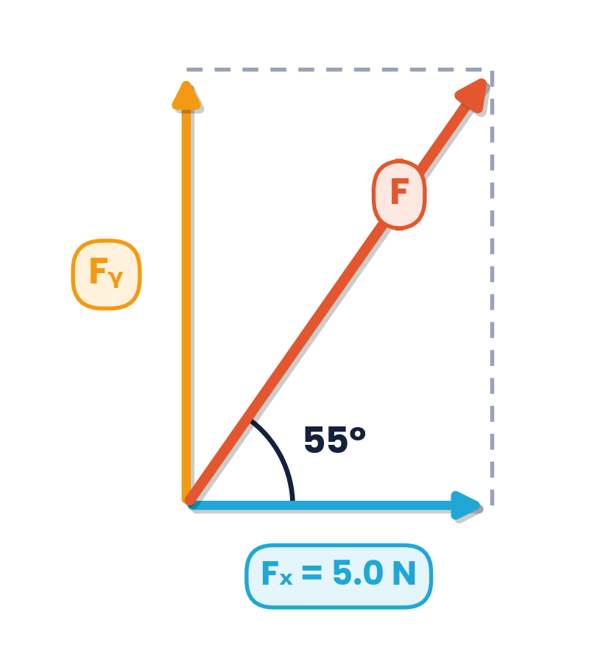
PAPER 1 STYLE · MULTIPLE CHOICE
Past paper set A · Units and vectors
1
What is essential when recording a measurement of a physical quantity?
2
What is the unit of resistance when expressed in SI base units?
A the measurement has an SI unit
B the measurement has a unit and a number
C the measurement has a unit given as a base unit
D the measurement is from an analogue scale
A kg⁻¹ m⁻² s A²
B kg⁻¹ m⁻² s³ A²
C kg m² s⁻¹ A⁻²
D kg m² s⁻³ A⁻²
3
A force F is resolved into a vertical component Fᵧ and a horizontal component Fₓ = 5.0 N. F makes 55° with the horizontal. What is Fᵧ?
4
Four force vectors have these components (x, y) in N: A (2, 9), B (3, 8), C (4, 7), D (5, 6). Which has the largest magnitude?
A (2, 9)
B (3, 8)
C (4, 7)
D (5, 6)
A 2.9 N
B 3.5 N
C 7.1 N
D 8.7 N
Topic 1 · Physical quantities and units | Cambridge International AS Level Physics 9702
49

Slide 50
ANSWERS AND KEY WORKING
Past paper set A · Answers
1
Answer B
2
Answer D
A physical quantity needs a numerical magnitude and a unit. The unit need not be SI or a base unit.
R = V / I; V = kg m² s⁻³ A⁻¹, so R = kg m² s⁻³ A⁻².
3
Answer C
4
Answer A
tan 55° = Fᵧ / Fₓ → Fᵧ = 5.0 × tan 55° = 7.1 N. B (3.5 N) uses tan 35°.
|F| = √(x² + y²): A √85 = 9.2 N, B √73 = 8.5 N, C √65 = 8.1 N, D √61 = 7.8 N.
Topic 1 · Physical quantities and units | Cambridge International AS Level Physics 9702
50

Slide 51
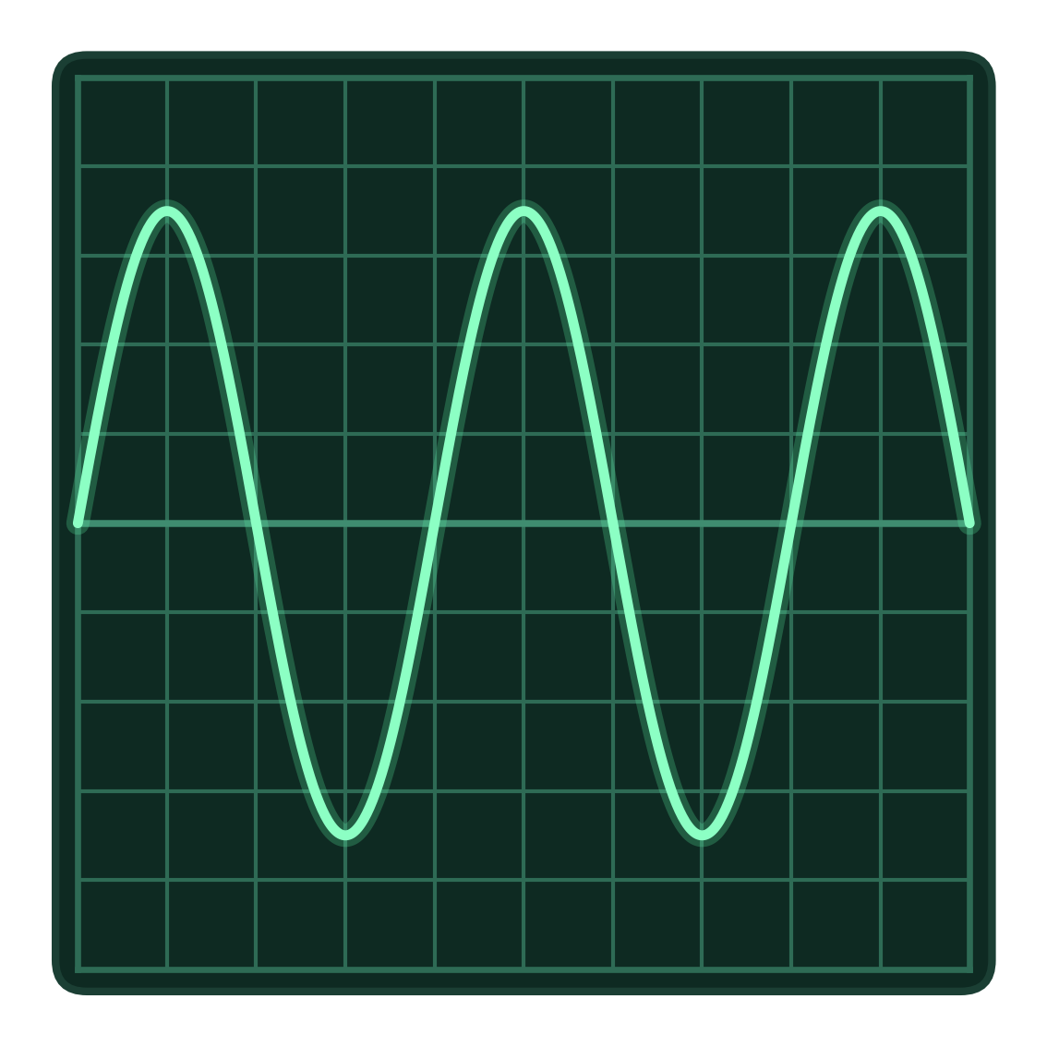
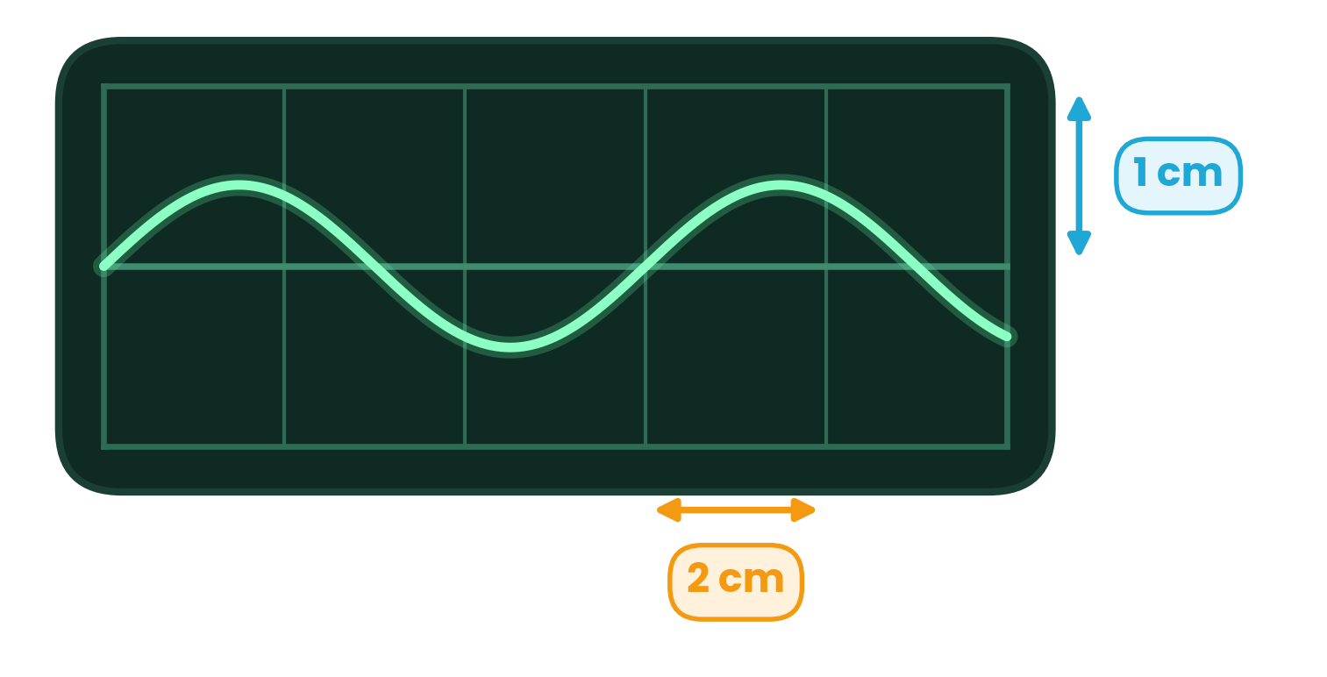
PAPER 1 STYLE · MULTIPLE CHOICE
Past paper set B · CRO, prefixes, uncertainty
5
C.r.o. trace (squares 1 cm): time-base 0.5 ms cm⁻¹, Y-sensitivity 2 V cm⁻¹. Which statement is correct?
6
Trace of a sound wave; time-base 7 μs mm⁻¹. What is the frequency of the sound wave?
A The amplitude is 3.5 cm.
B The frequency is 0.5 kHz.
C The period is 1 ms.
D The wavelength is 4 cm.
A 2.4 Hz
B 24 Hz
C 2.4 kHz
D 24 kHz
7
The cross-sectional area of a wire is 1.5 mm². What is this area in m²?
8
The power dissipated in a resistor is P = V² / R. The uncertainty in V is 4% and in R is 2%. What is the percentage uncertainty in P?
A 1.5 × 10⁻³ m²
B 1.5 × 10⁻⁴ m²
C 1.5 × 10⁻⁶ m²
D 1.5 × 10⁻⁹ m²
A 2%
B 6%
C 8%
D 10%
Topic 1 · Physical quantities and units | Cambridge International AS Level Physics 9702
51

Slide 52
ANSWERS AND KEY WORKING
Past paper set B · Answers
5
Answer B
6
Answer C
T = 4 cm × 0.5 ms cm⁻¹ = 2 ms, so f = 1/T = 500 Hz = 0.5 kHz. The amplitude is 3.5 cm × 2 V cm⁻¹ = 7 V, not ‘3.5 cm’.
6 cm = 60 mm; T = 60 × 7 μs = 4.2 × 10⁻⁴ s; f = 1/T = 2400 Hz = 2.4 kHz.
7
Answer C
8
Answer D
1 mm² = (10⁻³ m)² = 10⁻⁶ m². A forgets to square the prefix.
%P = 2 × %V + %R = 2 × 4% + 2% = 10%.
Topic 1 · Physical quantities and units | Cambridge International AS Level Physics 9702
52
Notes:
Q5 is a classic trap: amplitude must be a voltage, and 4 cm is the length of one cycle on the screen, not a wavelength.

Slide 53
PAPER 1 STYLE · MULTIPLE CHOICE
Exam-style set C · Quick checks
9
Which pair contains one scalar quantity and one vector quantity?
10
Which estimate is the most reasonable?
A displacement, acceleration
B force, kinetic energy
C momentum, velocity
D power, speed
A mass of an apple ≈ 1 kg
B height of a classroom door ≈ 2 m
C walking speed ≈ 10 m s⁻¹
D power of an electric kettle ≈ 20 W
11
Two forces of 3.0 N and 4.0 N act at a point. Which value is not a possible magnitude of their resultant?
12
Repeated readings are close together but all far from the true value. How are the readings described?
A 1.0 N
B 5.0 N
C 7.0 N
D 8.0 N
A accurate and precise
B precise but not accurate
C accurate but not precise
D neither accurate nor precise
Topic 1 · Physical quantities and units | Cambridge International AS Level Physics 9702
53

Slide 54
ANSWERS AND KEY WORKING
Exam-style set C · Answers
9
Answer B
10
Answer B
Force is a vector; kinetic energy is a scalar.
A door is about 2 m tall. An apple ≈ 0.1 kg, walking ≈ 1.5 m s⁻¹, a kettle ≈ 2 kW.
11
Answer D
12
Answer B
The resultant lies between 1.0 N (opposite) and 7.0 N (parallel).
Small spread = precise; far from the true value = not accurate.
Topic 1 · Physical quantities and units | Cambridge International AS Level Physics 9702
54

Slide 55
PAPER 2 STYLE · STRUCTURED QUESTION
Past paper 1 · SI base units
(a) In the list: ampere, coulomb, metre, newton — identify all the units that are SI base units.
(b) A sphere of radius r moves at speed v through air of density ρ. The resistive force F is given by F = Br²ρvᵏ, where B and k are constants without units.
(a) State which of the units are SI base units. [1]
(b)(i) State the SI base units of F, ρ and v. [3]
(b)(ii) Use base units to determine the value of k. [2]
Topic 1 · Physical quantities and units | Cambridge International AS Level Physics 9702
55

Slide 56
MARK SCHEME STYLE SOLUTION
Past paper 1 · Solution
(a)
ampere and metre (the coulomb = A s and the newton = kg m s⁻² are derived)
(b)(i)
F: kg m s⁻²; ρ: kg m⁻³; v: m s⁻¹
(b)(ii)
kg m s⁻² = m² × kg m⁻³ × (m s⁻¹)ᵏ = kg m⁽ᵏ⁻¹⁾ s⁻ᵏ → powers of s: k = 2 (check m: 2 − 1 = 1 ✓)
Topic 1 · Physical quantities and units | Cambridge International AS Level Physics 9702
56

Slide 57
PAPER 2 STYLE · STRUCTURED QUESTION
Past paper 2 · Base units of power and p.d.
Power is the rate of doing work. The power in an electrical component can be written as P = VI.
(a) Use the definition of power to show that the SI base units of power are kg m² s⁻³. [2]
(b) Use an expression for electrical power to determine the SI base units of potential difference. [2]
Topic 1 · Physical quantities and units | Cambridge International AS Level Physics 9702
57

Slide 58
MARK SCHEME STYLE SOLUTION
Past paper 2 · Solution
(a)
P = W / t = Fs / t; F → kg m s⁻²; Fs → kg m² s⁻²; ÷ s → kg m² s⁻³
(b)
V = P / I → kg m² s⁻³ ÷ A = kg m² s⁻³ A⁻¹
Topic 1 · Physical quantities and units | Cambridge International AS Level Physics 9702
58

Slide 59
PAPER 2 STYLE · STRUCTURED QUESTION
Past paper 3 · Flow through a pipe
The volume V of liquid that flows through a pipe in time t is given by V / t = πPr⁴ / (8Cl), where P is the pressure difference between the ends of the pipe of radius r and length l. The constant C depends on the frictional effects of the liquid.
Determine the base units of C. [3]
Topic 1 · Physical quantities and units | Cambridge International AS Level Physics 9702
59

Slide 60
MARK SCHEME STYLE SOLUTION
Past paper 3 · Solution
Step 1
Rearrange: C = πPr⁴t / (8Vl)
Step 2
P → kg m⁻¹ s⁻²; r⁴ → m⁴; t → s; V → m³; l → m
Step 3
C → (kg m⁻¹ s⁻² × m⁴ × s) ÷ (m³ × m) = kg m⁻¹ s⁻¹
Topic 1 · Physical quantities and units | Cambridge International AS Level Physics 9702
60

Slide 61
PAPER 2 STYLE · STRUCTURED QUESTION
Past paper 4 · Current in a wire
(a) The current in a wire is I. Charge Q passes one point in the wire in time t.
(b) The current is due to electrons, each with charge q, moving along the wire with speed v. There are n electrons per unit volume. For a wire of cross-sectional area S, I = nSqvᵏ, where k is a constant.
(a)(i) State the relation between I, Q and t. [1]
(a)(ii) State which of I, Q and t are base quantities. [2]
(b)(i) State the units of I, n, S, q and v in terms of base units. [3]
(b)(ii) Use base units to determine the value of k. [1]
Topic 1 · Physical quantities and units | Cambridge International AS Level Physics 9702
61

Slide 62
MARK SCHEME STYLE SOLUTION
Past paper 4 · Solution
(a)
I = Q / t (or Q = It). Base quantities: current I and time t (charge is derived)
(b)(i)
I: A; n: m⁻³; S: m²; q: A s; v: m s⁻¹
(b)(ii)
A = m⁻³ × m² × A s × (m s⁻¹)ᵏ = A m⁽ᵏ⁻¹⁾ s⁽¹⁻ᵏ⁾ → k = 1
Topic 1 · Physical quantities and units | Cambridge International AS Level Physics 9702
62

Slide 63
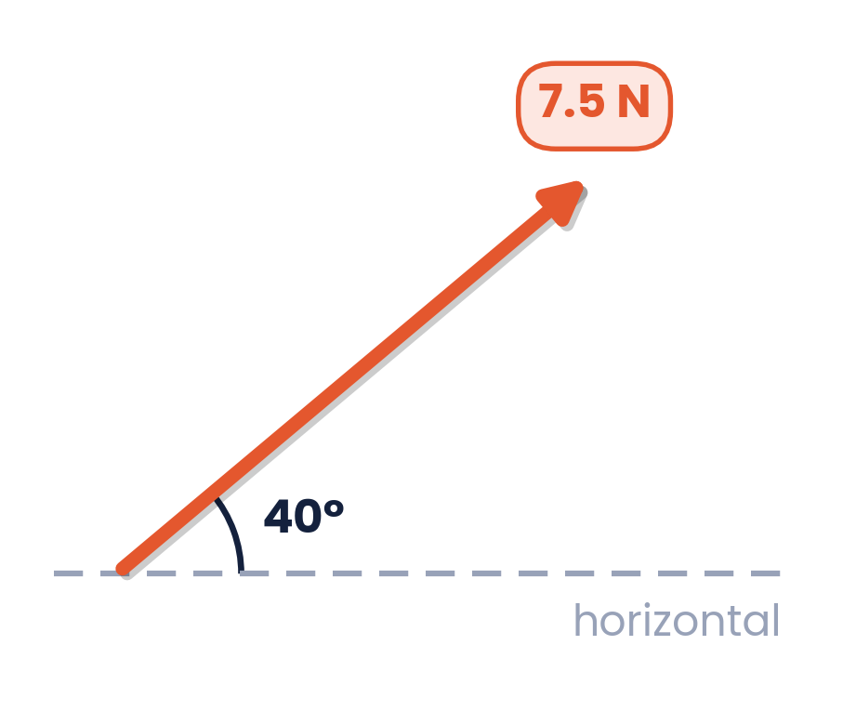
PAPER 2 STYLE · STRUCTURED QUESTION
Past paper 5 · Components of a force
A force of 7.5 N acts at 40° to the horizontal, as shown.
Calculate the component of the force that acts
(i) horizontally, [1]
(ii) vertically. [1]
Topic 1 · Physical quantities and units | Cambridge International AS Level Physics 9702
63

Slide 64
MARK SCHEME STYLE SOLUTION
Past paper 5 · Solution
(i)
horizontal = 7.5 cos 40° = 5.7 N
(ii)
vertical = 7.5 sin 40° = 4.8 N
Topic 1 · Physical quantities and units | Cambridge International AS Level Physics 9702
64

Slide 65
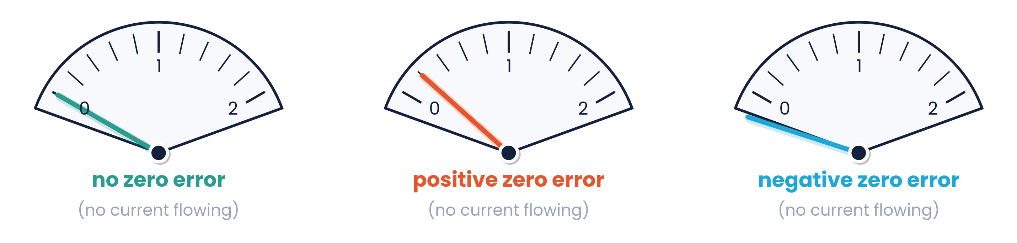
PAPER 2 STYLE · STRUCTURED QUESTION
Past paper 6 · Errors with an analogue ammeter
Measurements of a constant current in a wire are taken using an analogue ammeter.
For these measurements, describe one possible cause of:
1. a random error,
2. a systematic error. [2]
Topic 1 · Physical quantities and units | Cambridge International AS Level Physics 9702
65

Slide 66
MARK SCHEME STYLE SOLUTION
Past paper 6 · Solution
1.
Random: reading the scale from different angles (parallax), or wrongly interpolating between scale divisions
2.
Systematic: a zero error (needle not at zero with no current), or a wrongly calibrated scale
Topic 1 · Physical quantities and units | Cambridge International AS Level Physics 9702
66

Slide 67
PAPER 2 STYLE · STRUCTURED QUESTION
Practice · Zero error and precision
Q1. A vernier caliper has a +0.05 cm zero error. A student records the length of a rod as 12.30 cm.
Q2. A micrometer screw gauge has a −0.01 mm zero error. The measured diameter of a wire is 0.75 mm.
Q3. A pendulum swing has a true time of 2.00 s. A student's stopwatch readings are 1.75 s, 1.74 s and 1.76 s.
Q1 What is the corrected length?
Q2 State the corrected reading.
Q3 Comment on the accuracy and precision of these results.
Topic 1 · Physical quantities and units | Cambridge International AS Level Physics 9702
67

Slide 68
MARK SCHEME STYLE SOLUTION
Practice · Solution
Q1
corrected = 12.30 − (+0.05) = 12.25 cm
Q2
corrected = 0.75 − (−0.01) = 0.76 mm
Q3
Readings are very close together → high precision. Mean 1.75 s is well below 2.00 s → low accuracy (likely a systematic error, e.g. reaction time).
Topic 1 · Physical quantities and units | Cambridge International AS Level Physics 9702
68

Slide 69
PAPER 2 STYLE · STRUCTURED QUESTION
Practice · Combining uncertainties
You measure: A = 1.0 ± 0.2 m, B = 2.0 ± 0.2 m, C = 2.5 ± 0.5 m s⁻¹, D = 0.10 ± 0.01 s.
Calculate the value and uncertainty of:
(a) A + B
(b) A − B
(c) C × D
(d) C / D
Topic 1 · Physical quantities and units | Cambridge International AS Level Physics 9702
69

Slide 70
MARK SCHEME STYLE SOLUTION
Practice · Solution
(a)
A + B = 3.0 ± 0.4 m (absolute uncertainties add)
(b)
A − B = −1.0 ± 0.4 m (still add — never subtract uncertainties)
(c)
C × D = 0.25 m; % = 20% + 10% = 30% → 0.25 ± 0.08 m
(d)
C / D = 25 m s⁻²; % = 30% → 25 ± 8 m s⁻²
Topic 1 · Physical quantities and units | Cambridge International AS Level Physics 9702
70

Slide 71
PAPER 2 STYLE · STRUCTURED QUESTION
Past paper 7 · Uncertainty in a speed
An object of mass m travels with speed v in a circle of radius r. The force F acting on the object is given by F = mv² / r. The percentage uncertainties are: F ± 3%, m ± 4%, r ± 5%. The value of v is determined from F, m and r.
(i) Calculate the percentage uncertainty in v. [2]
(ii) The value of v is 15.0 m s⁻¹. Calculate the absolute uncertainty in v. [1]
Topic 1 · Physical quantities and units | Cambridge International AS Level Physics 9702
71

Slide 72
MARK SCHEME STYLE SOLUTION
Past paper 7 · Solution
(i)
v = √(Fr / m), so %v = ½(%F + %r + %m) = (3 + 5 + 4) / 2 = 6%
(ii)
Δv = 0.06 × 15.0 = 0.9 m s⁻¹
Topic 1 · Physical quantities and units | Cambridge International AS Level Physics 9702
72
Notes:
Stress that the square root halves the total percentage.

Slide 73
PAPER 2 STYLE · STRUCTURED QUESTION
Past paper 8 · Energy in a coil
The current I in a coil of wire produces a magnetic field. The energy stored is E = I²L / 2, where L is a constant. The manufacturer states L = 7.5 × 10⁻⁶ ± 5% in SI base units. The current is measured as (0.50 ± 0.02) A.
Determine the percentage uncertainty in the value of E. [2]
Topic 1 · Physical quantities and units | Cambridge International AS Level Physics 9702
73

Slide 74
MARK SCHEME STYLE SOLUTION
Past paper 8 · Solution
Step 1
%I = 0.02 / 0.50 × 100% = 4% (or fractional uncertainty 0.04)
Step 2
%E = %L + 2 × %I = 5% + (4% × 2) = 13% (the ½ has no uncertainty)
Topic 1 · Physical quantities and units | Cambridge International AS Level Physics 9702
74

Slide 75
PAPER 2 STYLE · STRUCTURED QUESTION
Past paper 9 · Oscilloscope trace
The figure shows an a.c. waveform displayed on an oscilloscope screen. The time-base is set at 2.0 ms per division and the y-gain at 1.5 V per division.
(a) Calculate the time period of the wave.
(b) Calculate the frequency of the waveform. State an appropriate unit.
(c) Determine the peak voltage.
Topic 1 · Physical quantities and units | Cambridge International AS Level Physics 9702
75

Slide 76
MARK SCHEME STYLE SOLUTION
Past paper 9 · Solution
(a)
One cycle = 8 divisions → T = 8 × 2.0 ms = 16 ms
(b)
f = 1 / T = 1 / (16 × 10⁻³ s) = 62.5 Hz ≈ 63 Hz
(c)
Peak = 2 divisions × 1.5 V = 3.0 V
Topic 1 · Physical quantities and units | Cambridge International AS Level Physics 9702
76

Slide 77
COMMON DOUBTS & MISCONCEPTIONS
Students often ask… (1)
?
“Are precision and accuracy the same thing?”
?
“If I repeat my readings, do I remove all errors?”
No. Precision is the spread of repeated readings; accuracy is closeness to the true value. Readings can be precise but inaccurate.
Only random errors are reduced. A systematic error (e.g. zero error) shifts every reading and survives averaging.
?
“If an equation is homogeneous, is it correct?”
?
“Is a reading with many decimal places ‘precise’?”
Not necessarily. Units cannot check numbers like ½ or 2π, and a term could be missing.
No — that is high resolution. Precision describes how close repeated readings are to each other.
Topic 1 · Physical quantities and units | Cambridge International AS Level Physics 9702
77

Slide 78
COMMON DOUBTS & MISCONCEPTIONS
Students often ask… (2)
?
“Why add percentages when multiplying?”
?
“Is the newton (or coulomb) a base unit?”
For x = ab, a small fractional change in a or b gives the same fractional change in x, so the fractional (percentage) uncertainties add.
No. N = kg m s⁻² and C = A s. The base units here are kg, m, s, A, K (and mol).
?
“Is the amplitude on a CRO in cm?”
?
“A negative zero error — do I subtract it?”
No. Divisions × y-gain gives volts. Likewise the length of one cycle × time-base gives the period, not a wavelength.
Yes: correct = reading − zero error. With a −0.01 mm error, 0.75 − (−0.01) = 0.76 mm.
Topic 1 · Physical quantities and units | Cambridge International AS Level Physics 9702
78

Slide 79
COMMAND WORDS AND MARK-SCHEME HABITS
Exam technique for physical quantities
Show that (units)
Determine a power
write the base units of every quantity and show the cancelling, not just the final line
match the powers of kg, m and s separately; use one to find k and one to check
Uncertainties
Vectors
quote Δx to 1 (or 2) s.f.; give the value to the same decimal place: 9.7 ± 0.2 m s⁻²
for a scale drawing, state the scale and draw accurately with a ruler and protractor
CRO questions
Always
count divisions carefully; convert ms, μs and mm before using f = 1/T
include units in every answer and use sensible significant figures (2–3 s.f.)
Topic 1 · Physical quantities and units | Cambridge International AS Level Physics 9702
79

Slide 80
KEY IDEAS TO TAKE AWAY
Topic 1 in one slide
Δx = Δa + Δb
%x = %a + %b
%(aⁿ) = n × %a
F → F cos θ, F sin θ
Units
quantity = number × unit · base units kg, m, s, A, K · check homogeneity with base units
Errors
random → scatter, reduce by averaging · systematic → shift, correct it · precision ≠ accuracy
Measuring
micrometer 0.01 mm · vernier 0.1 mm · CRO: T = div × time-base, V₀ = div × y-gain
Topic 1 · Physical quantities and units | Cambridge International AS Level Physics 9702
80

