Slide 1
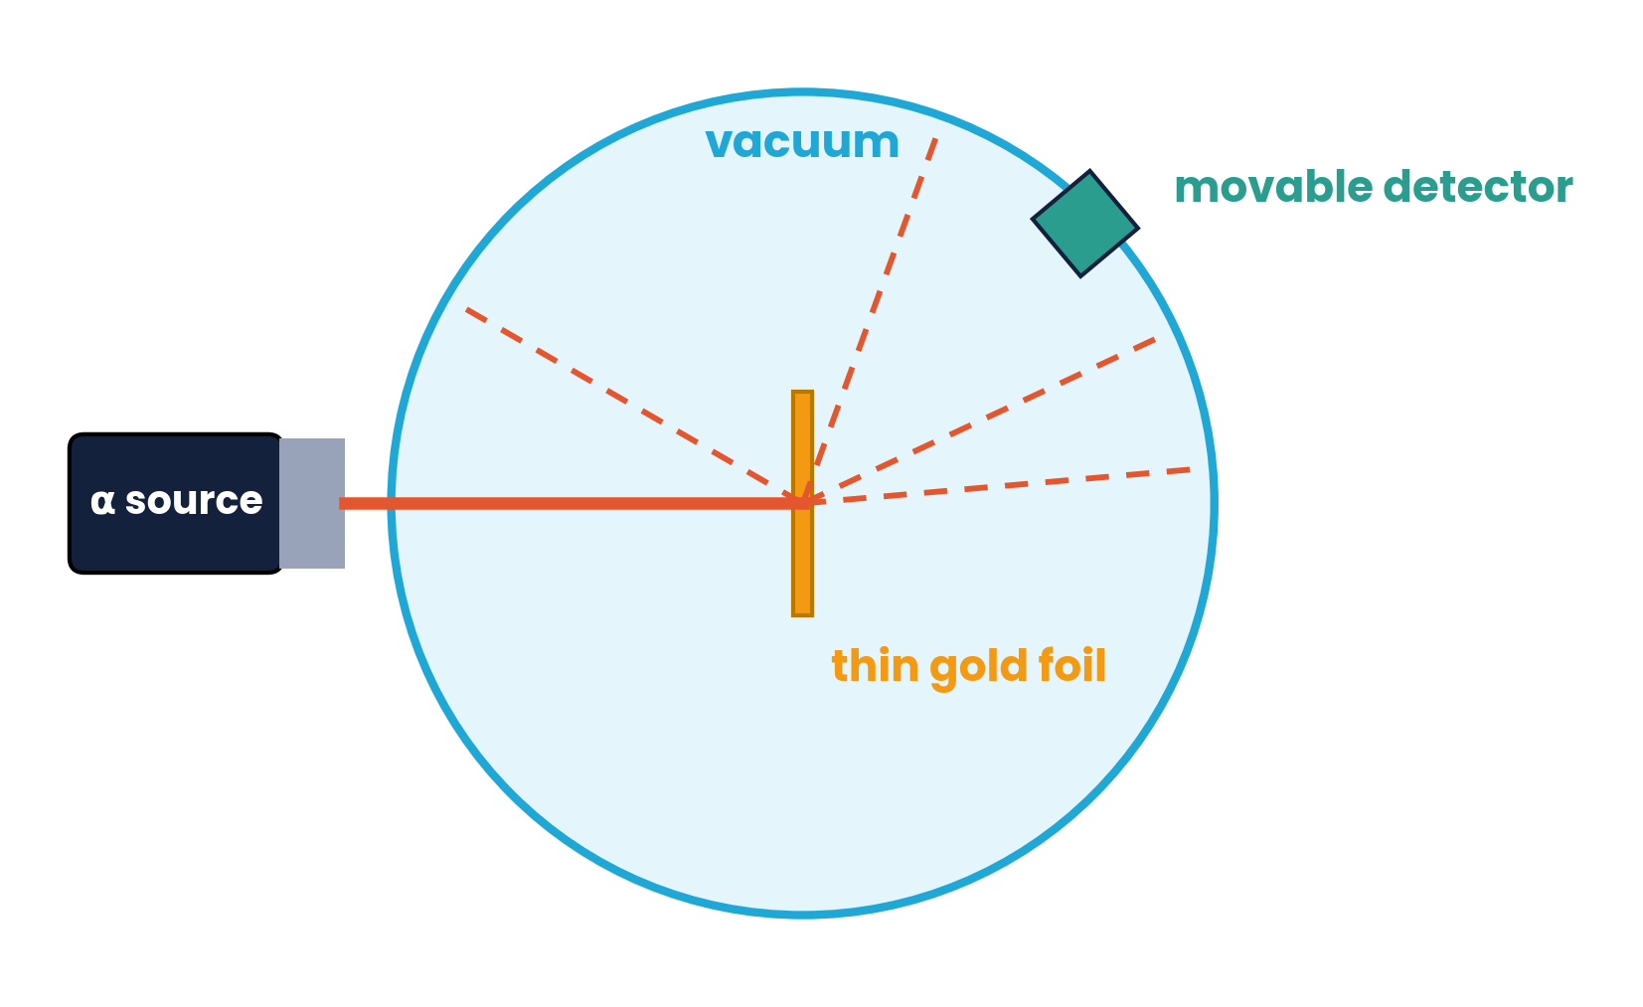
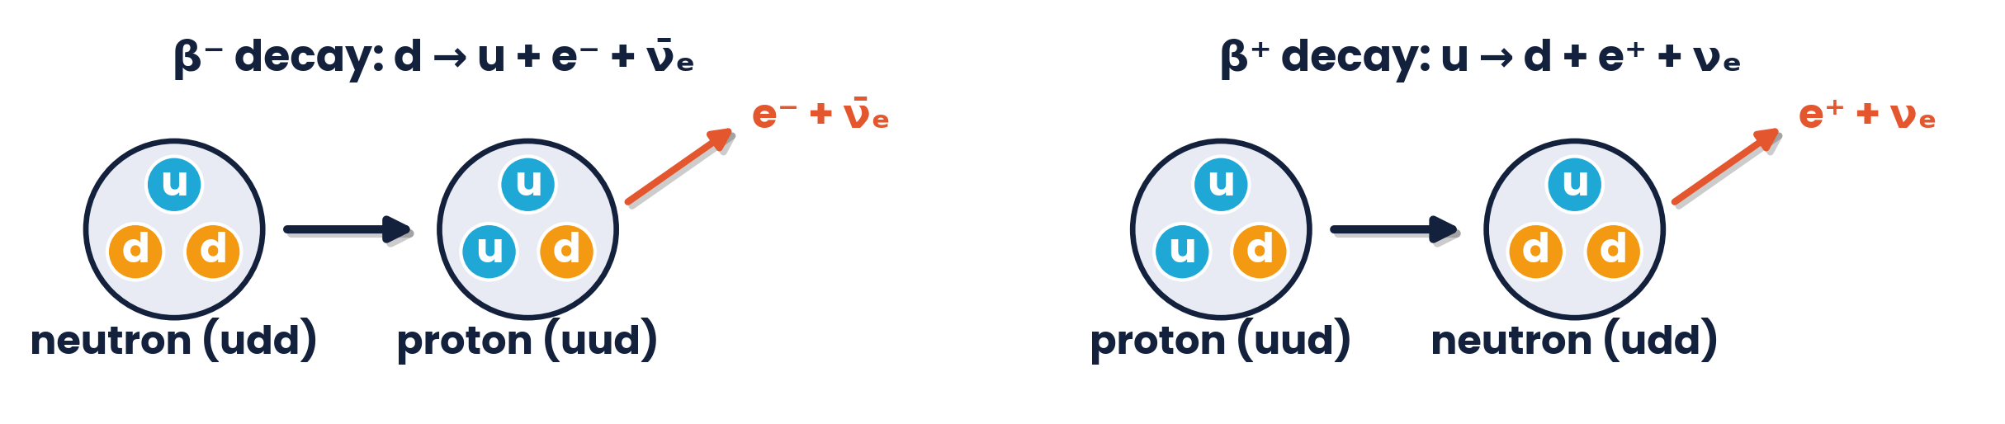
CAMBRIDGE AS & A LEVEL · PHYSICS 9702 · TOPIC 11
Particle Physics
Nuclei to Quarks
Rutherford scattering · radioactivity · antimatter · quarks & leptons
Syllabus 11.1 – 11.2 | Exams 2025 – 2027
WA
Waseem Ahmad
Head of Science & IB Physics Lead Teacher
Presidential School, Jizzakh · Cambridge Examiner
Author, Orange Publication · www.examspath.com

Slide 2
SYLLABUS 11.1 – 11.2 · PARTICLE PHYSICS
What the syllabus asks you to do
Nuclear atom
Nuclear processes
Decay details
11.1.1–11.1.5 · α-scattering evidence; model of p, n and electrons; nucleon and proton number; isotopes; A–Z notation
11.1.6–11.1.8 · conservation of nucleon number and charge; α, β⁻, β⁺, γ composition, mass and charge; antiparticles
11.1.9–11.1.12 · (anti)neutrinos in β decay; α discrete, β continuous energies; decay equations; the unified atomic mass unit u
Quarks
Hadrons
β decay & leptons
11.2.1–11.2.2 · quarks are fundamental; six flavours; charges of quarks and antiquarks
11.2.3–11.2.4 · protons and neutrons are not fundamental (uud, udd); baryons (qqq) and mesons (q q̄)
11.2.5–11.2.6 · quark changes in β⁻ and β⁺ decay; electrons and neutrinos are leptons
Topic 11 · Particle physics | Cambridge International AS Level Physics 9702
2

Slide 3
TOPIC 11 · PARTICLE PHYSICS
Lesson roadmap
01
02
03
04
Rutherford scattering
The nuclear atom
Nuclear equations
Radioactivity
Evidence for the nucleus
Notation, isotopes, u
Conserve A and Z
α, β⁻, β⁺, γ
05
06
07
08
Energy & neutrinos
Antimatter
Quarks & leptons
Hadrons
Discrete vs continuous
Same mass, opposite charge
Fundamental particles
Baryons, mesons, β decay
Topic 11 · Particle physics | Cambridge International AS Level Physics 9702
3

Slide 4
LEARNING OUTCOME 11.1.1
01
α-particle scattering
Rutherford's evidence for a small, dense nucleus
Topic 11 · Particle physics | Cambridge International AS Level Physics 9702
4

Slide 5
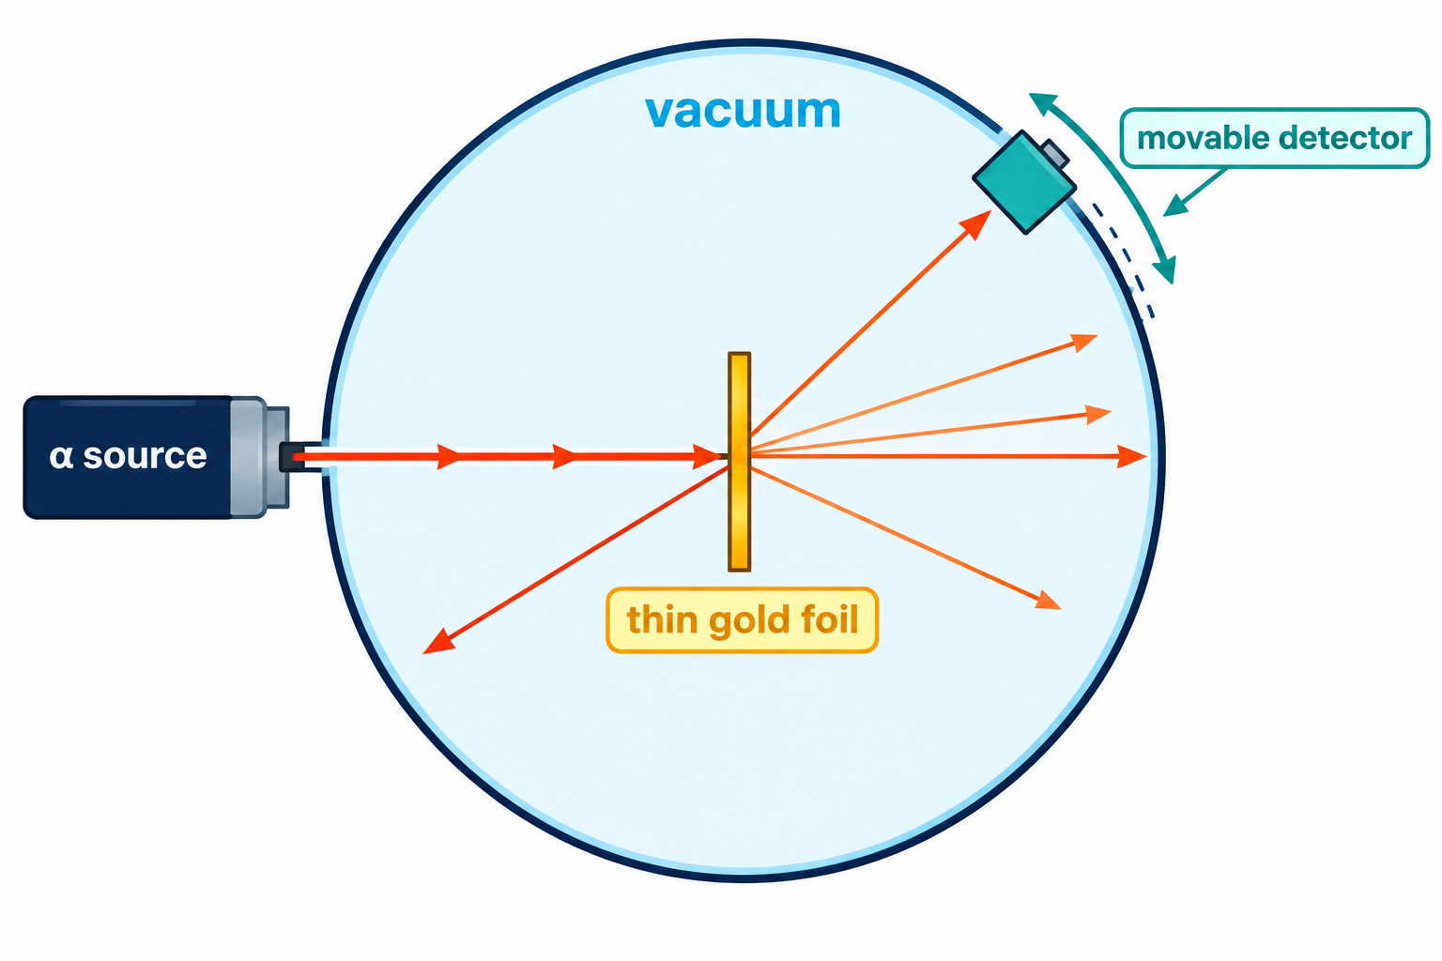
11.1.1 · GEIGER, MARSDEN AND RUTHERFORD (1909–1911)
The α-particle scattering experiment
A narrow beam of α-particles is fired at very thin gold foil
The apparatus is in a vacuum so α-particles are not absorbed or scattered by air
A detector (zinc sulfide screen / microscope) is moved round to count α-particles at each angle θ
Gold is used because it can be beaten very thin and has a large, highly charged nucleus
α-particles are positively charged helium nuclei, so they are repelled by the positive nucleus.
Topic 11 · Particle physics | Cambridge International AS Level Physics 9702
5

Slide 6
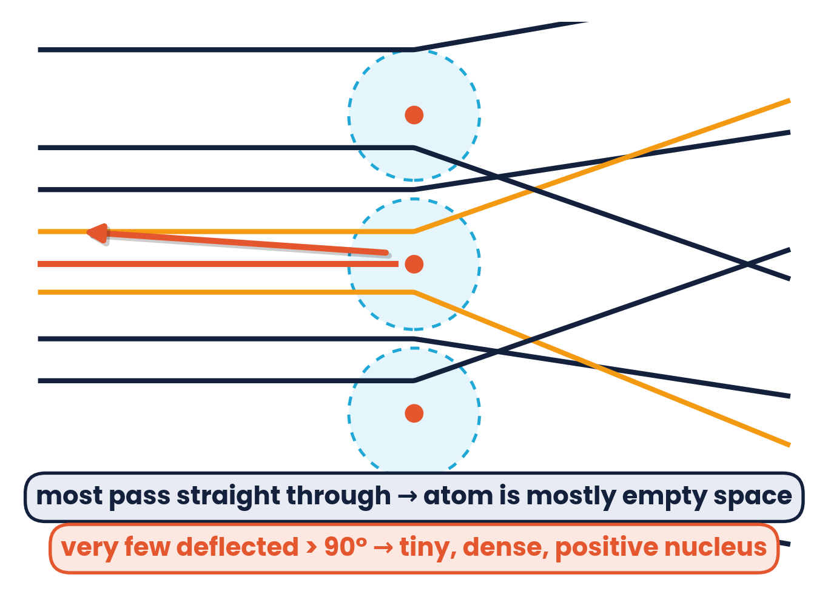
11.1.1 · INFER THE EXISTENCE AND SMALL SIZE OF THE NUCLEUS
Results and conclusions
Most α-particles pass straight through or are deviated by small angles
→ most of the atom is empty space
A small proportion are deflected through large angles
→ charge is concentrated in a small positive nucleus
Very few (≈ 1 in 8000) are deflected by more than 90°
→ the nucleus contains most of the mass and is very small compared with the atom
The number detected n falls very rapidly as θ increases — most arrive close to θ = 0.
Topic 11 · Particle physics | Cambridge International AS Level Physics 9702
6

Slide 7
LEARNING OUTCOMES 11.1.2 – 11.1.5, 11.1.12
02
The nuclear atom
Protons, neutrons, electrons and notation
Topic 11 · Particle physics | Cambridge International AS Level Physics 9702
7

Slide 8
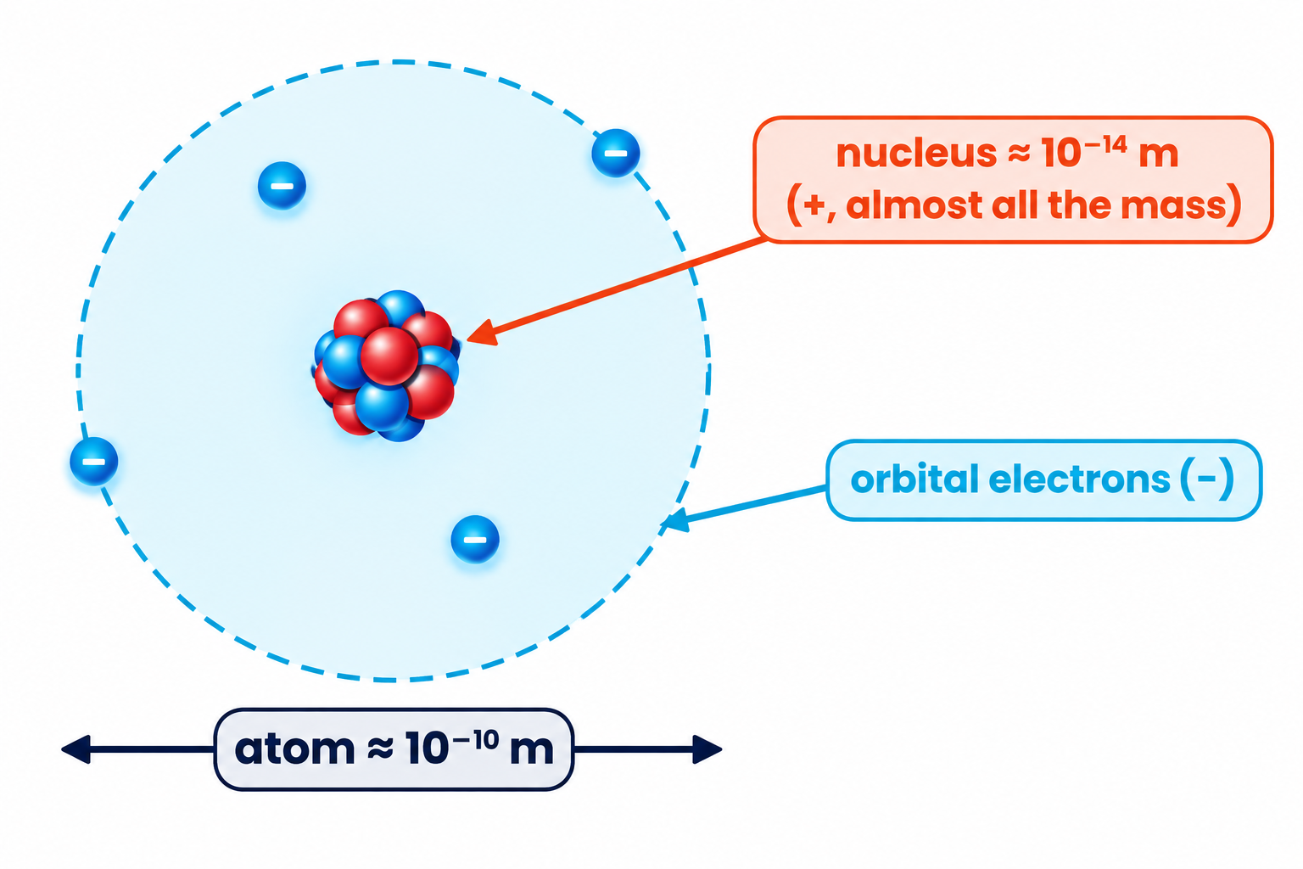
11.1.2 · PROTONS AND NEUTRONS IN THE NUCLEUS, ORBITAL ELECTRONS
A simple model of the atom
Particle | Relative charge | Relative mass
proton | +1 | ≈ 1
neutron | 0 | ≈ 1
electron | −1 | ≈ 1/2000 (0.0005)
Nucleus ≈ 10⁻¹⁴ m; atom ≈ 10⁻¹⁰ m
A neutral atom has equal numbers of protons and electrons
Charge of a proton = +e = +1.60 × 10⁻¹⁹ C
Nucleon: a proton or a neutron. Nuclide: a nucleus with a particular number of protons and neutrons.
Topic 11 · Particle physics | Cambridge International AS Level Physics 9702
8

Slide 9
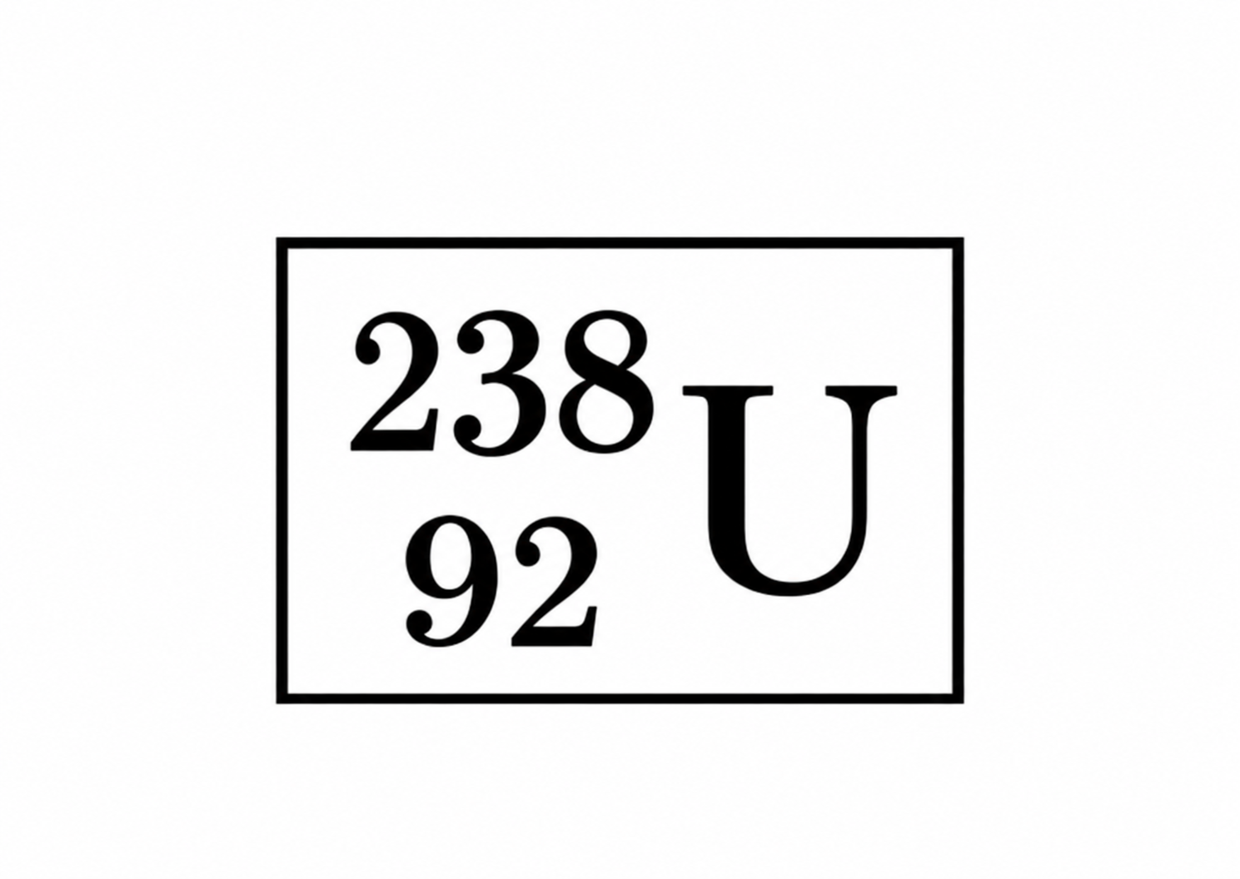
11.1.3 & 11.1.5 · NUCLIDE NOTATION
Nucleon number, proton number and notation
Proton number Z = number of protons
Nucleon number A = protons + neutrons
Neutron number N = A − Z
²³⁸₉₂U: 92 p, 146 n; ²³⁵₉₂U: 92 p, 143 n
A = 238 nucleon (mass) number
Z = 92 proton (atomic) number
Worked example:
a neutral atom of ¹⁹²₇₇Ir contains 77 protons, 192 − 77 = 115 neutrons and 77 electrons.
Topic 11 · Particle physics | Cambridge International AS Level Physics 9702
9

Slide 10
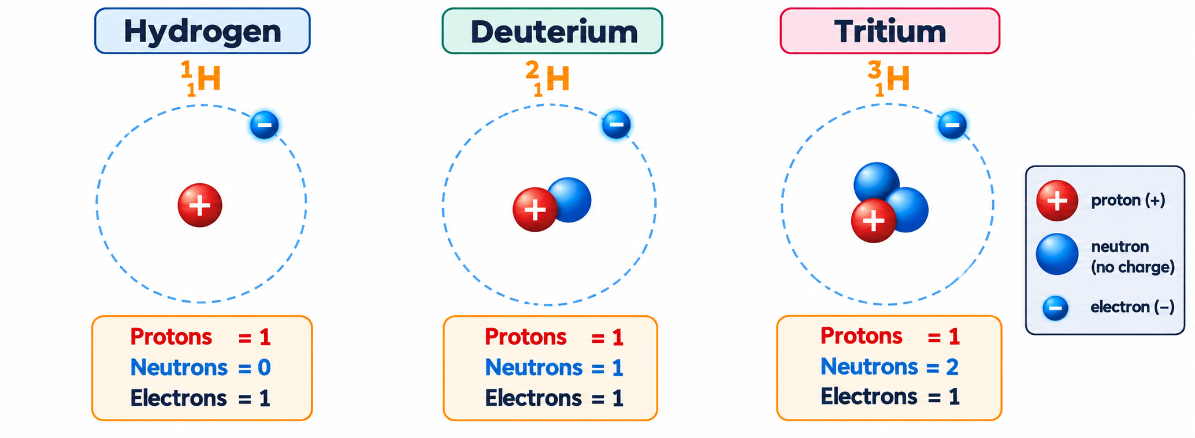
11.1.4 · SAME ELEMENT, DIFFERENT NUMBERS OF NEUTRONS
Isotopes
Isotopes
are nuclei of the same element with the same number of protons but different numbers of neutrons. They have the same chemical properties but different masses.
Which pair are isotopes?
nucleon numbers 37 & 35, neutrons 20 & 18 → protons 17 & 17 ✓ (same element: chlorine)
Mercury (Z = 80)
isotopes 196–204 have 116–124 neutrons. Average nucleon number from abundances ≈ 200.6
Topic 11 · Particle physics | Cambridge International AS Level Physics 9702
10

Slide 11
11.1.12 · 1 U = 1.66 × 10⁻²⁷ KG
The unified atomic mass unit
1 u = 1.66 × 10⁻²⁷ kg
proton: ≈ 1 u
neutron: ≈ 1 u
1/12 of the mass of a carbon-12 atom (on the data sheet)
electron: ≈ 0.0005 u
α-particle: ≈ 4 u
Worked example
Estimate the mass of a nucleus of copernicium-285 in kg.
Mass in u ≈ nucleon number = 285 u
mass ≈ 285 × 1.66 × 10⁻²⁷ = 4.73 × 10⁻²⁵ kg
Topic 11 · Particle physics | Cambridge International AS Level Physics 9702
11

Slide 12
LEARNING OUTCOMES 11.1.6 & 11.1.11
03
Nuclear equations
Conservation of nucleon number and charge
Topic 11 · Particle physics | Cambridge International AS Level Physics 9702
12

Slide 13
11.1.6 · NUCLEON NUMBER AND CHARGE ARE CONSERVED
Balancing nuclear equations
²³⁸₉₂U → ²³⁴₉₀Th + ⁴₂He
nucleon number: 238 = 234 + 4 proton number (charge): 92 = 90 + 2
Fission neutrons
Making lawrencium
α bombardment
²³⁵₉₂U + ¹₀n → ⁹⁶₃₇Rb + ¹³⁷₅₅Cs + N ¹₀n
²⁵²₉₈Cf + X (A = 10, Z = Y) → 3 ¹₀n + Lr (A = ?, Z = 103)
²⁵₁₂Mg + ⁴₂He → ¹₁H + X (A, Z)
236 = 96 + 137 + N → N = 3
Y = 103 − 98 = 5 (boron); Z = 252 + 10 − 3 = 259
A = 28, Z = 13 → ²⁸₁₃Al
Topic 11 · Particle physics | Cambridge International AS Level Physics 9702
13

Slide 14
11.1.6 · BALANCE A AND Z EACH TIME
Practice · Identify X
X → ⁹⁷₄₁Nb + ⁰₋₁β
X = ⁹⁷₄₀Zr
²⁰⁵₈₃Bi → ²⁰⁵₈₂Pb + X
X = ⁰₊₁β (positron)
a
b
²⁶₁₂Mg + ¹₁p → ⁴₂α + X
X = ²³₁₁Na
²³⁸₉₂U + ¹²₆C → X + 6 ¹₀n
X = ²⁴⁴₉₈Cf
c
d
⁵⁹₂₇Co + ²₁H → ⁶⁰₂₇Co + X
X = ¹₁H (proton)
²³⁹₉₄Pu → ²³⁵₉₂U + X
X = ⁴₂α
e
f
²⁰₈O → ²⁰₉F + X
X = ⁰₋₁β
X + ⁴₂He → ¹⁷₈O + ¹₁H
X = ¹⁴₇N
g
h
Topic 11 · Particle physics | Cambridge International AS Level Physics 9702
14

Slide 15
LEARNING OUTCOMES 11.1.7, 11.1.11
04
Radioactivity
α, β⁻, β⁺ and γ radiation
Topic 11 · Particle physics | Cambridge International AS Level Physics 9702
15

Slide 16
11.1.7 · STRONG FORCE VS ELECTROSTATIC REPULSION
Why are some nuclei unstable?
Strong nuclear force
attracts all nucleons (p–p, p–n, n–n) but acts only over very short distances (≈ 10⁻¹⁵ m).
Electrostatic repulsion
between protons acts across the whole nucleus. In large nuclei it can overcome the strong force.
Radioactive decay: an unstable nucleus emits α, β or γ radiation to become more stable
Decay is random (cannot predict which nucleus) and spontaneous (not affected by temperature, pressure or chemistry)
Too many nucleons → α; too many neutrons → β⁻; too many protons → β⁺; excess energy → γ
Topic 11 · Particle physics | Cambridge International AS Level Physics 9702
16

Slide 17
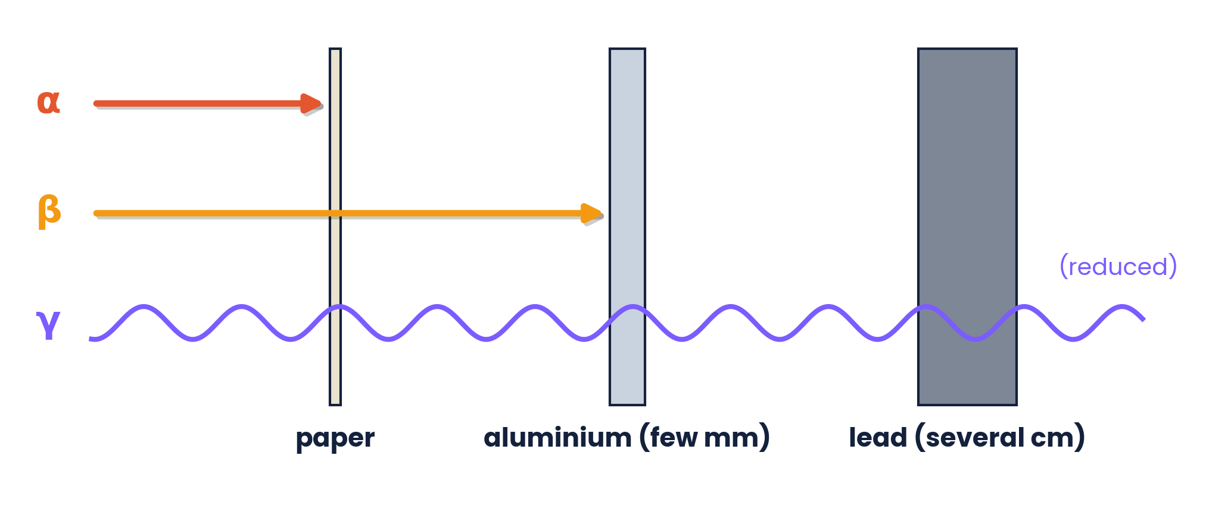
11.1.7 · COMPOSITION, MASS AND CHARGE
Properties of α, β and γ
 | Composition | Mass / u | Charge / e | Speed | Ionising / penetration
α | 2 protons + 2 neutrons (⁴₂He nucleus) | 4 | +2 | ≈ 0.05c (discrete) | strong: stopped by paper
β⁻ | electron ⁰₋₁e | ≈ 0.0005 | −1 | up to 0.99c (range) | stopped by a few mm of Al
β⁺ | positron ⁰₊₁e | ≈ 0.0005 | +1 | up to 0.99c (range) | annihilates with an electron
γ | EM photon | 0 | 0 | c | weak: reduced by thick lead
α is the most ionising (large charge, slow) so it has the shortest range; γ is the least ionising and most penetrating.
Topic 11 · Particle physics | Cambridge International AS Level Physics 9702
17

Slide 18
11.1.11 · REPRESENTING Α AND Β DECAY
Decay equations
α decay
A − 4, Z − 2
β⁻ decay
A same, Z + 1
X (A, Z) → Y (A − 4, Z − 2) + ⁴₂α
n → p + e⁻ + ν̄ₑ
²¹²₈₄Po → ²⁰⁸₈₂Pb + ⁴₂α
¹⁴₆C → ¹⁴₇N + ⁰₋₁β + ν̄ₑ
β⁺ decay
A same, Z − 1
γ emission
no change in A or Z
p → n + e⁺ + νₑ
excited nucleus → nucleus + γ
¹¹₆C → ¹¹₅B + ⁰₊₁β + νₑ
²³⁸₉₂U* → ²³⁸₉₂U + γ
Topic 11 · Particle physics | Cambridge International AS Level Physics 9702
18

Slide 19
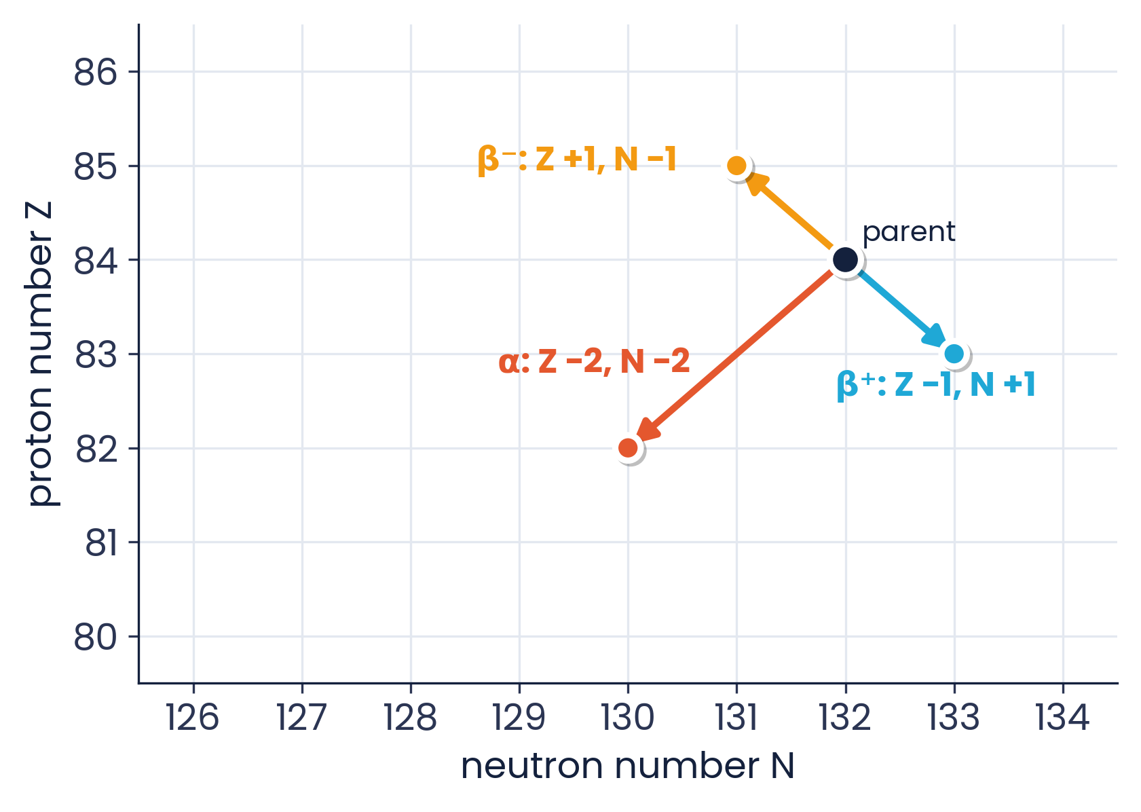
11.1.11 · TRACKING CHANGES
Decays on an N–Z chart
Rn-222 α decay
²²²₈₆Rn (136 n) → ²¹⁸₈₄Po (134 n)
Two β⁺ decays
²¹²₈₂ (130 n) → ²¹²₈₁ (131 n) → ²¹²₈₀ (132 n)
β⁻, then α, then β⁺
²³⁷₉₂W → ²³⁷₉₃X → ²³³₉₁Y → ²³³₉₀Z
α: diagonal down-left by 2; β⁻: up-left; β⁺: down-right.
Topic 11 · Particle physics | Cambridge International AS Level Physics 9702
19

Slide 20
LEARNING OUTCOMES 11.1.9 – 11.1.10
05
Energy in decay and neutrinos
Discrete α energies, continuous β energies
Topic 11 · Particle physics | Cambridge International AS Level Physics 9702
20

Slide 21
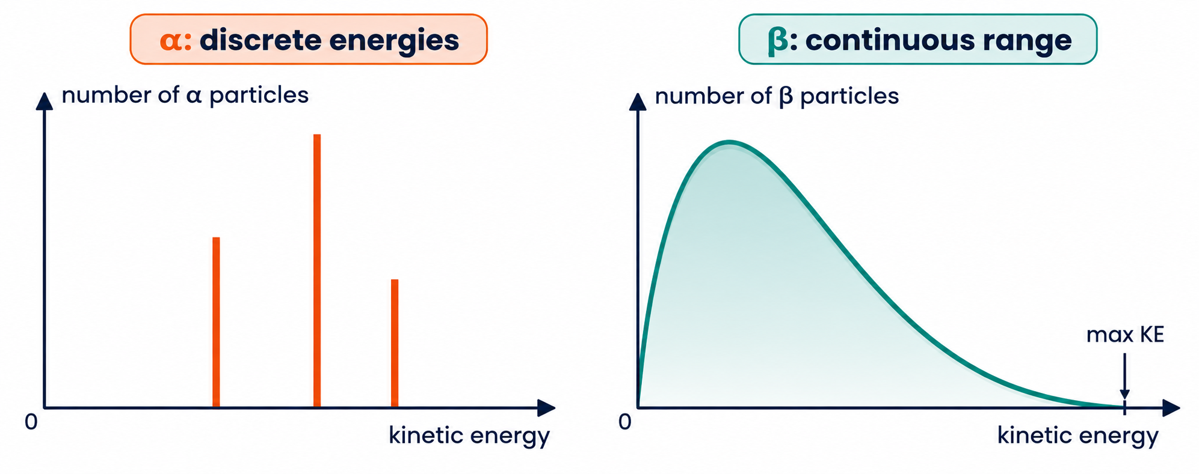
11.1.9 & 11.1.10 · EVIDENCE FOR THE NEUTRINO
α discrete, β continuous
Why?
In α decay the energy is shared between two bodies only, so each α from a given decay has the same energy. In β decay the energy is shared with a third particle — the (anti)neutrino.
β⁻ decay:
an electron antineutrino (ν̄ₑ) is emitted. It has no charge and almost no mass, and carries the missing energy.
β⁺ decay:
an electron neutrino (νₑ) is emitted with the positron. Charge, nucleon number and lepton number balance.
Topic 11 · Particle physics | Cambridge International AS Level Physics 9702
21

Slide 22
LEARNING OUTCOME 11.1.8
06
Antimatter
Every particle has an antiparticle
Topic 11 · Particle physics | Cambridge International AS Level Physics 9702
22

Slide 23
11.1.8 · SAME MASS, OPPOSITE CHARGE
Antiparticles
Particle | Charge | Antiparticle | Charge
electron e⁻ | −1 | positron e⁺ | +1
proton p | +1 | antiproton p̄ | −1
neutron n | 0 | antineutron n̄ | 0
electron neutrino νₑ | 0 | electron antineutrino ν̄ₑ | 0
An antiparticle has the same mass as its particle but the opposite charge
The positron is the antiparticle of the electron
Antiparticles use a bar (p̄) or ‘anti-’ prefix
When a particle meets its antiparticle they annihilate, producing γ-ray photons
A neutral particle such as the neutron still has a distinct antiparticle (made of antiquarks).
Topic 11 · Particle physics | Cambridge International AS Level Physics 9702
23

Slide 24
LEARNING OUTCOMES 11.2.1, 11.2.2, 11.2.6
07
Quarks and leptons
The fundamental particles
Topic 11 · Particle physics | Cambridge International AS Level Physics 9702
24

Slide 25
11.2.1 & 11.2.2 · SIX FLAVOURS
Quarks
u
c
t
Quarks are fundamental: no internal structure
They are never observed alone — always in groups of three or quark–antiquark pairs
Each antiquark has the opposite charge: ū = −⅔e, d̄ = +⅓e, s̄ = +⅓e
Knowledge of other quark properties is not required
up +⅔e
charm +⅔e
top +⅔e
d
s
b
down −⅓e
strange −⅓e
bottom −⅓e
The charge of a hadron is the sum of its quark charges: proton uud = +⅔ + ⅔ − ⅓ = +1e
Topic 11 · Particle physics | Cambridge International AS Level Physics 9702
25

Slide 26
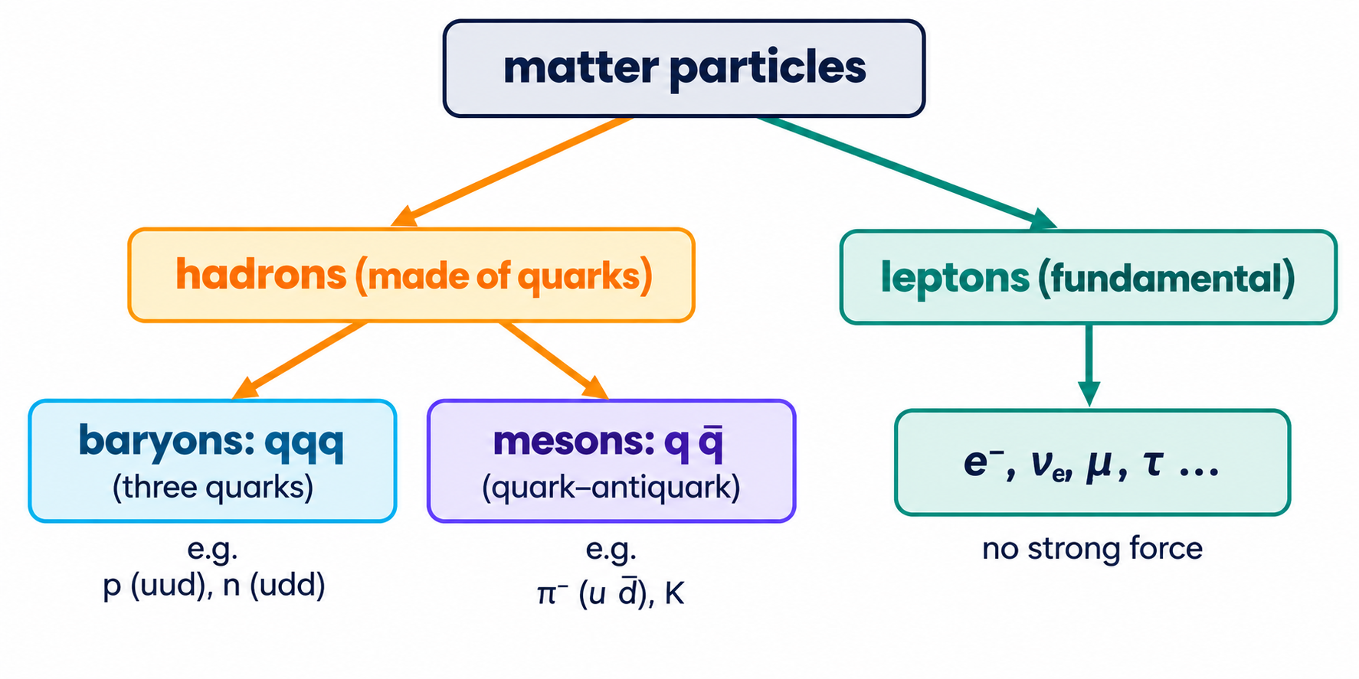
11.2.6 · ELECTRONS AND NEUTRINOS ARE FUNDAMENTAL
Leptons
Leptons are fundamental particles that do not feel the strong force
Examples: electron e⁻ and electron neutrino νₑ (also muon, tau and their neutrinos)
Neutrinos: no charge, very small mass
They interact through the weak, electromagnetic (if charged) and gravitational forces
Correction to note:
the muon (≈ 207 mₑ) and tau (≈ 3500 mₑ) are much heavier than the electron — they share its −1e charge, not its mass.
Topic 11 · Particle physics | Cambridge International AS Level Physics 9702
26

Slide 27
LEARNING OUTCOMES 11.2.3 – 11.2.5
08
Hadrons
Baryons, mesons and β decay at quark level
Topic 11 · Particle physics | Cambridge International AS Level Physics 9702
27

Slide 28
11.2.3 & 11.2.4 · HADRONS ARE MADE OF QUARKS
Baryons and mesons
Baryons: three quarks
Mesons: quark + antiquark
proton p = uud (+1e)
neutron n = udd (0)
Δ⁺⁺ = uuu (+2e); antiproton p̄ = ū ū d̄
π⁺ = u d̄ (+⅔ + ⅓ = +1e)
π⁻ = ū d (−1e); φ = s s̄ (0)
ρ-meson u d̄ has charge +1e
Protons and neutrons are NOT fundamental — they are baryons
All hadrons have whole-number charges; a baryon is all quarks or all antiquarks (u d̄ d cannot exist)
Worked example: ⁵⁶₂₆Fe has 26 p (52 u) and 30 n (30 u) → 82 up quarks
Topic 11 · Particle physics | Cambridge International AS Level Physics 9702
28

Slide 29
11.2.5 · QUARK CHANGES
β decay at the quark level
β⁻:
a down quark becomes an up quark: udd → uud, emitting e⁻ and ν̄ₑ.
β⁺:
an up quark becomes a down quark: uud → udd, emitting e⁺ and νₑ. Both are caused by the weak interaction.
Topic 11 · Particle physics | Cambridge International AS Level Physics 9702
29

Slide 30
CAMBRIDGE PAST PAPER QUESTIONS
09
Past paper practice
Paper 1 multiple choice · Paper 2 structured questions
Topic 11 · Particle physics | Cambridge International AS Level Physics 9702
30

Slide 31
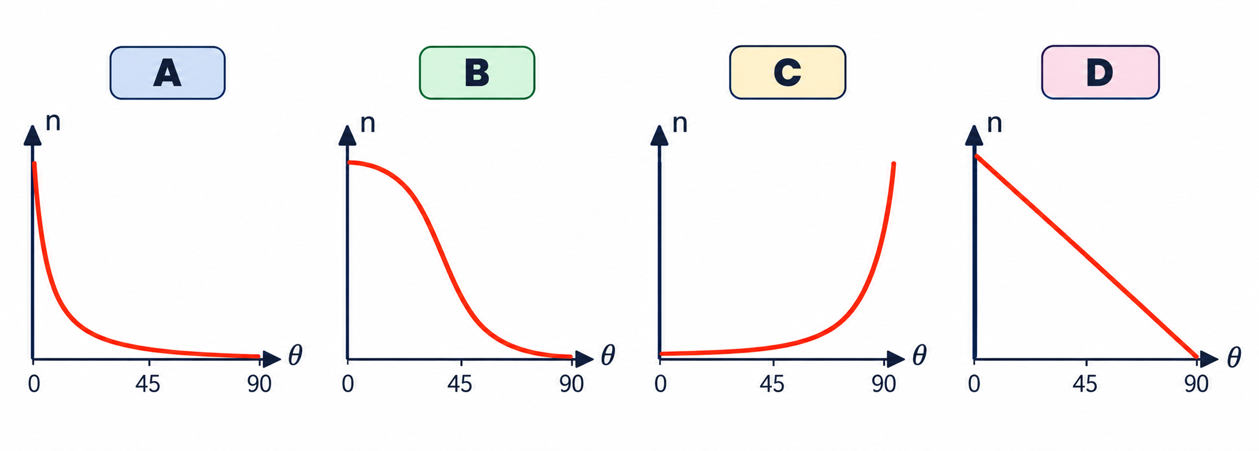
PAPER 1 STYLE · MULTIPLE CHOICE
Past paper · α-scattering graph
1
A detector counts the number n of α-particles per unit time at angle θ to the incident beam. Which graph best shows how n varies with θ from 0 to 90°?
Choose A, B, C or D
Topic 11 · Particle physics | Cambridge International AS Level Physics 9702
31

Slide 32
PAPER 1 STYLE · MULTIPLE CHOICE
Past paper set A · Nuclei and decay
2
The atom ¹⁹²₇₇Ir is a neutral atom. How many protons, neutrons and electrons are in this atom?
3
Which pair of nuclei (nucleon number; neutron number) are isotopes of one element?
A 77, 192, 77
B 115, 77, 77
C 192, 77, 192
D 77, 115, 77
A 39 and 35; 19 and 22
B 37 and 35; 20 and 18
C 37 and 35; 18 and 20
D 35 and 35; 20 and 18
4
²³⁷₉₂W decays by β⁻ emission to X, then by α emission to Y, then by β⁺ emission to Z. What is nuclide Z?
A ²³⁷₉₀Z
B ²³³₉₂Z
C ²³⁷₈₉Z
D ²³³₉₀Z
Topic 11 · Particle physics | Cambridge International AS Level Physics 9702
32

Slide 33
ANSWERS AND KEY WORKING
Answers · Questions 1 – 4
1
Answer A
2
Answer D
Most α-particles are scattered through very small angles, so n is largest near 0° and falls very rapidly as θ increases.
Z = 77 protons; neutrons = 192 − 77 = 115; neutral, so 77 electrons.
3
Answer B
4
Answer D
Protons: 37 − 20 = 17 and 35 − 18 = 17 — same element (Cl).
β⁻: ²³⁷₉₃; α: ²³³₉₁; β⁺: ²³³₉₀.
Topic 11 · Particle physics | Cambridge International AS Level Physics 9702
33

Slide 34
PAPER 1 STYLE · MULTIPLE CHOICE
Past paper set B · Decay and particles
5
²²²₈₆Rn undergoes α decay into a daughter nucleus of polonium. What are its nucleon and proton numbers?
6
A nuclide with nucleon number 212 and proton number 82 decays by β⁺ emission, and the daughter decays by β⁺ again. What is the granddaughter?
A 222, 84
B 218, 84
C 218, 88
D 220, 85
A 212, 80 (132 neutrons)
B 212, 84 (128 neutrons)
C 208, 80 (128 neutrons)
D 212, 81 (131 neutrons)
7
In the decay π⁺ → μ⁺ + ν(μ), which particle is an anti-lepton?
8
Which quark combination would NOT give a particle of charge −1e or 0?
A π⁺
B μ⁺
C ν(μ)
D both μ⁺ and ν(μ)
A up, strange, strange
B charm, charm, down
C top, anti-up
D anti-up, anti-up, anti-strange
Topic 11 · Particle physics | Cambridge International AS Level Physics 9702
34

Slide 35
ANSWERS AND KEY WORKING
Answers · Questions 5 – 8
5
Answer B
6
Answer A
α decay: A − 4 = 218, Z − 2 = 84 → ²¹⁸₈₄Po.
Each β⁺: Z − 1, N + 1 → ²¹²₈₁ (131 n) → ²¹²₈₀ (132 n).
7
Answer B
8
Answer B
π⁺ is a meson (hadron), not a lepton. μ⁺ is the antimuon (anti-lepton); ν(μ) is a lepton.
c c d = +⅔ + ⅔ − ⅓ = +1e. A = 0; C = +⅔ − ⅔ = 0; D = −⅔ − ⅔ + ⅓ = −1e.
Topic 11 · Particle physics | Cambridge International AS Level Physics 9702
35

Slide 36
PAPER 1 STYLE · MULTIPLE CHOICE
Set C · Quarks and hadrons
9
The baryon Δ⁺⁺ has a charge of +2e. Which is its quark combination?
10
How many up quarks are in the nucleus of ⁵⁶₂₆Fe?
A uuu
B cd̄s
C ūd
D c̄c̄c̄
A 26
B 52
C 78
D 82
11
Which change occurs inside a nucleon during β⁻ decay?
12
Which of these particles is NOT fundamental?
A up → down
B down → up
C up → strange
D down → strange
A electron
B electron neutrino
C up quark
D proton
Topic 11 · Particle physics | Cambridge International AS Level Physics 9702
36

Slide 37
ANSWERS AND KEY WORKING
Answers · Questions 9 – 12
9
Answer A
10
Answer D
A baryon has three quarks (not C, a meson; not B, a mix); uuu = +2e. c̄c̄c̄ = −2e.
26 protons × 2 u + 30 neutrons × 1 u = 52 + 30 = 82.
11
Answer B
12
Answer D
β⁻: n → p, udd → uud, so a down quark changes into an up quark.
The proton is a baryon (uud). Electrons, neutrinos and quarks are fundamental.
Topic 11 · Particle physics | Cambridge International AS Level Physics 9702
37

Slide 38
PAPER 2 STYLE · STRUCTURED QUESTION
Past paper 1 · α-particle scattering
The results of an α-particle scattering experiment provided evidence for the nuclear model of the atom.
(a) Describe the two main results of the α-particle scattering experiment. [2]
(b) Relate each of the results in (a) to the conclusions that were made about the nature of atoms. [2]
Topic 11 · Particle physics | Cambridge International AS Level Physics 9702
38

Slide 39
MARK SCHEME STYLE SOLUTION
Past paper 1 · Solution
(a)
The majority of α-particles went straight through or were deviated by small angles (B1). A very small proportion were deviated by large angles, more than 90° (B1)
(b)
Most of the atom is empty space; the nucleus is very small compared with the atom (B1). Mass and charge are concentrated in the very small nucleus (B1)
Topic 11 · Particle physics | Cambridge International AS Level Physics 9702
39

Slide 40
PAPER 2 STYLE · STRUCTURED QUESTION
Book question · Changing the experiment
(1) Rutherford's scattering experiments were done in an evacuated container. (2) In Rutherford's experiment a small fraction of α-particles were back-scattered through 180°.
(1) Explain why the container is evacuated.
(2) Describe and explain how the fraction back-scattered changes if: (a) a thicker foil is used (b) faster α-particles are used (c) a silver foil (smaller nuclear charge) is used.
Topic 11 · Particle physics | Cambridge International AS Level Physics 9702
40

Slide 41
MARK SCHEME STYLE SOLUTION
Book question · Solution
(1)
Air molecules would scatter the α-particles and distort the results; α-particles are absorbed by about 6 cm of air
(2)
(a) more: more nuclei, more chances of a close approach; (b) fewer: larger inertia carries them through; (c) fewer: the repulsive force is smaller
Topic 11 · Particle physics | Cambridge International AS Level Physics 9702
41

Slide 42
PAPER 2 STYLE · STRUCTURED QUESTION
Past paper 2 · β⁺ decay of argon (9702/21)
The decay of a nucleus of ³⁵₁₈Ar by β⁺ emission is represented by ³⁵₁₈Ar → X + β⁺ + Y. A nucleus X and two particles, β⁺ and Y, are produced by the decay.
(a)(i) State the proton number and the nucleon number of nucleus X. [1]
(a)(ii) State the name of the particle represented by the symbol Y. [1]
(b) Describe the quark change that occurs. [1]
Topic 11 · Particle physics | Cambridge International AS Level Physics 9702
42

Slide 43
MARK SCHEME STYLE SOLUTION
Past paper 2 · Solution
(a)(i)
proton number = 17 and nucleon number = 35 (chlorine-35)
(a)(ii)
(electron) neutrino
(b)
An up quark changes into a down quark (uud → udd) — the weak interaction
Topic 11 · Particle physics | Cambridge International AS Level Physics 9702
43

Slide 44
PAPER 2 STYLE · STRUCTURED QUESTION
Past paper 3 · Forming potassium-39 (9702/22)
A nucleus of an element X decays by emitting a β⁺ particle to produce a nucleus of potassium-39 (³⁹₁₉K) and a neutrino. The decay is written X → ³⁹₁₉K + β + ν, where X has nucleon number Q and proton number S, and the β particle has nucleon number P and charge number R.
(a)(i) State the numbers represented by P, Q, R and S. [2]
(a)(ii) State the name of the interaction that gives rise to β decay. [1]
Topic 11 · Particle physics | Cambridge International AS Level Physics 9702
44

Slide 45
MARK SCHEME STYLE SOLUTION
Past paper 3 · Solution
(a)(i)
P = 0 and Q = 39; R = +1 and S = 20 (X is calcium-39)
(a)(ii)
The weak (nuclear) interaction / force
Topic 11 · Particle physics | Cambridge International AS Level Physics 9702
45

Slide 46
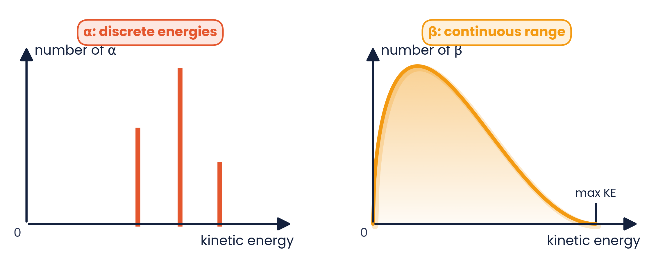
PAPER 2 STYLE · STRUCTURED QUESTION
Past paper 4 · Carbon-14 (9702/23)
The nuclide ¹⁴₆C (carbon-14) is unstable and undergoes β⁻ decay, emitting a high-energy electron and an antineutrino to form a new nuclide X.
(a) Complete the equation: ¹⁴₆C → X + e⁻ + ν̄. [2]
(b) Explain why the emitted electrons have a range of kinetic energies. [2]
(c) State the quark change. [1]
Topic 11 · Particle physics | Cambridge International AS Level Physics 9702
46

Slide 47
MARK SCHEME STYLE SOLUTION
Past paper 4 · Solution
(a)
¹⁴₆C → ¹⁴₇X + ⁰₋₁e + ⁰₀ν̄ (X is nitrogen-14)
(b)
The decay energy is shared between the electron and the antineutrino (and recoiling nucleus) in varying proportions
(c)
A down quark changes into an up quark
Topic 11 · Particle physics | Cambridge International AS Level Physics 9702
47

Slide 48
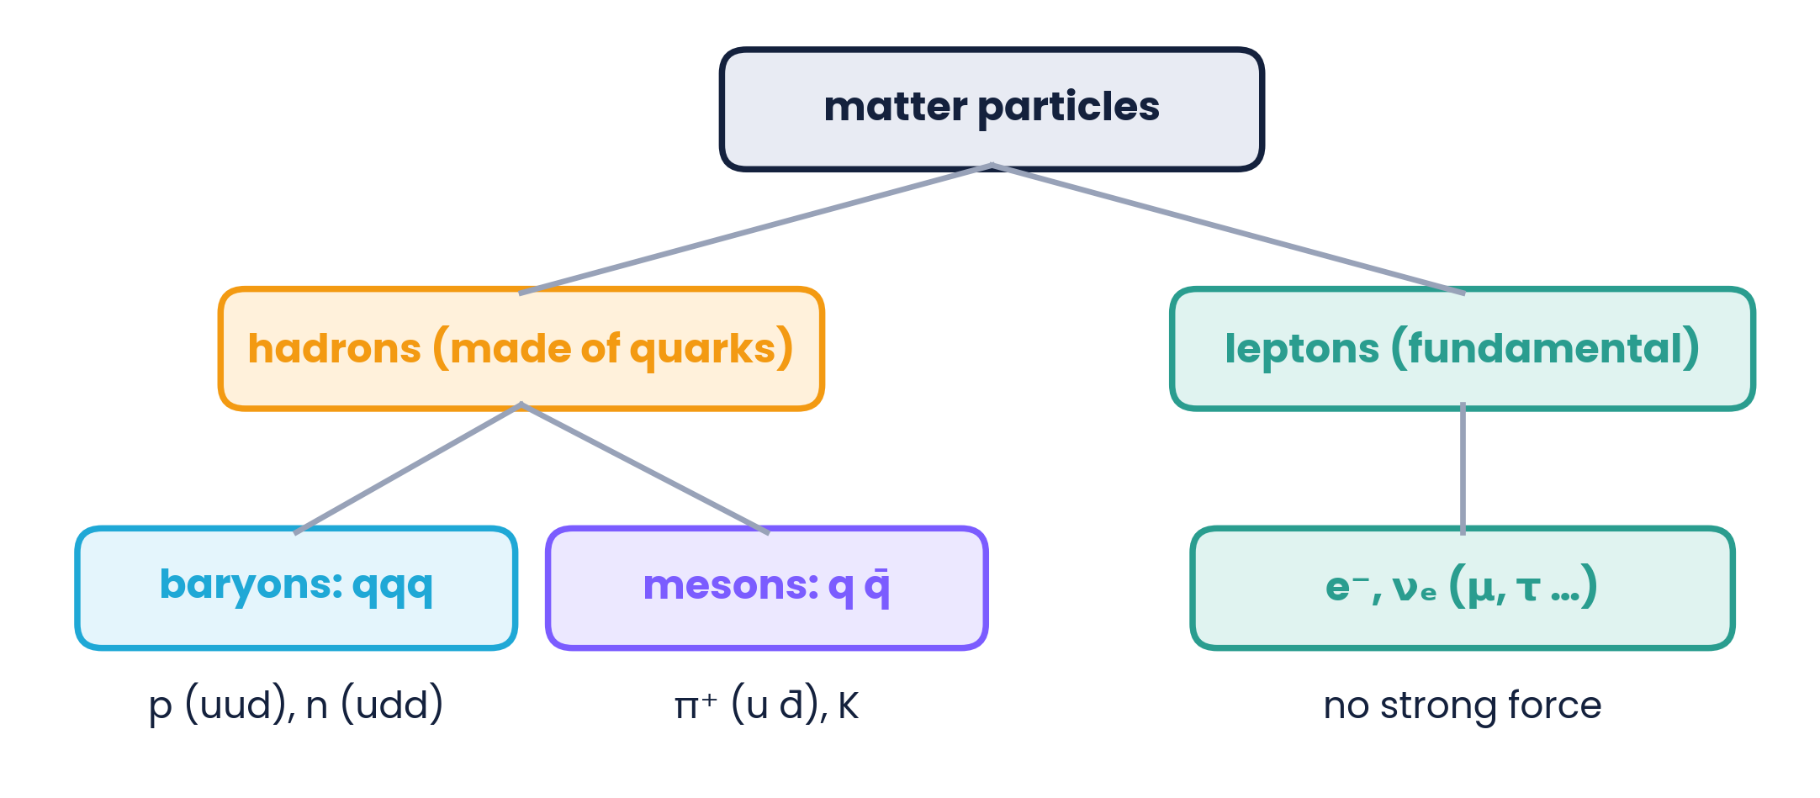
PAPER 2 STYLE · STRUCTURED QUESTION
Book questions · Hadrons and leptons
Quark charges: u = +⅔e, d = −⅓e, s = −⅓e; antiquarks have opposite charges.
(a) A ρ-meson is made of an up quark and an antidown quark. Calculate its charge.
(b) Suggest which quarks or antiquarks make up a π⁻ meson.
(c) Show that the φ-meson (s s̄) is neutral.
(d) State two differences between hadrons and leptons.
Topic 11 · Particle physics | Cambridge International AS Level Physics 9702
48

Slide 49
MARK SCHEME STYLE SOLUTION
Book questions · Solution
(a)
+⅔e + ⅓e = +1e
(b)
π⁻ has charge −1e: an antiup quark (−⅔e) and a down quark (−⅓e): ū d
(c)
s = −⅓e and s̄ = +⅓e, so the total charge is zero
(d)
Leptons are fundamental, hadrons are made of quarks; leptons do not feel the strong force, hadrons do
Topic 11 · Particle physics | Cambridge International AS Level Physics 9702
49

Slide 50
PAPER 2 STYLE · STRUCTURED QUESTION
Book question · Range of α and β
α-particles and β⁻-particles are emitted by radioactive sources.
(a) Explain why you would expect β⁻-particles to travel further through air than α-particles.
(b) Explain why you would expect β⁻-particles to travel further through air than through metal.
(c) State one use of γ-radiation that relies on its penetrating power.
Topic 11 · Particle physics | Cambridge International AS Level Physics 9702
50

Slide 51
MARK SCHEME STYLE SOLUTION
Book question · Solution
(a)
A β-particle has less charge, is smaller and travels faster, so it causes less ionisation per unit length and loses its energy more slowly
(b)
Air is much less dense, so fewer atoms are ionised per unit distance travelled
(c)
e.g. sterilising medical equipment or treating deep tumours (radiotherapy)
Topic 11 · Particle physics | Cambridge International AS Level Physics 9702
51

Slide 52
COMMON DOUBTS & MISCONCEPTIONS
Students often ask… (1)
?
“Did Rutherford show that electrons orbit the nucleus?”
?
“Is the β⁻ electron one of the orbital electrons?”
No. Scattering showed a small, dense, positive nucleus. The electrons' arrangement was not tested by the experiment.
No. It is created in the nucleus when a neutron changes into a proton.
?
“Why do β-particles have a range of energies?”
?
“Does γ emission change the element?”
The energy is shared with an (anti)neutrino. α decay produces only two products, so α energies are discrete.
No. γ is a photon: A and Z are unchanged; the nucleus just loses energy.
Topic 11 · Particle physics | Cambridge International AS Level Physics 9702
52

Slide 53
COMMON DOUBTS & MISCONCEPTIONS
Students often ask… (2)
?
“Are protons and neutrons fundamental?”
?
“Can a baryon contain a quark and an antiquark?”
No. They are baryons made of quarks (uud and udd). Electrons and neutrinos are fundamental (leptons).
No. Baryons have three quarks or three antiquarks; a quark–antiquark pair is a meson.
?
“In β⁺ decay, is an antineutrino emitted?”
?
“Is a positron just a proton?”
No — a neutrino (νₑ) is emitted with the positron. The antineutrino goes with the electron in β⁻ decay.
No. A positron is the antielectron: electron mass (≈ 0.0005 u) with charge +e.
Topic 11 · Particle physics | Cambridge International AS Level Physics 9702
53

Slide 54
COMMAND WORDS AND MARK-SCHEME HABITS
Exam technique for particle physics
Rutherford
Equations
link each RESULT to its CONCLUSION; say ‘most’, ‘small proportion’, ‘> 90°’
balance A (top) and Z (bottom) separately; include ν or ν̄ in β decay
β decay
Quark charges
β⁻: n → p (d → u) + e⁻ + ν̄; β⁺: p → n (u → d) + e⁺ + ν
u, c, t = +⅔; d, s, b = −⅓; antiquarks opposite; total must be an integer
Antiparticles
u
same mass, opposite charge — the positron is the antielectron
1 u = 1.66 × 10⁻²⁷ kg; mass in u ≈ nucleon number
Topic 11 · Particle physics | Cambridge International AS Level Physics 9702
54

Slide 55
KEY IDEAS TO TAKE AWAY
Particle physics in one slide
N = A − Z
1 u = 1.66 × 10⁻²⁷ kg
d → u + e⁻ + ν̄
u → d + e⁺ + ν
Nucleus
tiny (10⁻¹⁴ m), dense, positive · A and Z conserved in every nuclear equation
Radiation
α: ⁴₂He, +2e · β⁻: e⁻ · β⁺: e⁺ · γ: photon · α discrete, β continuous (neutrinos)
Particles
quarks (6 flavours) and leptons are fundamental · baryons qqq · mesons q q̄
Topic 11 · Particle physics | Cambridge International AS Level Physics 9702
55

