Slide 1
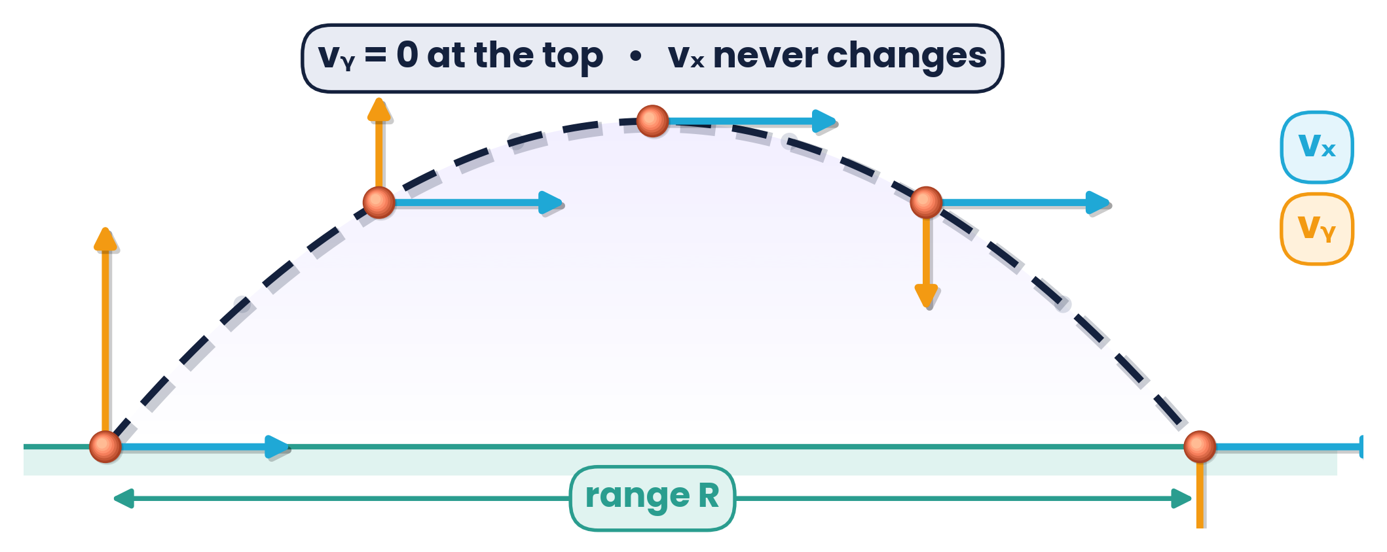
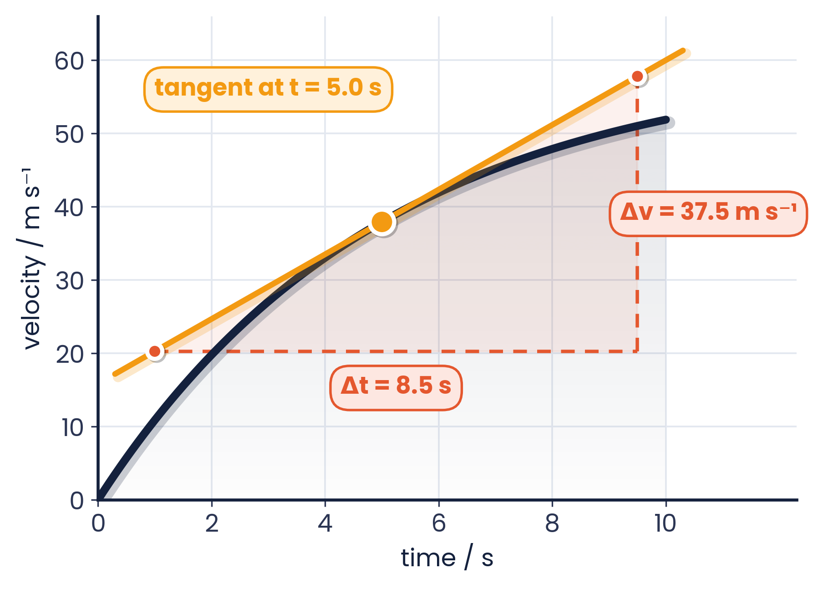
CAMBRIDGE AS & A LEVEL · PHYSICS 9702 · TOPIC 2
Kinematics
Equations of Motion
Motion graphs · SUVAT · free fall · projectiles · past paper practice
Syllabus 2.1 | Exams 2025 – 2027
WA
Waseem Ahmad
Head of Science & IB Physics Lead Teacher
Presidential School, Jizzakh · Cambridge Examiner
Author, Orange Publication · www.examspath.com

Slide 2
SYLLABUS 2.1 · EQUATIONS OF MOTION
What the syllabus asks you to do
1
LO 2.1.1
2
LO 2.1.2
3
LO 2.1.3
Define and use distance, displacement, speed, velocity and acceleration
Use graphical methods to represent motion
Displacement = area under a velocity–time graph
4
LO 2.1.4
5
LO 2.1.5
6
LO 2.1.6
Velocity = gradient of a displacement–time graph
Acceleration = gradient of a velocity–time graph
Derive the equations of uniformly accelerated motion
7
LO 2.1.7
8
LO 2.1.8
9
LO 2.1.9
Solve problems with SUVAT, including free fall without air resistance
Describe an experiment to determine g using a falling object
Uniform velocity in one direction with uniform acceleration perpendicular to it
Topic 2 · Kinematics | Cambridge International AS Level Physics 9702
2
Notes:
The nine learning outcomes of syllabus section 2.1 (9702, 2025–2027). Amber cards are the application outcomes that dominate Paper 1 and Paper 2 questions.

Slide 3
TOPIC 2 · KINEMATICS
Lesson roadmap
01
02
03
Describing motion
Motion graphs
Equations of motion
Scalars, vectors and the key definitions
Gradients, areas and tangents
Deriving and using SUVAT
04
05
06
Free fall
Projectile motion
Practice & doubts
g and the falling-ball experiment
Independent horizontal and vertical motion
Past paper MCQs, structured questions, misconceptions
Topic 2 · Kinematics | Cambridge International AS Level Physics 9702
3

Slide 4
LEARNING OUTCOME 2.1.1
01
Describing motion
Scalars and vectors · speed, velocity and acceleration
Topic 2 · Kinematics | Cambridge International AS Level Physics 9702
4

Slide 5
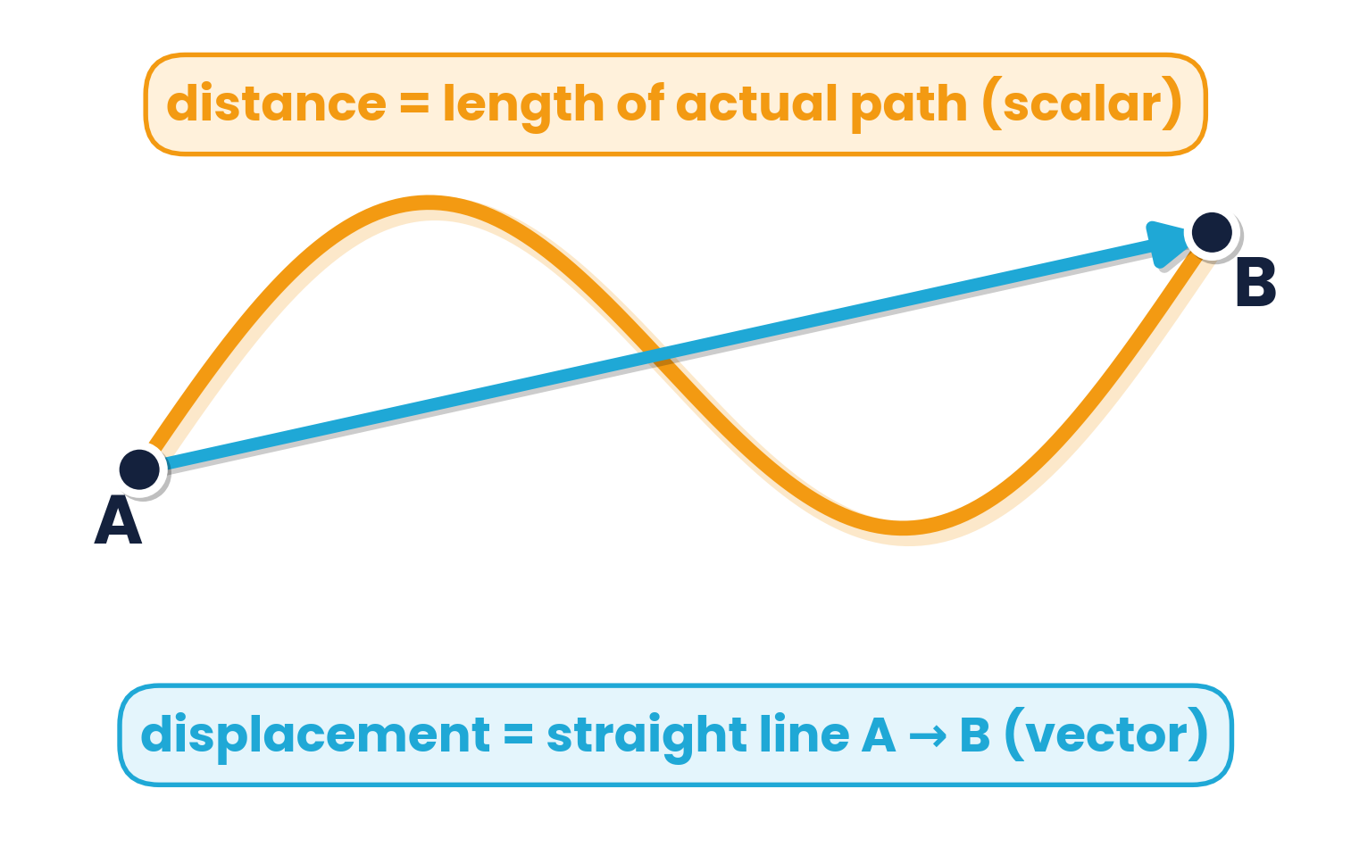
2.1.1 · DISTANCE AND DISPLACEMENT
Scalars vs vectors
SCALAR
VECTOR
magnitude only
magnitude and direction
Distance
total length of path travelled
Speed
distance travelled per unit time
Displacement
distance in a specified direction from a fixed point
Velocity
rate of change of displacement
Acceleration
rate of change of velocity
A runner completes one lap of a 400 m track: distance = 400 m, but displacement = 0. Average speed ≠ 0, average velocity = 0.
Topic 2 · Kinematics | Cambridge International AS Level Physics 9702
5

Slide 6
2.1.1 · VELOCITY AND ACCELERATION
Key definitions you must write word-perfect
v = Δs / Δt
a = Δv / Δt
speed = d / t
velocity · unit m s⁻¹
acceleration · unit m s⁻²
average speed = total distance ÷ total time
Exam-ready wording
The Δ symbol
Velocity: the rate of change of displacement
Acceleration: the rate of change of velocity
Avoid “speed in a direction” unless the question allows it — Cambridge rewards “rate of change”
Δ means “change in”: final − initial
Δs = change in displacement, Δt = time interval, Δv = change in velocity
A negative a with positive v means the object is slowing down
Topic 2 · Kinematics | Cambridge International AS Level Physics 9702
6

Slide 7
LEARNING OUTCOMES 2.1.2 – 2.1.5
02
Motion graphs
Gradients give rates · areas give accumulated change
Topic 2 · Kinematics | Cambridge International AS Level Physics 9702
7

Slide 8
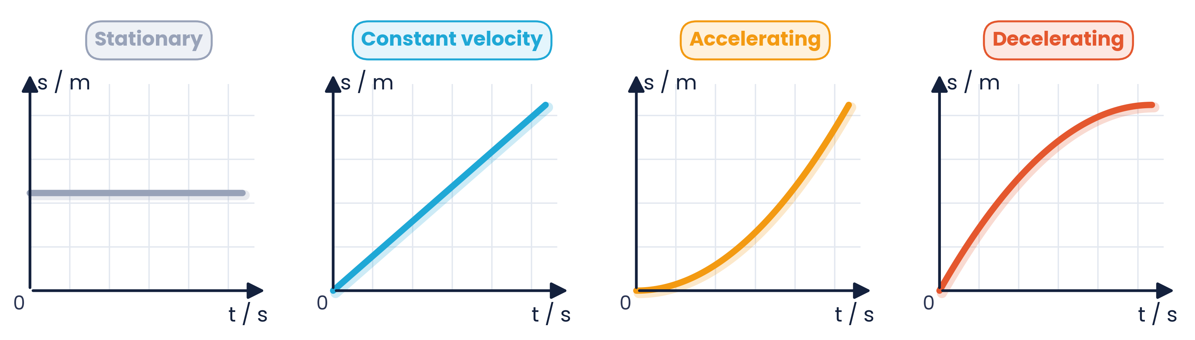
2.1.4 · GRADIENT = VELOCITY
Displacement–time graphs
Gradient = velocity
Straight line
Curve
v = Δs / Δt at any instant
constant velocity; horizontal line = stationary
velocity is changing — draw a tangent to find instantaneous velocity
Topic 2 · Kinematics | Cambridge International AS Level Physics 9702
8

Slide 9
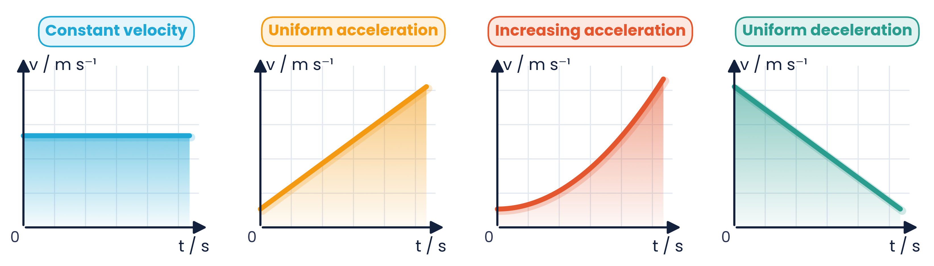
2.1.3 & 2.1.5 · GRADIENT = ACCELERATION, AREA = DISPLACEMENT
Velocity–time graphs
Gradient = acceleration
Area = displacement
Below the t-axis
a = Δv / Δt; straight line = uniform acceleration
shaded area under the line between two times
velocity negative: object moves the opposite way; area counts as negative displacement
Topic 2 · Kinematics | Cambridge International AS Level Physics 9702
9

Slide 10
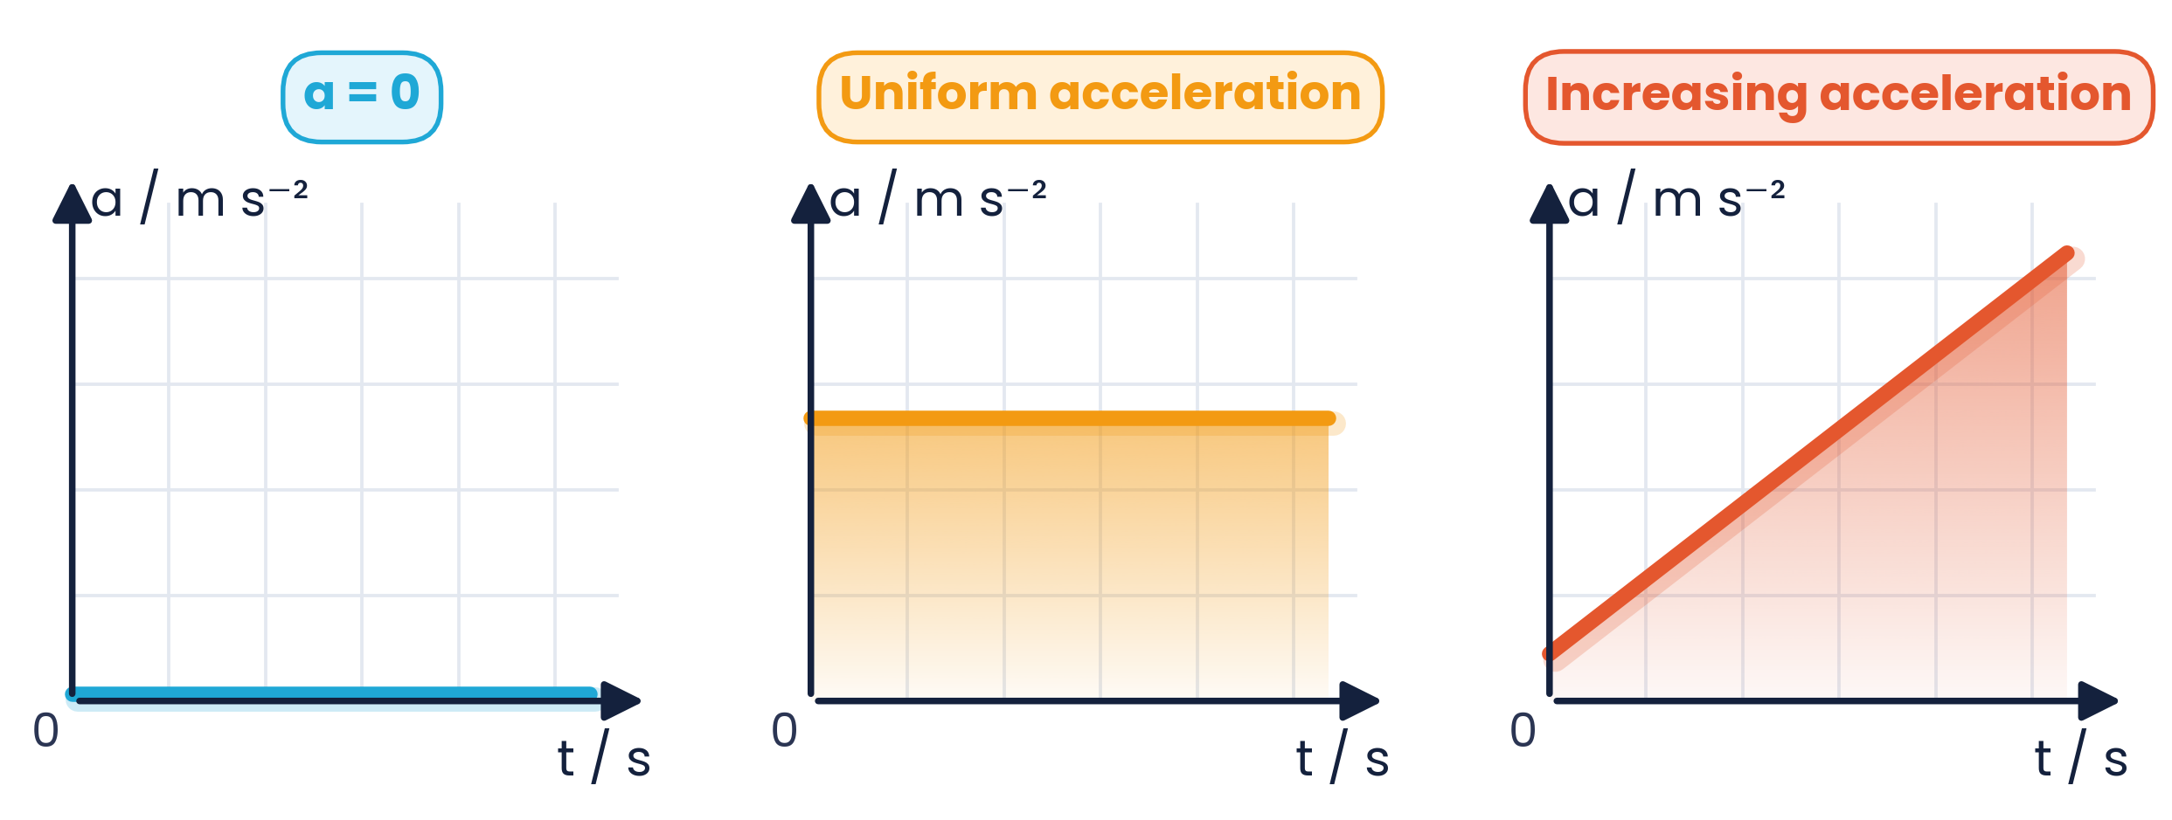
2.1.2 · AREA = CHANGE IN VELOCITY
Acceleration–time graphs
Reading an a–t graph
Area under the graph = change in velocity Δv
Horizontal line = uniform acceleration (SUVAT allowed)
a = 0 means constant velocity, not necessarily at rest
Gradient of an a–t graph is not needed at AS
Quick check
A car has a constant acceleration of 2.0 m s⁻² for 6.0 s. The area of the a–t graph = 2.0 × 6.0 = 12 m s⁻¹, so its velocity increases by 12 m s⁻¹.
Topic 2 · Kinematics | Cambridge International AS Level Physics 9702
10

Slide 11
2.1.2 – 2.1.5 · ONE MAP TO REMEMBER
How the three graphs connect
gradient
gradient
displacement–time
velocity–time
acceleration–time
area
area
Moving right → take the gradient (rate of change). Moving left → find the area (accumulated change).
Topic 2 · Kinematics | Cambridge International AS Level Physics 9702
11

Slide 12
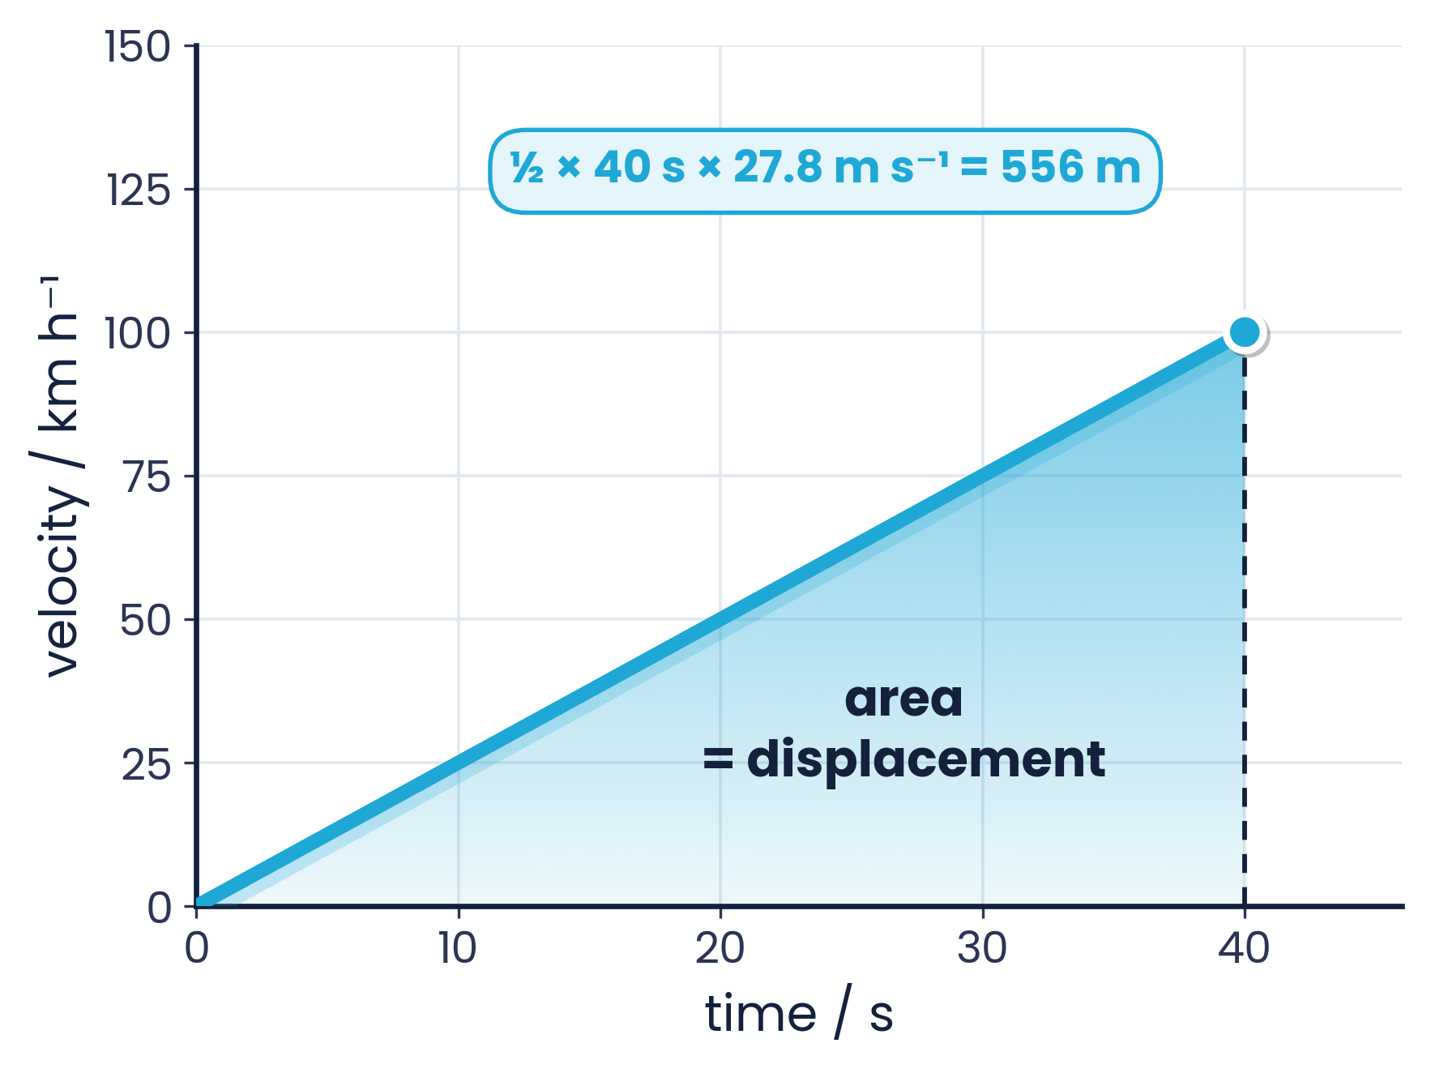
2.1.3 · DISPLACEMENT FROM A VELOCITY–TIME GRAPH
Worked example 1 · Area under a v–t graph
The v–t graph of a vehicle with uniform acceleration is shown. Calculate the displacement of the vehicle at 40 s.
1
Convert units: 100 km h⁻¹ = 100 000 m ÷ 3600 s = 27.8 m s⁻¹
2
Area of triangle = ½ × base × height
3
s = ½ × 40 s × 27.8 m s⁻¹
4
s = 556 m (≈ 560 m or 0.56 km)
Trap: using 100 directly mixes km h⁻¹ with seconds.
Topic 2 · Kinematics | Cambridge International AS Level Physics 9702
12

Slide 13
2.1.5 · INSTANTANEOUS ACCELERATION FROM A TANGENT
Worked example 2 · Gradient of a curve
A skydiver's velocity–time graph is shown. Use the graph to find her acceleration at t = 5.0 s.
1
Draw the tangent touching the curve at t = 5.0 s
2
Choose two points on the tangent far apart: (1.0, 20.3) and (9.5, 57.8)
3
a = Δv / Δt = (57.8 − 20.3) / (9.5 − 1.0)
4
a = 37.5 / 8.5 = 4.4 m s⁻² (2 s.f.)
Pick tangent points more than half the line apart.
Topic 2 · Kinematics | Cambridge International AS Level Physics 9702
13

Slide 14
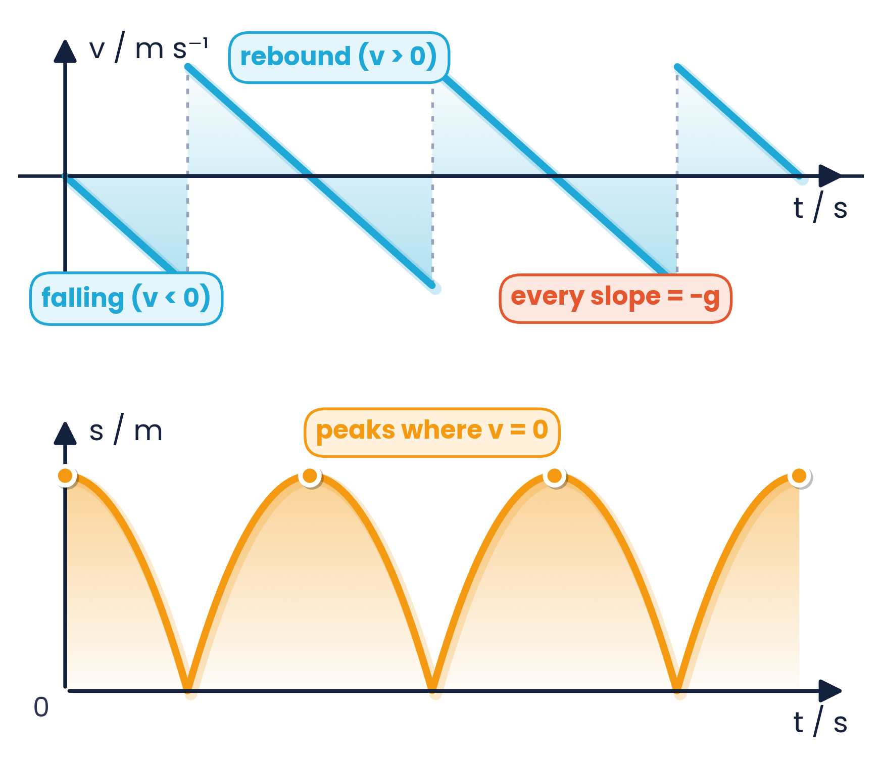
2.1.2 · INTERPRETING REAL MOTION
Graphs of a bouncing ball
What each feature means
Sloping lines are parallel: gradient = −g = −9.81 m s⁻² both going up and coming down
Near-vertical jumps: velocity reverses direction during the very short impact
v = 0 on the v–t graph ↔ maximum height (peak) on the s–t graph
Area of each triangle on the v–t graph = height travelled
Energy lost at each bounce → smaller rebound velocity and lower peaks (real ball)
Topic 2 · Kinematics | Cambridge International AS Level Physics 9702
14

Slide 15
LEARNING OUTCOMES 2.1.6 – 2.1.7
03
Equations of motion
Deriving and applying SUVAT for uniform acceleration
Topic 2 · Kinematics | Cambridge International AS Level Physics 9702
15

Slide 16
2.1.6 · CONSTANT ACCELERATION IN A STRAIGHT LINE
The five SUVAT quantities
s
u
v
a
t
displacement
initial velocity
final velocity
acceleration
time interval
m
m s⁻¹
m s⁻¹
m s⁻²
s
Only valid when…
Sign convention
acceleration is constant (uniform)
motion is along a straight line (or treated one component at a time)
s, u, v and a are vectors: choose one direction as positive
t is a scalar and is always positive
Topic 2 · Kinematics | Cambridge International AS Level Physics 9702
16

Slide 17
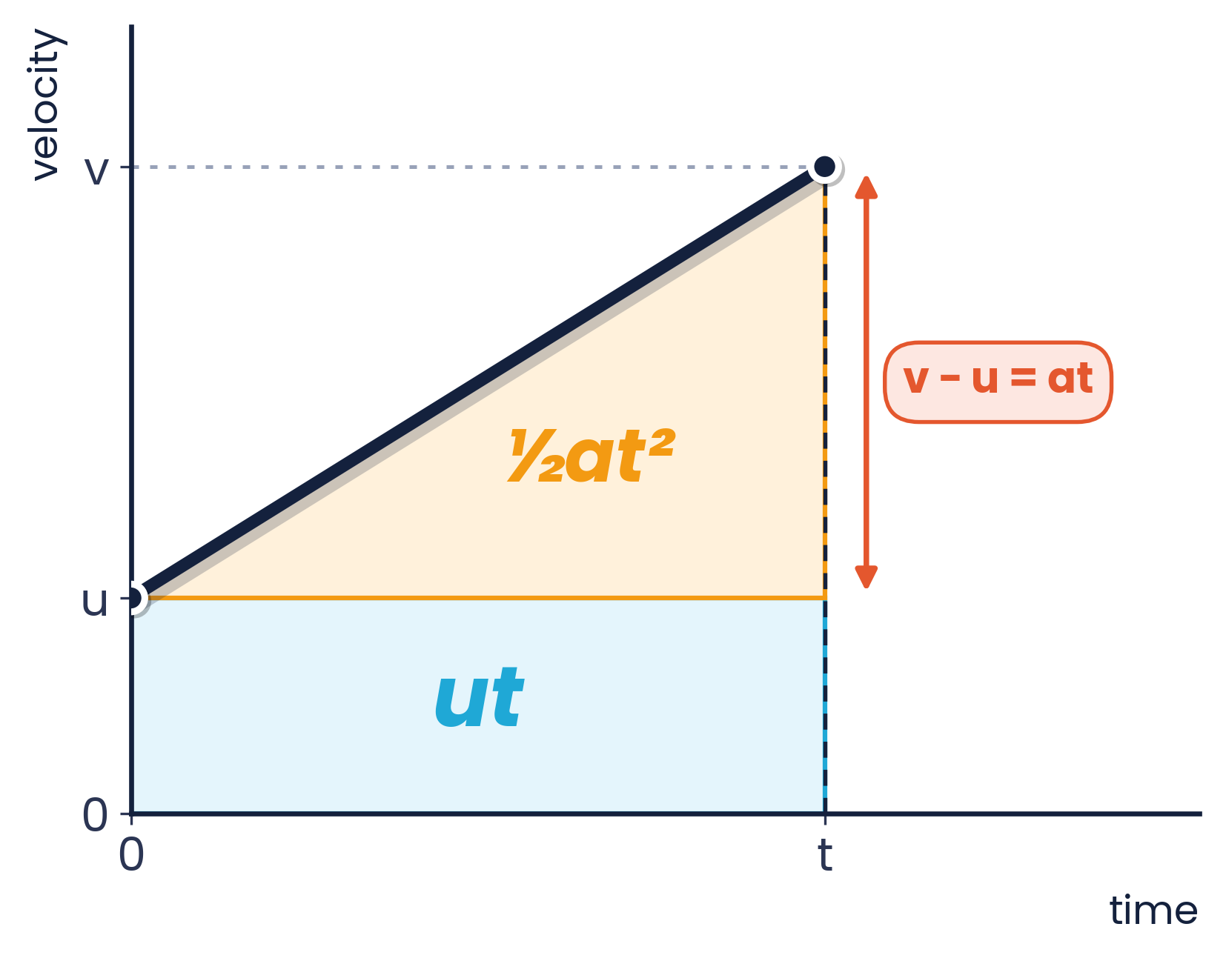
2.1.6 · FROM THE DEFINITIONS AND THE V–T GRAPH
Deriving v = u + at and s = ½(u + v)t
① From the definition of acceleration
a = (v − u) / t
multiply by t and rearrange:
v = u + at
② Area under the v–t graph (trapezium)
displacement = average velocity × time
s = (u + v) t / 2
valid because the graph is a straight line (uniform a)
Topic 2 · Kinematics | Cambridge International AS Level Physics 9702
17

Slide 18
2.1.6 · COMBINING EQUATIONS ① AND ②
Deriving s = ut + ½at² and v² = u² + 2as
③ Eliminate v
④ Eliminate t
Substitute v = u + at into s = (u + v)t / 2
s = (u + u + at) t / 2
s = (2ut + at²) / 2
s = ut + ½at²
Graph view: rectangle ut + triangle ½ × t × at
From ①: t = (v − u) / a; substitute into ②
s = (u + v)(v − u) / 2a
2as = v² − u²
v² = u² + 2as
No time needed — ideal for braking-distance problems
Topic 2 · Kinematics | Cambridge International AS Level Physics 9702
18

Slide 19
2.1.7 · CHOOSING THE RIGHT EQUATION
SUVAT toolkit: pick the equation by the missing quantity
v = u + at
s = ½(u + v)t
s = ut + ½at²
v² = u² + 2as
no s
no a
no v
no t
Method
On the data sheet
List the three quantities you know and the one you want
The fifth quantity is the one you don't need — choose the equation without it
s = ut + ½at² and v² = u² + 2as are printed on page 2 of Papers 1 and 2
v = u + at and s = ½(u + v)t must be recalled
Topic 2 · Kinematics | Cambridge International AS Level Physics 9702
19

Slide 20
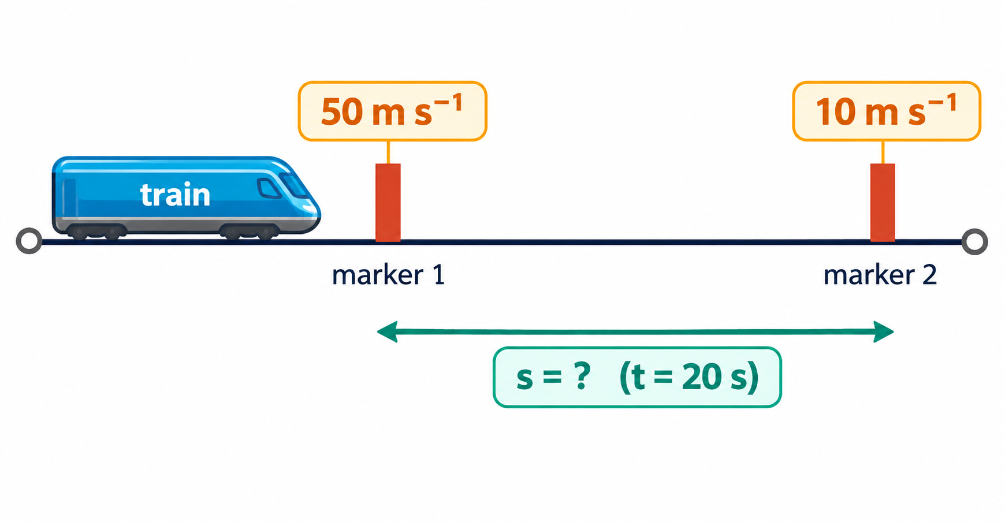
2.1.7 · SOLVING WITH SUVAT
Worked example 3 · Train approaching two markers
A train passes marker 1 at 50 m s⁻¹, then decelerates uniformly so that it passes marker 2 at no more than 10 m s⁻¹. The time between the markers must be no less than 20 s. How far from marker 2 should marker 1 be placed?
1
Known: u = 50 m s⁻¹, v = 10 m s⁻¹, t = 20 s; wanted: s
2
a is not needed → use s = ½(u + v)t
3
s = ½ × (50 + 10) × 20
4
s = 600 m
Topic 2 · Kinematics | Cambridge International AS Level Physics 9702
20

Slide 21
LEARNING OUTCOMES 2.1.7 – 2.1.8
04
Free fall
Acceleration of free fall g and how to measure it
Topic 2 · Kinematics | Cambridge International AS Level Physics 9702
21

Slide 22
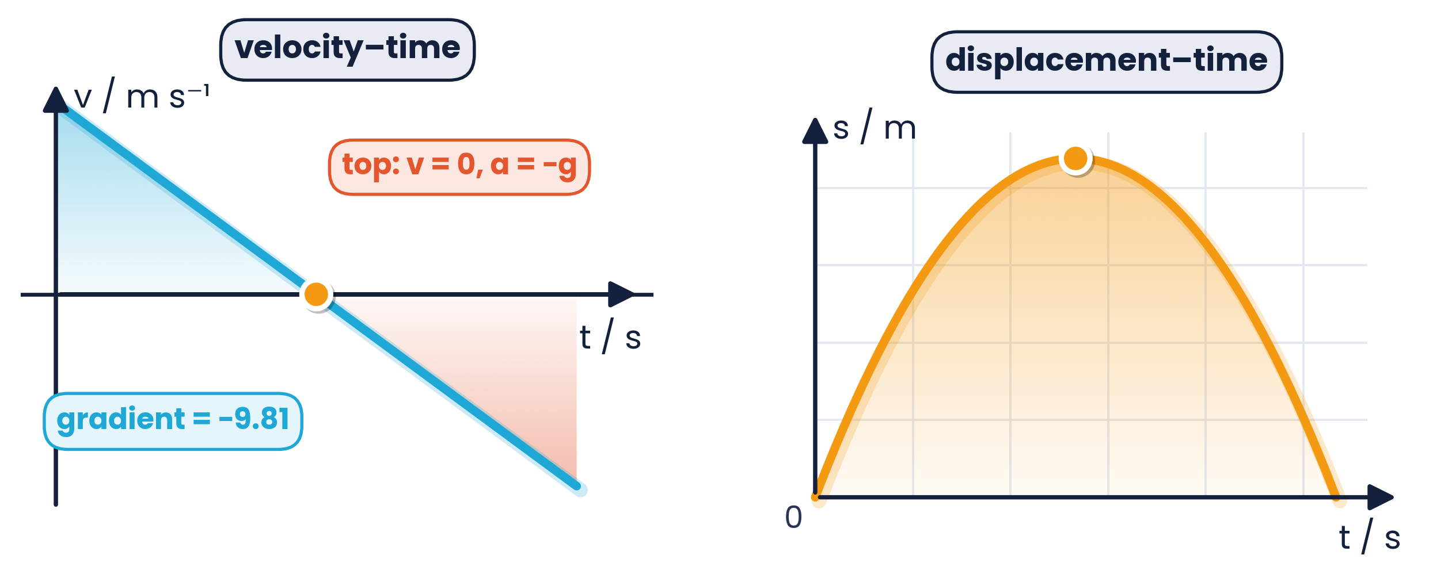
2.1.7 · FREE FALL WITHOUT AIR RESISTANCE
Motion in a uniform gravitational field
g = 9.81 m s⁻² downwards (value on the data sheet)
All objects fall with the same acceleration, whatever their mass, if air resistance is negligible
Taking up as positive: a = −9.81 m s⁻²
At maximum height v = 0 for an instant — but a is still g
Time up = time down (for the same level), and the object returns with the same speed
Ball thrown up at 9.81 m s⁻¹
time to top t = u/g = 1.0 s; max height = u²/2g = 4.9 m; back in hand after 2.0 s
Topic 2 · Kinematics | Cambridge International AS Level Physics 9702
22

Slide 23
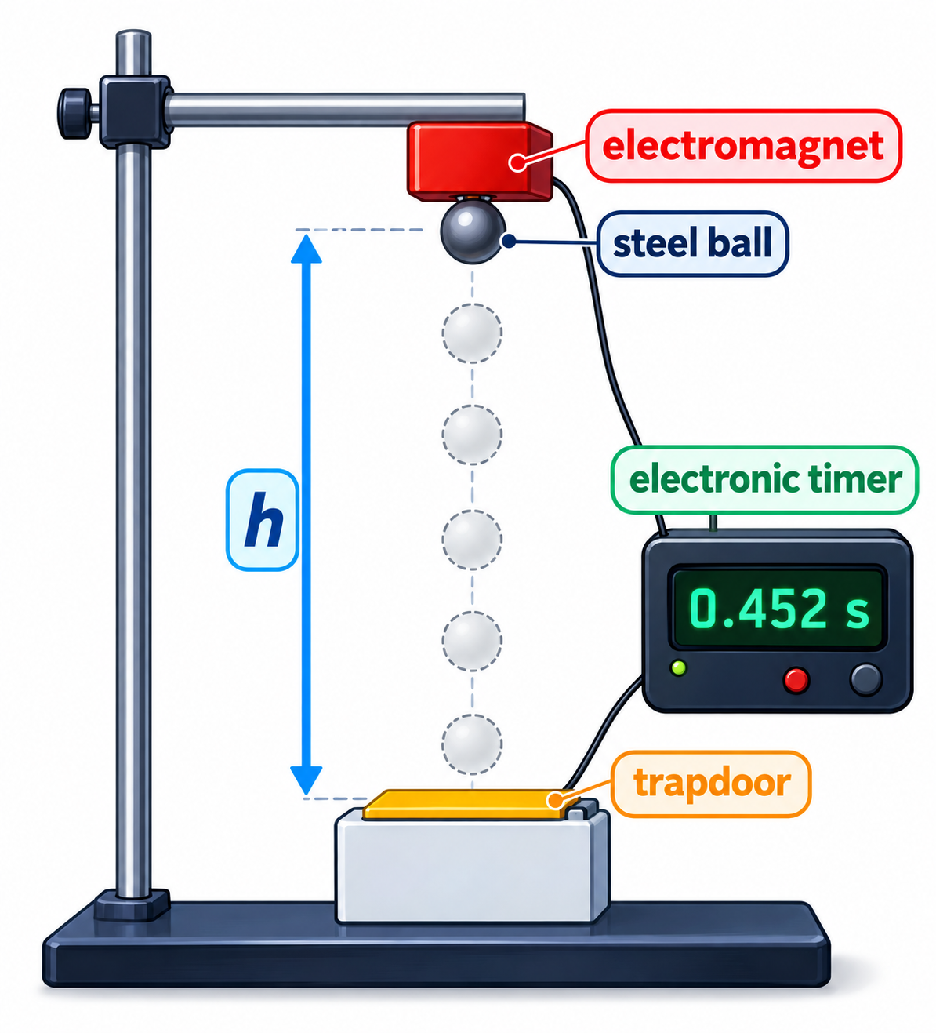
2.1.8 · DESCRIBE AN EXPERIMENT
Experiment: determining g with a falling ball
Method
1
Hold a steel ball with an electromagnet above a trapdoor
2
Switching off the magnet releases the ball and starts the timer
3
The ball opens the trapdoor, which stops the timer: time t
4
Measure h (bottom of ball to trapdoor) with a metre rule
5
Repeat for each h and average t; take 5–6 values of h between about 0.20 m and 1.00 m
Topic 2 · Kinematics | Cambridge International AS Level Physics 9702
23

Slide 24
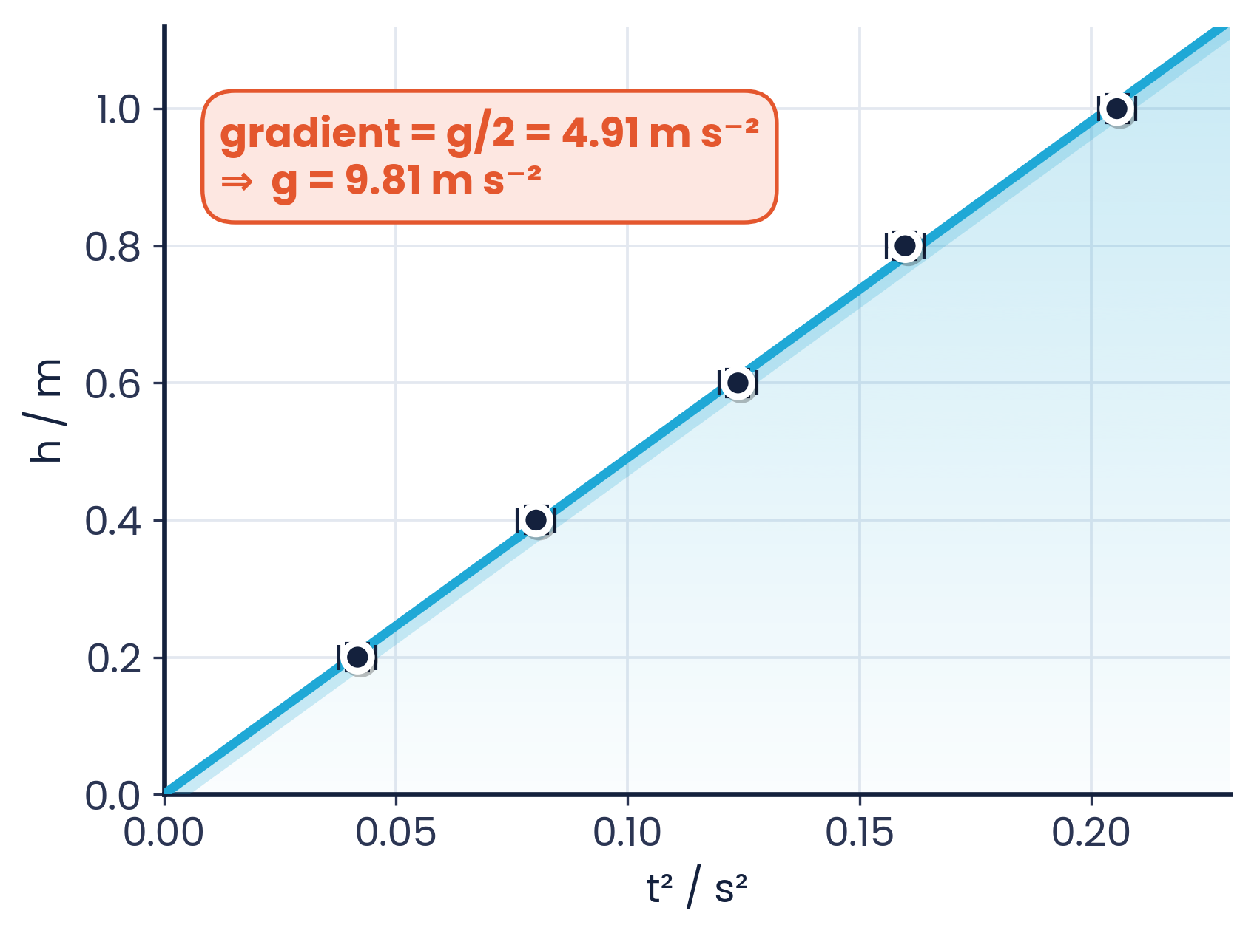
2.1.8 · FROM THE GRAPH TO G
Analysis and sources of error
Systematic error
Residual magnetism delays the release after the timer starts, so t is too large and g is too small
Random error
Parallax when reading h on the metre rule; variation in how the trapdoor opens
Improvements
Use light gates and a data logger; repeat and average; read h at eye level with a set square
h = ½gt² compares with y = mx
plot h against t²: gradient = g/2, so g = 2 × gradient
Topic 2 · Kinematics | Cambridge International AS Level Physics 9702
24

Slide 25
LEARNING OUTCOME 2.1.9
05
Projectile motion
Uniform velocity horizontally · uniform acceleration vertically
Topic 2 · Kinematics | Cambridge International AS Level Physics 9702
25

Slide 26
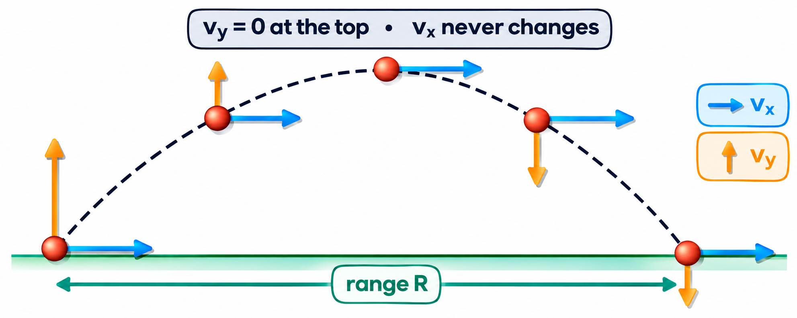
2.1.9 · HORIZONTAL AND VERTICAL COMPONENTS
Two independent motions, one shared time
Horizontal
Vertical
The link
No force (no air resistance) → aₓ = 0
uₓ = u cos θ stays constant
x = (u cos θ) t
Weight acts → a = −g
uᵧ = u sin θ; vᵧ = u sin θ − gt
use SUVAT with a = −9.81 m s⁻²
Time t is the same for both
Solve one direction for t, use it in the other
Resultant v = √(vₓ² + vᵧ²)
Topic 2 · Kinematics | Cambridge International AS Level Physics 9702
26

Slide 27
2.1.9 · DERIVE THEM — DON'T JUST MEMORISE
Key results for launch at angle θ on level ground
T = 2u sin θ / g
H = u² sin²θ / 2g
R = u² sin 2θ / g
time of flight: vertical displacement = 0
maximum height: vᵧ = 0 at the top
range = uₓ × T
Where they come from
Be careful
H: v² = u² + 2as with v = 0, u = u sin θ, a = −g
T: s = ut + ½at² with s = 0
R: (u cos θ) × T and 2 sin θ cos θ = sin 2θ
These only apply when launch and landing heights are equal
Maximum range at 45° (no air resistance)
With air resistance: lower H, shorter R, asymmetric path
Topic 2 · Kinematics | Cambridge International AS Level Physics 9702
27

Slide 28
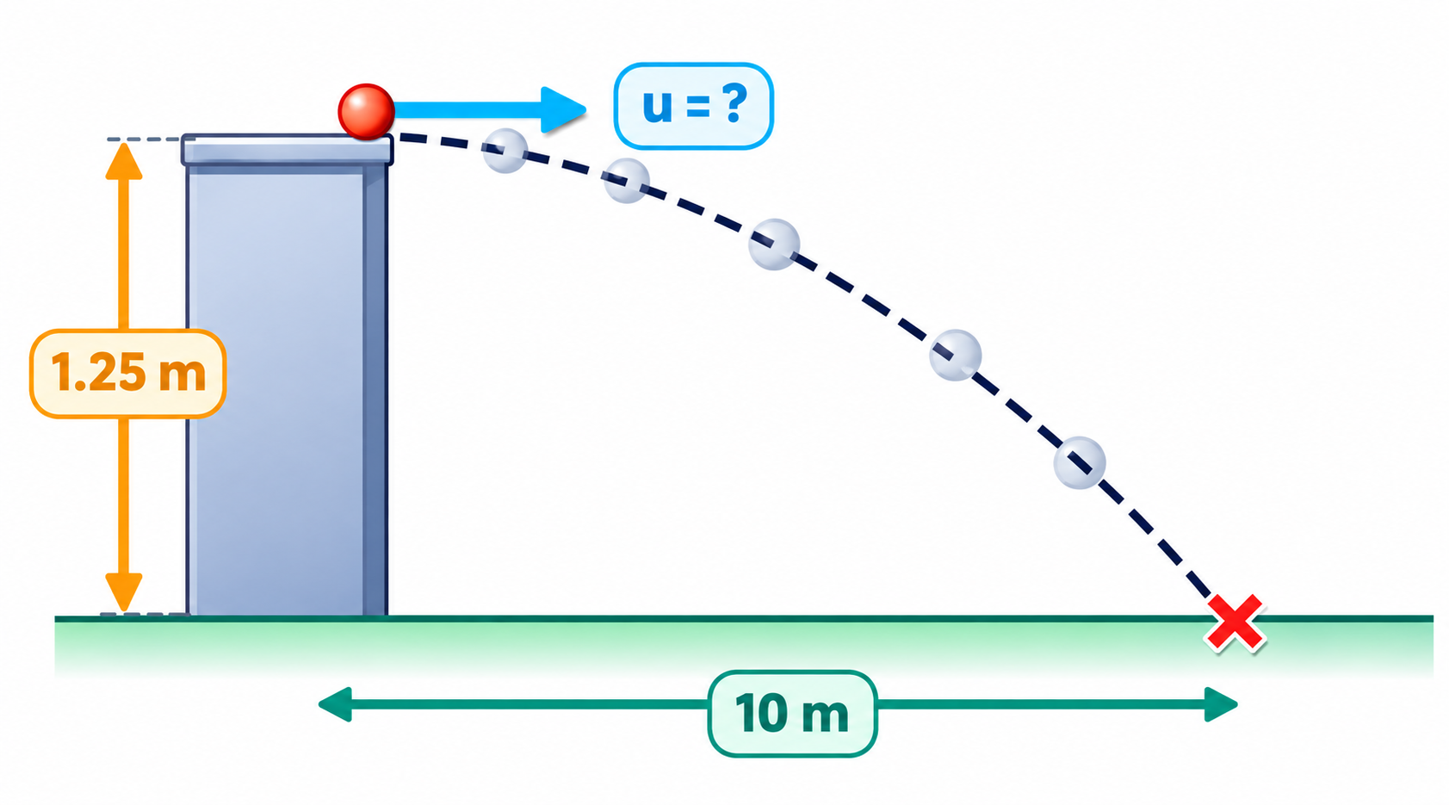
2.1.9 · MOTORCYCLE STUNT
Worked example 4 · Horizontal launch
A stunt rider moving horizontally takes off from a point 1.25 m above the ground and lands 10 m away. What was the speed at take-off?
1
Vertical first: u = 0, a = 9.81 m s⁻², s = 1.25 m
2
s = ½at² → t = √(2 × 1.25 / 9.81) = 0.505 s
3
Horizontal: aₓ = 0, so speed = distance ÷ time
4
u = 10 / 0.505 = 19.8 m s⁻¹ ≈ 20 m s⁻¹
Topic 2 · Kinematics | Cambridge International AS Level Physics 9702
28

Slide 29
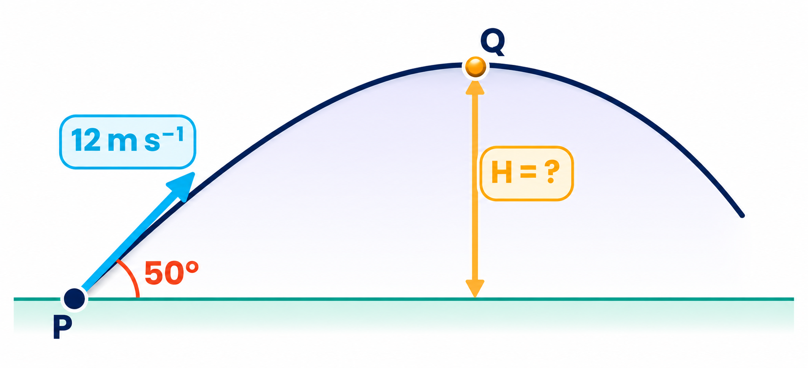
2.1.9 · MAXIMUM HEIGHT
Worked example 5 · Launch at an angle
A ball is thrown from P with an initial velocity of 12 m s⁻¹ at 50° to the horizontal. What is the maximum height reached at Q?
1
Vertical component: uᵧ = 12 sin 50° = 9.19 m s⁻¹
2
At Q: vᵧ = 0, a = −9.81 m s⁻²; t unknown → use v² = u² + 2as
3
0 = 9.19² − 2 × 9.81 × H
4
H = 9.19² / 19.62 = 4.3 m
Topic 2 · Kinematics | Cambridge International AS Level Physics 9702
29

Slide 30
EXAM-STYLE QUESTIONS
06
Past paper practice
Paper 1 multiple choice · Paper 2 structured questions
Topic 2 · Kinematics | Cambridge International AS Level Physics 9702
30

Slide 31
PAPER 1 STYLE · MULTIPLE CHOICE
Practice set A · Equations of motion
1
A body with uniform acceleration increases its velocity from u to v in time t. Which expression would not give a correct value for the displacement during time t?
2
A sprinter runs a 100 m race in a straight line. He accelerates from the start at 2.5 m s⁻² to his maximum speed of 10 m s⁻¹, then keeps this speed to the finish. What time does he take?
A 4 s B 10 s C 12 s D 20 s
A ut + ½at² B vt − ½at²
C (v + u)(v − u) / 2a D (v − u)t / 2
3
A ball-bearing is held by an electromagnet. When the current is switched off, a clock starts and the ball falls a distance h, then strikes a switch that stops the clock at time t. Which expression gives g?
4
An object is thrown vertically upwards on the Moon with velocity 5.2 m s⁻¹. The acceleration due to gravity on the Moon is 1.62 m s⁻². What is the time taken for it to return to its starting point?
A ht² / 2 B h / 2t² C √(2h) / t D 2h / t²
A 2.5 s B 3.2 s C 4.5 s D 6.4 s
Topic 2 · Kinematics | Cambridge International AS Level Physics 9702
31

Slide 32
ANSWERS AND KEY WORKING
Practice set A · Answers
1
Answer D
2
Answer C
Correct displacement is (u + v)t / 2. D uses (v − u) — that is ½ × Δv × t, not the area. A, B and C are all valid SUVAT forms.
Accelerating: t₁ = 10/2.5 = 4 s; s₁ = ½ × 2.5 × 4² = 20 m. Remaining 80 m at 10 m s⁻¹ takes 8 s. Total = 12 s.
3
Answer D
4
Answer D
u = 0, so h = ½gt² → g = 2h / t².
Symmetry: time up = u/g = 5.2/1.62 = 3.21 s. Total = 2 × 3.21 = 6.4 s (s = 0 in s = ut + ½at²).
Topic 2 · Kinematics | Cambridge International AS Level Physics 9702
32
Notes:
Q1 is a favourite trap: students confuse (u + v) with (v − u). Q4 distractor B (3.2 s) is the time to the top only.

Slide 33
PAPER 1 STYLE · MULTIPLE CHOICE
Practice set B · Speed and SUVAT
5
An experiment measures g. A body falls between two fixed points. Which measurement is not required to calculate g?
6
An aeroplane travels at an average speed of 600 km h⁻¹ on an outward flight and at 400 km h⁻¹ on the return flight over the same distance. What is the average speed for the whole flight?
A distance fallen B initial velocity
C mass of the body D time to fall
A 111 km h⁻¹ B 167 km h⁻¹
C 480 km h⁻¹ D 500 km h⁻¹
7
A train driver applies the brake at a yellow signal 1.0 km from a red signal, where the train stops. The maximum deceleration is 0.20 m s⁻². Assuming uniform deceleration, what is the maximum safe speed at the yellow signal?
8
A person travels a total distance of 200 km. The first 90 km is at an average speed of 80 km h⁻¹. What average speed is needed for the rest of the journey to arrive in a total time of 2 hours 0 minutes?
A 14 m s⁻¹ B 20 m s⁻¹
C 40 m s⁻¹ D 400 m s⁻¹
A 110 km h⁻¹ B 120 km h⁻¹
C 122 km h⁻¹ D 126 km h⁻¹
Topic 2 · Kinematics | Cambridge International AS Level Physics 9702
33

Slide 34
ANSWERS AND KEY WORKING
Practice set B · Answers
5
Answer C
6
Answer C
Free-fall acceleration does not depend on mass (no air resistance). Distance, initial velocity at the first point and time are all needed.
Let each leg be d: total time = d/600 + d/400. Average = 2d ÷ (d/600 + d/400) = 480 km h⁻¹. D (500) wrongly averages the two speeds.
7
Answer B
8
Answer D
v² = u² + 2as with v = 0: u² = 2 × 0.20 × 1000 = 400 → u = 20 m s⁻¹. Convert 1.0 km to 1000 m first.
Time for first 90 km = 90/80 = 1.125 h. Remaining 110 km in 0.875 h → 110/0.875 = 126 km h⁻¹.
Topic 2 · Kinematics | Cambridge International AS Level Physics 9702
34
Notes:
Q6 exposes the 'average of the speeds' misconception. Q7 distractor D is u² instead of u.

Slide 35
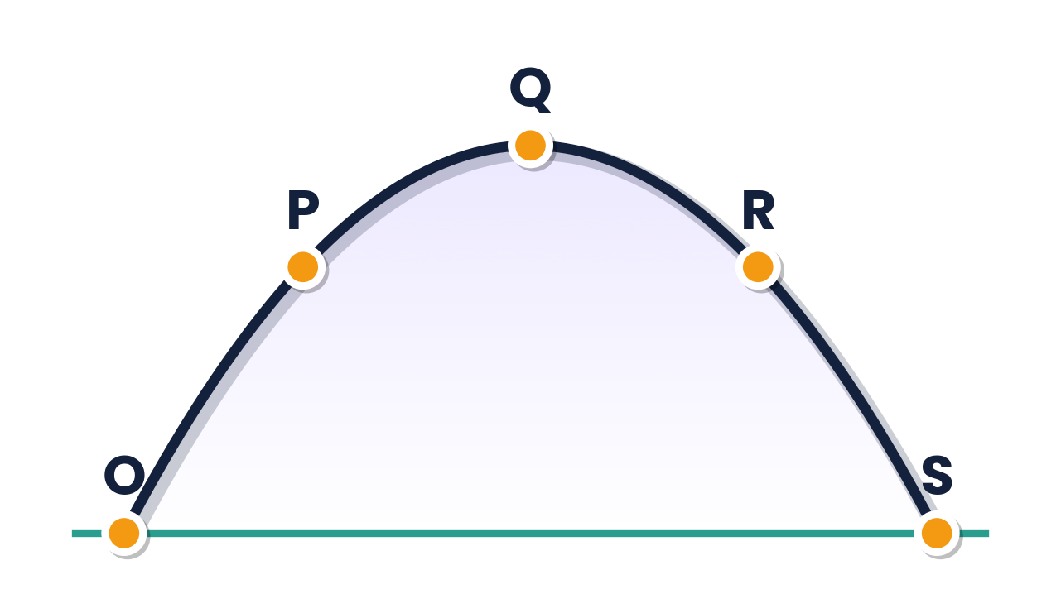
PAPER 1 STYLE · MULTIPLE CHOICE
Practice set C · Projectiles
9
A cannon fires a cannonball with initial speed v at angle α to the horizontal. Which equation is correct for the maximum height H reached?
10
A stone is thrown upwards and follows a curved path. Air resistance is negligible. Why does the path have this shape?
A H = v sin α / 2g B H = g sin α / 2v
C H = (v sin α)² / 2g D H = g² sin α / 2v
A constant vₓ, constant vertical acceleration
B constant horizontal acceleration, constant vᵧ
C constant up, then constant down acceleration
D constant up, then constant down velocity
11
A projectile is fired at angle α to the horizontal at speed u. What are the vertical and horizontal components of its velocity after time t? (air resistance negligible)
12
A projectile is launched at O and follows the path OPQRS. Air resistance is negligible. Which statement is true at the highest point Q?
A vertical u sin α, horizontal u cos α
B vertical u sin α − gt, horizontal u cos α − gt
C vertical u sin α − gt, horizontal u cos α
D vertical u cos α, horizontal u sin α − gt
A horizontal acceleration is zero
B horizontal velocity is zero
C kinetic energy is zero
D momentum is zero
Topic 2 · Kinematics | Cambridge International AS Level Physics 9702
35

Slide 36
ANSWERS AND KEY WORKING
Practice set C · Answers
9
Answer C
10
Answer A
Vertical: v² = u² + 2as with v = 0, u = v sin α, a = −g → H = (v sin α)² / 2g. Check units: only C gives metres.
No horizontal force → constant horizontal velocity; weight gives constant downward acceleration. Together they make a parabola.
11
Answer C
12
Answer A
Horizontal component never changes (u cos α). Vertical: v = u + at = u sin α − gt.
The horizontal acceleration is zero everywhere on the path. At Q only the vertical velocity is zero — the ball still moves horizontally, so KE and momentum are not zero.
Topic 2 · Kinematics | Cambridge International AS Level Physics 9702
36
Notes:
Q12 is a powerful doubt-clearer: ask students why B is wrong before revealing.

Slide 37
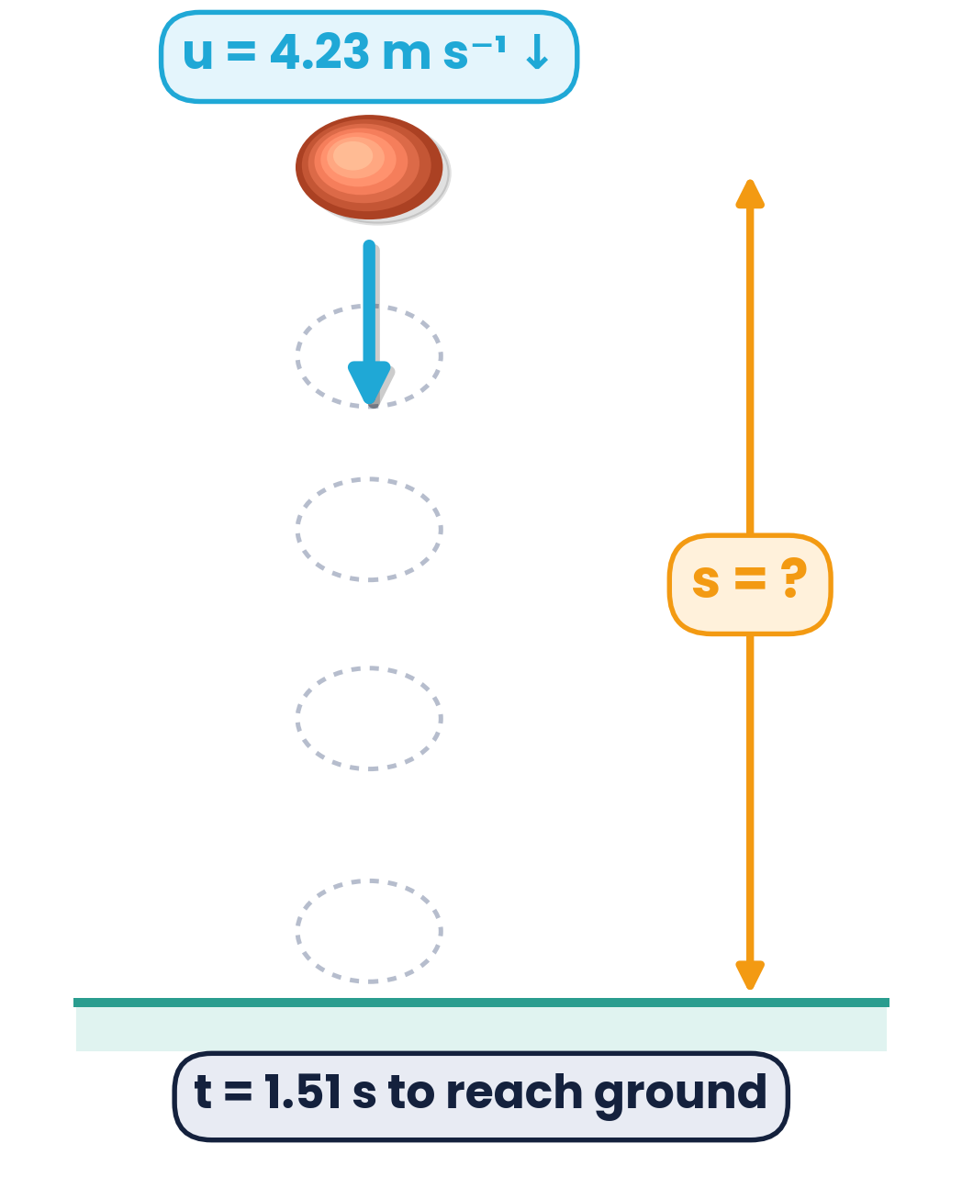
PAPER 2 STYLE · STRUCTURED QUESTION
Structured question 1 · Ball thrown downwards
A ball is thrown vertically down towards the ground with an initial velocity of 4.23 m s⁻¹. The ball falls for a time of 1.51 s before hitting the ground. Air resistance is negligible.
(a)(i) Show that the downwards velocity of the ball when it hits the ground is 19.0 m s⁻¹. [2]
(a)(ii) Calculate, to three significant figures, the distance the ball falls to the ground. [2]
(b) The ball rebounds vertically upwards with a speed of 18.6 m s⁻¹. Determine the maximum height it reaches after the bounce. [2]
Topic 2 · Kinematics | Cambridge International AS Level Physics 9702
37

Slide 38
MARK SCHEME STYLE SOLUTION
Structured question 1 · Solution
(a)(i)
v = u + at = 4.23 + 9.81 × 1.51 (C1) = 19.04 ≈ 19.0 m s⁻¹ (A1). A “show that” needs the unrounded value 19.04.
(a)(ii)
s = ut + ½at² = 4.23 × 1.51 + ½ × 9.81 × 1.51² (C1) = 17.6 m (A1). Also accepted: v² = u² + 2as with v = 19.0.
(b)
v² = u² + 2as with v = 0, u = 18.6, a = −9.81: 0 = 18.6² − 2 × 9.81 × h (C1) → h = 17.6 m (A1). An energy method mgh = ½mv² is equally valid.
Topic 2 · Kinematics | Cambridge International AS Level Physics 9702
38
Notes:
Common error in (a)(ii): using g = 10 or u = 0. Stress the given 3 s.f. requirement.

Slide 39
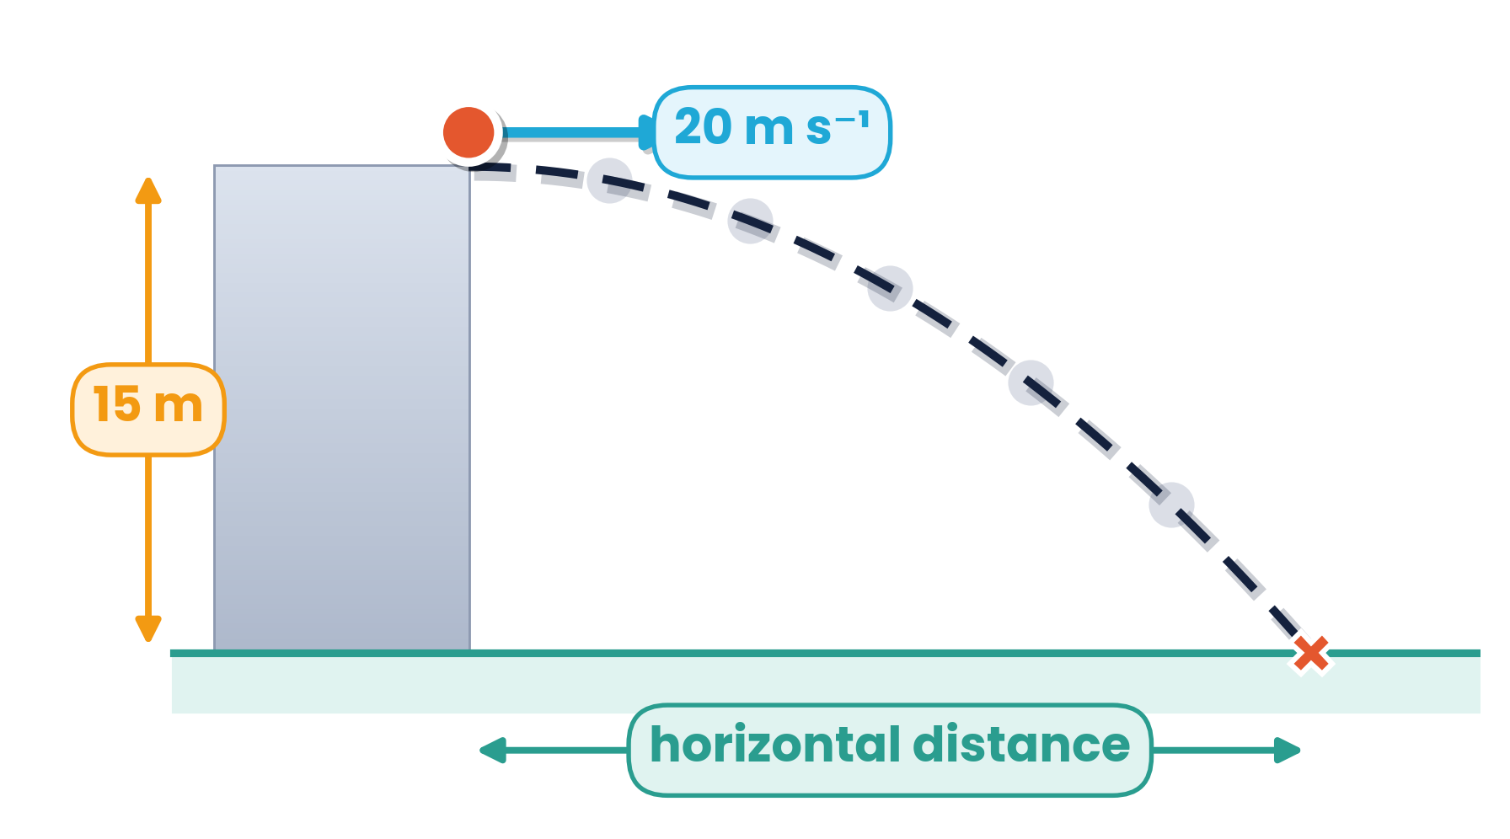
PAPER 2 STYLE · STRUCTURED QUESTION
Structured question 2 · Stone from a cliff
A stone is thrown with a horizontal velocity of 20 m s⁻¹ from the top of a cliff 15 m high. Air resistance is negligible.
(i) Calculate the time to fall 15 m. [2]
(ii) Calculate the magnitude of the resultant velocity after falling 15 m. [3]
(iii) Describe the difference between the displacement of the stone and the distance that it travels. [2]
Topic 2 · Kinematics | Cambridge International AS Level Physics 9702
39

Slide 40
MARK SCHEME STYLE SOLUTION
Structured question 2 · Solution
(i)
Vertical, u = 0: 15 = ½ × 9.81 × t² (C1) → t = 1.7 s (1.75 s) (A1).
(ii)
vᵧ = 9.81 × 1.75 = 17.2 m s⁻¹ (or vᵧ² = 2 × 9.81 × 15) (C1). v = √(20² + 17.2²) (C1) = 26 m s⁻¹ (A1). Using u = 20 m s⁻¹ vertically scores 0.
(iii)
Distance is the length of the actual curved path travelled (B1). Displacement is the straight-line distance from start to finish in a specified direction (B1).
Topic 2 · Kinematics | Cambridge International AS Level Physics 9702
40
Notes:
Doubt to address: the 20 m s⁻¹ is horizontal only — the vertical initial velocity is zero.

Slide 41
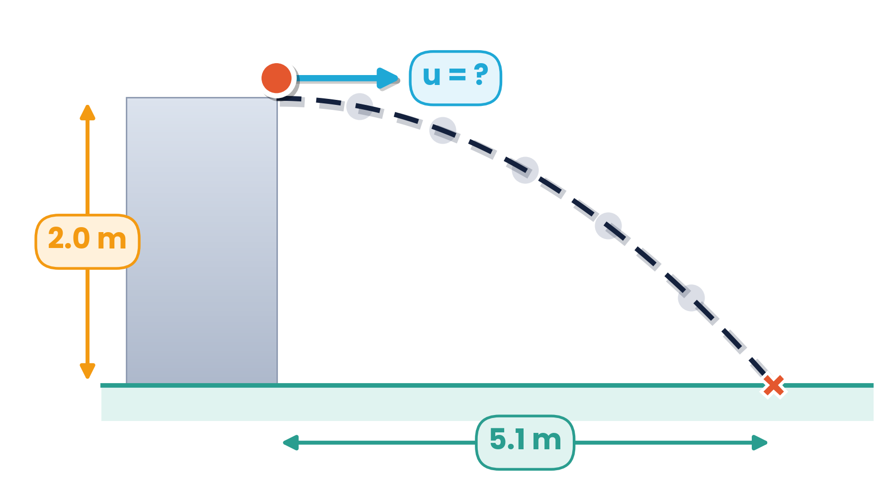
PAPER 2 STYLE · STRUCTURED QUESTION
Structured question 3 · Jumping a river
A stunt motorcyclist attempts to jump a river which is 5.1 m wide. The bank from which he takes off is 2.0 m higher than the bank on which he will land. He leaves the bank moving horizontally.
Calculate the minimum horizontal speed he must achieve before take-off to avoid landing in the river. [3]
Topic 2 · Kinematics | Cambridge International AS Level Physics 9702
41

Slide 42
MARK SCHEME STYLE SOLUTION
Structured question 3 · Solution
Step 1
Vertical motion, uᵧ = 0, a = 9.81 m s⁻², s = 2.0 m: 2.0 = ½ × 9.81 × t² (C1)
Step 2
t = √(4.0 / 9.81) = 0.639 s (C1)
Step 3
Horizontal: u = 5.1 / 0.639 = 8.0 m s⁻¹ (A1). Any lower speed and he lands before the far bank.
Topic 2 · Kinematics | Cambridge International AS Level Physics 9702
42

Slide 43
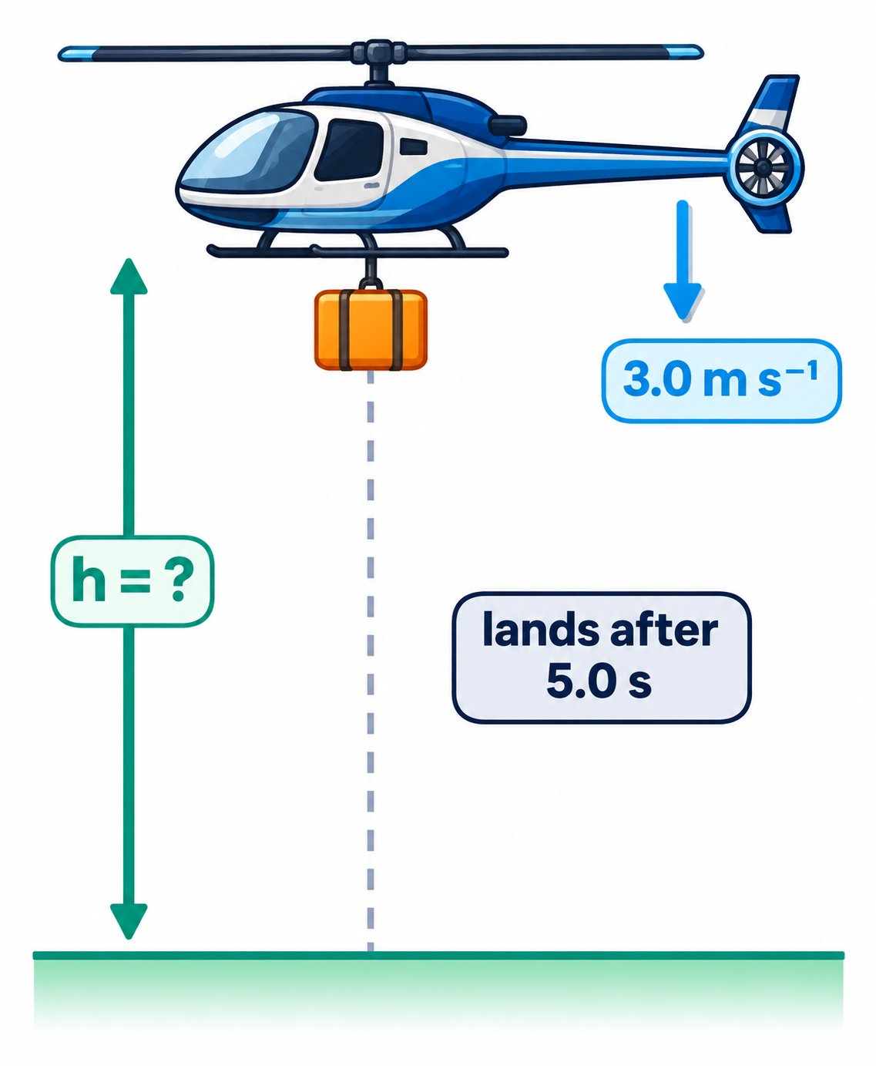
PAPER 2 STYLE · STRUCTURED QUESTION
Structured question 4 · Sandbag from a helicopter
A helicopter is descending vertically at a constant speed of 3.0 m s⁻¹. A sandbag is released from the helicopter and hits the ground 5.0 s later. Air resistance is negligible.
Calculate the height of the helicopter above the ground at the time the sandbag was released. [3]
Hint: what is the velocity of the sandbag at the moment it is released?
Topic 2 · Kinematics | Cambridge International AS Level Physics 9702
43

Slide 44
MARK SCHEME STYLE SOLUTION
Structured question 4 · Solution
Key idea
At release the sandbag moves with the helicopter: u = 3.0 m s⁻¹ downwards, not zero.
Working
Taking down as positive: s = ut + ½at² = 3.0 × 5.0 + ½ × 9.81 × 5.0² (C1, C1)
Answer
s = 15 + 122.6 = 138 m ≈ 140 m (A1). Taking u = 0 gives 123 m — a very common error.
Topic 2 · Kinematics | Cambridge International AS Level Physics 9702
44
Notes:
A classic doubt: objects released from moving vehicles carry the vehicle's velocity.

Slide 45
PAPER 2 STYLE · STRUCTURED QUESTION
Structured question 5 · Projectile at 25°
A projectile is fired with a velocity of 20 m s⁻¹ at an angle of 25° above the horizontal. Air resistance can be ignored, and it lands at the same level it was fired from.
(a) Calculate (i) the initial vertical component and (ii) the initial horizontal component of the velocity. [2]
(b) Calculate the maximum height reached. [2]
(c) Calculate the horizontal range. [3]
Topic 2 · Kinematics | Cambridge International AS Level Physics 9702
45

Slide 46
MARK SCHEME STYLE SOLUTION
Structured question 5 · Solution
(a)
uᵧ = 20 sin 25° = 8.45 m s⁻¹; uₓ = 20 cos 25° = 18.1 m s⁻¹
(b)
0 = 8.45² − 2 × 9.81 × H → H = 8.45² / 19.62 = 3.6 m
(c)
Time of flight T = 2 × 8.45 / 9.81 = 1.72 s; R = 18.1 × 1.72 = 31 m
Topic 2 · Kinematics | Cambridge International AS Level Physics 9702
46

Slide 47
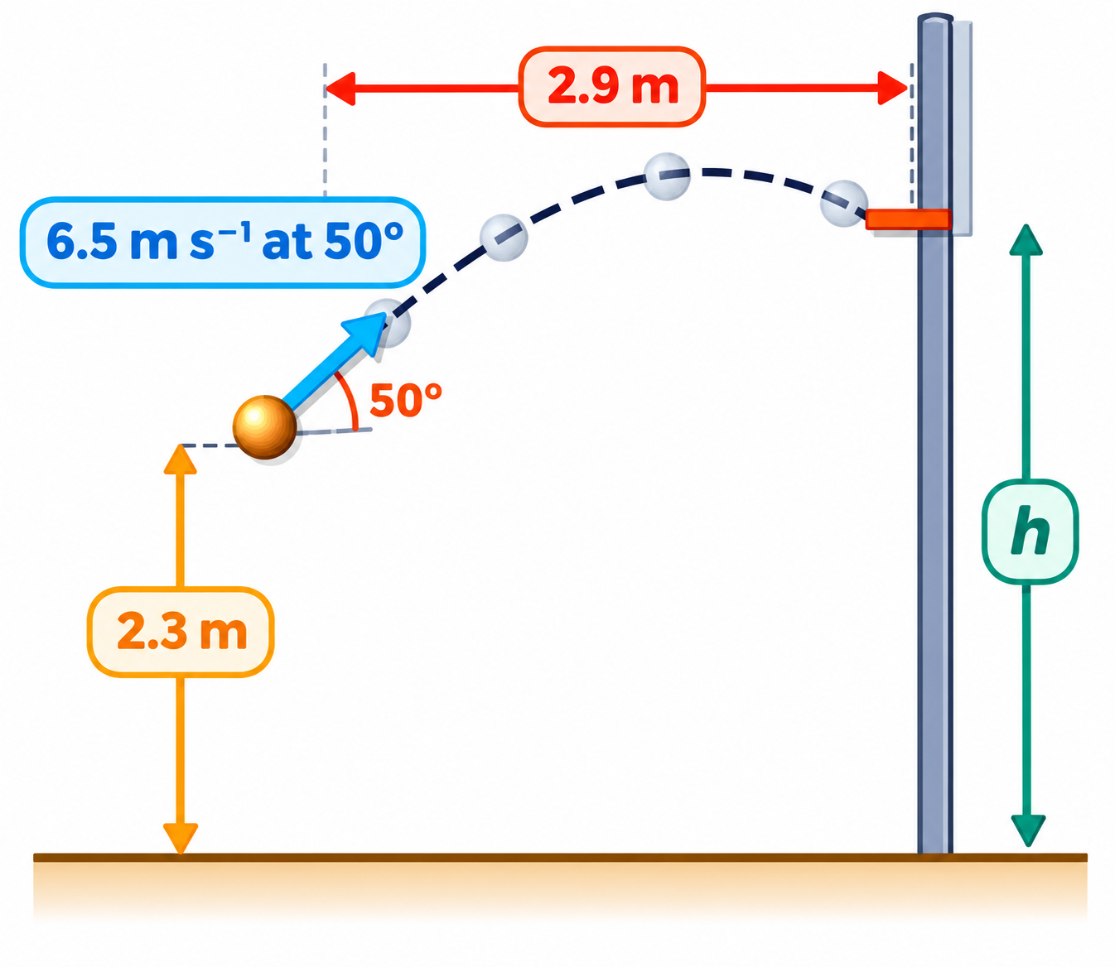
PAPER 2 STYLE · STRUCTURED QUESTION
Structured question 6 · Basketball shot
A basketball player throws a ball with an initial velocity of 6.5 m s⁻¹ at an angle of 50° to the horizontal. The ball is 2.3 m above the ground when released and travels a horizontal distance of 2.9 m to reach the top of the basket. Air resistance can be ignored.
(a) Calculate the horizontal and vertical components of the initial velocity. [2]
(b) Show that the time taken to reach the basket is 0.69 s. [1]
(c) Calculate the height h of the top of the basket. [3]
(d) A student says: “Throw at a higher speed at the same angle — the ball lands in the basket in a shorter time.” Explain why this is incorrect. [2]
Topic 2 · Kinematics | Cambridge International AS Level Physics 9702
47

Slide 48
MARK SCHEME STYLE SOLUTION
Structured question 6 · Solution
(a)
uₓ = 6.5 cos 50° = 4.18 m s⁻¹; uᵧ = 6.5 sin 50° = 4.98 m s⁻¹
(b)
t = 2.9 / 4.18 = 0.694 s ≈ 0.69 s
(c)
Vertical: s = 4.98 × 0.694 − ½ × 9.81 × 0.694² = 1.09 m; h = 2.3 + 1.09 = 3.4 m
(d)
A higher speed also increases the vertical component, and in the shorter time the ball falls less, so at 2.9 m it is higher than the basket — the path changes and the ball misses.
Topic 2 · Kinematics | Cambridge International AS Level Physics 9702
48

Slide 49
COMMON DOUBTS & MISCONCEPTIONS
Students often ask… (1)
?
“At the top of its flight the ball stops — so is its acceleration zero?”
?
“Does a negative velocity mean the object is slowing down?”
No. v = 0 for an instant only; a = g = 9.81 m s⁻² downwards throughout. If a were zero, the ball would stay up there.
No. The sign shows direction. An object slows down when its velocity and acceleration have opposite signs.
?
“What does area below the time axis mean?”
?
“Can I use SUVAT for a skydiver?”
Negative displacement. Displacement = net area (above − below). Distance = total area, all counted positive.
Only if acceleration is constant. With air resistance a keeps changing, so use the graph: tangents for a, area for s.
Topic 2 · Kinematics | Cambridge International AS Level Physics 9702
49

Slide 50
COMMON DOUBTS & MISCONCEPTIONS
Students often ask… (2)
?
“Is average speed always (u + v) / 2?”
?
“Does a heavier ball fall faster?”
Only for uniform acceleration. Otherwise use total distance ÷ total time (the aeroplane question gives 480, not 500 km h⁻¹).
Not without air resistance: every object has a = g, because the mass cancels. With air resistance, shape and mass matter.
?
“Does the horizontal velocity of a projectile change?”
?
“An object dropped from a moving balloon — is u = 0?”
No. With no air resistance there is no horizontal force, so uₓ stays constant. Only the vertical component changes.
No. At release it has the balloon's velocity. A bag released from a rising balloon first moves up, then falls.
Topic 2 · Kinematics | Cambridge International AS Level Physics 9702
50

Slide 51
COMMAND WORDS AND MARK-SCHEME HABITS
Exam technique for kinematics
Derive
Show that
start from definitions (a = Δv/Δt, area of v–t graph) and show every algebraic step
give your answer to one more s.f. than the value quoted
Determine
Sketch
read values from the graph; draw large gradient triangles or tangents
correct shape, labelled axes, key points (intercepts, v = 0) marked
Describe an experiment
Always
labelled diagram, what is measured and with which instrument, the graph plotted and how g is found from it
g = 9.81 m s⁻², consistent units (km h⁻¹ → m s⁻¹), state your positive direction, 2–3 s.f.
Topic 2 · Kinematics | Cambridge International AS Level Physics 9702
51

Slide 52
KEY IDEAS TO TAKE AWAY
Kinematics in one slide
v = u + at
s = ½(u + v)t
s = ut + ½at²
v² = u² + 2as
Graphs
gradient of s–t = v · gradient of v–t = a · area of v–t = s · area of a–t = Δv
Free fall
a = g = 9.81 m s⁻² downwards for every mass; plot h against t² → gradient = g/2
Projectiles
horizontal: constant velocity · vertical: constant acceleration g · time links the two
Topic 2 · Kinematics | Cambridge International AS Level Physics 9702
52

