Slide 1
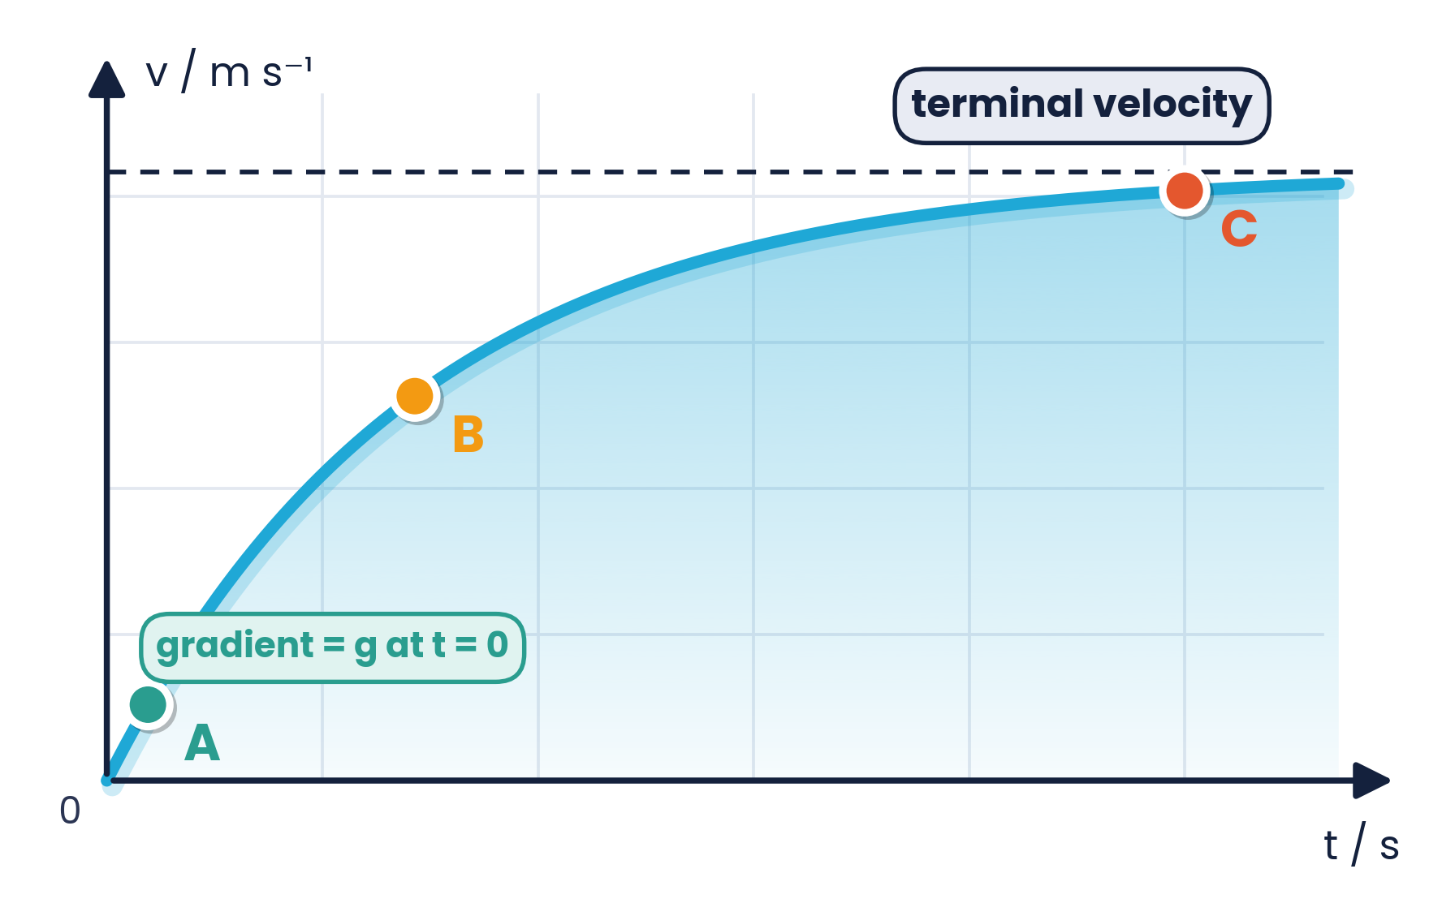
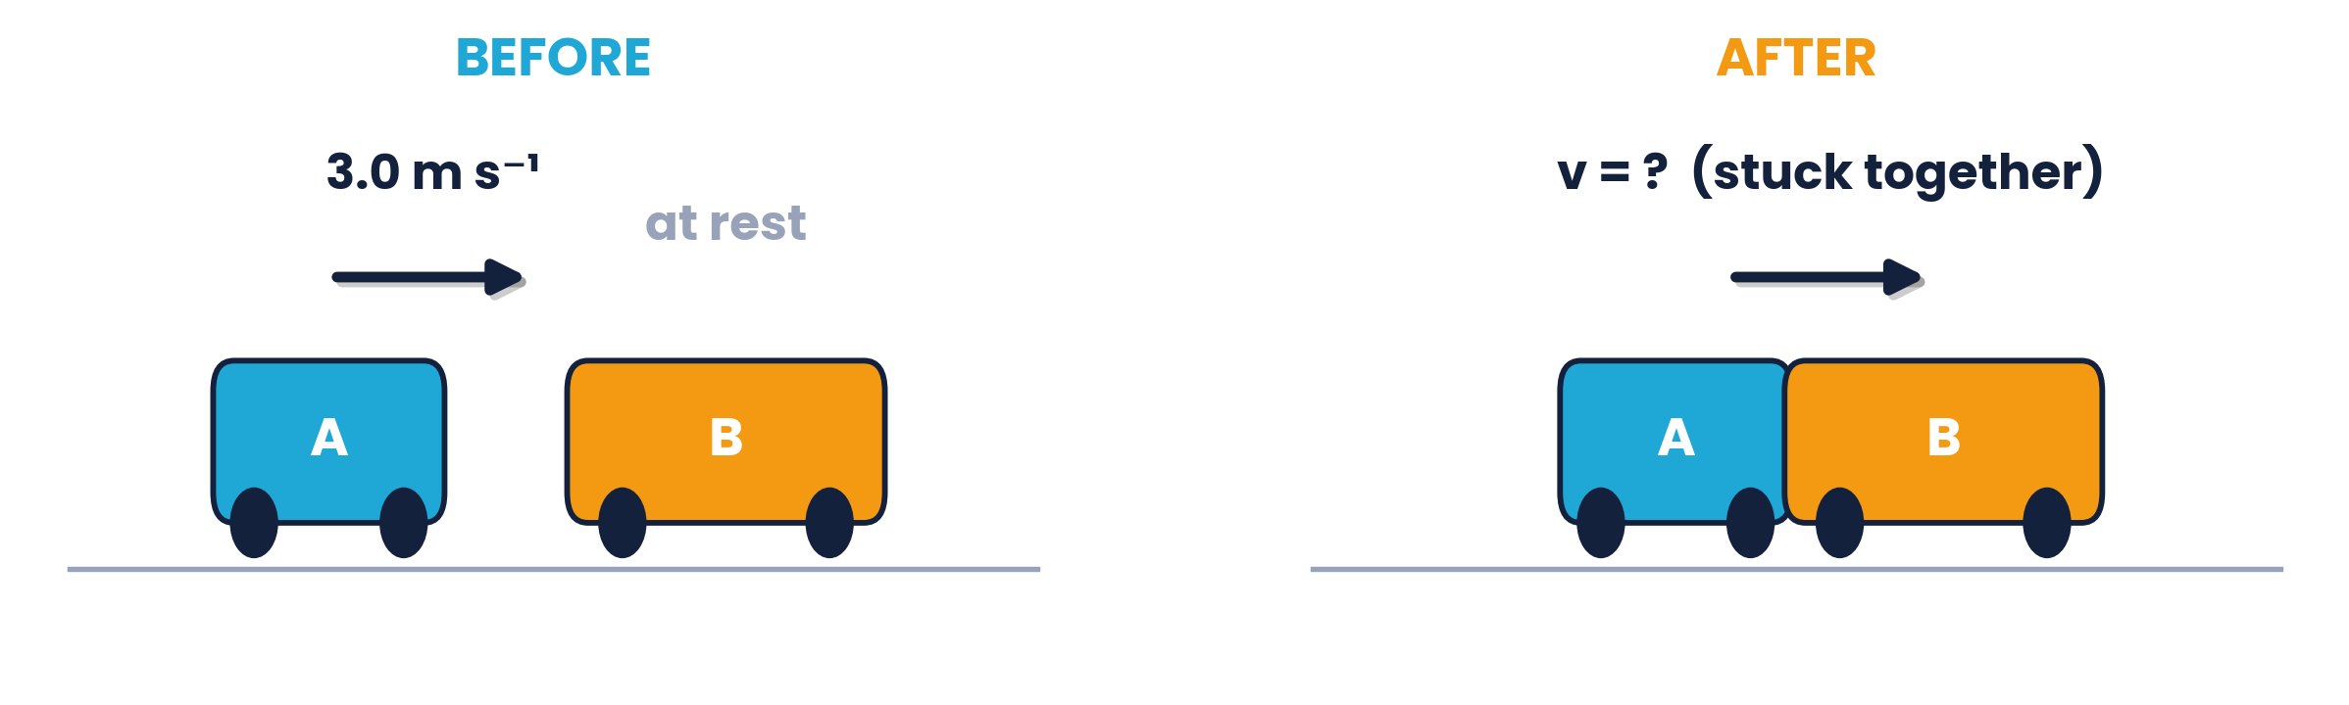
CAMBRIDGE AS & A LEVEL · PHYSICS 9702 · TOPIC 3
Dynamics
Forces & Momentum
Newton's laws · momentum · drag & terminal velocity · collisions
Syllabus 3.1 – 3.3 | Exams 2025 – 2027
WA
Waseem Ahmad
Head of Science & IB Physics Lead Teacher
Presidential School, Jizzakh · Cambridge Examiner
Author, Orange Publication · www.examspath.com

Slide 2
SYLLABUS 3.1 – 3.3 · DYNAMICS
What the syllabus asks you to do
1
LO 3.1.1
2
LO 3.1.2
3
LO 3.1.3
4
LO 3.1.4
5
LO 3.1.5
Mass is the property of an object that resists change in motion
Recall F = ma; a and resultant F are in the same direction
Define and use momentum p = mv
Define and use force as rate of change of momentum
State and apply each of Newton's laws
6
LO 3.1.6
7
LO 3.2.1
8
LO 3.2.2
9
LO 3.2.3
10
LO 3.3.1
Weight = effect of a gravitational field on a mass; W = mg
Qualitative understanding of friction and drag forces
Motion in a uniform field with air resistance
Objects may reach a terminal (constant) velocity
State the principle of conservation of momentum
An understanding of forces from IGCSE / O Level is assumed.
11
LO 3.3.2
12
LO 3.3.3
13
LO 3.3.4
Apply it in 1D and 2D, elastic and inelastic
Elastic: KE conserved; approach speed = separation speed
Momentum always conserved; KE may change
Topic 3 · Dynamics | Cambridge International AS Level Physics 9702
2

Slide 3
TOPIC 3 · DYNAMICS
Lesson roadmap
01
02
03
04
Mass, weight & force
Newton's laws
Momentum & force
Drag & terminal velocity
W = mg, resultant force, F = ma
First, second and third laws
p = mv, F = Δp / Δt
Non-uniform motion
05
06
07
08
Conservation of momentum
Collisions
Past paper practice
Doubts & exam tips
1D collisions, trolleys, bowls
Elastic, inelastic, 2D
MCQs and structured questions
Misconceptions and technique
Topic 3 · Dynamics | Cambridge International AS Level Physics 9702
3

Slide 4
LEARNING OUTCOMES 3.1.1, 3.1.2, 3.1.6
01
Mass, weight and force
What resists motion, what gravity does, and F = ma
Topic 3 · Dynamics | Cambridge International AS Level Physics 9702
4

Slide 5
3.1.1 & 3.1.6 · TWO DIFFERENT QUANTITIES
Mass and weight
MASS m
WEIGHT W = mg
The property of an object that resists change in motion (its inertia)
A measure of the amount of matter; scalar; unit kg
The same everywhere in the Universe
The effect of a gravitational field on a mass
A force, so a vector; unit N; acts downwards
Changes with g: Earth 9.81 N kg⁻¹, Moon 1.63 N kg⁻¹
60 kg
589 N
98 N
mass on Earth and on the Moon
weight on Earth: 60 × 9.81
weight on the Moon: 60 × 1.63 (≈ 6× less)
Topic 3 · Dynamics | Cambridge International AS Level Physics 9702
5

Slide 6
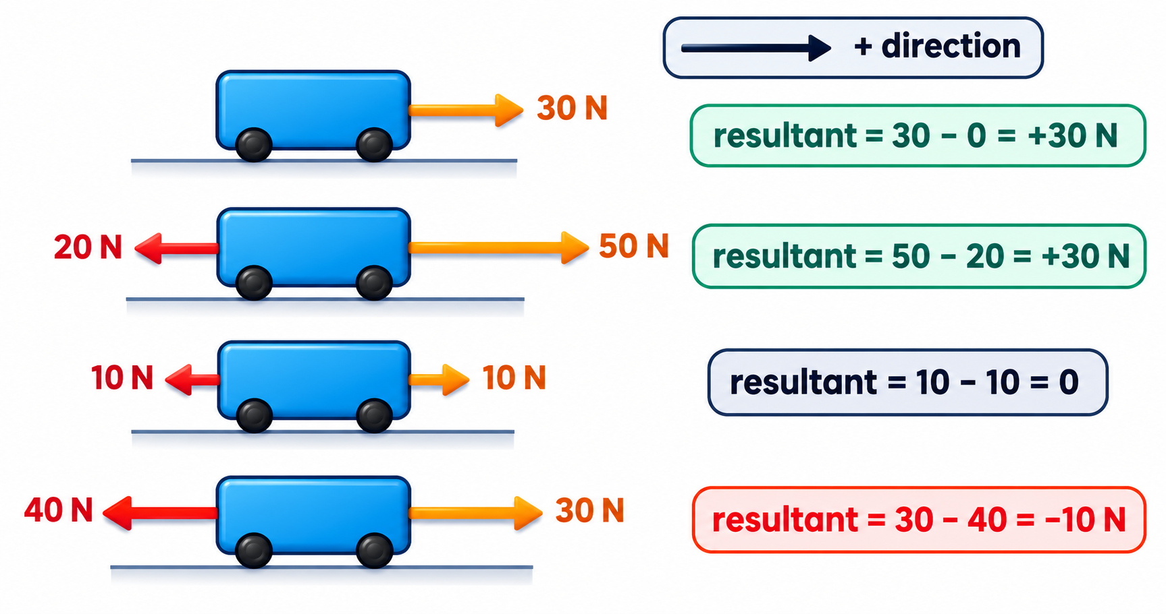
3.1.2 · FORCES ARE VECTORS — ADD THEM WITH SIGNS
Resultant force
Key ideas
The resultant force is the vector sum of all forces on the body
Choose a positive direction; forces the other way are negative
Resultant = 0 → no acceleration (balanced forces)
A negative resultant means the resultant acts in the negative direction
Topic 3 · Dynamics | Cambridge International AS Level Physics 9702
6

Slide 7
3.1.2 · ACCELERATION IS IN THE DIRECTION OF THE RESULTANT FORCE
Newton's second law: F = ma
F = ma
F is the RESULTANT force, not any single force.
a always points the same way as the resultant force. 1 N is the force that gives 1 kg an acceleration of 1 m s⁻².
resultant force (N) = mass (kg) × acceleration (m s⁻²)
Quick practice
A 1200 kg car has a driving force of 3000 N and total resistive force 600 N → a = 2400 / 1200 = 2.0 m s⁻²
A 0.50 kg ball has a resultant force of 4.0 N → a = 8.0 m s⁻²
A 70 kg sprinter accelerates at 4.0 m s⁻² → resultant force = 280 N
Topic 3 · Dynamics | Cambridge International AS Level Physics 9702
7

Slide 8
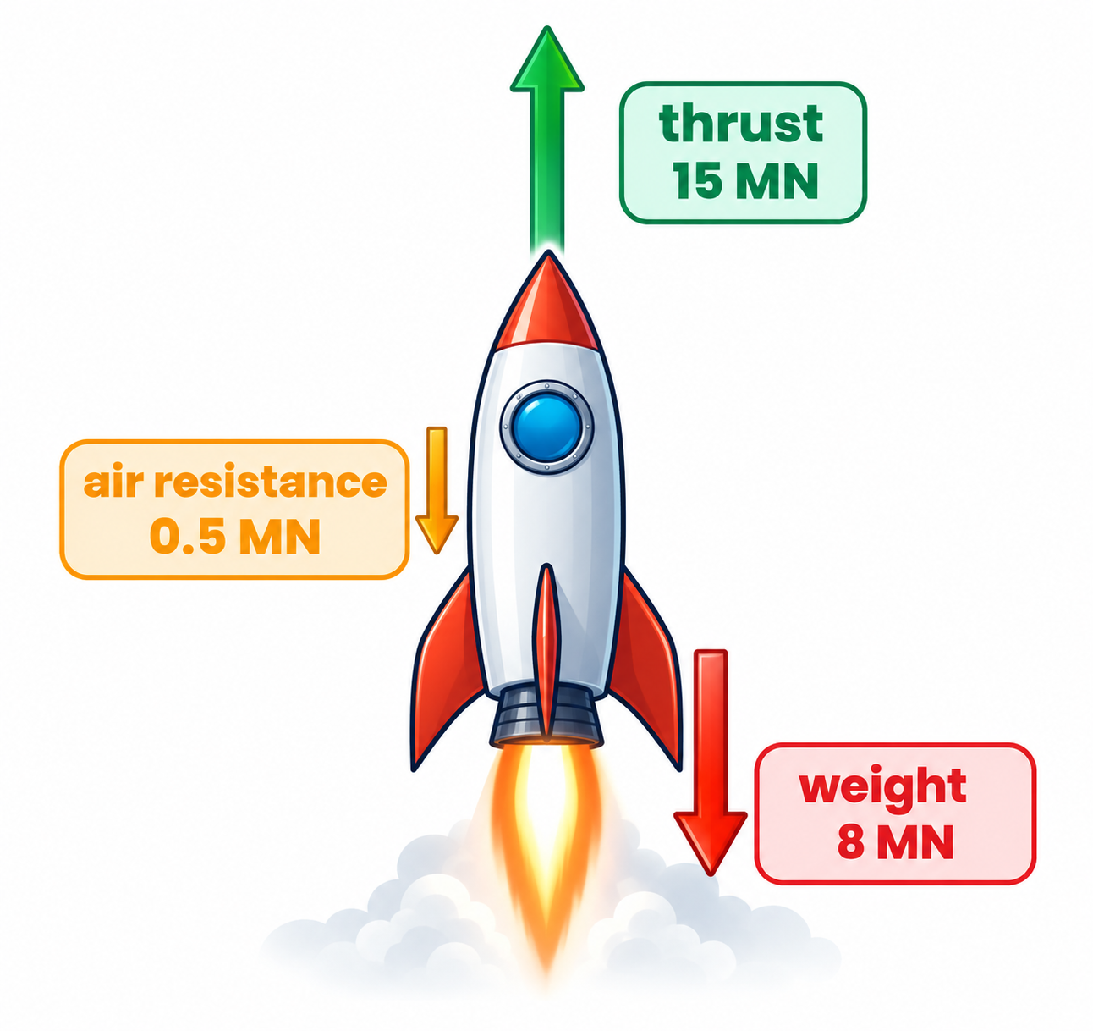
3.1.2 · RESULTANT FORCE AND ACCELERATION
Worked example · Rocket launch
A rocket produces an upward thrust of 15 MN and has a weight of 8 MN. Air resistance is 500 kN. (a) Calculate the resultant force. (b) The mass is 0.8 × 10⁵ kg — find the acceleration.
1
Convert to N: thrust 15 × 10⁶ N; weight 8 × 10⁶ N; air resistance 0.5 × 10⁶ N
2
Take upwards as positive: F = 15 × 10⁶ − 8 × 10⁶ − 0.5 × 10⁶
3
F = 6.5 × 10⁶ N upwards
4
a = F / m = 6.5 × 10⁶ / 0.8 × 10⁵ = 81 m s⁻² upwards
Topic 3 · Dynamics | Cambridge International AS Level Physics 9702
8

Slide 9
LEARNING OUTCOME 3.1.5
02
Newton's laws of motion
First, second and third laws
Topic 3 · Dynamics | Cambridge International AS Level Physics 9702
9

Slide 10
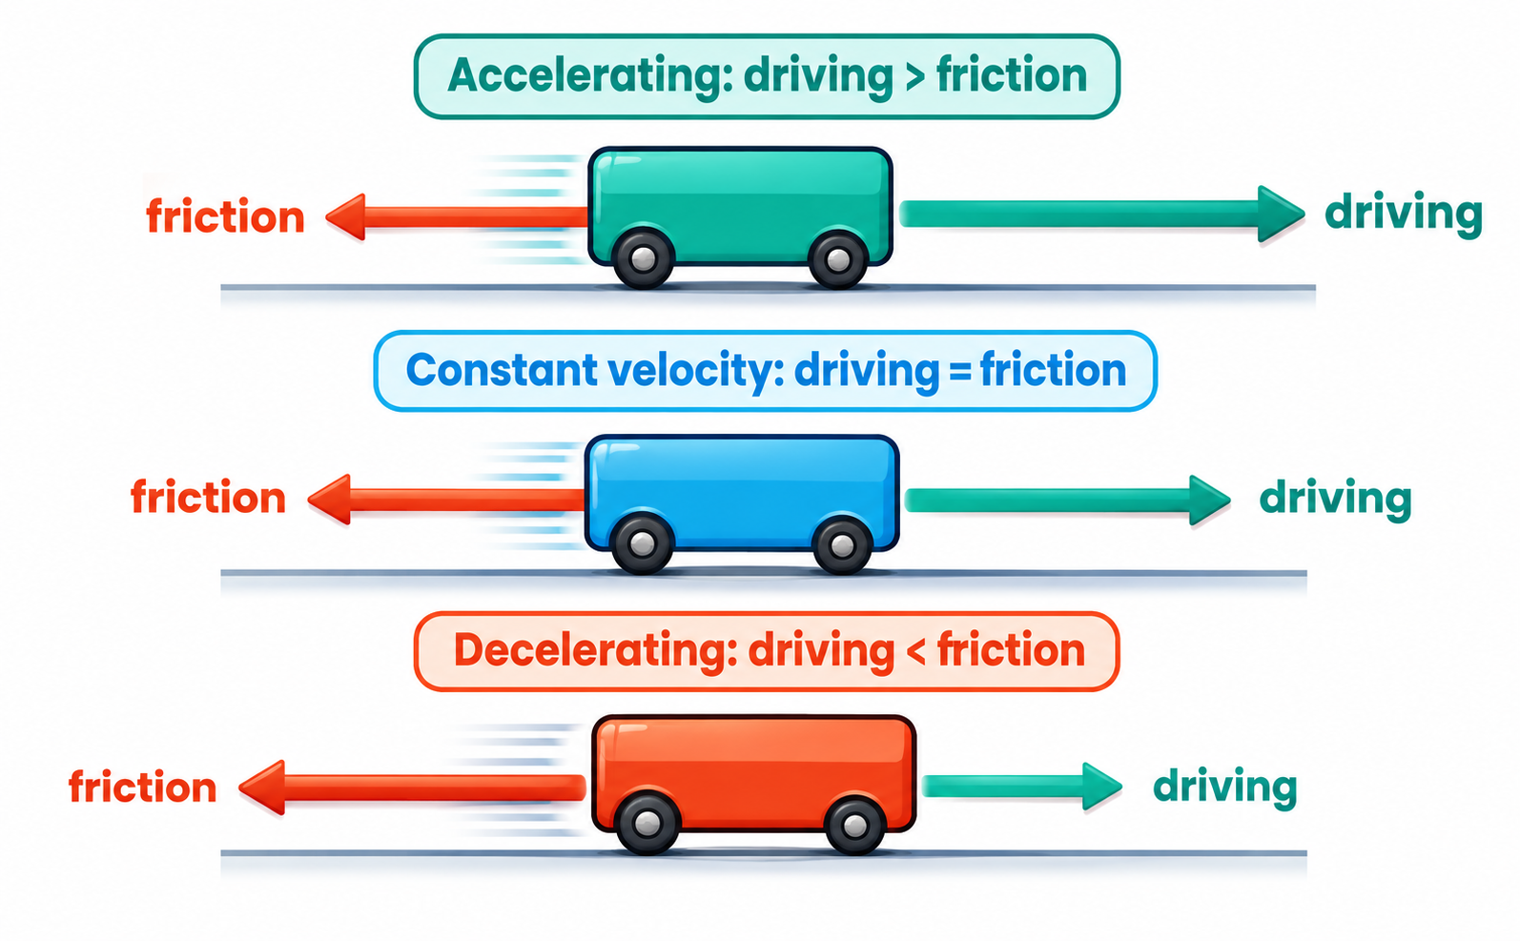
3.1.5 · NO RESULTANT FORCE → NO CHANGE IN MOTION
Newton's first law
A body remains at rest, or moves with constant velocity, unless acted on by a resultant force.
Worked example
A car moves at constant velocity. The driving force is 6 kN. Find the frictional force.
Constant velocity → no resultant force → forces balanced.
Frictional force = driving force = 6 kN (backwards).
Topic 3 · Dynamics | Cambridge International AS Level Physics 9702
10

Slide 11
3.1.4 & 3.1.5 · FORCE = RATE OF CHANGE OF MOMENTUM
Newton's second law
The resultant force on a body is proportional to the rate of change of its momentum, and in the same direction.
F = Δp / Δt
F = m(v − u) / t
F = ma
general form
constant mass
since a = (v − u) / t
Skateboard example:
a girl speeds up from 1 m s⁻¹ to 4 m s⁻¹ in 2.5 s with a forward force of 72 N. m = FΔt / (v − u) = 72 × 2.5 / 3 = 60 kg (girl + board).
Topic 3 · Dynamics | Cambridge International AS Level Physics 9702
11

Slide 12
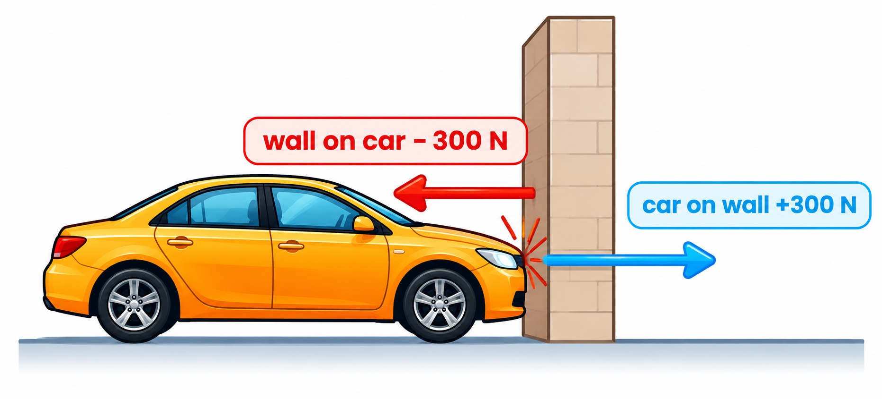
3.1.5 · FORCES COME IN PAIRS
Newton's third law
If body A exerts a force on body B, then B exerts a force on A of equal magnitude in the opposite direction.
A Newton III pair must be
the same type of force (both gravitational, both contact…)
equal in magnitude
opposite in direction, along the same line
acting on DIFFERENT objects
The car pushes the wall with 300 N; the wall pushes the car with 300 N.
Topic 3 · Dynamics | Cambridge International AS Level Physics 9702
12

Slide 13
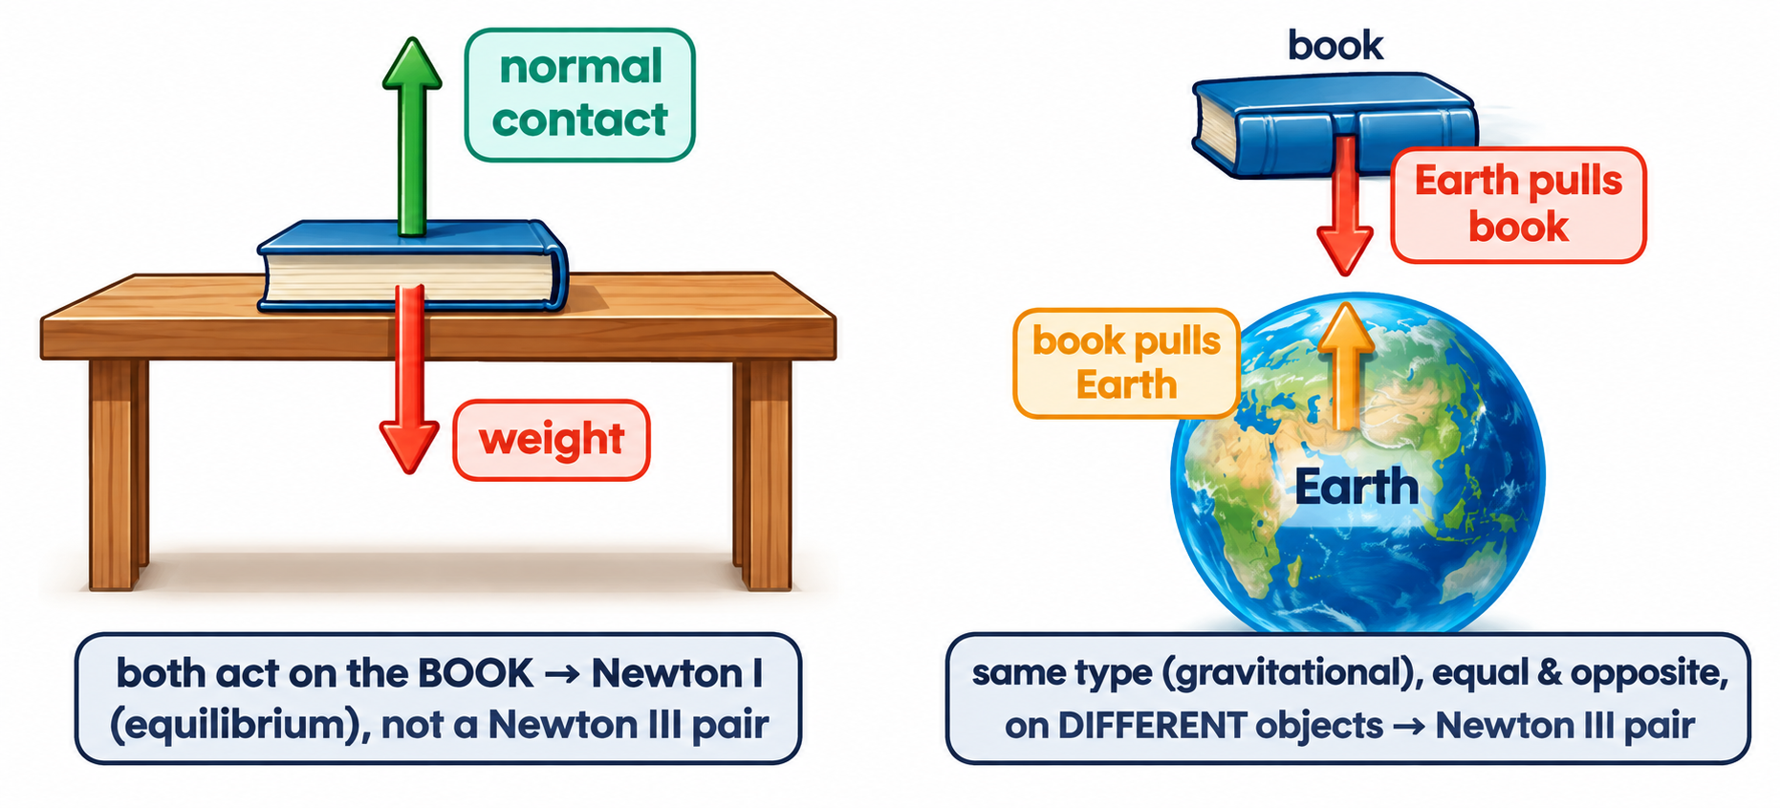
3.1.5 · A BOOK RESTING ON A TABLE
Worked example · Is it a Newton III pair?
Eugene says the weight and the reaction force on the book are a Newton III pair. William says it is Newton I. Who is correct?
William is correct.
Both forces act on the same object (the book), so they cannot be a third-law pair. The book is at rest, so the forces balance — Newton's first law.
The true partner of the book's weight is the gravitational pull of the book on the Earth.
Walking: your foot pushes the ground backwards; the ground pushes you forwards — a Newton III pair.
Topic 3 · Dynamics | Cambridge International AS Level Physics 9702
13

Slide 14
LEARNING OUTCOMES 3.1.3 – 3.1.4
03
Momentum and force
p = mv and F = Δp / Δt
Topic 3 · Dynamics | Cambridge International AS Level Physics 9702
14

Slide 15
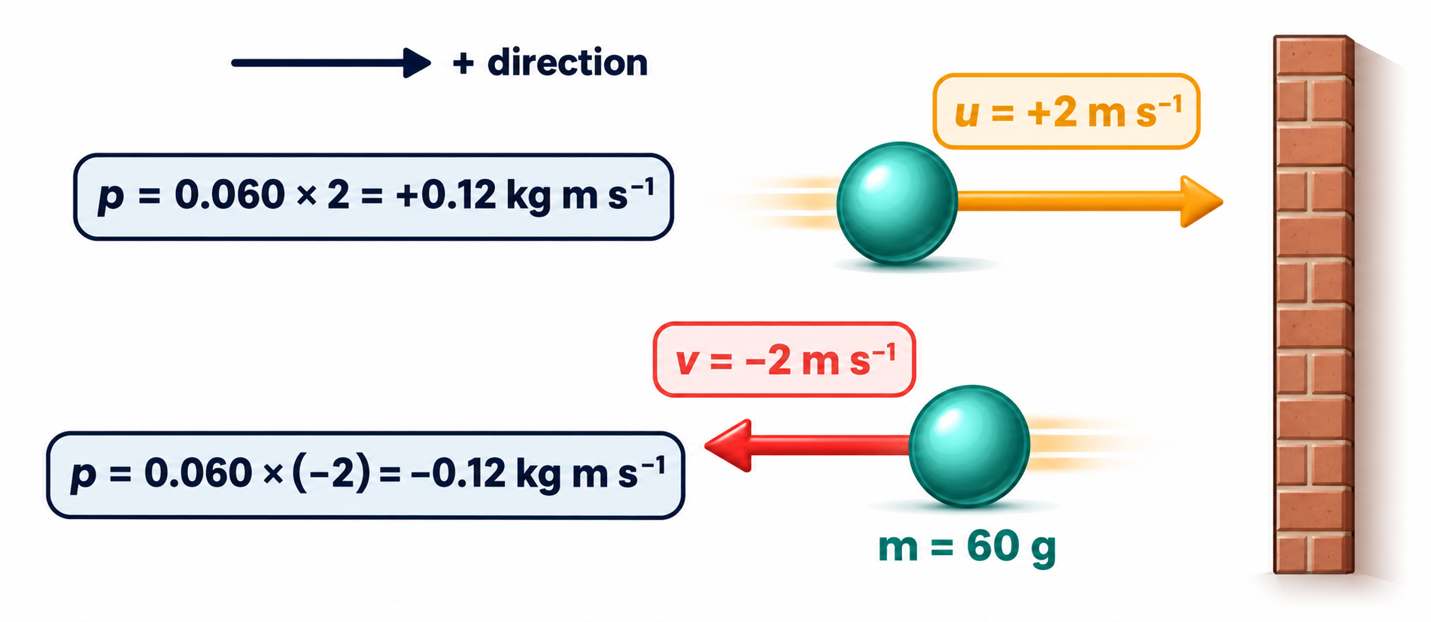
3.1.3 · P = MV
Linear momentum
p = mv
Momentum is a vector.
It has the direction of the velocity: moving right (+) gives positive momentum, moving left gives negative momentum.
momentum (kg m s⁻¹ = N s)
Change in momentum
Δp = p(final) − p(initial)
= (−0.12) − (+0.12) = −0.24 kg m s⁻¹
Not zero! The direction reversed.
Topic 3 · Dynamics | Cambridge International AS Level Physics 9702
15

Slide 16
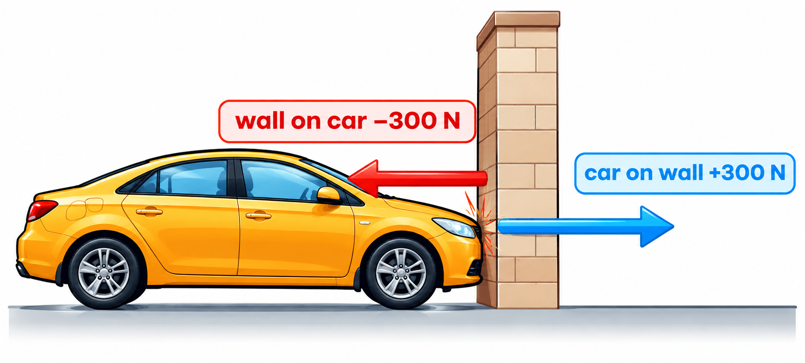
3.1.4 · AVERAGE FORCE FROM CHANGE IN MOMENTUM
Worked example · Car hits a wall
A car of mass 1500 kg hits a wall at 15 m s⁻¹, rebounds at 5 m s⁻¹ and comes to rest after 3.0 s. Calculate the average force on the car.
1
Positive towards the wall: p(initial) = 1500 × 15 = 22 500 kg m s⁻¹
2
p(final) = 1500 × (−5) = −7500 kg m s⁻¹
3
Δp = −7500 − 22 500 = −30 000 kg m s⁻¹
4
F = Δp / Δt = −30 000 / 3.0 = −10 000 N (away from the wall)
Topic 3 · Dynamics | Cambridge International AS Level Physics 9702
16

Slide 17
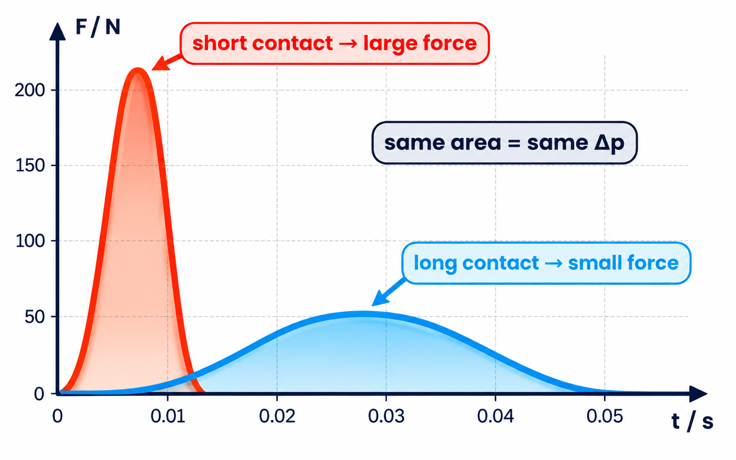
3.1.4 · SAME ΔP, LONGER TIME, SMALLER FORCE
Time of impact
Worked example
Two tennis balls each change momentum by 0.5 kg m s⁻¹ on a racket. Contact times: 2.0 s and 0.1 s. Which exerts the greater force?
F₁ = 0.5 / 2.0 = 0.25 N
F₂ = 0.5 / 0.1 = 5.0 N
The second ball exerts the greater force.
Crumple zones, air bags and bending your knees on landing all increase Δt.
Area under a force–time graph = change in momentum (impulse).
Topic 3 · Dynamics | Cambridge International AS Level Physics 9702
17

Slide 18
LEARNING OUTCOMES 3.2.1 – 3.2.3
04
Drag and terminal velocity
Non-uniform motion with resistive forces
Topic 3 · Dynamics | Cambridge International AS Level Physics 9702
18

Slide 19
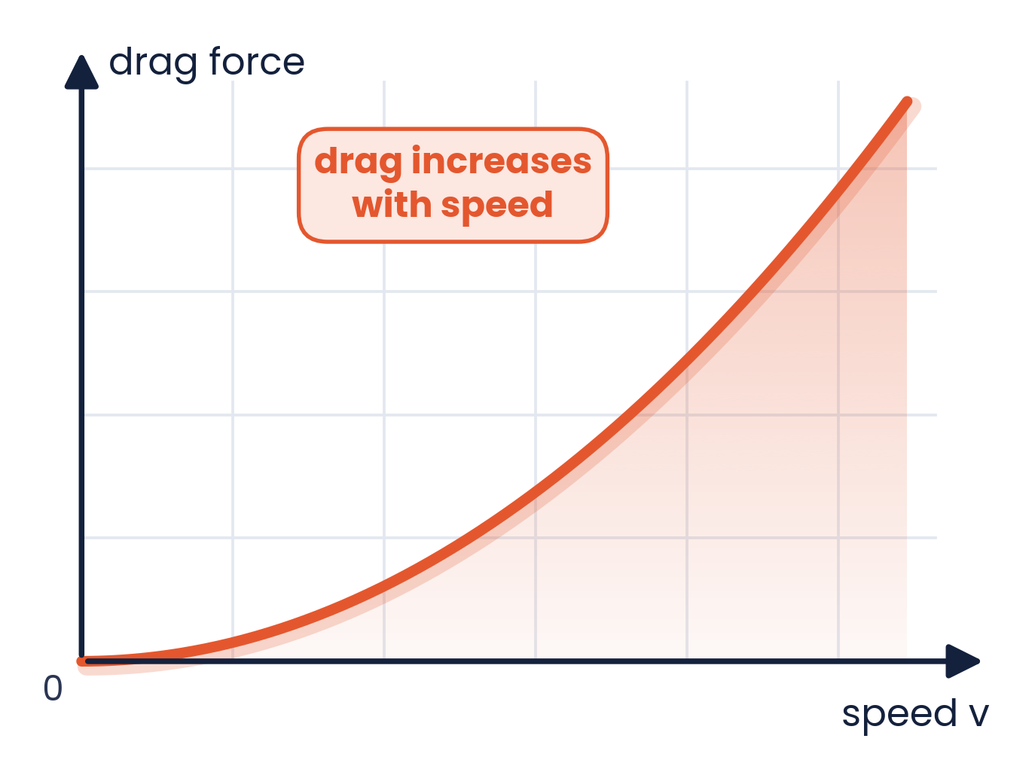
3.2.1 · FORCES THAT OPPOSE MOTION
Frictional and drag forces
Drag acts opposite to the motion of an object through a fluid (liquid or gas)
Examples: air resistance, viscous drag in liquids; friction between surfaces
Simple model: drag increases as speed increases (no coefficients needed)
Drag depends on shape: streamlining (cyclists, aircraft wings, cars) reduces it
At walking pace air resistance is tiny; at high speed it dominates
Drag always does work against the motion, turning kinetic energy into thermal energy.
Topic 3 · Dynamics | Cambridge International AS Level Physics 9702
19

Slide 20
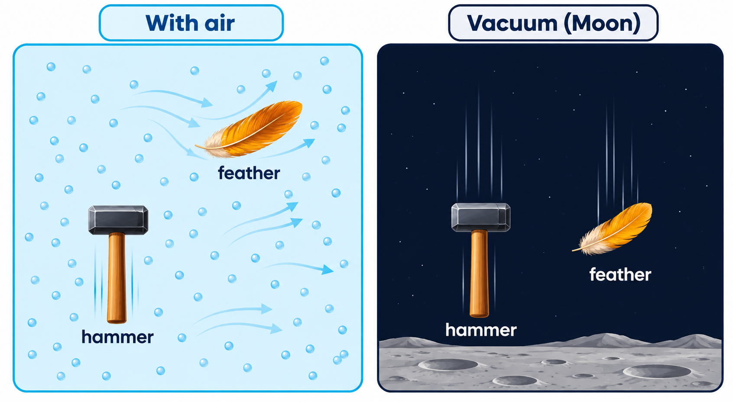
3.2.2 · FREE FALL WITH AND WITHOUT AIR RESISTANCE
The hammer and the feather
Apollo 15, 1971
On the Moon, Commander David Scott dropped a geological hammer and a falcon feather at the same time.
With no atmosphere there is no air resistance, so both fell with the same acceleration and landed together.
On Earth the feather's drag is comparable to its weight, so its acceleration is much less than g.
Topic 3 · Dynamics | Cambridge International AS Level Physics 9702
20

Slide 21
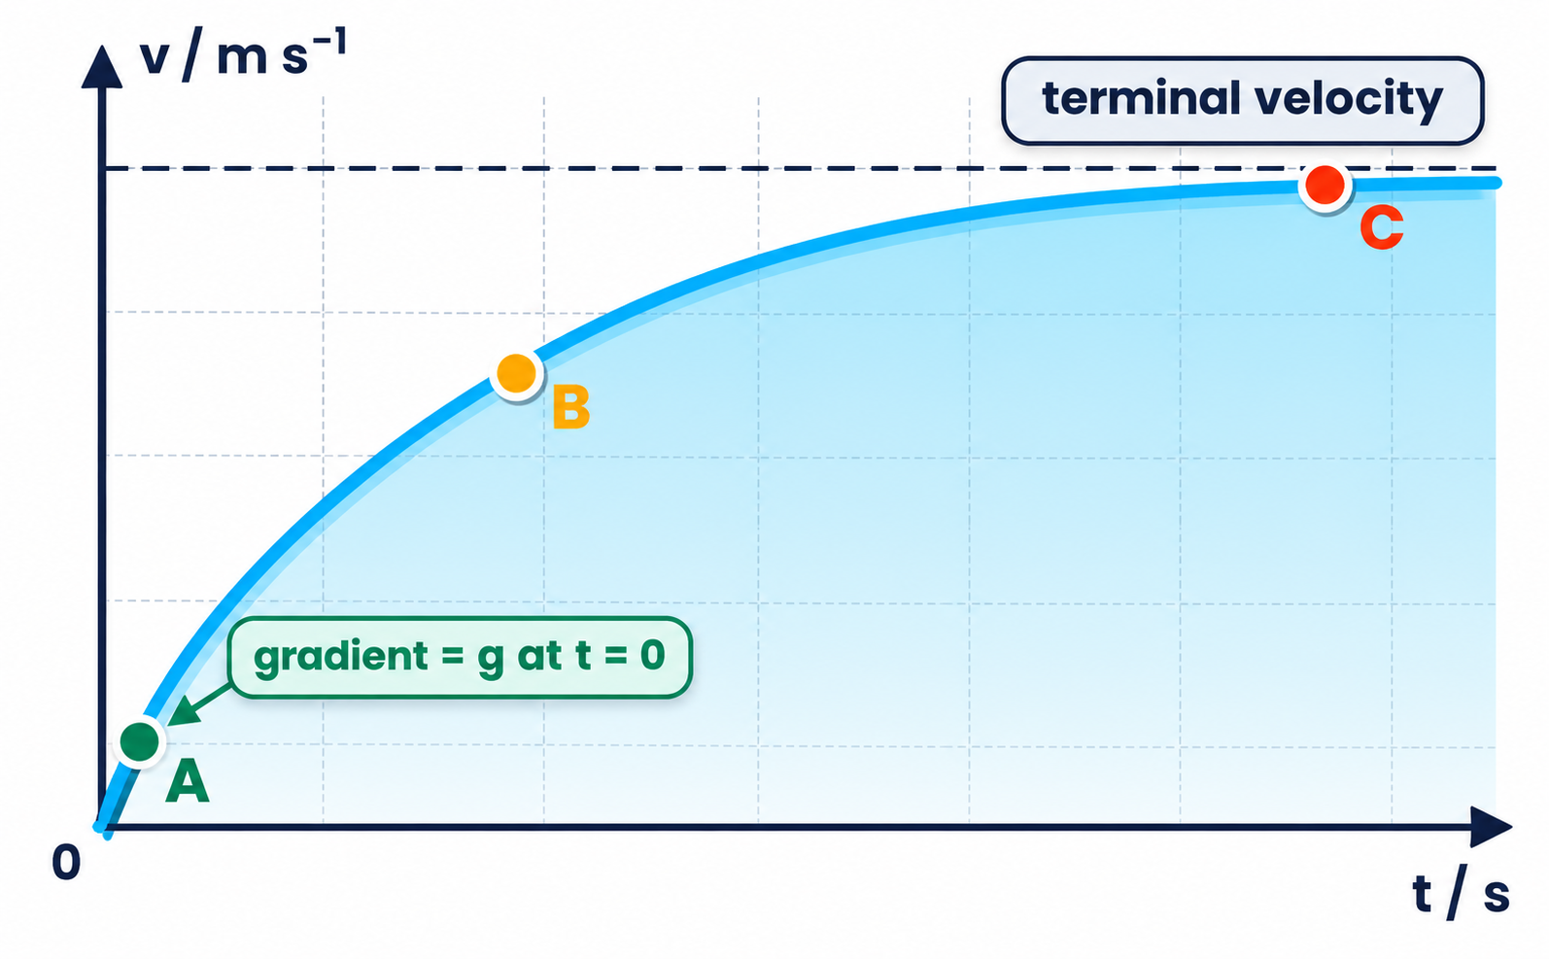
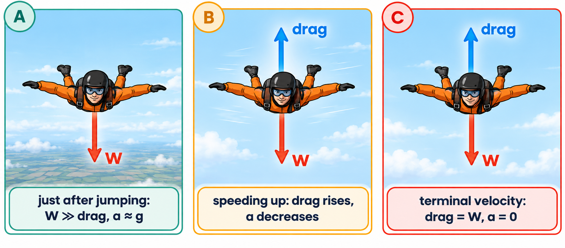
3.2.3 · WEIGHT = DRAG → A = 0
Reaching terminal velocity
A
Just after jumping: drag ≈ 0, resultant ≈ W, so a ≈ g
B
As v increases, drag increases; resultant and acceleration decrease
C
Drag = weight: resultant = 0, a = 0 — constant terminal velocity
Topic 3 · Dynamics | Cambridge International AS Level Physics 9702
21

Slide 22
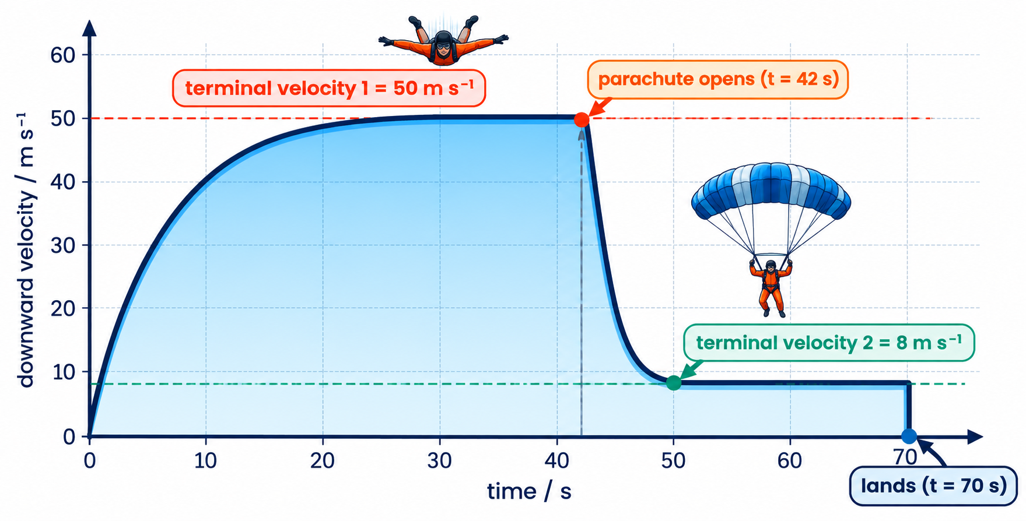
3.2.2 & 3.2.3 · TWO TERMINAL VELOCITIES
Worked example · Parachutist
0–20 s: accelerates; gradient (a) decreases as drag grows
First terminal velocity 50 m s⁻¹: drag = weight
t = 42 s: parachute opens → drag ≫ weight → resultant upwards → decelerates
Drag falls as speed falls until drag = weight again: 8 m s⁻¹
Last 28 s at 8 m s⁻¹: distance ≈ 8 × 28 = 224 m
The parachute increases the surface area, so the same drag is reached at a much lower speed.
Topic 3 · Dynamics | Cambridge International AS Level Physics 9702
22

Slide 23
3.2.3 · TERMINAL VELOCITY DEPENDS ON WEIGHT
Think about it · Who should jump first?
Skydivers jump from a plane a few seconds apart. Skydivers A and B want to join up as they fall. A is heavier than B and they adopt the same position. Who should jump first?
Heavier → higher terminal velocity
So B jumps first
Alternative
A needs a larger drag to balance his larger weight, so he must fall faster before a = 0.
A jumps second; falling faster, he catches up with B.
A can spread out (more drag) or B can dive head-first (less drag) to match speeds.
Topic 3 · Dynamics | Cambridge International AS Level Physics 9702
23

Slide 24
LEARNING OUTCOMES 3.3.1 – 3.3.2
05
Conservation of momentum
Total momentum before = total momentum after
Topic 3 · Dynamics | Cambridge International AS Level Physics 9702
24

Slide 25
3.3.1 · STATE IT PRECISELY
The principle of conservation of momentum
The total momentum of a system remains constant provided no resultant external force acts on it.
m₁u₁ + m₂u₂ = m₁v₁ + m₂v₂
External vs internal forces
External: act from outside the system, e.g. friction, weight
Internal: between parts of the system, e.g. the collision forces — they are a Newton III pair and cancel
Momentum is a vector: opposite directions cancel
total momentum before = total momentum after
Why? In a collision the forces on the two bodies are equal and opposite (N III) and last the same time, so the momentum gained by one equals the momentum lost by the other.
Topic 3 · Dynamics | Cambridge International AS Level Physics 9702
25

Slide 26
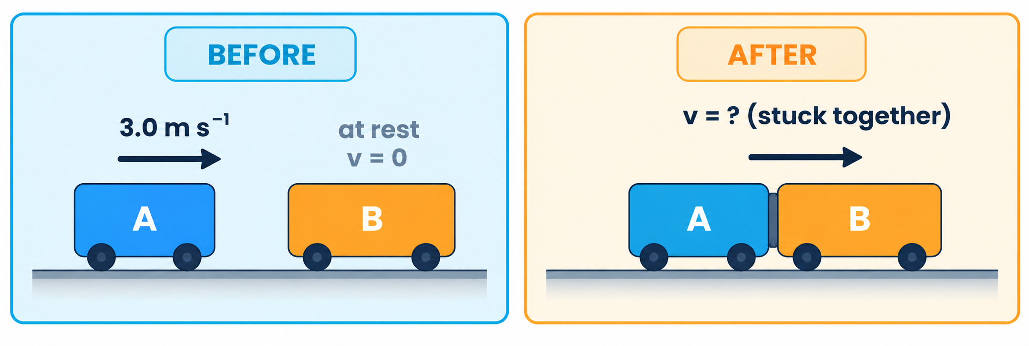
3.3.2 · ONE-DIMENSIONAL COLLISION
Worked example · Trolleys stick together
Trolley A (0.80 kg) moves at 3.0 m s⁻¹ and hits stationary trolley B, which has twice the mass. They stick together. Find their common velocity and whether the collision is elastic.
Momentum
before = 0.80 × 3.0 + 0 = 2.4 kg m s⁻¹
after = (0.80 + 1.60)v → v = 2.4 / 2.4 = 1.0 m s⁻¹
Kinetic energy
before = ½ × 0.80 × 3.0² = 3.6 J; after = ½ × 2.4 × 1.0² = 1.2 J
KE not conserved → inelastic
Topic 3 · Dynamics | Cambridge International AS Level Physics 9702
26

Slide 27
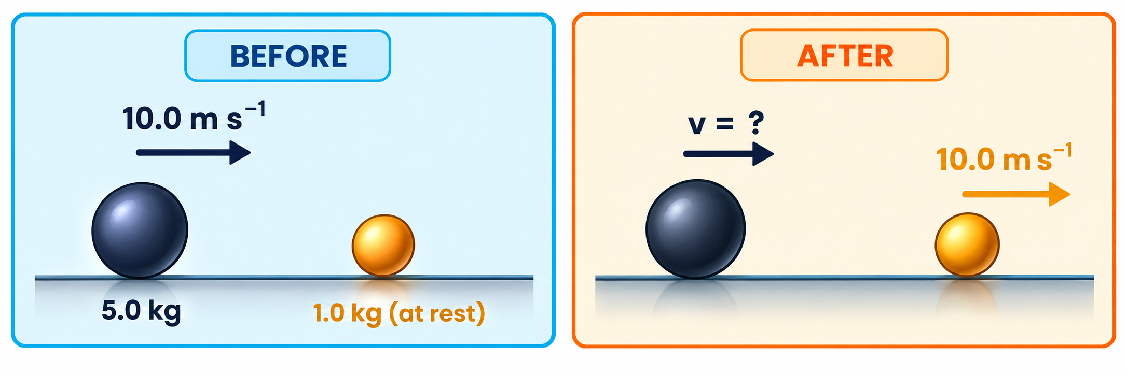
3.3.2 · FINDING A FINAL VELOCITY AND THE KE LOST
Worked example · Bowls
A 5.0 kg ball moving at 10.0 m s⁻¹ strikes a stationary 1.0 kg ball, which flies off at 10.0 m s⁻¹. Find the final velocity of the large ball and the KE ‘lost’.
Momentum
5.0 × 10 + 0 = 5.0v + 1.0 × 10
50 = 5.0v + 10 → v = 8.0 m s⁻¹
Kinetic energy
before 250 J; after ½(5.0)(8.0²) + ½(1.0)(10²) = 210 J
40 J becomes internal (thermal) energy and sound
Topic 3 · Dynamics | Cambridge International AS Level Physics 9702
27

Slide 28
LEARNING OUTCOMES 3.3.2 – 3.3.4
06
Elastic, inelastic and 2D collisions
Kinetic energy and momentum in two dimensions
Topic 3 · Dynamics | Cambridge International AS Level Physics 9702
28

Slide 29
3.3.3 & 3.3.4 · MOMENTUM ALWAYS CONSERVED; KE MAY NOT BE
Elastic and inelastic collisions
Elastic
Inelastic
Total kinetic energy is conserved
Relative speed of approach = relative speed of separation
Objects bounce apart (e.g. gas molecules, ideal snooker balls)
Total kinetic energy is NOT conserved (some becomes thermal energy, sound, deformation)
Relative speed of separation < relative speed of approach
Objects that stick together: maximum KE loss
Quick test:
X (50 g) at +4.5 m s⁻¹ meets Y at −2.8 m s⁻¹; afterwards −1.8 and +1.4 m s⁻¹. Approach speed = 4.5 + 2.8 = 7.3 m s⁻¹; separation = 1.8 + 1.4 = 3.2 m s⁻¹. Not equal → inelastic.
Topic 3 · Dynamics | Cambridge International AS Level Physics 9702
29

Slide 30
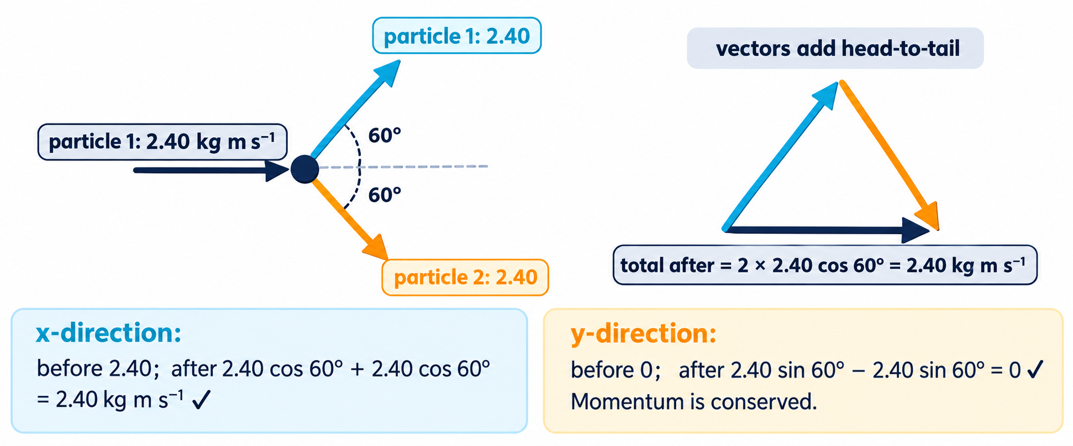
3.3.2 · CONSERVE EACH COMPONENT SEPARATELY
Momentum in two dimensions
Topic 3 · Dynamics | Cambridge International AS Level Physics 9702
30

Slide 31
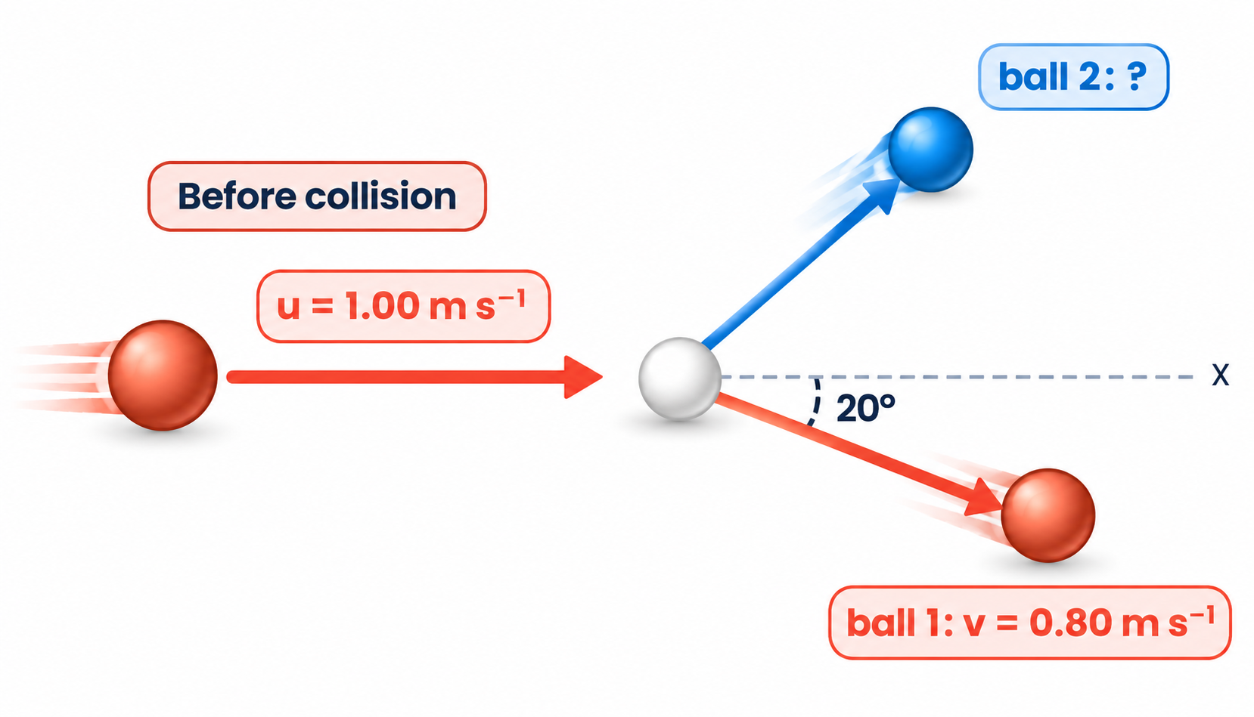
3.3.2 · GLANCING COLLISION IN 2D
Worked example · Snooker balls
Ball 1 (1.00 m s⁻¹) hits identical stationary ball 2. Ball 1 leaves at 0.80 m s⁻¹ at 20° below the x-axis. Find the velocity of ball 2.
1
Ball 1 after: vₓ = 0.80 cos 20° = 0.752; vᵧ = −0.80 sin 20° = −0.274 m s⁻¹
2
x: 1.00 = 0.752 + v₂ₓ → v₂ₓ = 0.248 m s⁻¹
3
y: 0 = −0.274 + v₂ᵧ → v₂ᵧ = +0.274 m s⁻¹
4
v₂ = √(0.248² + 0.274²) = 0.37 m s⁻¹ at tan⁻¹(0.274/0.248) = 48° above the x-axis
Topic 3 · Dynamics | Cambridge International AS Level Physics 9702
31

Slide 32
CAMBRIDGE PAST PAPER QUESTIONS
07
Past paper practice
Paper 1 multiple choice · Paper 2 structured questions
Topic 3 · Dynamics | Cambridge International AS Level Physics 9702
32

Slide 33
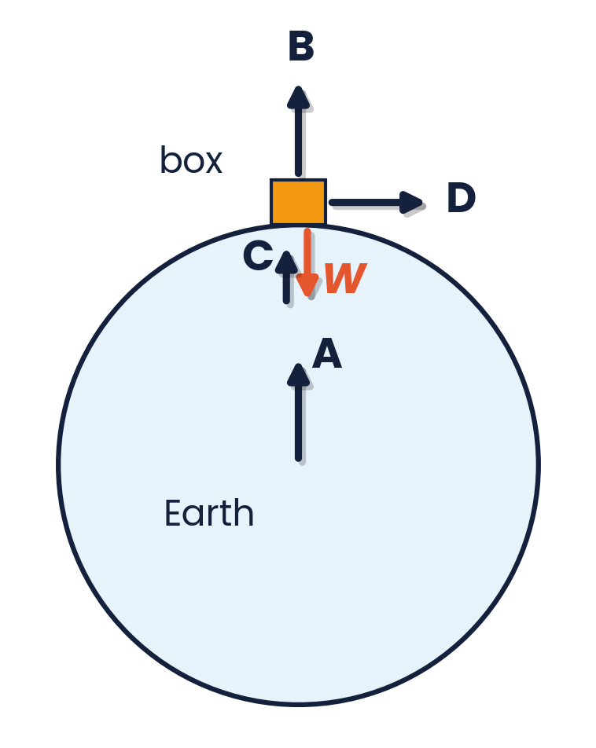
PAPER 1 STYLE · MULTIPLE CHOICE
Past paper set A · Newton's laws
1
A box rests on the Earth. Newton's third law says forces of the same type act in pairs. One force of a pair is the weight W of the box. Which arrow represents the other force of this pair?
2
Which gives an example of a pair of forces described by Newton's third law?
A car: driving force and total resistive force
B Earth and Moon: gravitational attraction on each
C box on floor: support force and weight
D aircraft: lift and weight
A B C D (see diagram)
3
An object moves along the ground in a straight line at a constant speed. Which statement about the resultant force on the object is correct?
4
Which statement is not a requirement of a pair of forces that obey Newton's third law?
A The forces act in opposite directions.
B The forces act on different objects.
C The forces act on objects in contact.
D The forces are of equal magnitude.
A It equals its weight.
B It equals the product of its mass and velocity.
C It equals the resistive force.
D It is zero.
Topic 3 · Dynamics | Cambridge International AS Level Physics 9702
33

Slide 34
ANSWERS AND KEY WORKING
Past paper set A · Answers
1
Answer A
2
Answer B
The partner of the Earth's pull on the box is the box's pull on the Earth: gravitational, acting on the Earth, towards the box — arrow A from the Earth's centre.
Same type (gravitational), equal and opposite, on different bodies. A, C and D are pairs of forces on ONE object.
3
Answer D
4
Answer C
Constant speed in a straight line = constant velocity → no resultant force (Newton I).
Gravitational pairs act at a distance — the objects need not touch.
Topic 3 · Dynamics | Cambridge International AS Level Physics 9702
34

Slide 35
PAPER 1 STYLE · MULTIPLE CHOICE
Set B · Forces and momentum
5
A rocket is fired from the Earth into space. One force of a Newton III pair is the weight of the rocket. What is the other force of this pair?
6
A resultant force of 12 N acts on a mass of 3.0 kg. What is its acceleration?
A air resistance
B force of the exhaust gases on the rocket
C force of the rocket on the exhaust gases
D gravitational force of the rocket on the Earth
A 0.25 m s⁻²
B 4.0 m s⁻²
C 9.0 m s⁻²
D 36 m s⁻²
7
A 0.20 kg ball hits a wall at 5.0 m s⁻¹ and rebounds at 3.0 m s⁻¹. The contact time is 0.040 s. What is the average force on the ball?
8
A skydiver falls at terminal velocity. Which statement is correct?
A 1.6 N
B 10 N
C 15 N
D 40 N
A The drag force is greater than the weight.
B The drag force equals the weight.
C The weight is zero.
D The acceleration equals g.
Topic 3 · Dynamics | Cambridge International AS Level Physics 9702
35

Slide 36
ANSWERS AND KEY WORKING
Set B · Answers
5
Answer D
6
Answer B
The weight is the Earth's gravitational pull on the rocket, so its partner is the rocket's gravitational pull on the Earth.
a = F / m = 12 / 3.0 = 4.0 m s⁻².
7
Answer D
8
Answer B
Δp = 0.20 × (3.0 − (−5.0)) = 1.6 kg m s⁻¹; F = 1.6 / 0.040 = 40 N. A is Δp; B ignores the rebound.
Terminal velocity: a = 0, so the resultant force is zero and drag = weight.
Topic 3 · Dynamics | Cambridge International AS Level Physics 9702
36
Notes:
Q7: the classic error is Δp = 0.20 × (5 − 3). Emphasise the sign change on rebound.

Slide 37
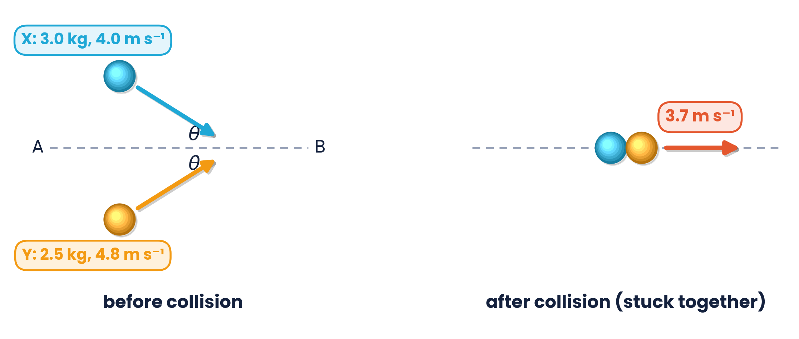
PAPER 2 STYLE · STRUCTURED QUESTION
Past paper 1 · Two balls collide at an angle
Ball X has a mass of 3.0 kg and a velocity of 4.0 m s⁻¹ at angle θ to a line AB. Ball Y has a mass of 2.5 kg and a velocity of 4.8 m s⁻¹ at angle θ to AB on the other side. The balls collide and stick together, then move at 3.7 m s⁻¹ along AB.
(a) State the principle of conservation of momentum. [2]
(b)(i) By considering components of momentum along AB, calculate θ. [3]
(b)(ii) By calculation of kinetic energies, state and explain whether the collision is inelastic or perfectly elastic. [2]
Topic 3 · Dynamics | Cambridge International AS Level Physics 9702
37

Slide 38
MARK SCHEME STYLE SOLUTION
Past paper 1 · Solution
(a)
Total momentum of a system is constant (sum before = sum after) (M1) if there is no resultant external force / closed system (A1)
(b)(i)
(3.0 × 4.0 × cos θ) + (2.5 × 4.8 × cos θ) = (5.5 × 3.7) (C1, C1) → 24 cos θ = 20.35 → θ = 32° (A1)
(b)(ii)
Initial Eₖ = ½ × 3.0 × 4.0² + ½ × 2.5 × 4.8² = 53 J; final Eₖ = ½ × 5.5 × 3.7² = 38 J. Eₖ decreases → inelastic (A1)
Topic 3 · Dynamics | Cambridge International AS Level Physics 9702
38
Notes:
Cambridge 9702/22 May/June 2022 style — mark scheme adapted.

Slide 39
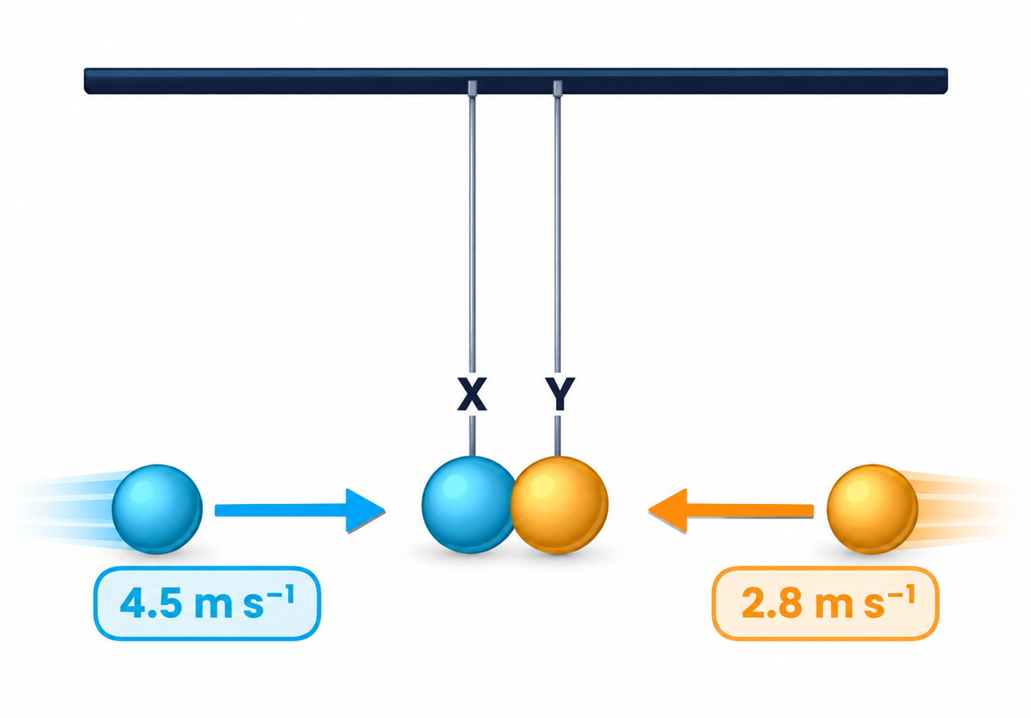
PAPER 2 STYLE · STRUCTURED QUESTION
Past paper 2 · Colliding pendulum balls
Two balls X and Y hang on long strings. They are pulled back and released; they collide when the strings are vertical and rebound in opposite directions. Positive is to the right. X: mass 50 g, velocity +4.5 m s⁻¹ before, −1.8 m s⁻¹ after. Y: mass M, velocity −2.8 m s⁻¹ before, +1.4 m s⁻¹ after.
(a) Use conservation of linear momentum to determine M. [3]
(b) State and explain whether the collision is elastic. [1]
(c) Use Newton's second and third laws to explain why the magnitude of the change in momentum of each ball is the same. [3]
Topic 3 · Dynamics | Cambridge International AS Level Physics 9702
39

Slide 40
MARK SCHEME STYLE SOLUTION
Past paper 2 · Solution
(a)
4.5 × 50 − 2.8 × M = −1.8 × 50 + 1.4 × M (C1, C1) → 315 = 4.2M → M = 75 g (A1)
(b)
Relative speed of approach (7.3 m s⁻¹) ≠ relative speed of separation (3.2 m s⁻¹), or total KE not conserved → inelastic
(c)
Force on X equals and is opposite to force on Y (N III); force = rate of change of momentum (N II); contact time is the same for both, so Δp is the same size
Topic 3 · Dynamics | Cambridge International AS Level Physics 9702
40

Slide 41
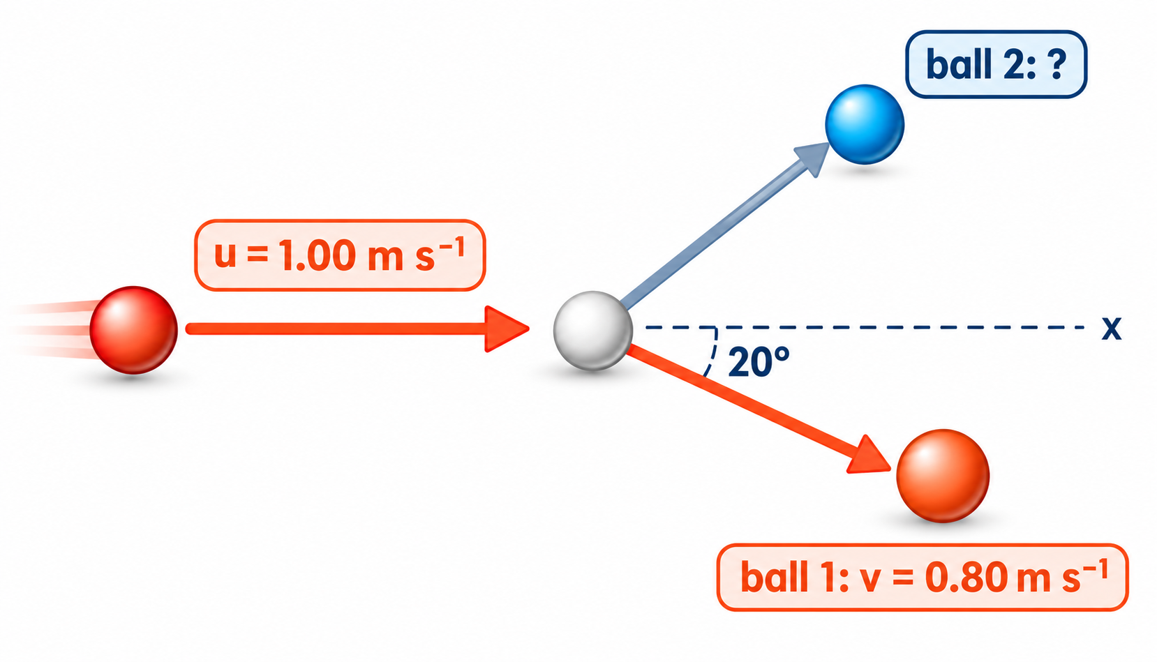
PAPER 2 STYLE · STRUCTURED QUESTION
Practice · Snooker balls in 2D
A snooker ball collides with a second, identical, stationary ball. Ball 1 approaches at u = 1.00 m s⁻¹ along the x-axis and leaves at 0.80 m s⁻¹ at 20° to the x-axis.
(a) Determine the components of the velocity of ball 1 after the collision.
(b) Hence determine the components of the velocity of ball 2.
(c) Hence determine the velocity (magnitude and direction) of ball 2.
Topic 3 · Dynamics | Cambridge International AS Level Physics 9702
41

Slide 42
MARK SCHEME STYLE SOLUTION
Practice · Solution
(a)
vₓ = 0.80 cos 20° = 0.75 m s⁻¹; vᵧ = 0.80 sin 20° = 0.27 m s⁻¹ (below the axis)
(b)
Equal masses cancel: v₂ₓ = 1.00 − 0.75 = 0.25 m s⁻¹; v₂ᵧ = 0.27 m s⁻¹ (above the axis)
(c)
v₂ = √(0.25² + 0.27²) = 0.37 m s⁻¹ at about 48° to the x-axis, on the opposite side to ball 1
Topic 3 · Dynamics | Cambridge International AS Level Physics 9702
42

Slide 43
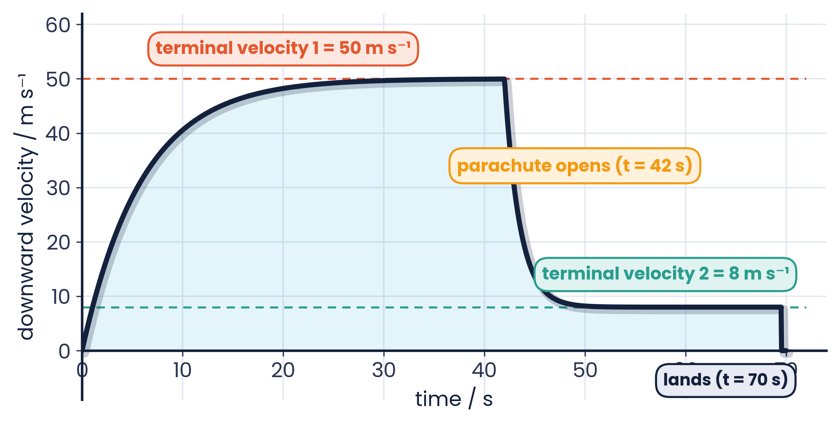
PAPER 2 STYLE · STRUCTURED QUESTION
Practice · Parachutist
The graph shows the vertical velocity of a parachutist who jumps from an aeroplane at t = 0, opens her parachute at t = 42 s and lands at t = 70 s.
(a) State the two terminal velocities.
(b) Explain, in terms of forces, why her acceleration decreases from t = 0 to t = 20 s.
(c) Explain why she decelerates when the parachute opens.
(d) Estimate the distance she falls between the second terminal velocity being reached and landing.
Topic 3 · Dynamics | Cambridge International AS Level Physics 9702
43

Slide 44
MARK SCHEME STYLE SOLUTION
Practice · Solution
(a)
50 m s⁻¹ (before the parachute opens) and 8 m s⁻¹ (after)
(b)
As speed increases, air resistance increases, so the resultant force (W − drag) decreases; a = F / m decreases
(c)
The larger area gives drag > weight, so the resultant force is upwards and she slows down
(d)
About 8 m s⁻¹ × 28 s ≈ 220 m (area under the graph)
Topic 3 · Dynamics | Cambridge International AS Level Physics 9702
44

Slide 45
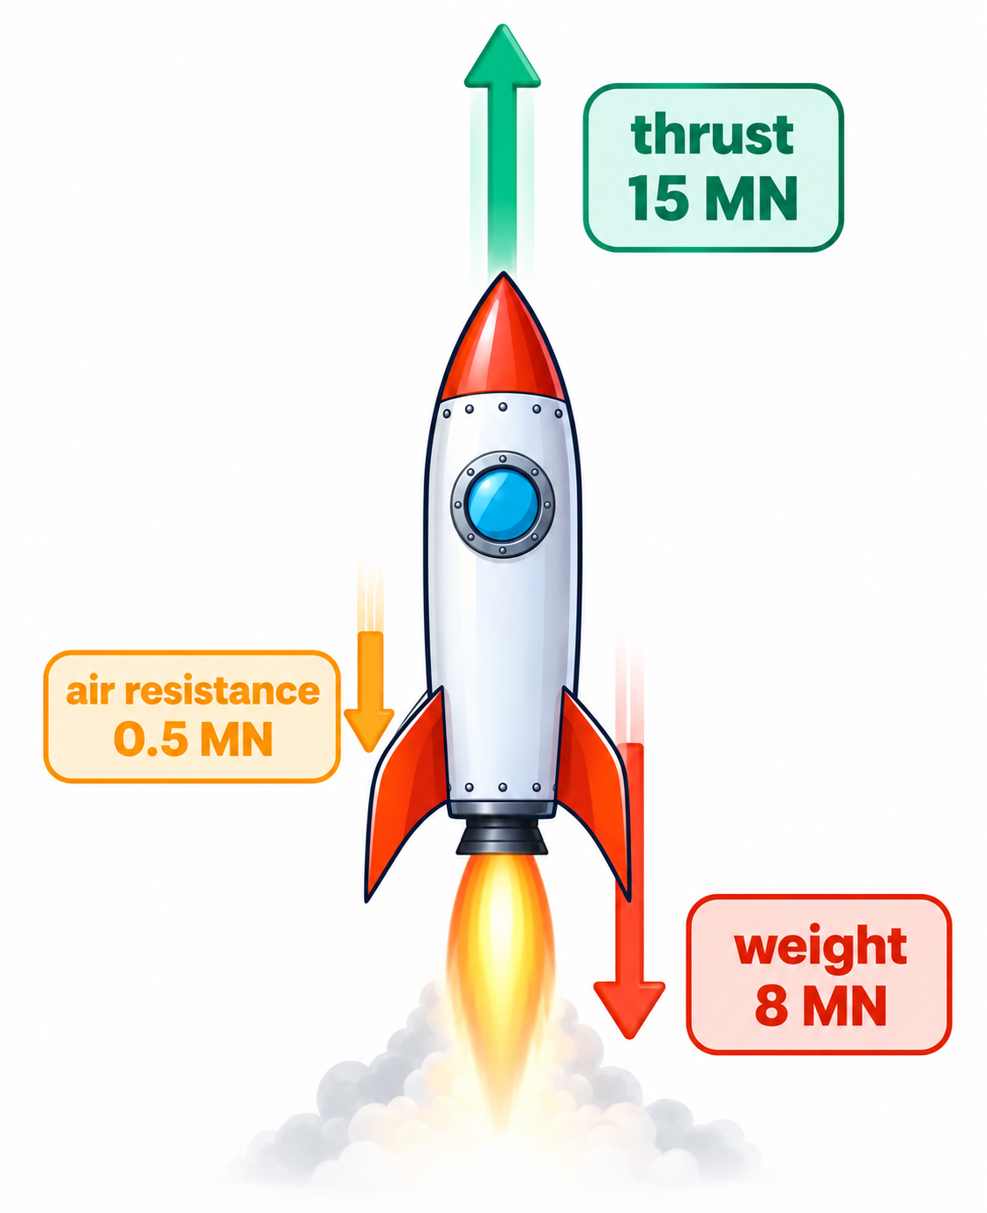
PAPER 2 STYLE · STRUCTURED QUESTION
Practice · Rocket and Newton's laws
A rocket produces an upward thrust of 15 MN. Its weight is 8 MN and the air resistance is 500 kN. The mass of the rocket is 0.8 × 10⁵ kg.
(a) Calculate the resultant force on the rocket.
(b) Calculate the acceleration and state its direction.
(c) State the Newton III partner of the thrust on the rocket.
(d) Suggest why the acceleration increases as the fuel burns.
Topic 3 · Dynamics | Cambridge International AS Level Physics 9702
45

Slide 46
MARK SCHEME STYLE SOLUTION
Practice · Solution
(a)
F = 15 × 10⁶ − 8 × 10⁶ − 0.5 × 10⁶ = 6.5 × 10⁶ N upwards
(b)
a = 6.5 × 10⁶ / 0.8 × 10⁵ = 81 m s⁻² upwards (same direction as the resultant force)
(c)
The force of the rocket on the exhaust gases (downwards)
(d)
The mass decreases (and the weight decreases), so the same thrust gives a larger acceleration
Topic 3 · Dynamics | Cambridge International AS Level Physics 9702
46

Slide 47
COMMON DOUBTS & MISCONCEPTIONS
Students often ask… (1)
?
“If the forces are balanced, is the object at rest?”
?
“Weight and normal reaction are equal and opposite — a Newton III pair?”
Not necessarily. Balanced forces mean no acceleration: at rest OR moving at constant velocity (Newton I).
No. Both act on the same object. A third-law pair acts on two different objects and is the same type of force.
?
“A ball bounces back at the same speed. Is Δp zero?”
?
“At terminal velocity, has gravity stopped acting?”
No. Momentum is a vector: Δp = m(−v) − m(v) = −2mv.
No. Weight is unchanged; drag has grown to equal it, so the resultant force and acceleration are zero.
Topic 3 · Dynamics | Cambridge International AS Level Physics 9702
47

Slide 48
COMMON DOUBTS & MISCONCEPTIONS
Students often ask… (2)
?
“Is kinetic energy conserved in every collision?”
?
“Do heavier objects fall faster?”
No. Momentum is always conserved (no external force). KE is conserved only in elastic collisions.
Without air resistance, no — all fall with acceleration g. With air resistance, a heavier object of the same shape reaches a higher terminal velocity.
?
“Is F = ma the definition of force?”
?
“Does the bigger truck exert the bigger force on the small car in a crash?”
Cambridge defines force as the rate of change of momentum; F = ma is the special case for constant mass.
No. The forces are equal and opposite (N III). The car has the larger acceleration because its mass is smaller.
Topic 3 · Dynamics | Cambridge International AS Level Physics 9702
48

Slide 49
COMMAND WORDS AND MARK-SCHEME HABITS
Exam technique for dynamics
State a law
Signs
use the exact wording: ‘resultant force’, ‘rate of change of momentum’, ‘no resultant external force’
choose a positive direction first; rebounding velocities are negative
Newton III pairs
Elastic or not?
name both objects: ‘force of A on B’ and ‘force of B on A’
calculate total KE before and after, or compare relative speeds of approach and separation
2D momentum
Terminal velocity
resolve along two perpendicular directions and conserve each separately
explain with forces: drag increases with speed until drag = weight, so a = 0
Topic 3 · Dynamics | Cambridge International AS Level Physics 9702
49

Slide 50
KEY IDEAS TO TAKE AWAY
Dynamics in one slide
W = mg
F = ma
p = mv
F = Δp / Δt
Newton
I: no resultant force → constant velocity · II: F = Δp/Δt · III: equal, opposite, same type, different bodies
Drag
increases with speed · terminal velocity when drag = weight, a = 0
Momentum
always conserved with no external force · KE conserved only in elastic collisions · resolve in 2D
Topic 3 · Dynamics | Cambridge International AS Level Physics 9702
50

