Slide 1
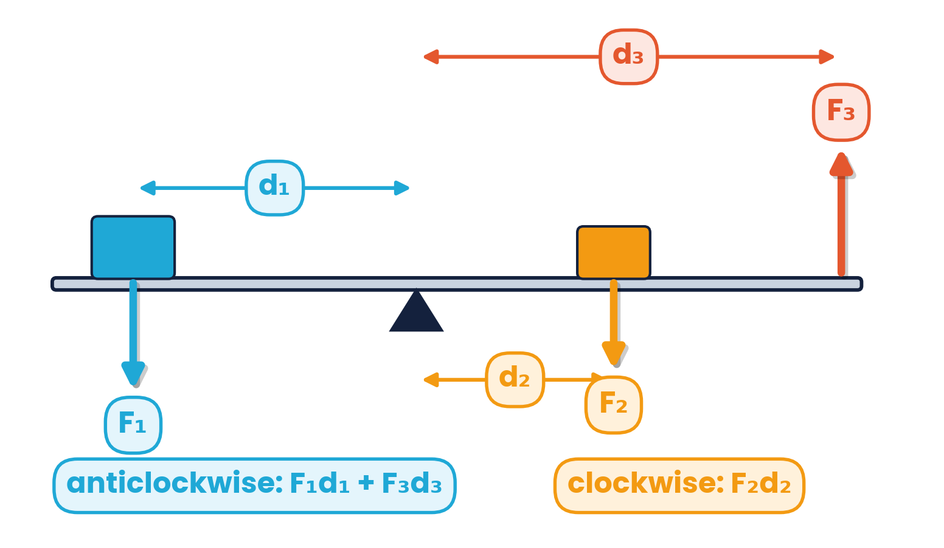
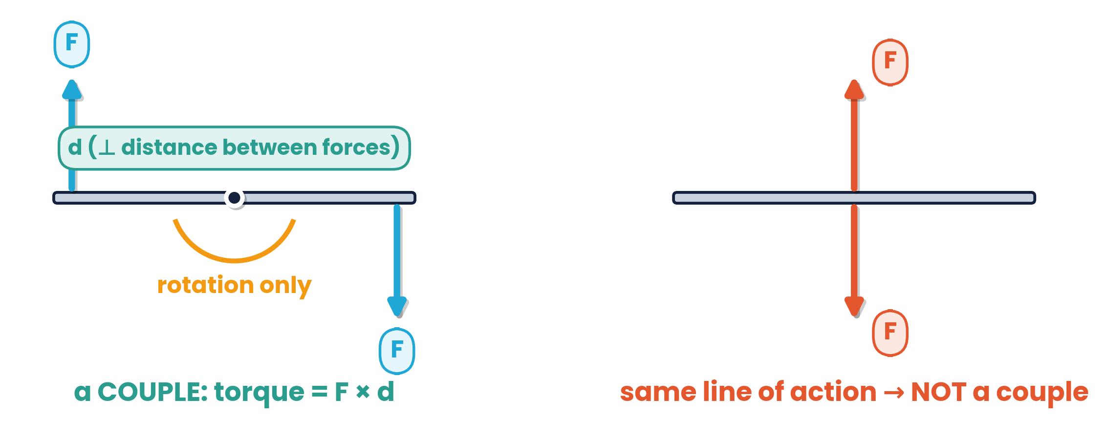
CAMBRIDGE AS & A LEVEL · PHYSICS 9702 · TOPIC 4
Turning Effects
& Equilibrium
Centre of gravity · moments · couples & torque · vector triangles
Syllabus 4.1 – 4.2 | Exams 2025 – 2027
WA
Waseem Ahmad
Head of Science & IB Physics Lead Teacher
Presidential School, Jizzakh · Cambridge Examiner
Author, Orange Publication · www.examspath.com

Slide 2
SYLLABUS 4.1 – 4.2 · TURNING EFFECTS AND EQUILIBRIUM
What the syllabus asks you to do
1
LO 4.1.1
2
LO 4.1.2
3
LO 4.1.3
4
LO 4.1.4
Weight may be taken as acting at a single point: the centre of gravity
Define and apply the moment of a force
A couple is a pair of forces that produces rotation only
Define and apply the torque of a couple
Section 4.3 (density and pressure) is not part of this deck.
5
LO 4.2.1
6
LO 4.2.2
7
LO 4.2.3
State and apply the principle of moments
No resultant force and no resultant torque → equilibrium
Use a vector triangle for coplanar forces in equilibrium
Topic 4 · Turning effects and equilibrium | Cambridge International AS Level Physics 9702
2

Slide 3
TOPIC 4 · TURNING EFFECTS AND EQUILIBRIUM
Lesson roadmap
01
02
03
04
Centre of gravity
Moments
Principle of moments
Couples & torque
Where weight acts; stability
Force × perpendicular distance
Clockwise = anticlockwise
Rotation without translation
05
06
07
08
Equilibrium
Vector triangles
Past paper practice
Doubts & exam tips
No resultant force, no resultant torque
Coplanar forces in equilibrium
MCQs and structured questions
Misconceptions and technique
Topic 4 · Turning effects and equilibrium | Cambridge International AS Level Physics 9702
3

Slide 4
LEARNING OUTCOME 4.1.1
01
Centre of gravity
The single point where the weight may be taken to act
Topic 4 · Turning effects and equilibrium | Cambridge International AS Level Physics 9702
4

Slide 5
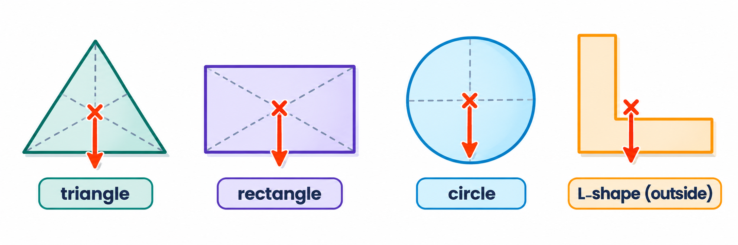
4.1.1 · WHERE THE WEIGHT ACTS
Centre of gravity
The centre of gravity of an object is the point at which the weight of the object may be considered to act.
Symmetrical, uniform objects: the centre of gravity is at the point of symmetry (lines of symmetry cross).
It can lie outside the object (L-shape, ring, boomerang). A person's CoG moves when they lean forward.
Topic 4 · Turning effects and equilibrium | Cambridge International AS Level Physics 9702
5

Slide 6
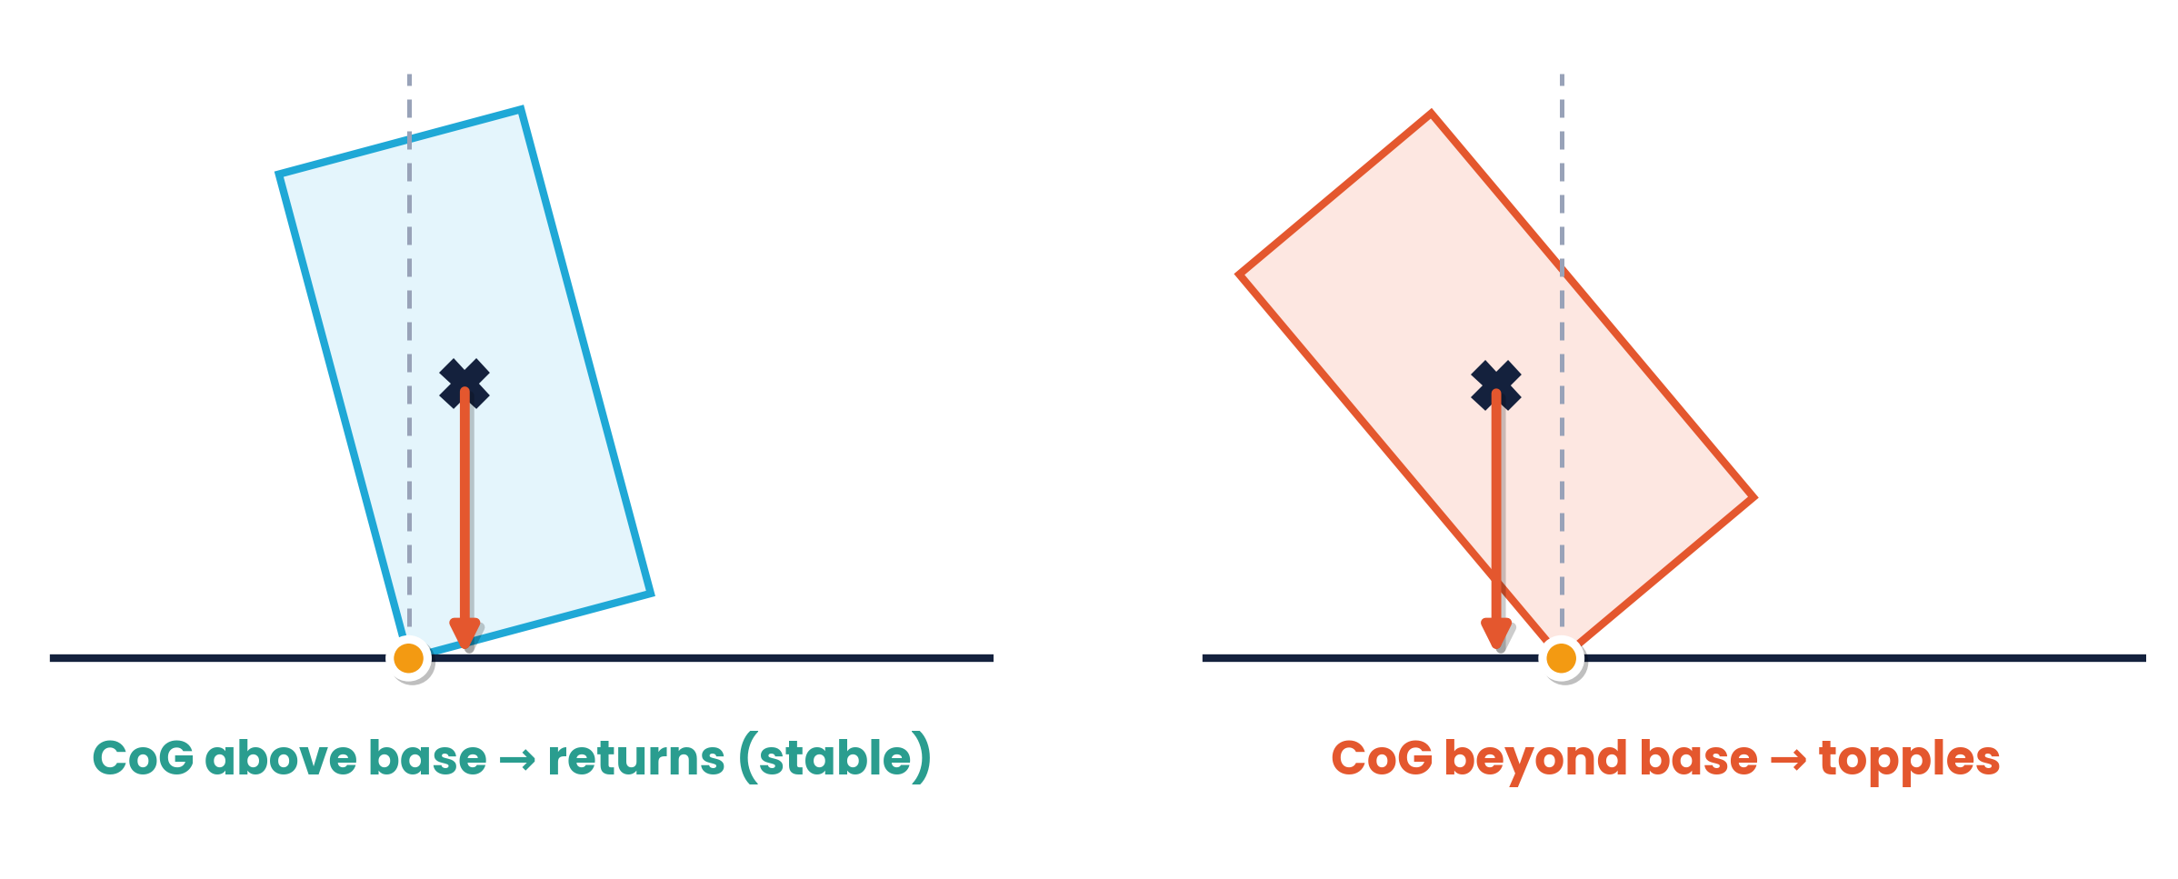
4.1.1 · CENTRE OF GRAVITY AND TOPPLING
Stability
An object is stable while the vertical line through its centre of gravity falls inside its base
Tilted past this point, the weight produces a moment that topples it
Wide base and low centre of gravity → more stable (racing cars, buses with heavy floors)
Narrow base and high centre of gravity → topples easily
Centre of gravity vs centre of mass:
identical in a uniform gravitational field. In a non-uniform field (e.g. a large object near Earth) the CoG shifts slightly towards the stronger field.
Topic 4 · Turning effects and equilibrium | Cambridge International AS Level Physics 9702
6

Slide 7
LEARNING OUTCOME 4.1.2
02
Moments
The turning effect of a force
Topic 4 · Turning effects and equilibrium | Cambridge International AS Level Physics 9702
7

Slide 8
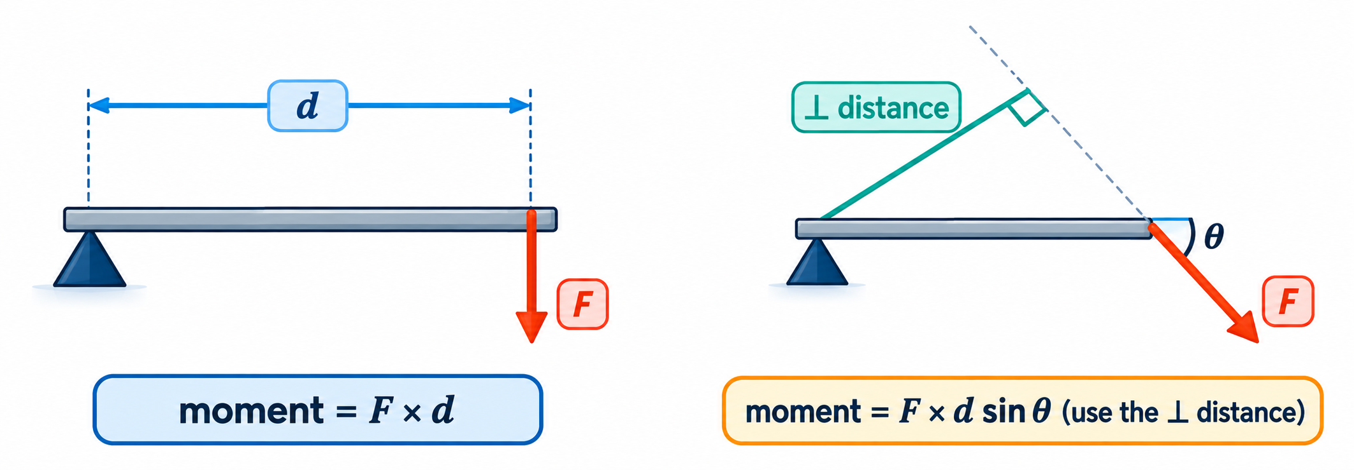
4.1.2 · DEFINE AND APPLY
The moment of a force
Moment of a force = force × perpendicular distance from the pivot to the line of action of the force.
Unit: N m (not joules — moment is not energy)
Bigger force or bigger ⊥ distance → bigger turning effect
A force through the pivot has zero moment
Topic 4 · Turning effects and equilibrium | Cambridge International AS Level Physics 9702
8

Slide 9
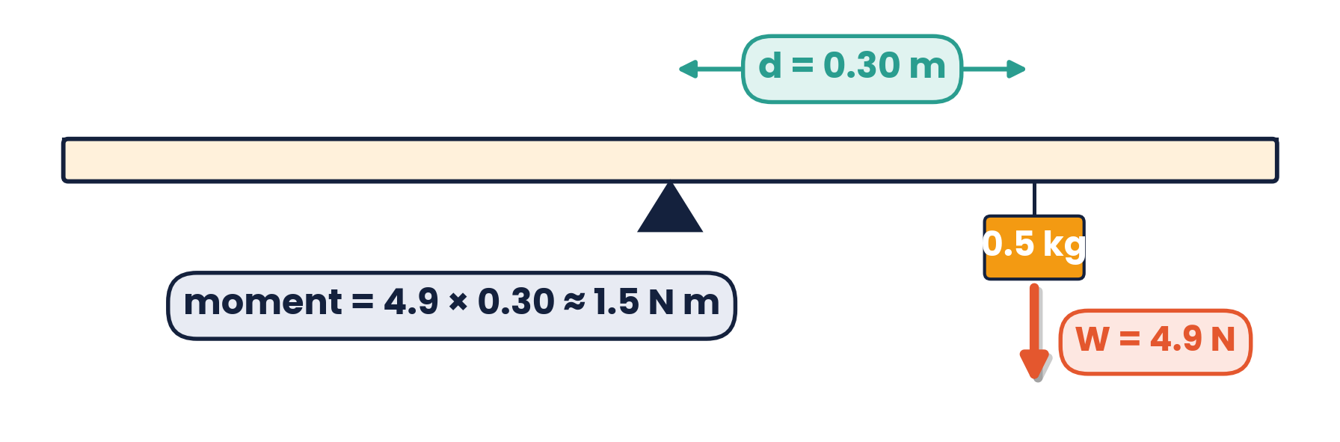
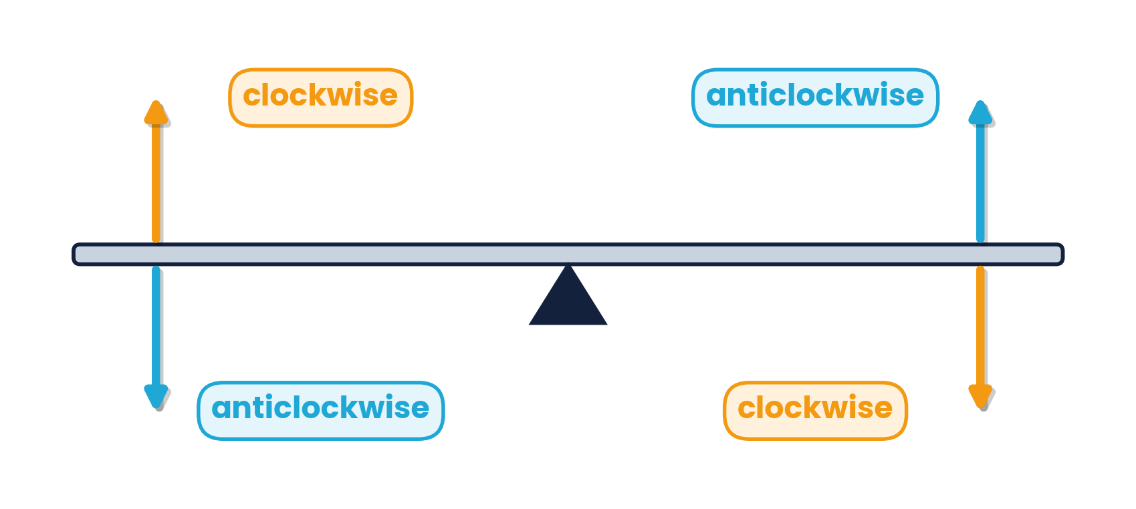
4.1.2 · CALCULATING A MOMENT
Worked example · Metre rule
A uniform metre rule is pivoted at 50 cm. A 0.5 kg mass hangs at 80 cm. Ignore the rule's weight. Find the turning moment.
1
W = mg = 0.5 × 9.81 = 4.9 N (acts downwards)
2
⊥ distance = 80 cm − 50 cm = 30 cm = 0.30 m
3
Moment = 4.9 × 0.30 = 1.5 N m (clockwise)
Topic 4 · Turning effects and equilibrium | Cambridge International AS Level Physics 9702
9

Slide 10
LEARNING OUTCOME 4.2.1
03
The principle of moments
Clockwise moments = anticlockwise moments
Topic 4 · Turning effects and equilibrium | Cambridge International AS Level Physics 9702
10

Slide 11
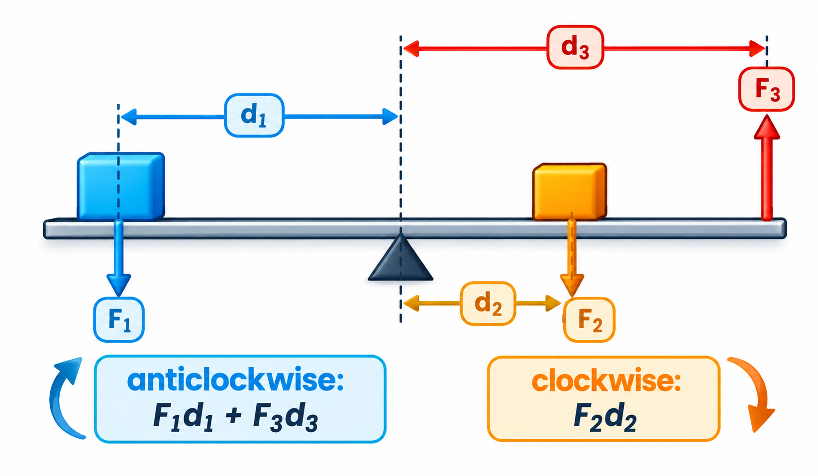
4.2.1 · STATE AND APPLY
The principle of moments
For a body in equilibrium, the sum of the clockwise moments about any point equals the sum of the anticlockwise moments about the same point.
Exam method
Choose the pivot at an unknown force — its moment is then zero
Uniform beam: weight acts at the midpoint
Use the same units for every distance
Σ clockwise = Σ anticlockwise; then use Σ up = Σ down
Topic 4 · Turning effects and equilibrium | Cambridge International AS Level Physics 9702
11

Slide 12
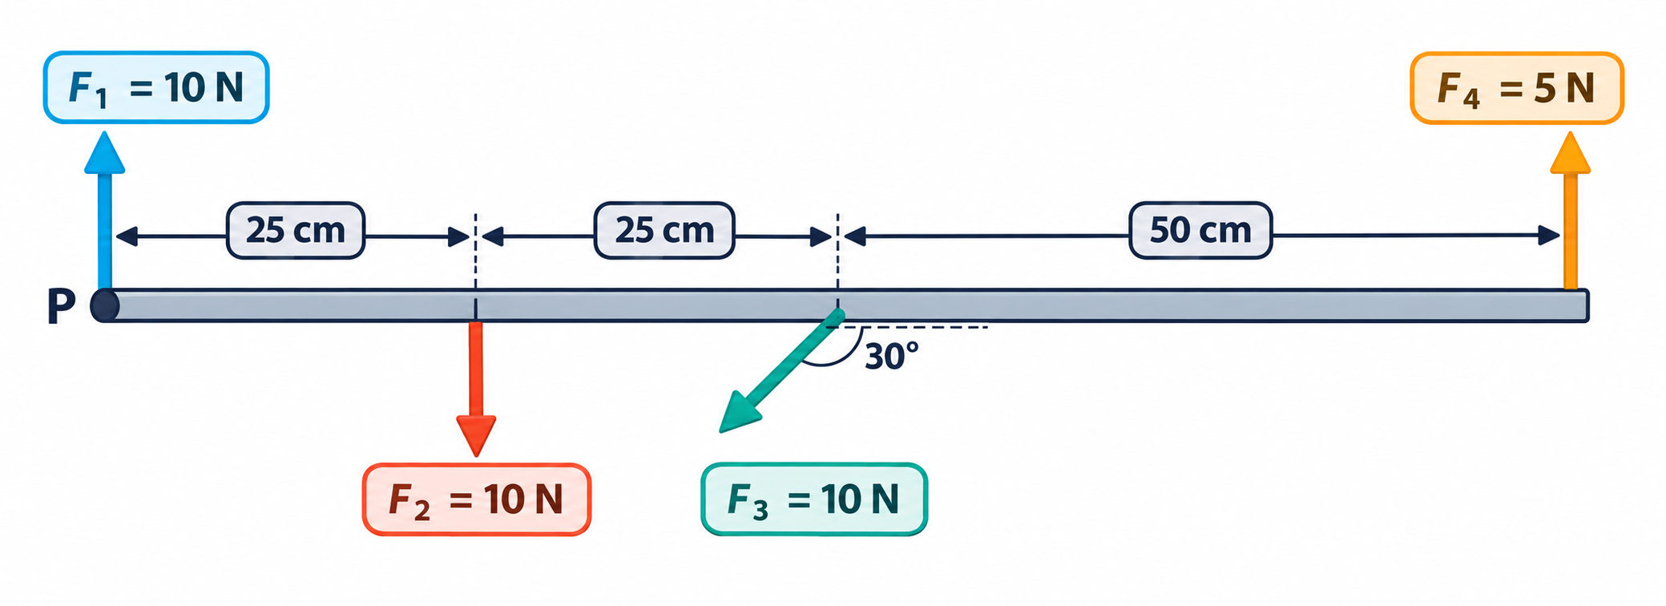
4.2.1 · ARE THE MOMENTS BALANCED?
Worked example · Four forces on a beam
F₁
F₂
F₃
F₄
acts through P → moment = 0
10 × 0.25 = 2.5 N m clockwise
10 sin 30° × 0.50 = 2.5 N m clockwise
5 × 1.00 = 5.0 N m anticlockwise
Total clockwise = 2.5 + 2.5 = 5.0 N m = total anticlockwise → the moments are balanced.
Note: only the perpendicular component of F₃ turns the beam.
Topic 4 · Turning effects and equilibrium | Cambridge International AS Level Physics 9702
12

Slide 13
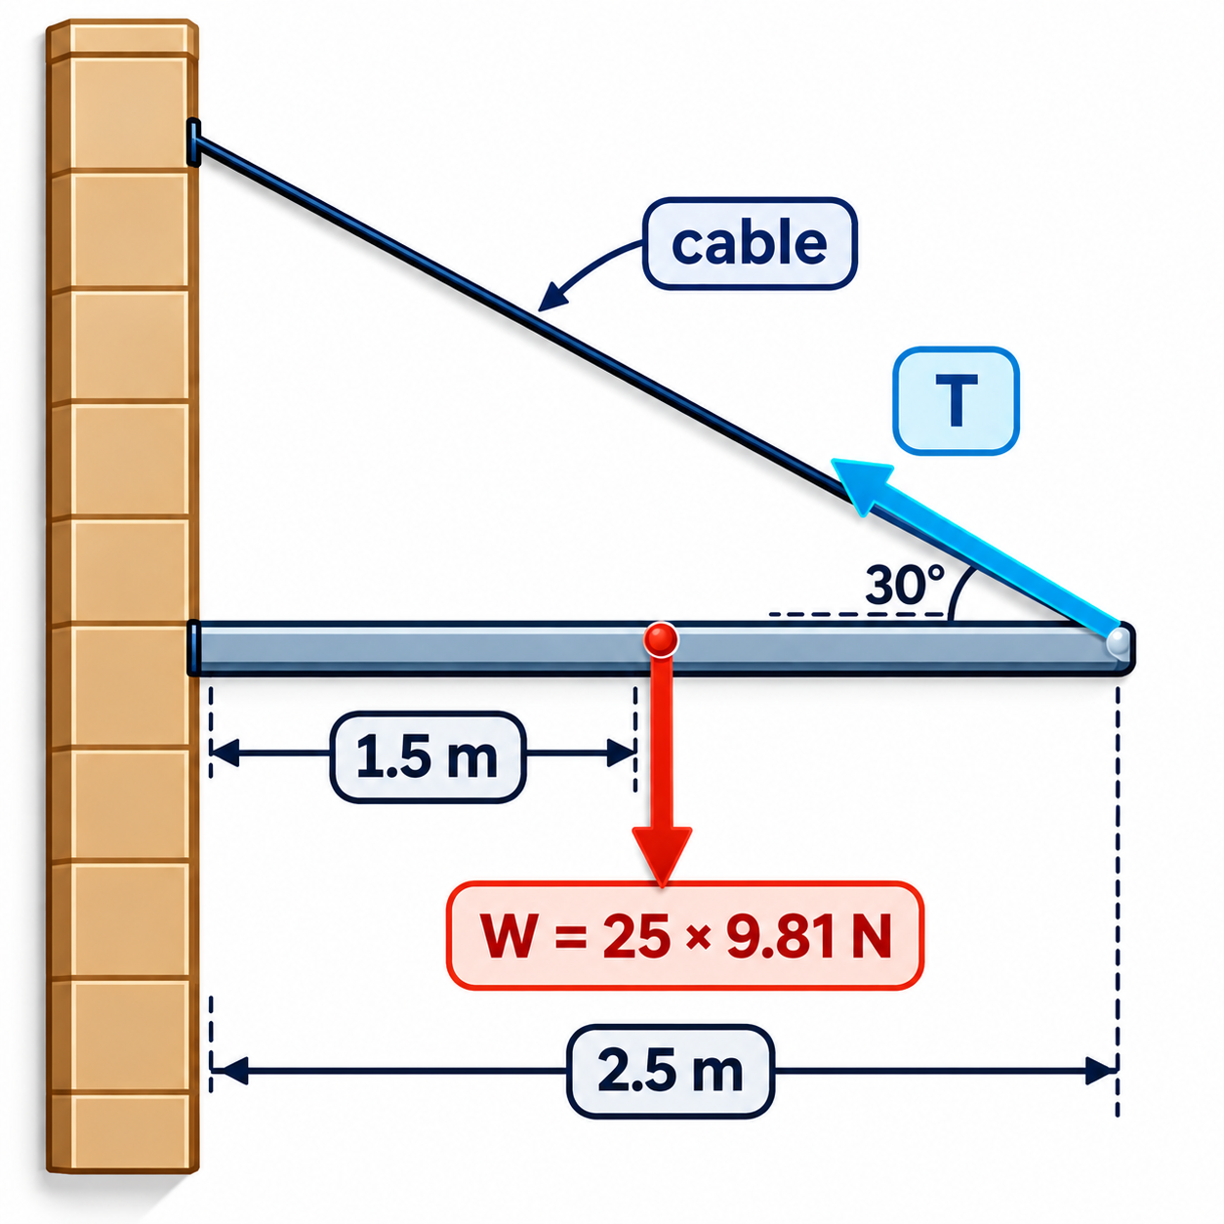
4.2.1 · MOMENTS WITH AN ANGLED FORCE
Worked example · Flagpole held by a cable
A 25 kg flagpole is held horizontal by a cable at 30° to the pole, fixed to its free end 2.5 m from the wall. Its CoG is 1.5 m from the wall. Find T and the vertical force from the wall.
1
Moments about the wall end (the wall force has no moment there)
2
⊥ distance of T from the wall end = 2.5 sin 30° = 1.25 m
3
25 × 9.81 × 1.5 = T × 1.25 → T = 294 N
Tip: take moments about the point where the unknown force you don't need acts.
4
Vertical: wall force = 245 − 294 sin 30° = 98 N upwards
Topic 4 · Turning effects and equilibrium | Cambridge International AS Level Physics 9702
13

Slide 14
LEARNING OUTCOMES 4.1.3 – 4.1.4
04
Couples and torque
A pair of forces that produces rotation only
Topic 4 · Turning effects and equilibrium | Cambridge International AS Level Physics 9702
14

Slide 15
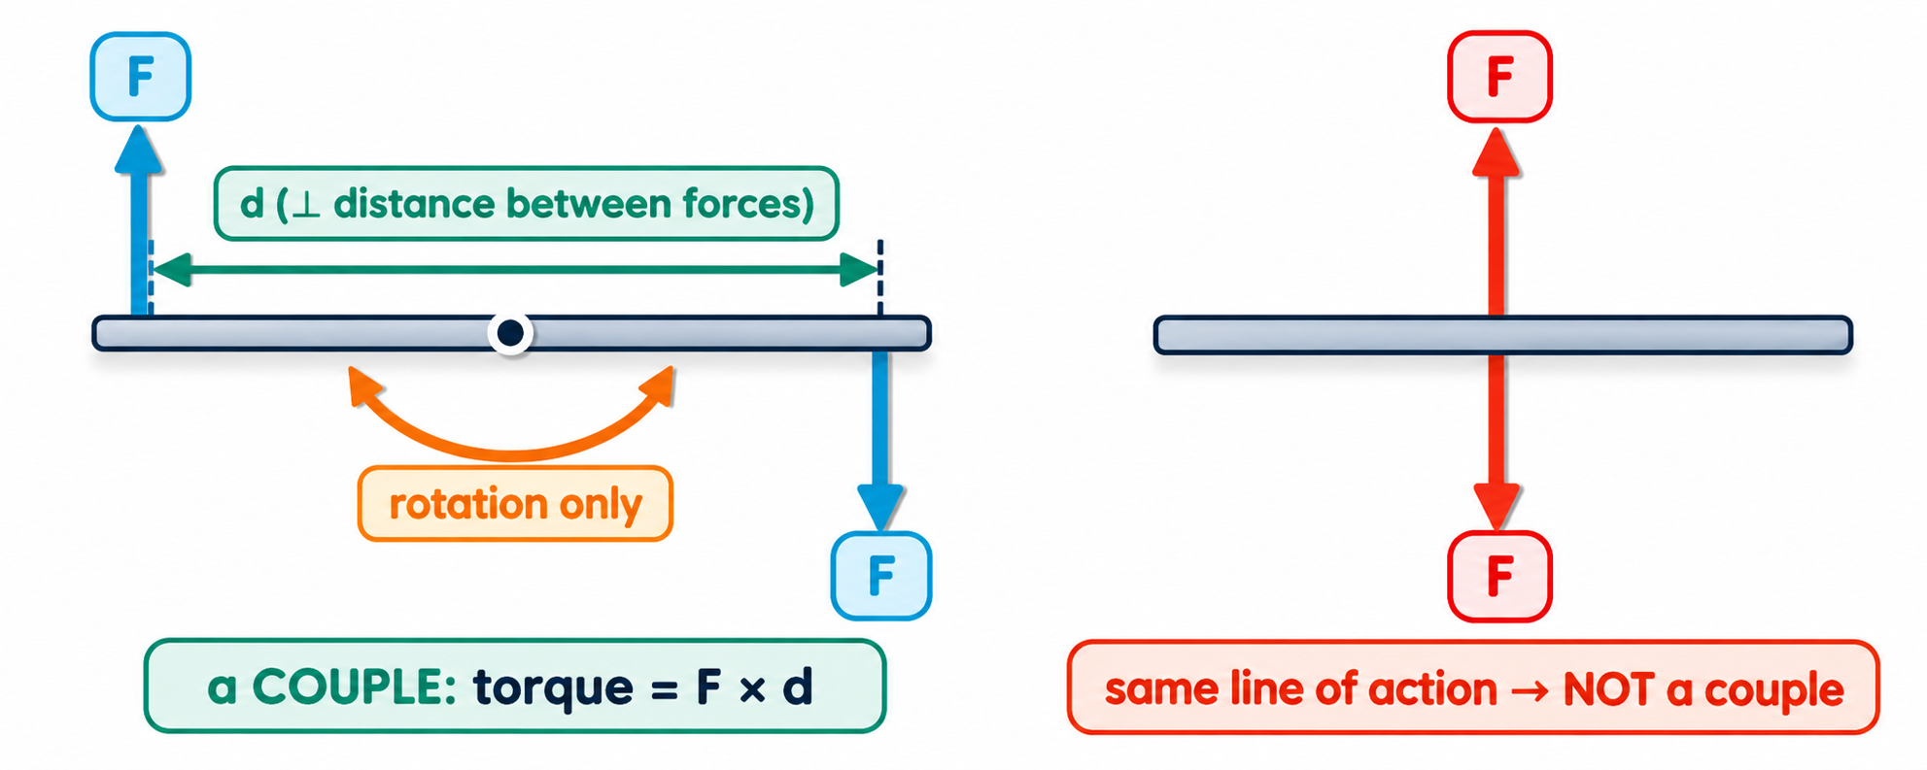
4.1.3 · ROTATION WITHOUT TRANSLATION
Couples
Equal in magnitude
Opposite in direction
Not along the same line
the two forces are the same size
so the resultant force is zero
separated by a perpendicular distance
Topic 4 · Turning effects and equilibrium | Cambridge International AS Level Physics 9702
15

Slide 16
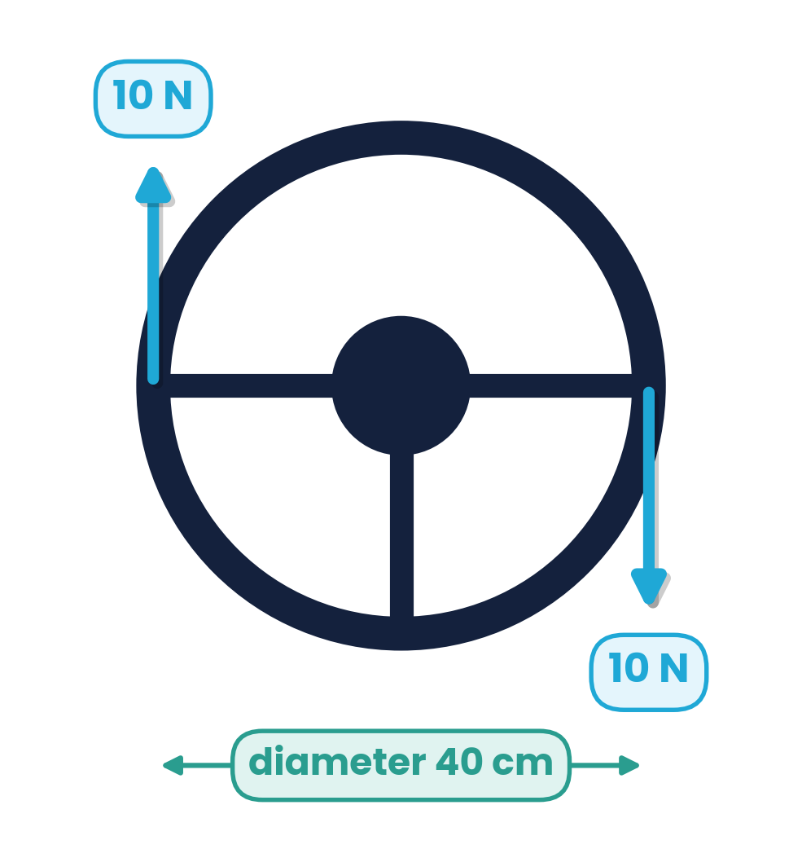
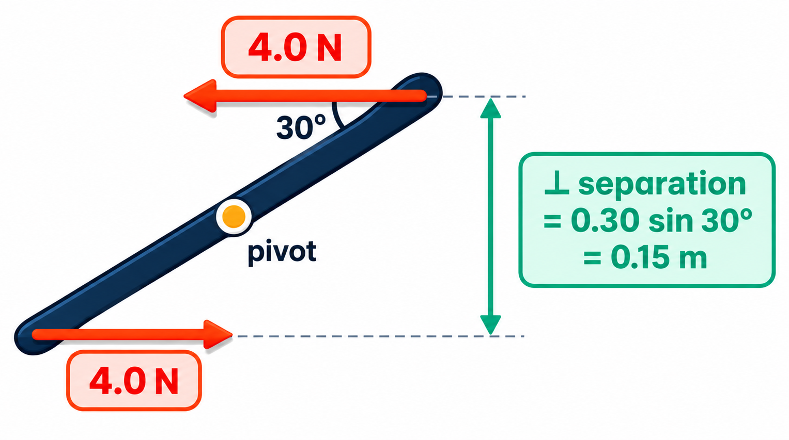
4.1.4 · DEFINE AND APPLY
Torque of a couple
torque = F × d
Independent of the pivot.
Taking moments about any point gives the same total F × d — a couple always turns, never translates.
one of the forces × perpendicular distance between the forces (N m)
Steering wheel
diameter 40 cm
couple of 10 N
τ = 10 × 0.40
= 4.0 N m
Ruler at 30°
0.30 m long, 4.0 N forces
τ = 4.0 × 0.15
= 0.60 N m
Topic 4 · Turning effects and equilibrium | Cambridge International AS Level Physics 9702
16

Slide 17
LEARNING OUTCOME 4.2.2
05
Equilibrium
No resultant force and no resultant torque
Topic 4 · Turning effects and equilibrium | Cambridge International AS Level Physics 9702
17

Slide 18
4.2.2 · BOTH MUST HOLD
Conditions for equilibrium
1
No resultant force
2
No resultant torque
in any direction: Σ up = Σ down and Σ left = Σ right
about any point: Σ clockwise = Σ anticlockwise
What equilibrium means
The body stays at rest or moves at constant velocity — and does not start to rotate (or rotates at constant rate)
A couple alone: zero resultant force but non-zero torque → NOT in equilibrium
A single off-centre force: non-zero force and torque → NOT in equilibrium
Topic 4 · Turning effects and equilibrium | Cambridge International AS Level Physics 9702
18

Slide 19
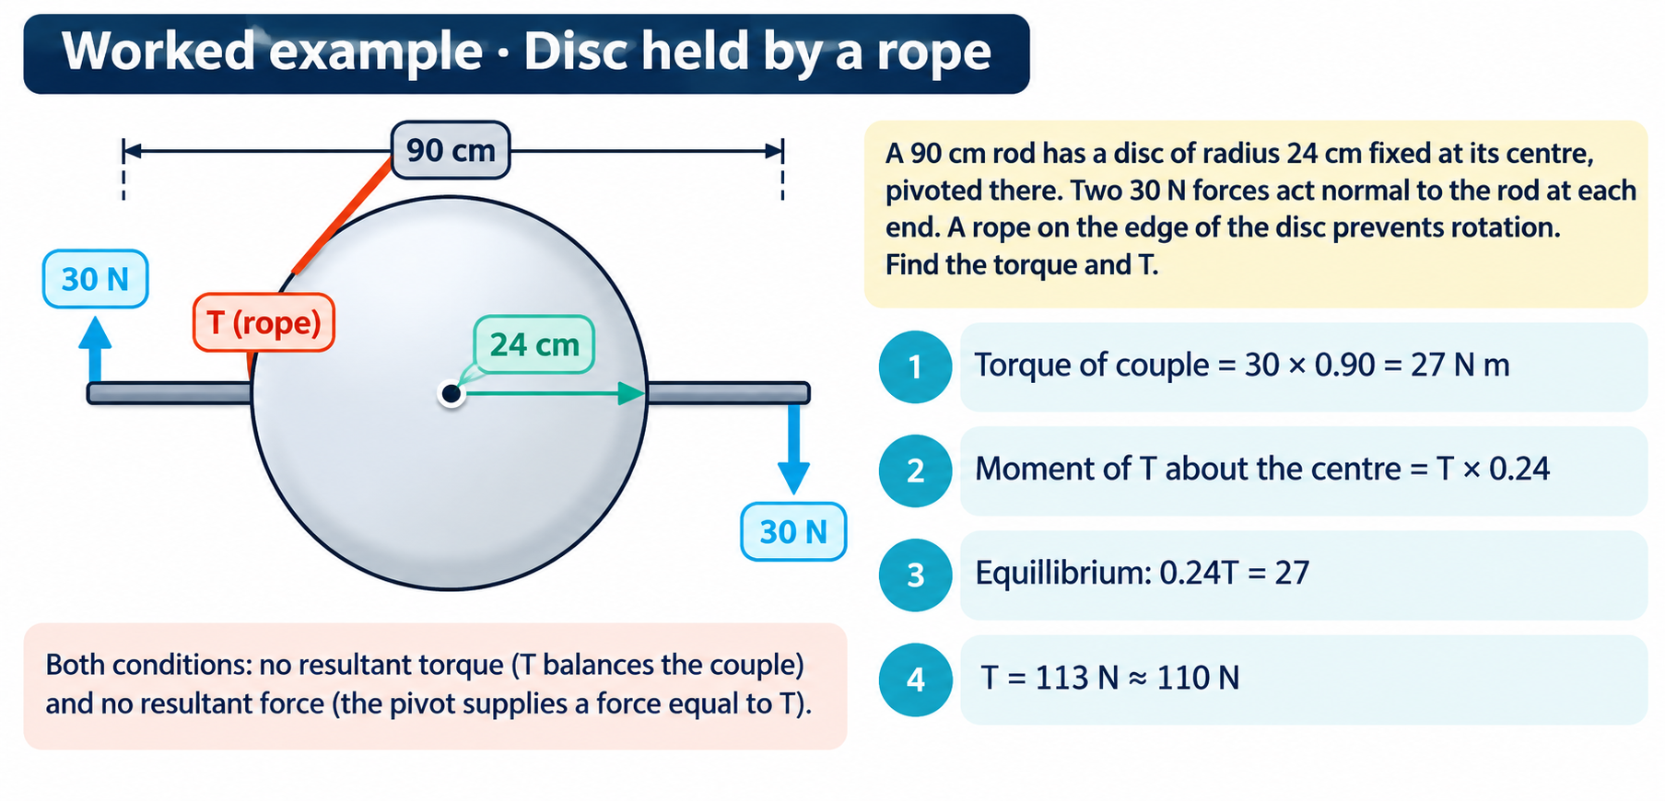
4.2.2 · BALANCING A COUPLE
Topic 4 · Turning effects and equilibrium | Cambridge International AS Level Physics 9702
19

Slide 20
LEARNING OUTCOME 4.2.3
06
Coplanar forces and vector triangles
Three forces in equilibrium form a closed triangle
Topic 4 · Turning effects and equilibrium | Cambridge International AS Level Physics 9702
20

Slide 21
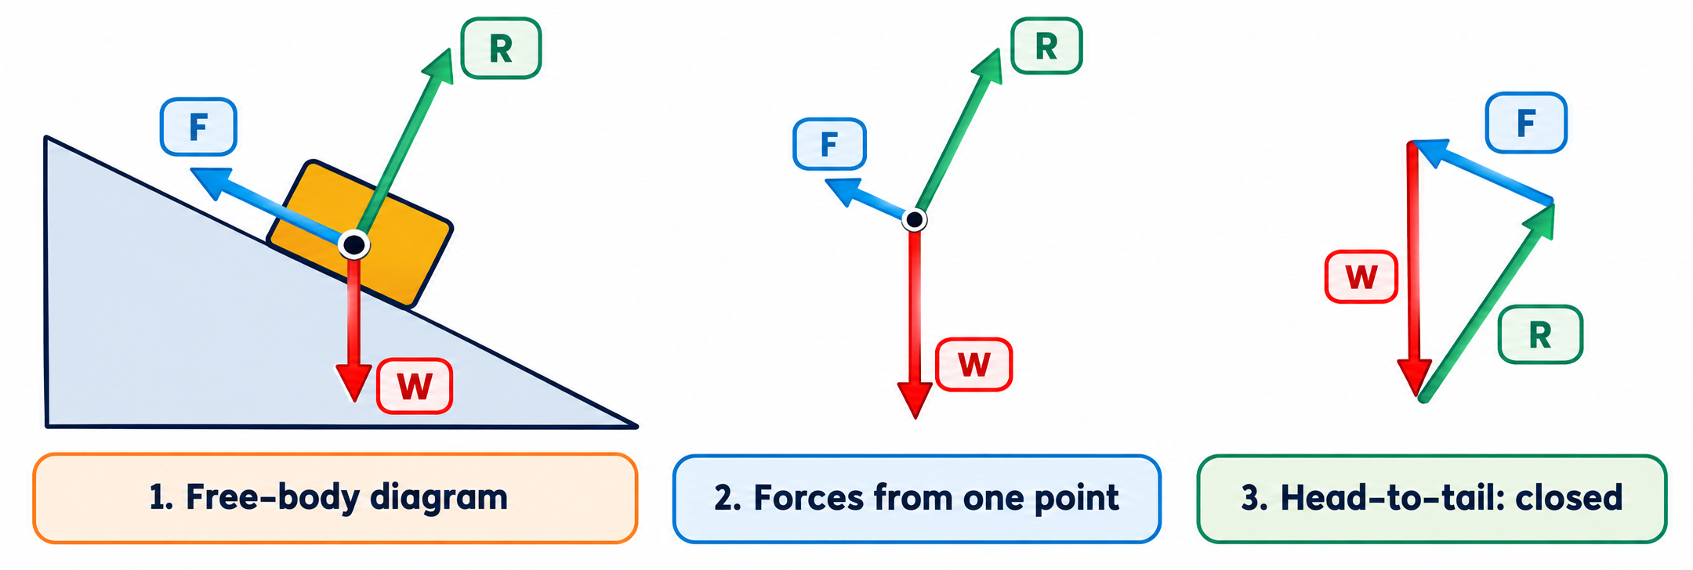
4.2.3 · A VEHICLE AT REST ON A SLOPE
From free-body diagram to vector triangle
1
Draw all the forces on a free-body diagram: weight W, normal reaction R, friction F
2
Redraw the forces starting from one point, keeping length and direction
3
Join them head-to-tail. In equilibrium the triangle is closed — no resultant
Topic 4 · Turning effects and equilibrium | Cambridge International AS Level Physics 9702
21

Slide 22
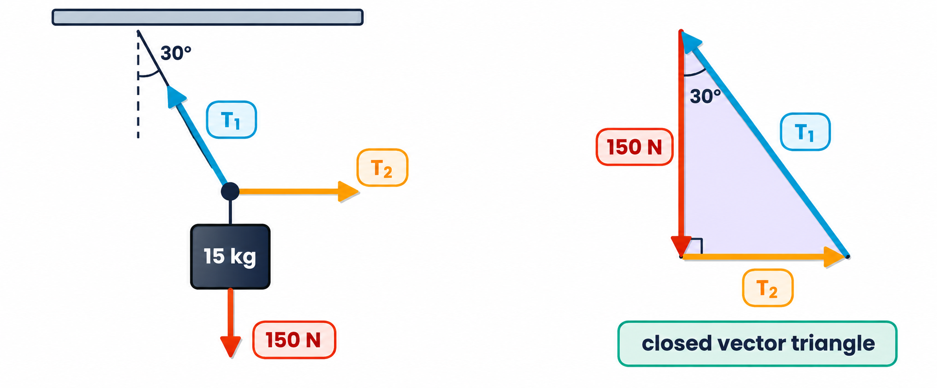
4.2.3 · SOLVING WITH A VECTOR TRIANGLE
Worked example · Hanging mass
A 15 kg mass (weight ≈ 150 N) hangs from a string at 30° to the vertical, pulled sideways by a horizontal string. Find T₁ and T₂.
1
Draw the closed triangle: 150 N down, T₂ across, T₁ back to the start
2
cos 30° = 150 / T₁ → T₁ = 173 N
3
tan 30° = T₂ / 150 → T₂ = 87 N
4
Check by resolving: T₁ cos 30° = 150 ✓, T₁ sin 30° = T₂ ✓
Classroom practical: three newton meters pulling a knot on paper — the forces close a triangle.
Topic 4 · Turning effects and equilibrium | Cambridge International AS Level Physics 9702
22

Slide 23
CAMBRIDGE PAST PAPER QUESTIONS
07
Past paper practice
Paper 1 multiple choice · Paper 2 structured questions
Topic 4 · Turning effects and equilibrium | Cambridge International AS Level Physics 9702
23

Slide 24
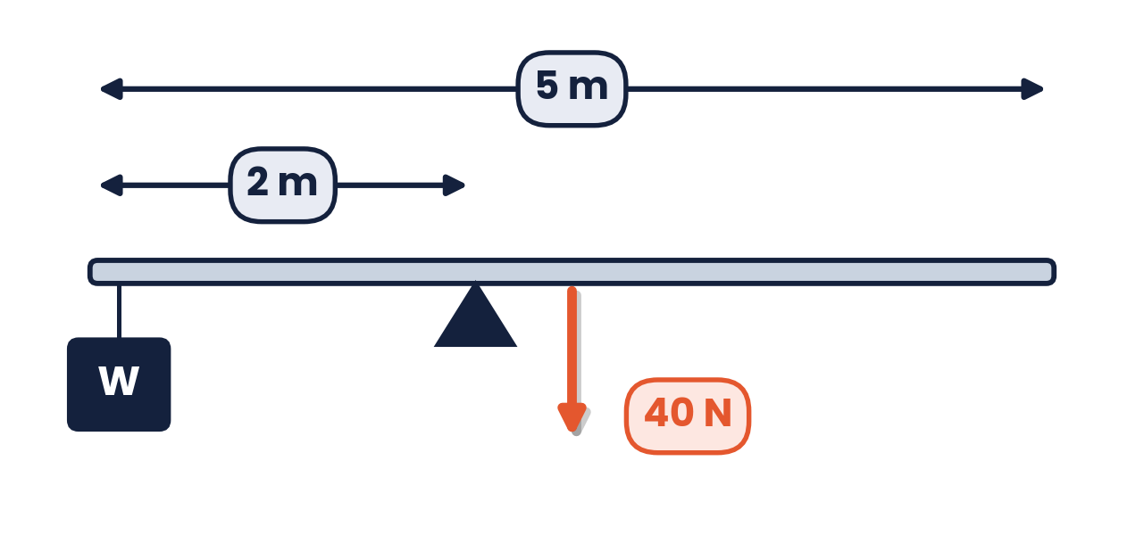
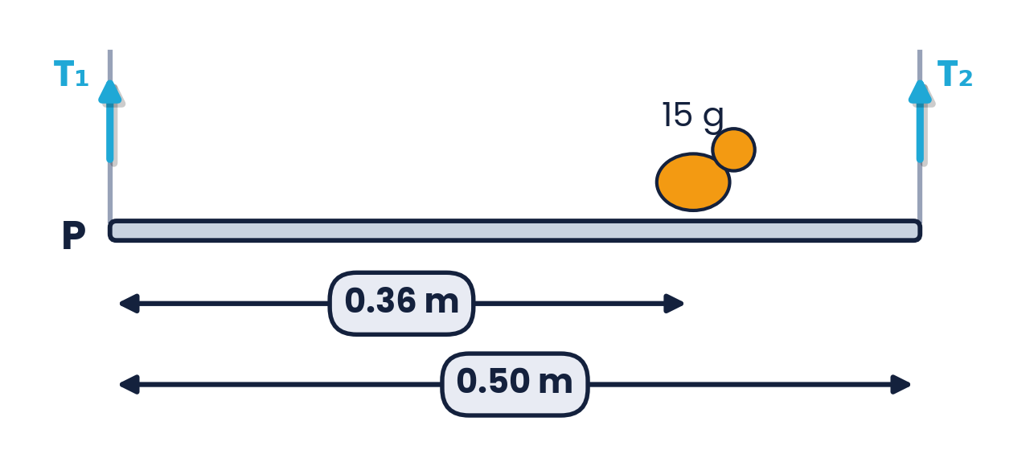
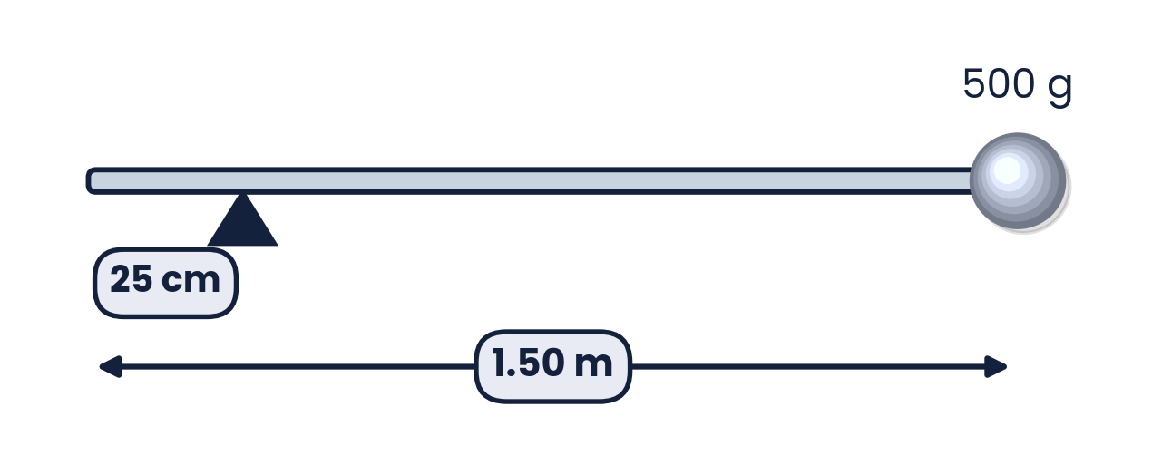
PAPER 1 STYLE · MULTIPLE CHOICE
Past paper set A · Moments
1
Uniform 40 N beam, 5 m long, pivot 2 m from one end, load W at that end. The beam is in equilibrium. What is W?
2
A 15 g bird sits 0.36 m from P on a uniform 0.50 m, 0.5 kg rod. Total clockwise moment about P?
A 0.053 N m
B 1.0 N m
C 1.2 N m
D 1.3 N m
A 10 N
B 50 N
C 25 N
D 30 N
3
500 g mass at one end of a 1.50 m rod pivoted 25 cm from the other end. Moment of the mass about the pivot?
4
What is the centre of gravity of an object?
A the geometrical centre of the object
B the point about which the total torque is zero
C the point at which the weight may be considered to act
D the point through which gravity acts
A 0.63 N m
B 1.2 N m
C 6.1 N m
D 7.4 N m
Topic 4 · Turning effects and equilibrium | Cambridge International AS Level Physics 9702
24

Slide 25
ANSWERS AND KEY WORKING
Past paper set A · Answers
1
Answer A
2
Answer D
Beam weight acts at 2.5 m, i.e. 0.5 m from the pivot. W × 2 = 40 × 0.5 → W = 10 N.
Bird: 0.015 × 9.81 × 0.36 = 0.053 N m; rod: 0.5 × 9.81 × 0.25 = 1.23 N m. Total = 1.3 N m. A forgets the rod.
3
Answer C
4
Answer C
Distance = 1.50 − 0.25 = 1.25 m; moment = 0.50 × 9.81 × 1.25 = 6.1 N m.
The definition. A is true only for uniform symmetrical objects.
Topic 4 · Turning effects and equilibrium | Cambridge International AS Level Physics 9702
25

Slide 26
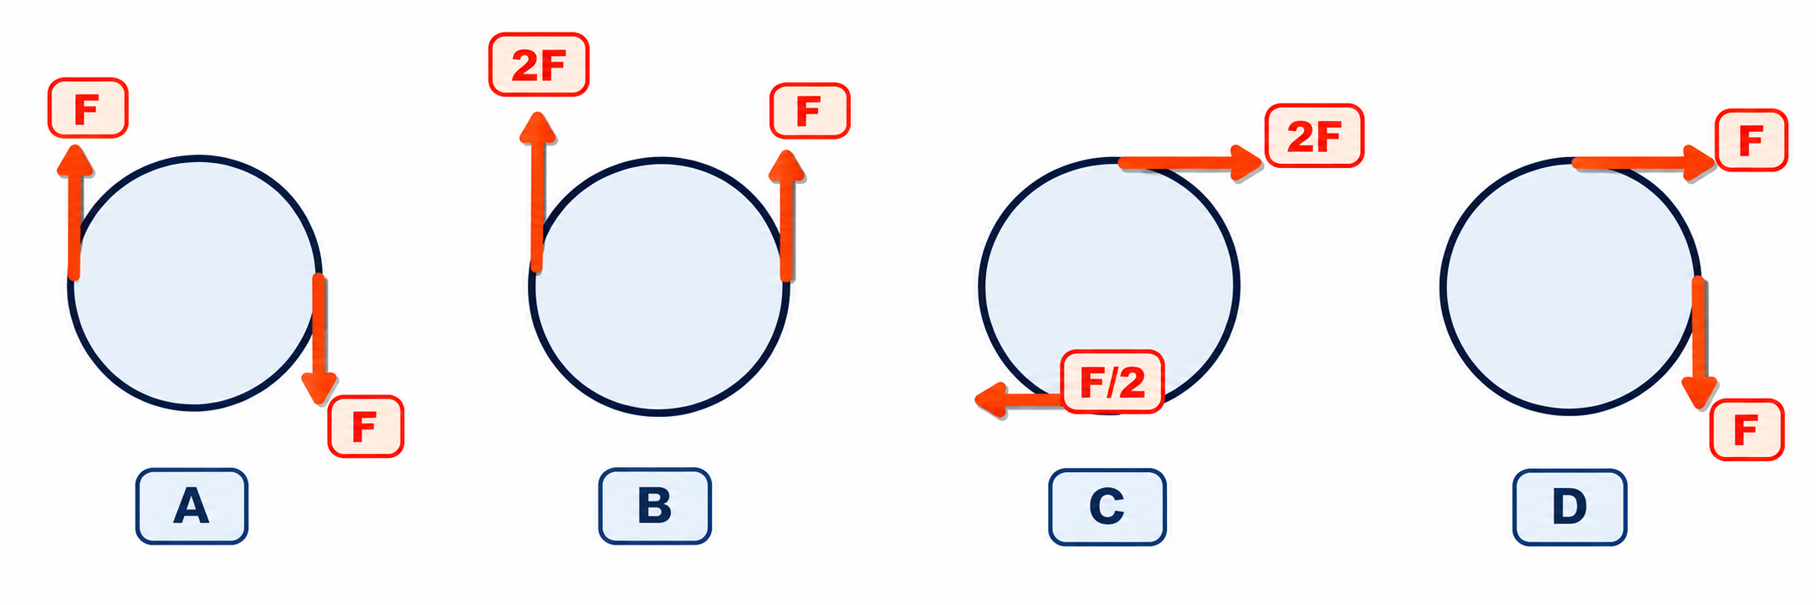
PAPER 1 STYLE · MULTIPLE CHOICE
Past paper · Which is a couple?
5
Which pair of forces acts as a couple on the circular object?
Choose A, B, C or D
Topic 4 · Turning effects and equilibrium | Cambridge International AS Level Physics 9702
26

Slide 27
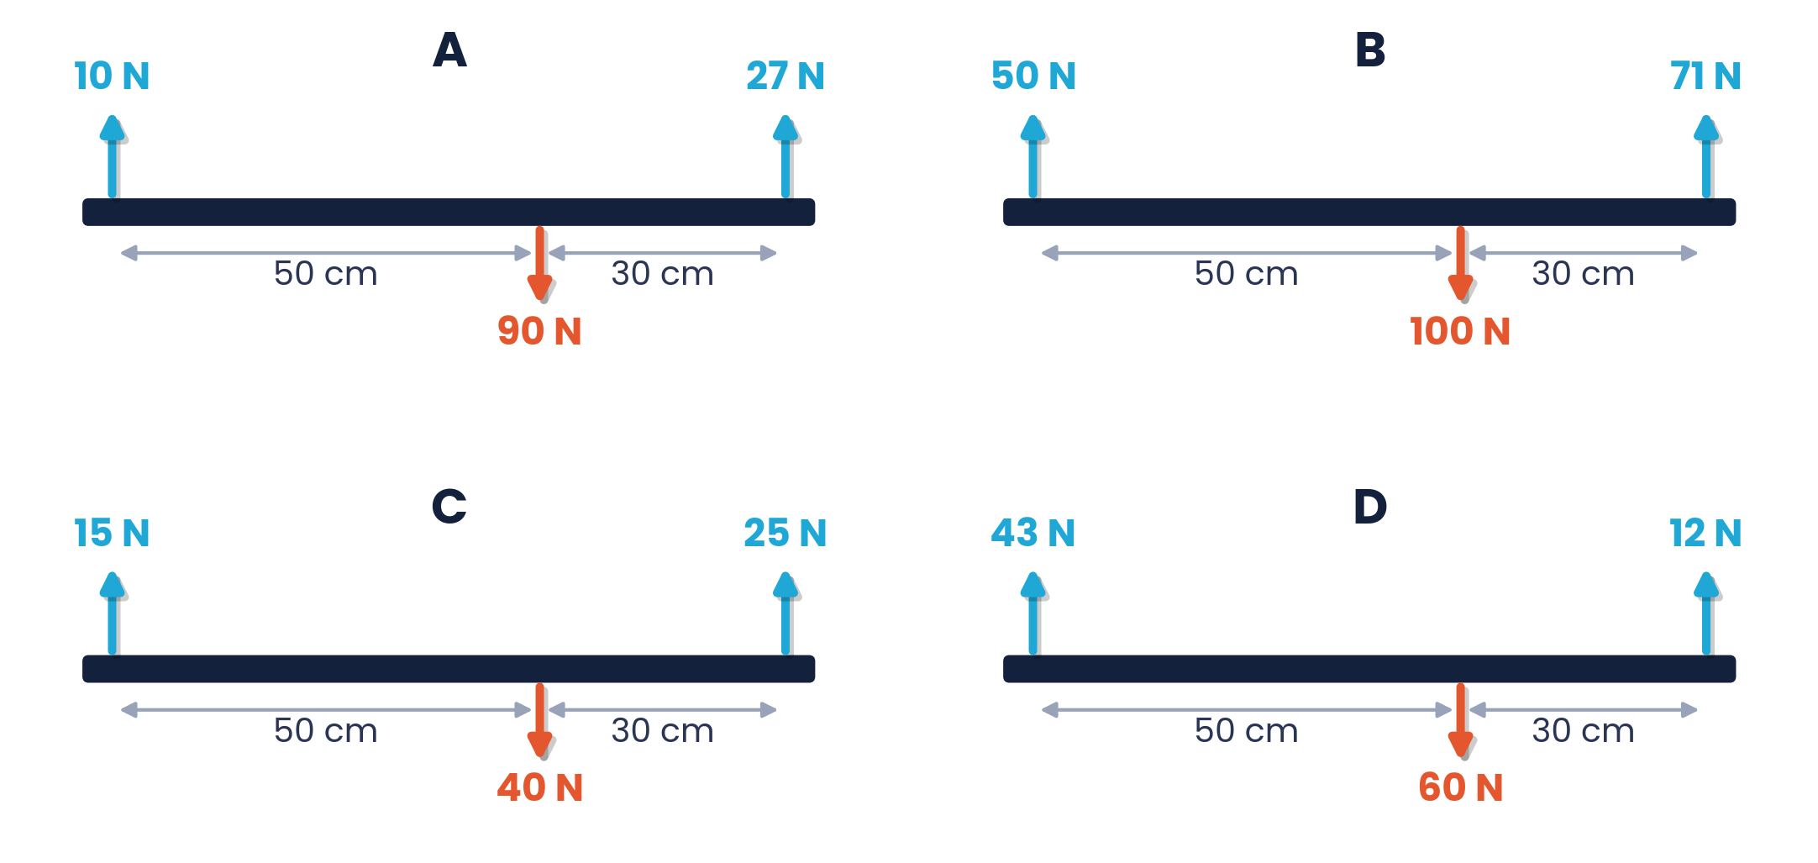
PAPER 1 STYLE · MULTIPLE CHOICE
Past paper · Zero force and zero torque
6
Four beams of the same length each have three forces acting on them. Which beam has both zero resultant force and zero resultant torque?
Choose A, B, C or D
Topic 4 · Turning effects and equilibrium | Cambridge International AS Level Physics 9702
27

Slide 28
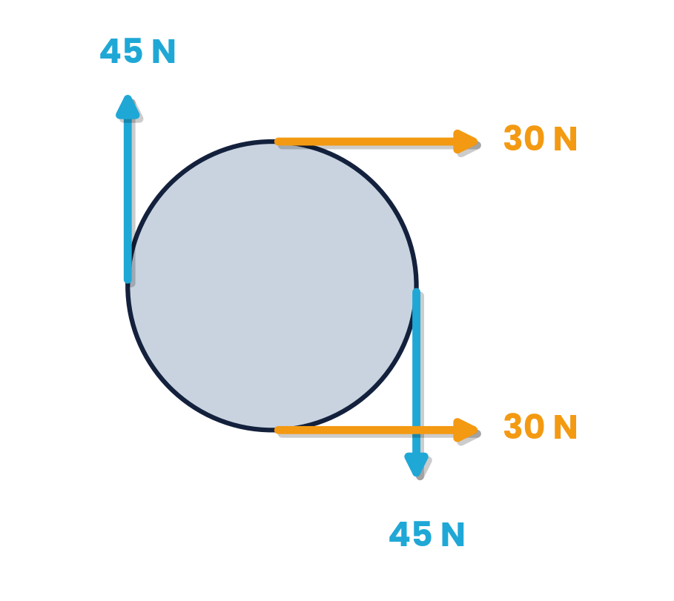
PAPER 1 STYLE · MULTIPLE CHOICE
Set B · Couples, torque, stability
7
Four forces act on the circular object shown. Which describes the resultant force and torque?
8
A couple consists of two forces of 6.0 N whose lines of action are 0.20 m apart. What is the torque of the couple?
A force non-zero, torque non-zero
B force non-zero, torque zero
C force zero, torque non-zero
D force zero, torque zero
A 0.60 N m
B 1.2 N m
C 2.4 N m
D 30 N m
9
Why are racing cars built with a wide wheelbase and a low body?
10
Which is the correct unit for the moment of a force?
A low CoG and wide base increase stability
B to reduce their weight
C to increase the engine torque
D to reduce friction with the road
A J
B N m⁻¹
C N m
D kg m s⁻²
Topic 4 · Turning effects and equilibrium | Cambridge International AS Level Physics 9702
28

Slide 29
ANSWERS AND KEY WORKING
Answers · Questions 5 – 8
5
Answer A
6
Answer C
Equal size, opposite direction, parallel and separated. B: same direction; C: different sizes; D: not parallel.
Up 15 + 25 = 40 N = down 40 N. About the 40 N force: 15 × 0.50 = 7.5 N m = 25 × 0.30 = 7.5 N m. A, B and D fail the force check.
7
Answer A
8
Answer B
The 45 N forces form a couple (torque ≠ 0); the two 30 N forces add to 60 N to the right (force ≠ 0) and their moments cancel.
Torque = one force × perpendicular separation = 6.0 × 0.20 = 1.2 N m.
Topic 4 · Turning effects and equilibrium | Cambridge International AS Level Physics 9702
29
Notes:
Q6: check the resultant force first, then take moments about one force to test torque.

Slide 30
ANSWERS AND KEY WORKING
Answers · Questions 9 – 10
9
Answer A
10
Answer C
A low centre of gravity and a wide base keep the vertical line through the CoG inside the base when tilted.
Moment = force × distance → N m. Write N m, not J, for moments and torques.
Topic 4 · Turning effects and equilibrium | Cambridge International AS Level Physics 9702
30

Slide 31
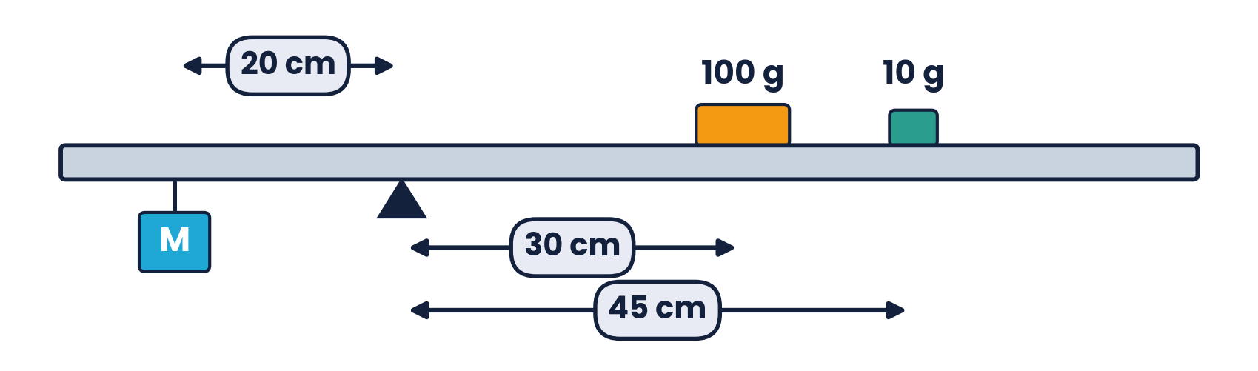
PAPER 2 STYLE · STRUCTURED QUESTION
Past paper 1 · A traditional pair of scales
A traditional pair of scales uses sliding masses of 10 g and 100 g to achieve a balance. The bar is supported with its centre of gravity at the pivot. Mass M hangs 20 cm from the pivot; the 100 g mass is 30 cm and the 10 g mass is 45 cm from the pivot on the other side.
(a) Calculate the value of the mass M attached at X.
(b) State one advantage of this method of measuring mass.
(c) Determine the upwards force of the pivot on the bar.
Topic 4 · Turning effects and equilibrium | Cambridge International AS Level Physics 9702
31

Slide 32
MARK SCHEME STYLE SOLUTION
Past paper 1 · Solution
(a)
g cancels: M × 20 = 100 × 30 + 10 × 45 = 3450 → M = 172.5 g ≈ 173 g
(b)
Weighing can be carried out with a limited selection of relatively small masses
(c)
Upward force = total weight hung = (0.1725 + 0.110) × 9.81 = 2.77 N (plus the bar's own weight)
Topic 4 · Turning effects and equilibrium | Cambridge International AS Level Physics 9702
32

Slide 33
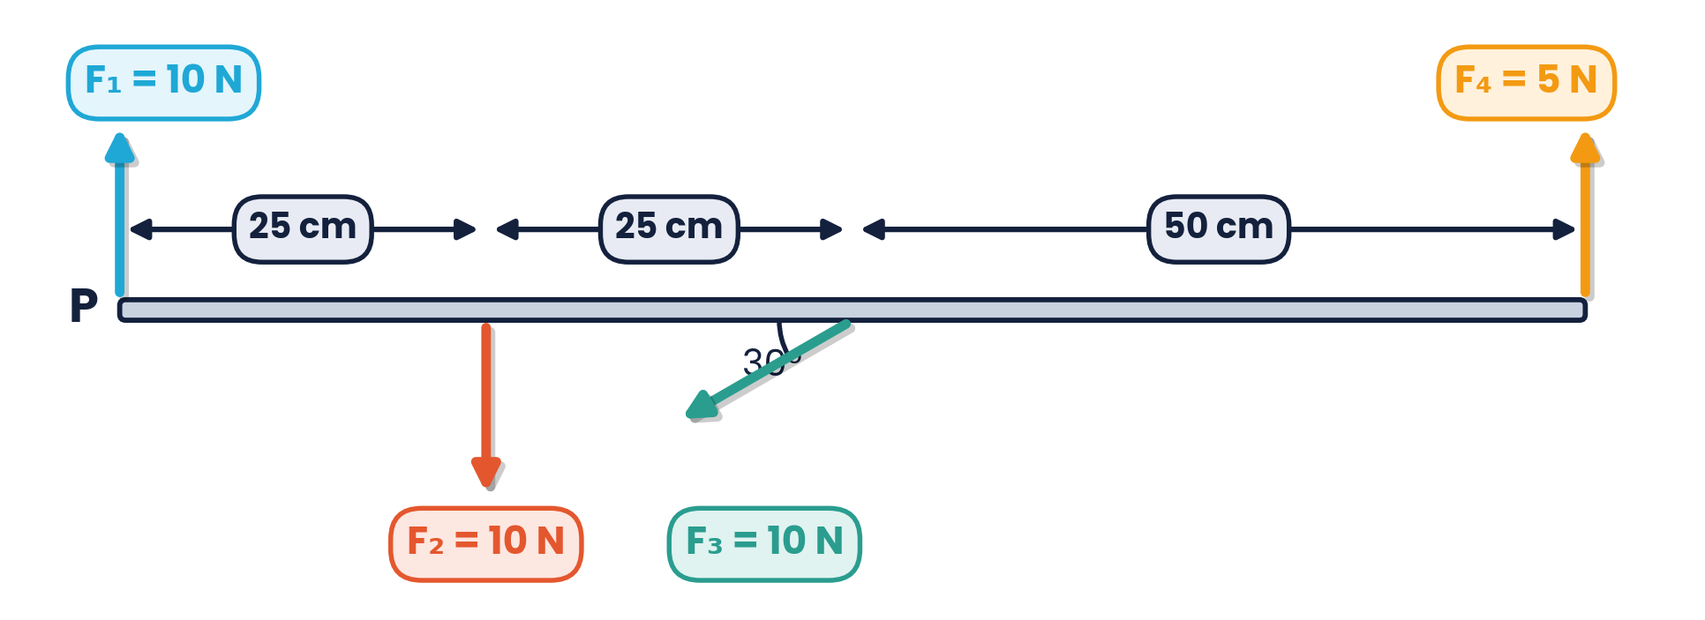
PAPER 2 STYLE · STRUCTURED QUESTION
Past paper 2 · Four forces on a beam
The figure shows a beam with four forces acting on it: F₁ = 10 N at P, F₂ = 10 N at 25 cm, F₃ = 10 N at 50 cm acting at 30° to the beam, and F₄ = 5 N at 100 cm.
(a) For each force, calculate the moment about P.
(b) State whether each moment is clockwise or anticlockwise.
(c) State whether or not the moments are balanced.
Topic 4 · Turning effects and equilibrium | Cambridge International AS Level Physics 9702
33

Slide 34
MARK SCHEME STYLE SOLUTION
Past paper 2 · Solution
(a)(b)
F₁: 0 (acts through P); F₂: 10 × 0.25 = 2.5 N m clockwise; F₃: 10 sin 30° × 0.50 = 2.5 N m clockwise; F₄: 5 × 1.0 = 5 N m anticlockwise
(c)
Sum of clockwise = 2.5 + 2.5 = 5 N m = sum of anticlockwise → yes, the moments are balanced
Topic 4 · Turning effects and equilibrium | Cambridge International AS Level Physics 9702
34

Slide 35
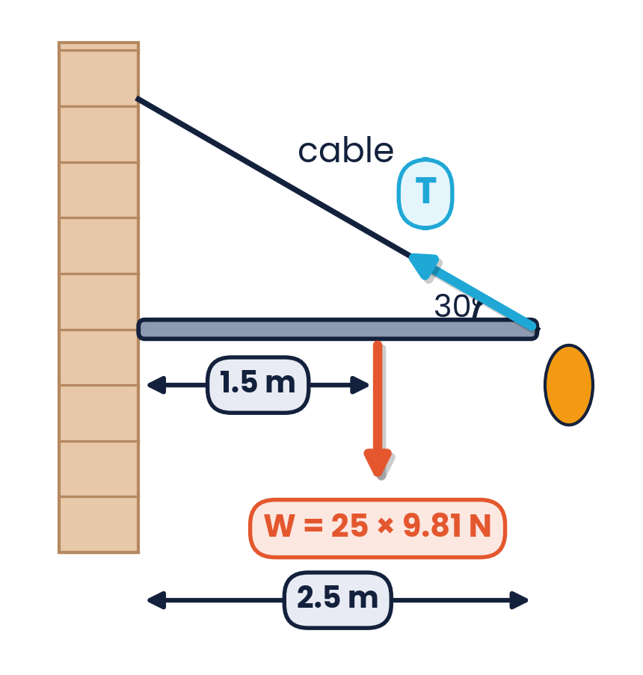
PAPER 2 STYLE · STRUCTURED QUESTION
Past paper 3 · Flagpole
(a) Explain what is meant by the centre of gravity of an object.
(b) A flagpole of mass 25 kg is held horizontal by a cable at 30° to the pole, fixed to the end 2.5 m from the wall. The centre of gravity is 1.5 m from the fixed end.
(a) Explain what is meant by centre of gravity. [1]
(b)(i) Take moments about the fixed end to find the tension T. [3]
(b)(ii) Determine the vertical component of the force at the fixed end. [2]
Topic 4 · Turning effects and equilibrium | Cambridge International AS Level Physics 9702
35

Slide 36
MARK SCHEME STYLE SOLUTION
Past paper 3 · Solution
(a)
The point where all the weight of the object may be considered to act
(b)(i)
(25 × 9.81) × 1.5 = T × x, where x = 2.5 sin 30° = 1.25 m → T = 294 N
(b)(ii)
Vertical: force at fixed end + T sin 30° = weight → 245 − 147 = 98 N
Topic 4 · Turning effects and equilibrium | Cambridge International AS Level Physics 9702
36

Slide 37
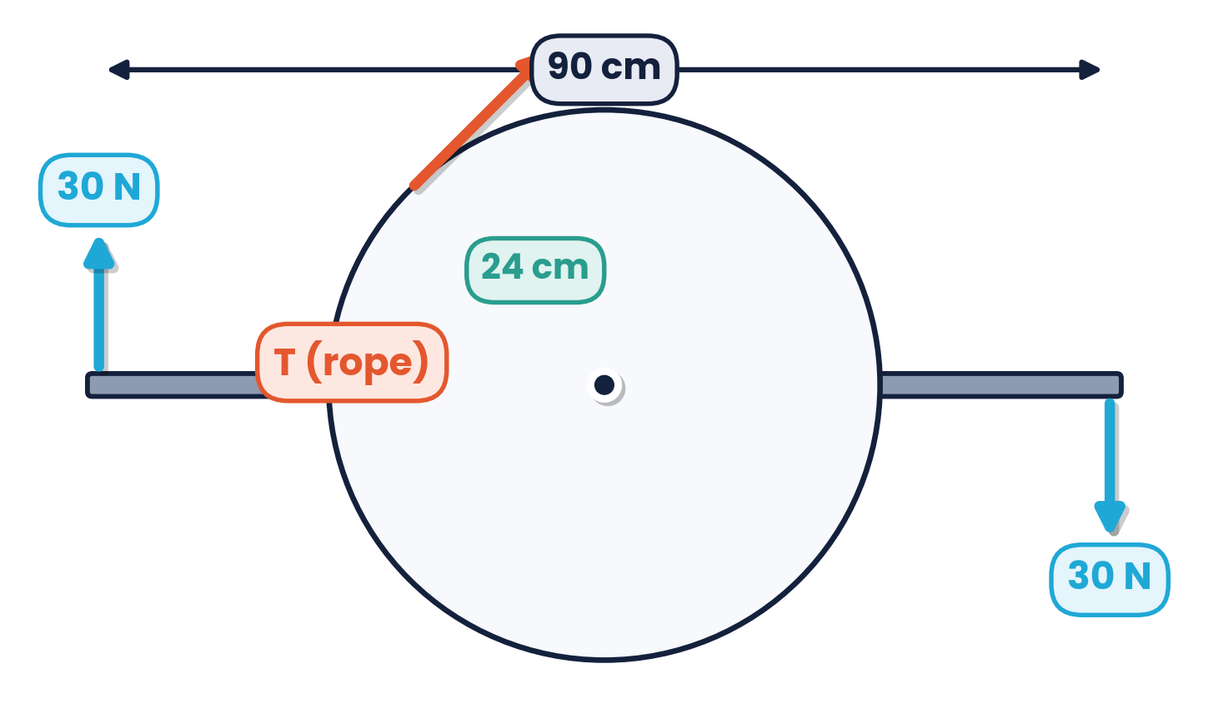
PAPER 2 STYLE · STRUCTURED QUESTION
Past paper 4 · Disc and rope
A 90 cm rod has a disc of radius 24 cm fixed at its centre and is pivoted there. Two 30 N forces act normal to the rod at each end. A rope on the edge of the disc prevents rotation.
(a) State the two conditions for equilibrium. [2]
(b)(i) Calculate the torque of the couple produced by the 30 N forces. [1]
(b)(ii) Calculate the tension T in the rope. [2]
Topic 4 · Turning effects and equilibrium | Cambridge International AS Level Physics 9702
37

Slide 38
MARK SCHEME STYLE SOLUTION
Past paper 4 · Solution
(a)
No resultant force (in any direction) and no resultant moment (torque) about any point
(b)(i)
Torque = 30 × 90 = 2700 N cm (= 27 N m)
(b)(ii)
Moment of T about the centre = T × 24; 24T = 2700 → T = 113 ≈ 110 N
Topic 4 · Turning effects and equilibrium | Cambridge International AS Level Physics 9702
38

Slide 39
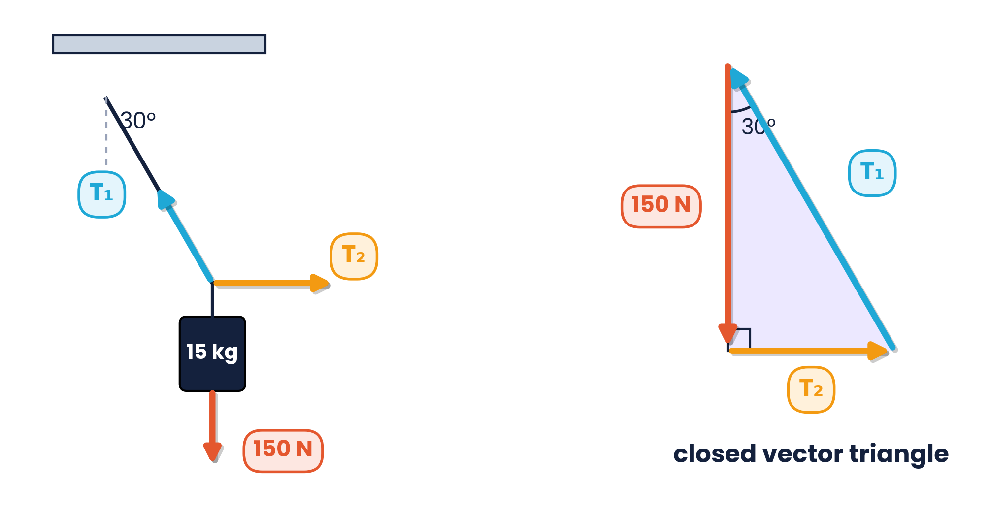
PAPER 2 STYLE · STRUCTURED QUESTION
Past paper 5 · Mass on two strings
A 15 kg mass (weight 150 N) hangs in equilibrium from a string at 30° to the vertical (tension T₁) and a horizontal string (tension T₂).
(a) Draw a vector triangle to represent the three forces.
(b) Calculate T₁.
(c) Calculate T₂.
(d) Explain why T₁ is always greater than the weight here.
Topic 4 · Turning effects and equilibrium | Cambridge International AS Level Physics 9702
39

Slide 40
MARK SCHEME STYLE SOLUTION
Past paper 5 · Solution
(a)
Closed triangle: 150 N vertically down, T₂ horizontal, T₁ back to the start at 30° to the vertical
(b)
T₁ cos 30° = 150 → T₁ = 173 N
(c)
T₂ = 150 tan 30° = 87 N
(d)
Only the vertical component of T₁ supports the weight, so T₁ must be larger than 150 N
Topic 4 · Turning effects and equilibrium | Cambridge International AS Level Physics 9702
40

Slide 41
COMMON DOUBTS & MISCONCEPTIONS
Students often ask… (1)
?
“Is moment just force × distance?”
?
“Is the centre of gravity always inside the object?”
Force × PERPENDICULAR distance from the pivot to the line of action. For an angled force use the ⊥ component or ⊥ distance.
No. For a ring, an L-shape or a boomerang it lies outside the material.
?
“Where does the weight of a uniform beam act?”
?
“Can I take moments about any point?”
At its midpoint. Include it as a force at the centre of the beam in every moments equation.
Yes, for a body in equilibrium. Choose the point where an unknown force acts to remove it from the equation.
Topic 4 · Turning effects and equilibrium | Cambridge International AS Level Physics 9702
41

Slide 42
COMMON DOUBTS & MISCONCEPTIONS
Students often ask… (2)
?
“Is a couple in equilibrium?”
?
“Is torque the same as a moment?”
No. The resultant force is zero but the resultant torque is not — the body rotates.
Torque is the turning effect of a couple; a moment is the turning effect of one force. Both are in N m.
?
“Is the unit N m the same as the joule?”
?
“Do the forces in a vector triangle have to be drawn in order?”
Dimensionally yes, but always write N m for moments and torque. The joule is used for energy.
Draw them head-to-tail in any order; for equilibrium the last arrow must end where the first began.
Topic 4 · Turning effects and equilibrium | Cambridge International AS Level Physics 9702
42

Slide 43
COMMAND WORDS AND MARK-SCHEME HABITS
Exam technique for moments and equilibrium
Define moment
Principle of moments
‘force × perpendicular distance from the pivot to the line of action of the force’
say ‘for a body in equilibrium’ and ‘about the same point’
Torque of a couple
Equilibrium
‘one of the forces × perpendicular distance between the lines of action’
state BOTH conditions: no resultant force and no resultant torque
Beams
Vector triangles
mark the weight at the centre of a uniform beam; convert cm to m
draw to scale, label forces with arrows, and show the triangle is closed
Topic 4 · Turning effects and equilibrium | Cambridge International AS Level Physics 9702
43

Slide 44
KEY IDEAS TO TAKE AWAY
Turning effects in one slide
moment = F × d⊥
Σ cw = Σ acw
torque = F × d
ΣF = 0, Στ = 0
Gravity
weight acts at the centre of gravity · stable while the CoG is above the base
Couples
equal, opposite, parallel forces · rotation only · torque independent of pivot
Triangles
three coplanar forces in equilibrium form a closed vector triangle
Topic 4 · Turning effects and equilibrium | Cambridge International AS Level Physics 9702
44

