Slide 1
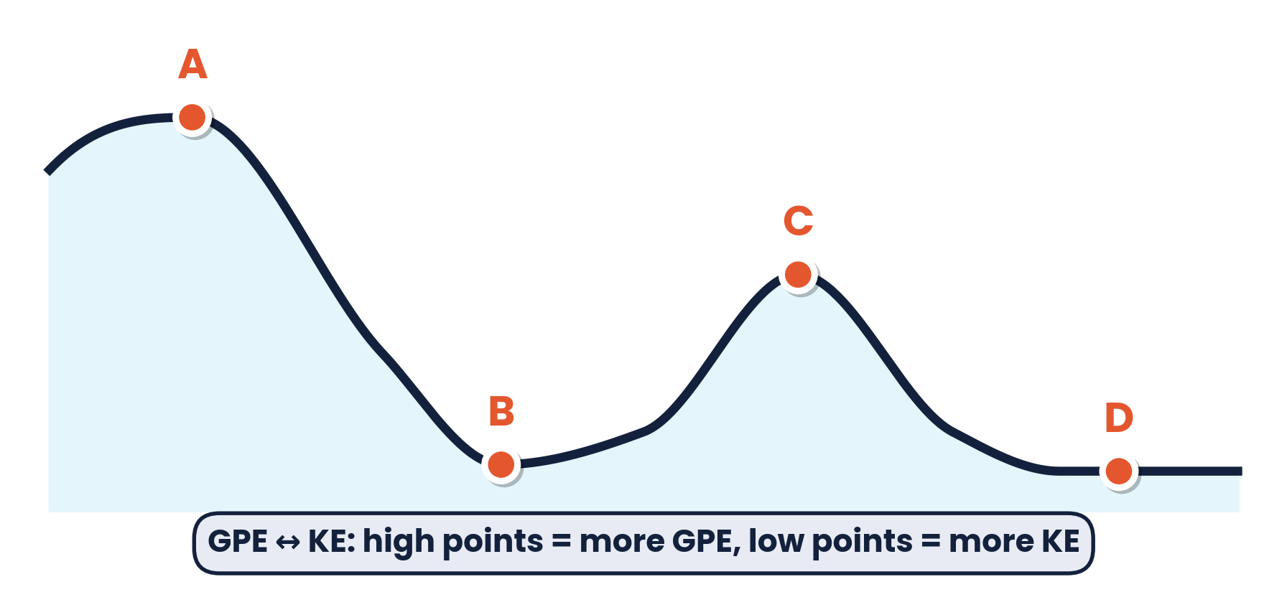
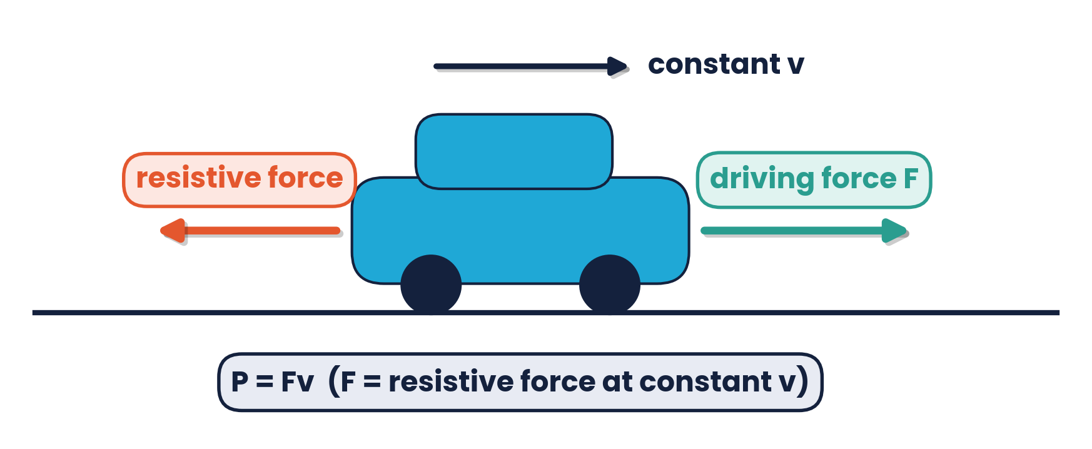
CAMBRIDGE AS & A LEVEL · PHYSICS 9702 · TOPIC 5
Work, Energy
& Power
Work done · conservation of energy · GPE & KE · efficiency · P = Fv
Syllabus 5.1 – 5.2 | Exams 2025 – 2027
WA
Waseem Ahmad
Head of Science & IB Physics Lead Teacher
Presidential School, Jizzakh · Cambridge Examiner
Author, Orange Publication · www.examspath.com

Slide 2
SYLLABUS 5.1 – 5.2 · WORK, ENERGY AND POWER
What the syllabus asks you to do
1
LO 5.1.1
2
LO 5.1.2
3
LO 5.1.3
4
LO 5.1.4
Work done = force × displacement in the direction of the force
Recall and apply the principle of conservation of energy
Efficiency = useful energy output / total energy input
Use efficiency to solve problems
5
LO 5.1.5
6
LO 5.1.6
7
LO 5.1.7
8
LO 5.2.1
Define power as work done per unit time
Solve problems using P = W / t
Derive P = Fv and use it
Derive ΔEp = mgΔh from W = Fs
9
10
11
Forms of energy from IGCSE / O Level are assumed.
LO 5.2.2
LO 5.2.3
LO 5.2.4
Recall and use ΔEp = mgΔh
Derive Ek = ½mv² using the equations of motion
Recall and use Ek = ½mv²
Topic 5 · Work, energy and power | Cambridge International AS Level Physics 9702
2

Slide 3
TOPIC 5 · WORK, ENERGY AND POWER
Lesson roadmap
01
02
03
04
Work done
Conservation of energy
Gravitational PE
Kinetic energy
W = Fs cos θ
Stores and transfers
ΔEp = mgΔh
Ek = ½mv²
05
06
07
08
Efficiency
Power
P = Fv
Practice & doubts
Useful ÷ total
P = W / t
Constant velocity
Past papers, misconceptions
Topic 5 · Work, energy and power | Cambridge International AS Level Physics 9702
3

Slide 4
LEARNING OUTCOME 5.1.1
01
Work done
Force × displacement in the direction of the force
Topic 5 · Work, energy and power | Cambridge International AS Level Physics 9702
4

Slide 5
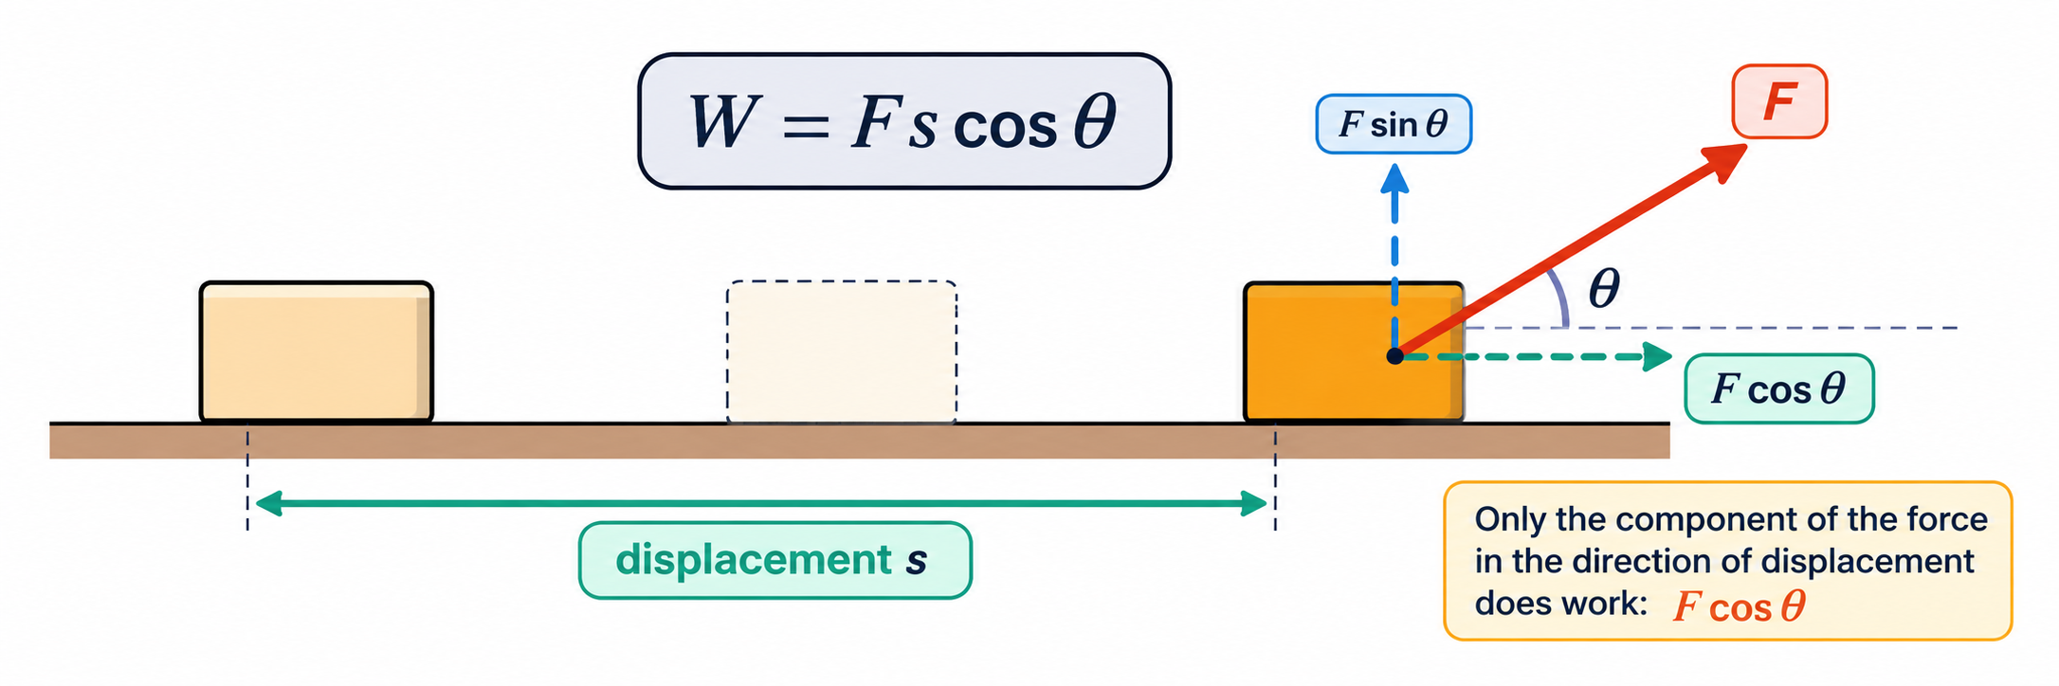
5.1.1 · W = FS
Work done
W = F s
Work is done when a force moves its point of application
Work done = energy transferred; 1 J = 1 N m
Force along the motion → object gains energy; opposite → loses energy
work (J) = force (N) × displacement in the direction of the force (m)
Force at an angle
only the component along the displacement does work: W = F s cos θ.
A rope pulls a box 5.0 m with 200 N at 30°: W = 200 cos 30° × 5.0 = 870 J
Topic 5 · Work, energy and power | Cambridge International AS Level Physics 9702
5

Slide 6
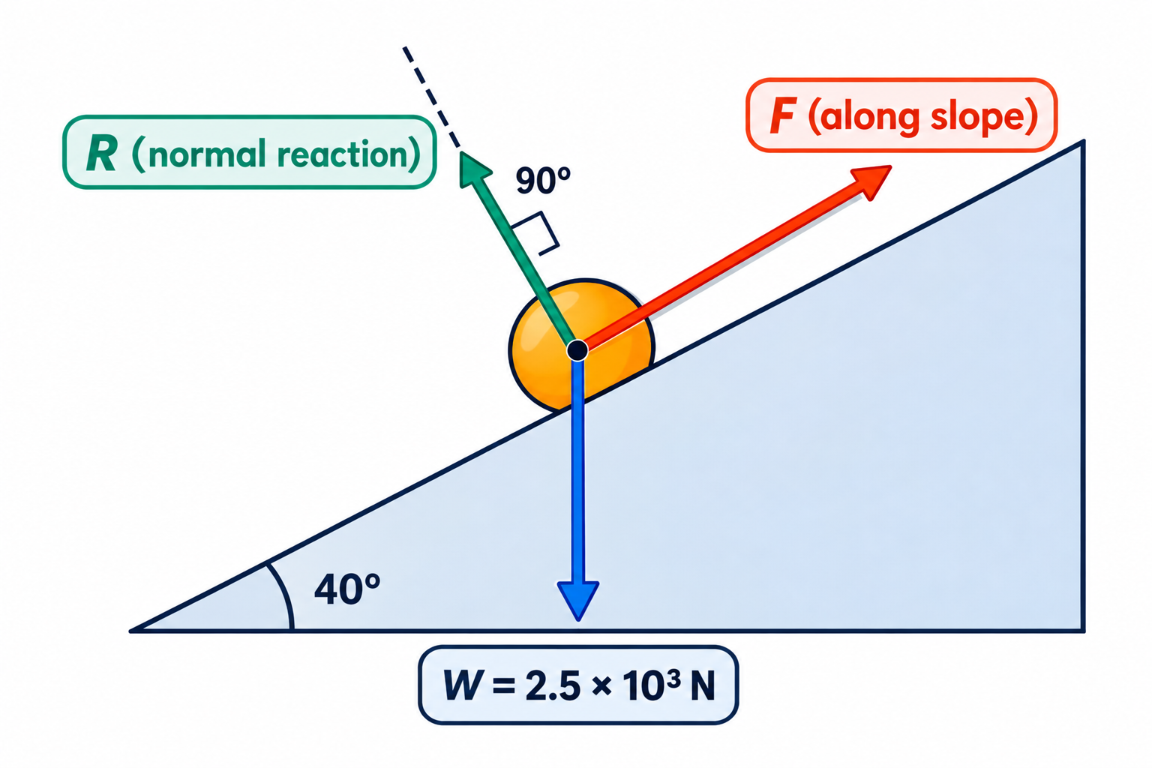
5.1.1 · CHOOSE THE FORCE PARALLEL TO THE MOTION
Worked example · Barrel up a slope
A barrel of weight 2.5 × 10³ N is pushed at constant speed 8.0 m up a frictionless slope at 40° to the horizontal, by a force parallel to the slope. What is the work done?
1
Constant speed → F balances the weight component down the slope
2
F = 2.5 × 10³ × sin 40° = 1.6 × 10³ N
3
W = F s = 1.6 × 10³ × 8.0
Exam tip: the force doing the work must be parallel to the displacement — the weight itself is not.
4
W = 1.3 × 10⁴ J (= mgΔh with Δh = 8.0 sin 40°)
Topic 5 · Work, energy and power | Cambridge International AS Level Physics 9702
6

Slide 7
LEARNING OUTCOME 5.1.2
02
Conservation of energy
Energy cannot be created or destroyed
Topic 5 · Work, energy and power | Cambridge International AS Level Physics 9702
7

Slide 8
5.1.2 · RECALL AND APPLY
The principle of conservation of energy
Energy cannot be created or destroyed; it can only be transferred from one form to another. The total energy of an isolated system is constant.
Falling object (vacuum)
Battery and lamp
Mass on a spring
Car braking
gravitational PE → kinetic energy
chemical → electrical → light (+ thermal)
elastic PE ↔ kinetic energy
kinetic → thermal (brakes) + sound
Energy dissipation:
energy that is not transferred to a useful store spreads into the surroundings, usually as thermal energy, sound or light. It is still conserved, but no longer useful.
Topic 5 · Work, energy and power | Cambridge International AS Level Physics 9702
8

Slide 9
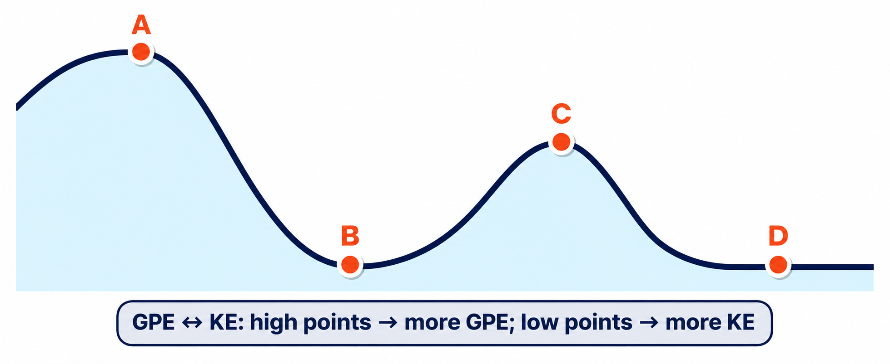
5.1.2 · GPE ↔ KE
Energy transfers on a roller-coaster
raised high: maximum GPE; GPE → KE as it descends
A
low point: KE is greatest; KE → GPE as it climbs the loop
B
top of the loop: GPE rises again; then GPE → KE
C
Sequence of energy changes A → B → C → D: GPE → KE → GPE → KE
flat track: only KE (friction dissipates some)
D
Topic 5 · Work, energy and power | Cambridge International AS Level Physics 9702
9

Slide 10
LEARNING OUTCOMES 5.2.1 – 5.2.2
03
Gravitational potential energy
ΔEp = mgΔh
Topic 5 · Work, energy and power | Cambridge International AS Level Physics 9702
10

Slide 11
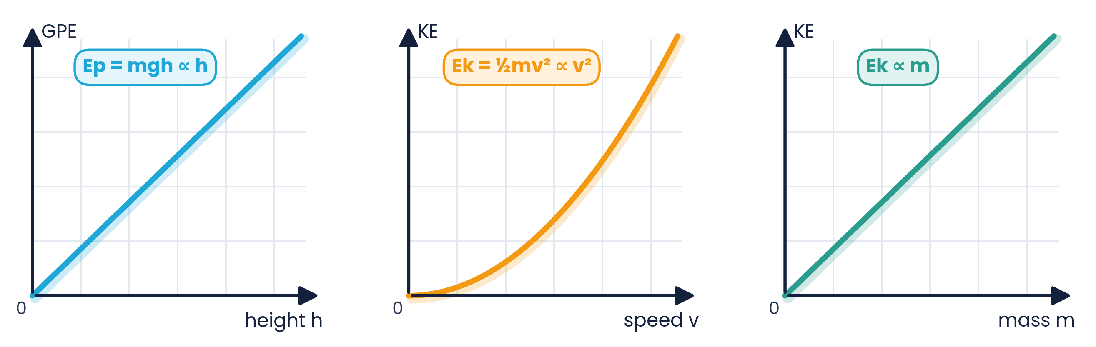
5.2.1 & 5.2.2 · DERIVE AND USE ΔEP = MGΔH
Gravitational potential energy
ΔEp = mgΔh
Derivation
To lift a mass at constant speed, the upward force = weight = mg. Work done W = Fs = mg × Δh, and this work is stored as gravitational potential energy: ΔEp = mgΔh.
valid in a uniform gravitational field (near Earth's surface)
Worked example
A 74 kg man climbs five flights of stairs, each 3.7 m high.
ΔEp = 74 × 9.81 × (5 × 3.7) = 1.3 × 10⁴ J
Topic 5 · Work, energy and power | Cambridge International AS Level Physics 9702
11

Slide 12
LEARNING OUTCOMES 5.2.3 – 5.2.4
04
Kinetic energy
Ek = ½mv²
Topic 5 · Work, energy and power | Cambridge International AS Level Physics 9702
12

Slide 13
5.2.3 · FROM W = FS AND V² = U² + 2AS
Deriving kinetic energy
1
A resultant force F accelerates mass m from rest over a distance s
Ek = ½mv²
2
Equation of motion: v² = 0 + 2as → s = v² / 2a
kinetic energy (J), mass (kg), speed (m s⁻¹)
3
Work done: W = F s = (ma) × (v² / 2a)
Ek ∝ v²: double the speed → four times the KE
Ek ∝ m
KE is a scalar — no direction
4
W = ½mv², and this is stored as kinetic energy: Ek = ½mv²
The work done by the resultant force equals the change in kinetic energy.
Topic 5 · Work, energy and power | Cambridge International AS Level Physics 9702
13

Slide 14
5.2.4 · RECALL AND USE EK = ½MV²
Worked examples · Kinetic energy
Speed increased
Pendulum
A body at 12 m s⁻¹ has 1650 J of KE. Its speed rises to 45 m s⁻¹.
A 5.0 kg bob is released 0.15 m above its lowest point.
Ek ∝ v²: 1650 × (45 / 12)² = 2.3 × 10⁴ J
½mv² = mgh → v = √(2 × 9.81 × 0.15) = 1.7 m s⁻¹ (mass cancels)
High diver
Descending aircraft
She reaches her highest point 10 m above the water.
80 000 kg aircraft drops from 10 000 m to 1000 m at constant speed.
v = √(2gh) = √(2 × 9.81 × 10) = 14 m s⁻¹ at the water
ΔEp = 80 000 × 9.81 × 9000 = 7.1 × 10⁹ J — dissipated by air resistance
Topic 5 · Work, energy and power | Cambridge International AS Level Physics 9702
14

Slide 15
LEARNING OUTCOMES 5.1.3 – 5.1.4
05
Efficiency
How much of the input is useful?
Topic 5 · Work, energy and power | Cambridge International AS Level Physics 9702
15

Slide 16
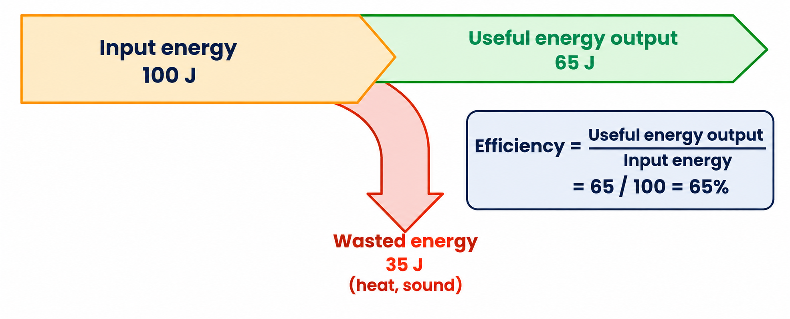
5.1.3 & 5.1.4 · USEFUL OUTPUT ÷ TOTAL INPUT
Efficiency
η = useful output / total input
η = P(useful) / P(total)
useful energy output ÷ total energy input; × 100% for a percentage
the same ratio using power (energy per second)
High efficiency: most energy is transferred usefully
Low efficiency: most energy is wasted (dissipated)
Wasted energy usually ends up as thermal energy of the surroundings
Topic 5 · Work, energy and power | Cambridge International AS Level Physics 9702
16

Slide 17
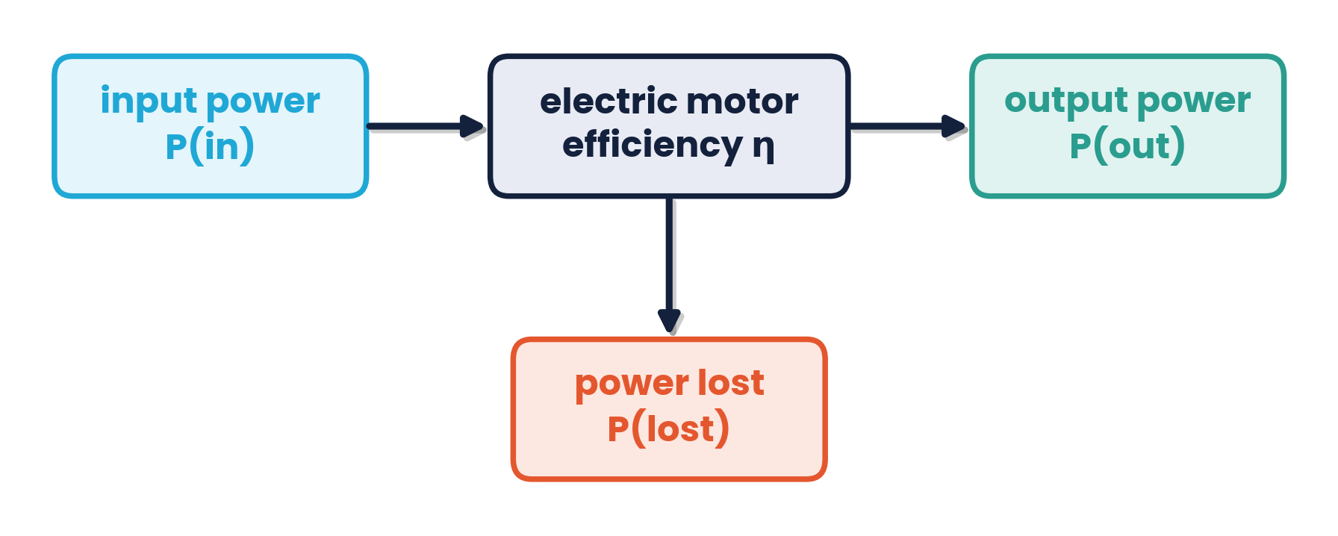
5.1.4 · REARRANGING EFFICIENCY EQUATIONS
Worked example · Motor efficiency
An electric motor has input power P(in), useful output power P(out), power lost P(lost) and efficiency η. Find P(out) in terms of η and P(lost).
1
η = P(out) / P(in), and P(in) = P(out) + P(lost)
2
η (P(out) + P(lost)) = P(out)
3
ηP(lost) = P(out)(1 − η)
4
P(out) = ηP(lost) / (1 − η) = −ηP(lost) / (η − 1)
Topic 5 · Work, energy and power | Cambridge International AS Level Physics 9702
17

Slide 18
LEARNING OUTCOMES 5.1.5 – 5.1.6
06
Power
The rate of doing work
Topic 5 · Work, energy and power | Cambridge International AS Level Physics 9702
18

Slide 19
5.1.5 & 5.1.6 · P = W / T
Power
P = W / t
Definition:
power is the work done (energy transferred) per unit time. It is a scalar. Kilowatts (kW) and megawatts (MW) are common.
1 W = 1 J s⁻¹ (watt)
50 kW engine
Car engine
Car pushed 1.0 km
Laser pulse
works for 1.0 min
does 4200 kJ of work in 1 min
by 500 N in 200 s
0.20 J in 10 ns
W = Pt = 50 000 × 60 = 3.0 MJ
P = 4.2 × 10⁶ / 60 = 70 kW
P = (500 × 1000) / 200 = 2.5 kW
P = 0.20 / 10 × 10⁻⁹ = 20 MW
Topic 5 · Work, energy and power | Cambridge International AS Level Physics 9702
19

Slide 20
LEARNING OUTCOME 5.1.7
07
Power and velocity
P = Fv
Topic 5 · Work, energy and power | Cambridge International AS Level Physics 9702
20

Slide 21
5.1.7 · DERIVE AND USE
Deriving P = Fv
1
Power = work done / time: P = W / t
P = Fv
2
Work done = force × distance: W = F s
F is the force in the direction of v
3
P = F s / t
4
At constant velocity s / t = v, so P = Fv
At constant velocity the driving force = total resistive force.
Topic 5 · Work, energy and power | Cambridge International AS Level Physics 9702
21

Slide 22
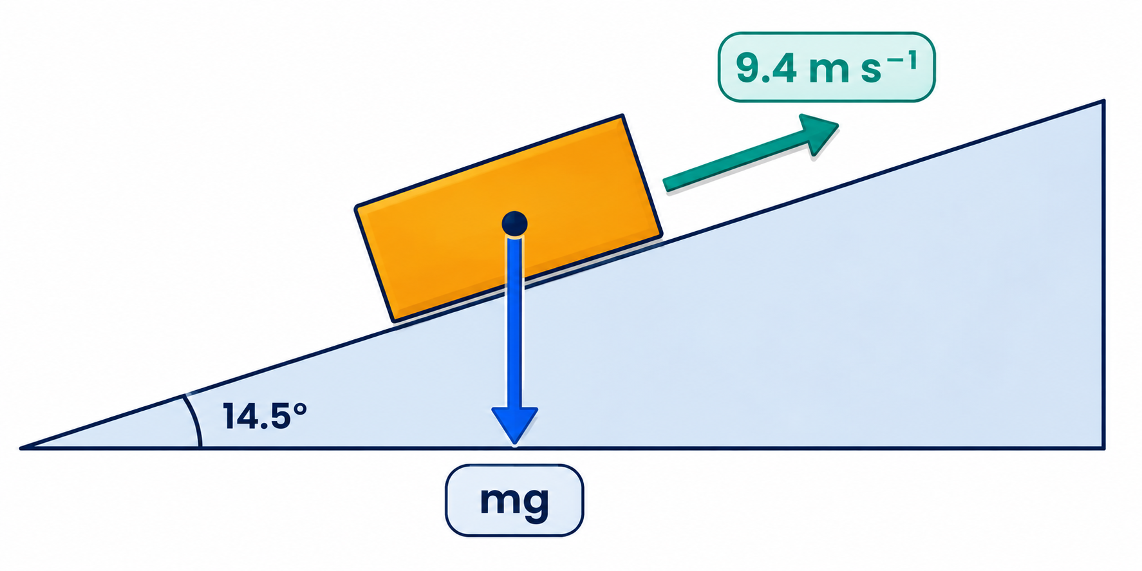
5.1.7 · ENGINES, LORRIES AND RESISTIVE FORCES
Worked examples · P = Fv
Lorry on a hill
A 3500 kg lorry moves at a constant 9.4 m s⁻¹ up a road inclined at 14.5°. Air resistance is negligible.
F = mg sin 14.5° = 3500 × 9.81 × 0.250 = 8.6 × 10³ N
P = Fv = 8.6 × 10³ × 9.4 = 8.1 × 10⁴ W (81 kW)
Car at top speed
700 N at 40 m s⁻¹: work in each second = 700 × 40 = 28 kJ, so the output power = 28 kW.
Drag ∝ v²
800 N at 20 m s⁻¹ → at 40 m s⁻¹ drag = 800 × 4 = 3200 N; P = 3200 × 40 = 128 kW (power ∝ v³).
Topic 5 · Work, energy and power | Cambridge International AS Level Physics 9702
22

Slide 23
CAMBRIDGE PAST PAPER QUESTIONS
08
Past paper practice
Paper 1 multiple choice · Paper 2 structured questions
Topic 5 · Work, energy and power | Cambridge International AS Level Physics 9702
23

Slide 24
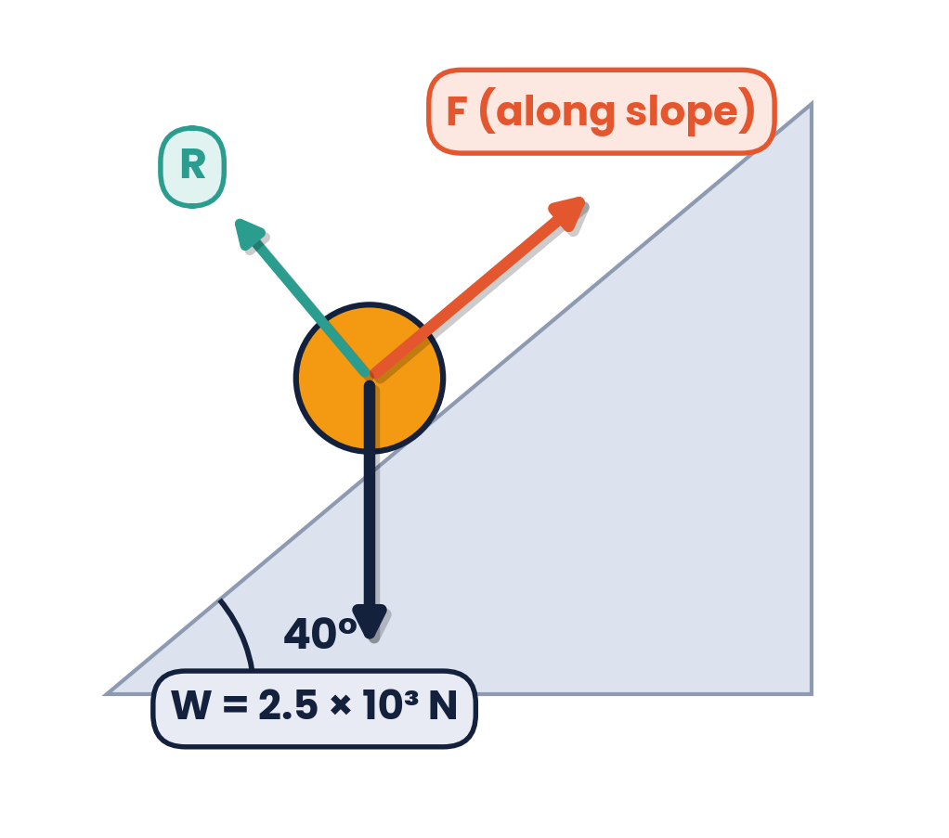
PAPER 1 STYLE · MULTIPLE CHOICE
Past paper set A · Energy and work
1
Which is a statement of the principle of conservation of energy?
2
Which expression defines power?
A force × distance moved in the direction of the force
B force × velocity
C work done × time taken
D work done ÷ time taken
A energy is the product of force and distance
B energy cannot be created, destroyed or transformed
C the total energy of an isolated system is constant
D power transmitted is proportional to the rate of energy transfer
3
A roller-coaster travels A → B → C → D (high, low, loop top, flat). Which describes the energy changes?
4
A barrel of weight 2.5 × 10³ N is pushed at constant speed 8.0 m up a frictionless 40° slope by a force parallel to the slope. What is the work done?
A KE → GPE → GPE → KE
B KE → GPE → KE → GPE
C GPE → KE → KE → GPE
D GPE → KE → GPE → KE
A 7.2 × 10³ J
B 2.0 × 10⁴ J
C 1.3 × 10⁴ J
D 9.6 × 10³ J
Topic 5 · Work, energy and power | Cambridge International AS Level Physics 9702
24

Slide 25
ANSWERS AND KEY WORKING
Answers · Questions 1 – 4
1
Answer C
2
Answer D
Energy can be transformed, so B is wrong. The total energy of an isolated system stays constant.
Power = work done per unit time. B (Fv) is a result derived from the definition, not the definition.
3
Answer D
4
Answer C
A: high GPE → B: KE → C: GPE again → D: flat, KE.
F = 2.5 × 10³ sin 40° = 1.6 × 10³ N; W = 1.6 × 10³ × 8.0 = 1.3 × 10⁴ J.
Topic 5 · Work, energy and power | Cambridge International AS Level Physics 9702
25

Slide 26
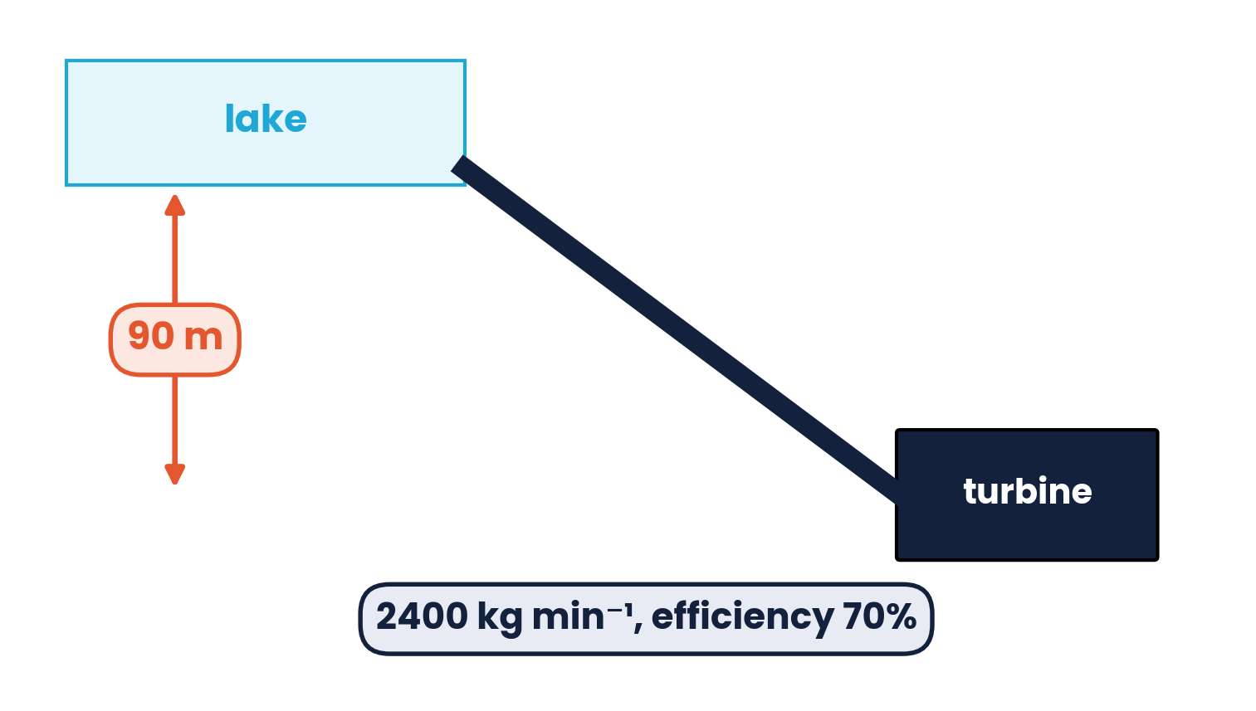
PAPER 1 STYLE · MULTIPLE CHOICE
Past paper set B · Power
5
Which operation involves the greatest mean power?
6
Water falls through 90 m to a turbine at a mass flow rate of 2400 kg min⁻¹. The turbine is 70% efficient. What is its output power?
A car against 0.4 kN resistance at 20 m s⁻¹
B crane lifting 3 kN at 2 m s⁻¹
C crane lifting 5 kN at 1 m s⁻¹
D weight pulled at 6 m s⁻¹ against 1.5 kN friction
A 25 kW
B 35 kW
C 1.5 MW
D 2.1 MW
7
The force resisting a car is proportional to the square of its speed; it is 800 N at 20 m s⁻¹. What power is needed to keep a steady 40 m s⁻¹?
8
Sand drops vertically at a rate m kg s⁻¹ onto a conveyor belt moving at constant speed v. What additional power is needed to keep the belt at speed v?
A 32 kW
B 64 kW
C 128 kW
D 512 kW
A ½mv
B mv
C ½mv²
D mv²
Topic 5 · Work, energy and power | Cambridge International AS Level Physics 9702
26

Slide 27
ANSWERS AND KEY WORKING
Answers · Questions 5 – 8
5
Answer D
6
Answer A
P = Fv: A 8 kW, B 6 kW, C 5 kW, D 1.5 × 10³ × 6 = 9 kW.
Input = (2400/60) × 9.81 × 90 = 35 kW (B); output = 0.70 × 35 = 25 kW.
7
Answer C
8
Answer D
F ∝ v²: 800 × 4 = 3200 N; P = Fv = 3200 × 40 = 128 kW.
Force = rate of change of momentum = mv; P = Fv = mv². Half of this becomes KE; half is dissipated.
Topic 5 · Work, energy and power | Cambridge International AS Level Physics 9702
27

Slide 28
PAPER 1 STYLE · MULTIPLE CHOICE
Past paper set C · Energy problems
9
What is the average power output of a laser that delivers 0.20 J of energy in 10 ns?
10
Which row is NOT correct (example → detail)?
A 2 mW
B 20 mW
C 200 kW
D 20 MW
A girl dives: she does work against gravity as she falls
B man pushes car: he does work against friction
C electron → + plate: field does work on it
D gas expands: gas does work on the atmosphere
11
Bungee jumper: 24 kJ GPE at the top, all EPE at the bottom; the rope stretches after a short free fall. Half-way down (GPE, EPE, KE / kJ)?
12
A pump lifts water in a hydraulic ram: 760 kg of water moving at 3.5 m s⁻¹ stops, and 20% of its KE lifts a small mass of water through 12 m. What mass is lifted?
A 12, 10, 2
B 12, 8, 4
C 8, 8, 8
D 12, 2, 10
A 6.2 kg
B 4.4 kg
C 7.9 kg
D 0.24 kg
Topic 5 · Work, energy and power | Cambridge International AS Level Physics 9702
28

Slide 29
ANSWERS AND KEY WORKING
Answers · Questions 9 – 12
9
Answer D
10
Answer A
P = E/t = 0.20 / 10 × 10⁻⁹ = 2.0 × 10⁷ W = 20 MW.
As she falls, gravity does work ON the girl; she does no work against gravity.
11
Answer D
12
Answer C
Half-way: GPE = 12 kJ, so EPE + KE = 12 kJ. The rope has only just begun to stretch, so EPE is small (EPE ∝ x²) and KE is large.
KE = ½ × 760 × 3.5² = 4655 J; useful = 931 J; m = 931 / (9.81 × 12) = 7.9 kg.
Topic 5 · Work, energy and power | Cambridge International AS Level Physics 9702
29

Slide 30
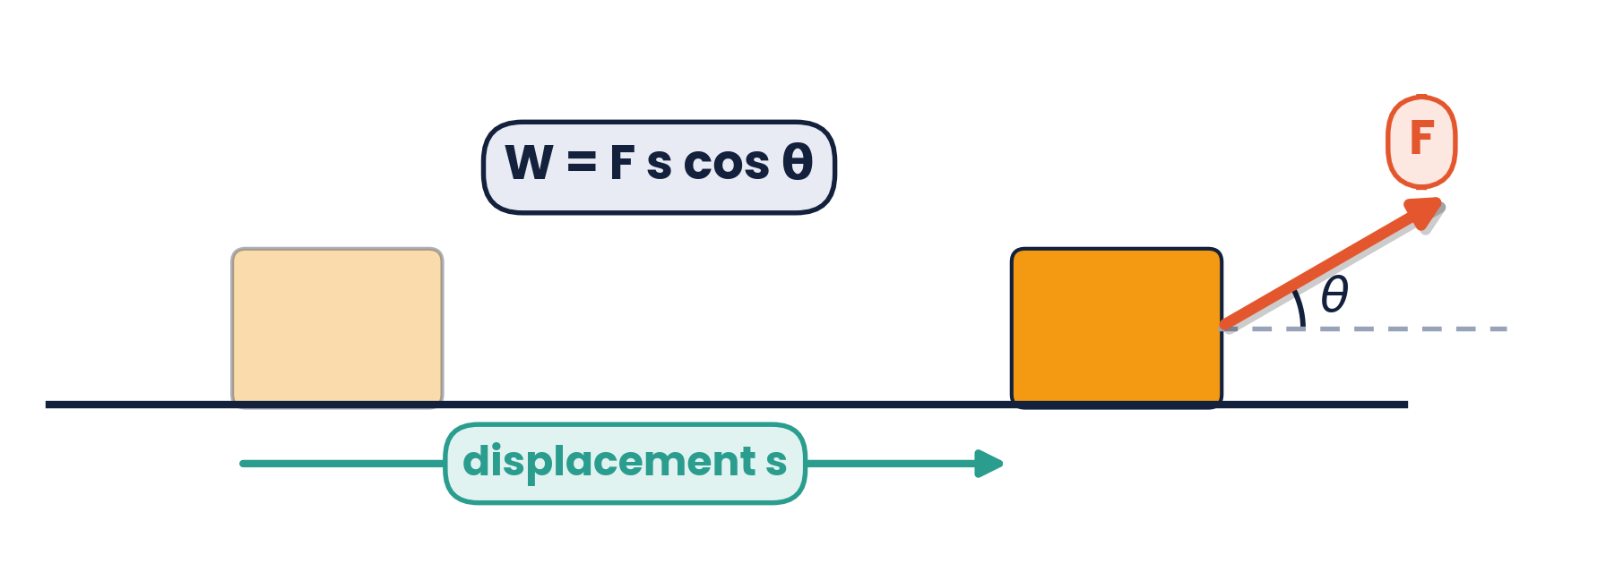
PAPER 2 STYLE · STRUCTURED QUESTION
Book questions · Work done and GPE
(a) A man pulls a box 5.0 m along horizontal ground with a rope at 30° to the horizontal; the tension is 200 N. (b) You climb a flight of stairs 2.5 m high; your mass is 52 kg. (c) A 106 kg climber (with equipment) ascends from sea level to the top of a 5500 m mountain.
(a) Calculate the work done on the box.
(b) Calculate the GPE you gain.
(c) Calculate the climber's change in GPE.
Topic 5 · Work, energy and power | Cambridge International AS Level Physics 9702
30

Slide 31
MARK SCHEME STYLE SOLUTION
Book questions · Solution
(a)
W = F s cos θ = 200 × cos 30° × 5.0 = 870 J
(b)
ΔEp = mgΔh = 52 × 9.81 × 2.5 = 1.3 × 10³ J
(c)
ΔEp = 106 × 9.81 × 5500 = 5.7 × 10⁶ J
Topic 5 · Work, energy and power | Cambridge International AS Level Physics 9702
31

Slide 32
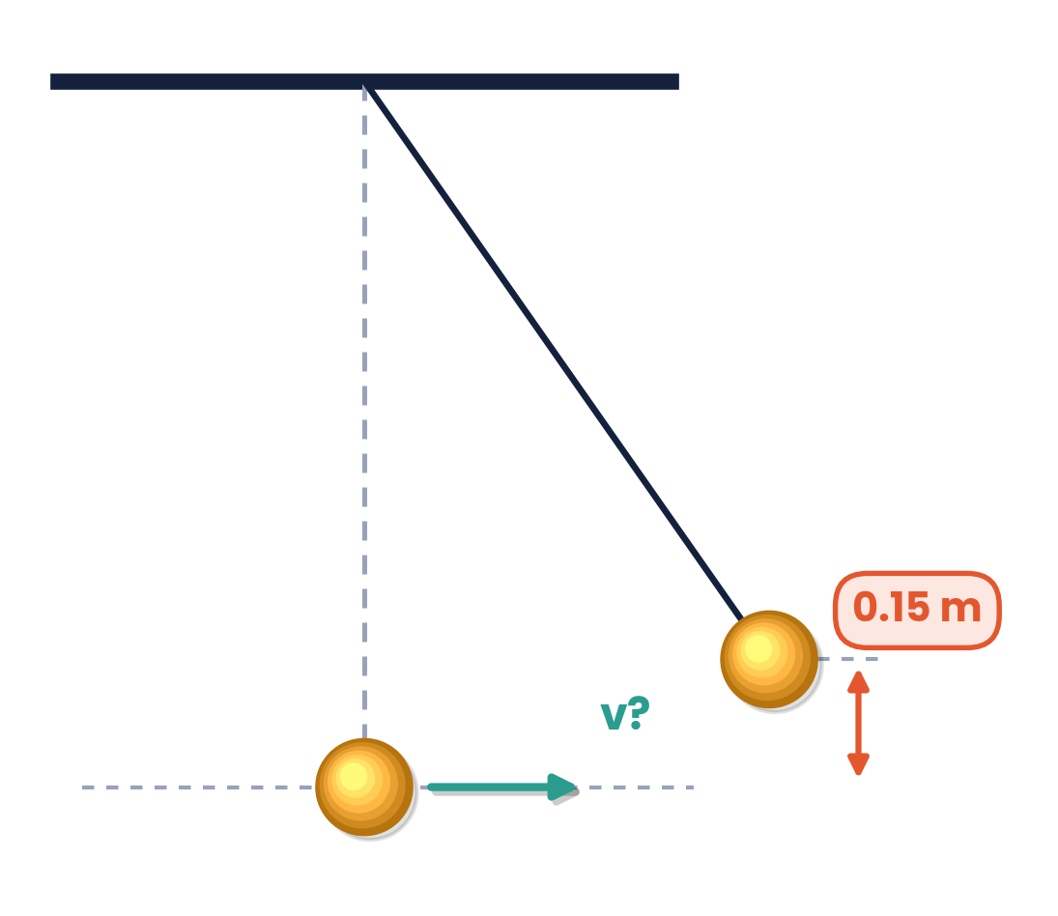
PAPER 2 STYLE · STRUCTURED QUESTION
Book question · Pendulum
A pendulum consists of a brass sphere of mass 5.0 kg hanging from a long string. The sphere is pulled to the side so that it is 0.15 m above its lowest point. It is then released.
(a) Calculate the GPE lost as it falls to its lowest point.
(b) Calculate how fast it is moving as it passes through the lowest point.
(c) Show that the answer to (b) does not depend on the mass.
Topic 5 · Work, energy and power | Cambridge International AS Level Physics 9702
32

Slide 33
MARK SCHEME STYLE SOLUTION
Book question · Solution
(a)
ΔEp = mgΔh = 5.0 × 9.81 × 0.15 = 7.4 J
(b)
½mv² = 7.4 J → v = √(2 × 7.4 / 5.0) = 1.7 m s⁻¹
(c)
½mv² = mgh → v = √(2gh); m cancels, so a 10 kg bob gives the same speed
Topic 5 · Work, energy and power | Cambridge International AS Level Physics 9702
33

Slide 34
PAPER 2 STYLE · STRUCTURED QUESTION
Practice · Lorry and power
A lorry of mass 3500 kg moves up a road inclined at 14.5° to the horizontal at a constant speed of 9.4 m s⁻¹. The force due to air resistance is negligible.
(a) Calculate the component of the lorry's weight down the slope.
(b) Calculate the useful power from the engine to move the lorry up the road.
(c) Explain why the actual power of the engine is greater.
Topic 5 · Work, energy and power | Cambridge International AS Level Physics 9702
34

Slide 35
MARK SCHEME STYLE SOLUTION
Practice · Solution
(a)
F = mg sin 14.5° = 3500 × 9.81 × sin 14.5° = 8.6 × 10³ N
(b)
P = Fv = 8.6 × 10³ × 9.4 = 8.1 × 10⁴ W (81 kW)
(c)
Energy is also dissipated by friction in the engine and gearbox and by rolling resistance, so the engine is not 100% efficient
Topic 5 · Work, energy and power | Cambridge International AS Level Physics 9702
35

Slide 36
PAPER 2 STYLE · STRUCTURED QUESTION
Practice · Deriving the equations
Use the definitions of work and power, and the equations of motion, to derive three results.
(a) Derive ΔEp = mgΔh from W = Fs.
(b) Derive Ek = ½mv² for a mass accelerated from rest.
(c) Derive P = Fv for a constant force.
Topic 5 · Work, energy and power | Cambridge International AS Level Physics 9702
36

Slide 37
MARK SCHEME STYLE SOLUTION
Practice · Solution
(a)
Lifting at constant speed: F = mg; W = Fs = mg × Δh = ΔEp
(b)
v² = 2as → s = v²/2a; W = Fs = ma × v²/2a = ½mv² = Ek
(c)
P = W/t = Fs/t, and s/t = v, so P = Fv
Topic 5 · Work, energy and power | Cambridge International AS Level Physics 9702
37

Slide 38
COMMON DOUBTS & MISCONCEPTIONS
Students often ask… (1)
?
“Is work done if I hold a heavy bag still?”
?
“Does a force at right angles to the motion do work?”
No mechanical work is done on the bag: there is no displacement. (Your muscles still transfer energy internally.)
No. W = Fs cos θ and cos 90° = 0 — e.g. the normal reaction on a sliding block.
?
“Is energy lost when a ball stops bouncing?”
?
“Does a heavier ball fall faster in a vacuum?”
It is not destroyed — it is dissipated as thermal energy and sound in the surroundings.
No. mgh = ½mv² gives v = √(2gh): the mass cancels.
Topic 5 · Work, energy and power | Cambridge International AS Level Physics 9702
38

Slide 39
COMMON DOUBTS & MISCONCEPTIONS
Students often ask… (2)
?
“Can efficiency be more than 100%?”
?
“Is P = Fv valid when accelerating?”
Never. The useful output cannot exceed the total input because energy is conserved.
It gives the power at that instant; for a steady speed F equals the total resistive force.
?
“Does doubling the speed double the kinetic energy?”
?
“Is power the same as energy?”
No — Ek ∝ v², so it quadruples.
No. Power is the RATE of energy transfer (J s⁻¹). A kW h is an amount of energy (3.6 MJ).
Topic 5 · Work, energy and power | Cambridge International AS Level Physics 9702
39

Slide 40
COMMAND WORDS AND MARK-SCHEME HABITS
Exam technique for work, energy and power
Define work done
Define power
‘force × displacement in the direction of the force’
‘work done per unit time’ or ‘rate of doing work’
Energy method
Efficiency
write the energy equation first: GPE lost = KE gained + work against friction
use the same units for useful and total; express as a ratio or percentage
P = Fv
Derivations
use it at constant speed with F = total resistive force (plus mg sin θ on a slope)
start from definitions and name each equation used
Topic 5 · Work, energy and power | Cambridge International AS Level Physics 9702
40

Slide 41
KEY IDEAS TO TAKE AWAY
Work, energy and power in one slide
W = Fs cos θ
ΔEp = mgΔh
Ek = ½mv²
P = W/t = Fv
Energy
conserved in an isolated system · dissipated energy is not useful but not destroyed
Efficiency
useful output ÷ total input (energy or power) · always < 100%
Power
rate of doing work · P = Fv at constant velocity (F = resistive force)
Topic 5 · Work, energy and power | Cambridge International AS Level Physics 9702
41

