Slide 1
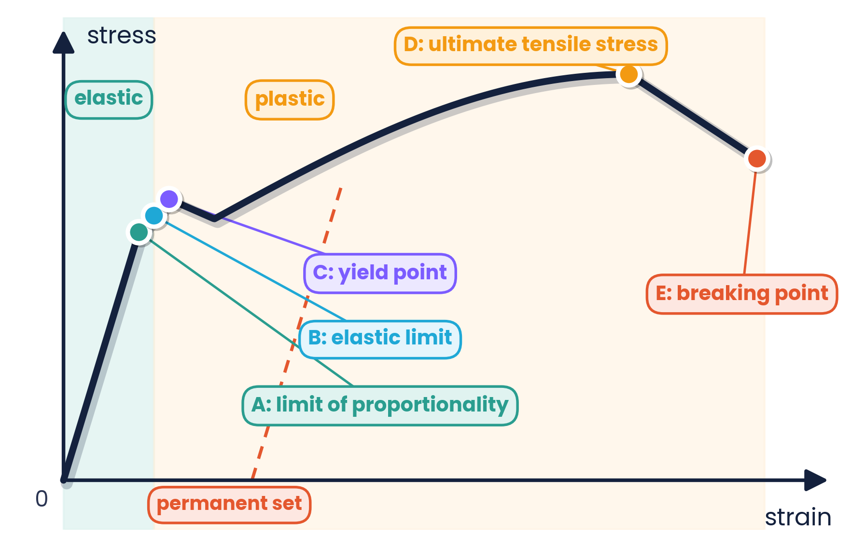
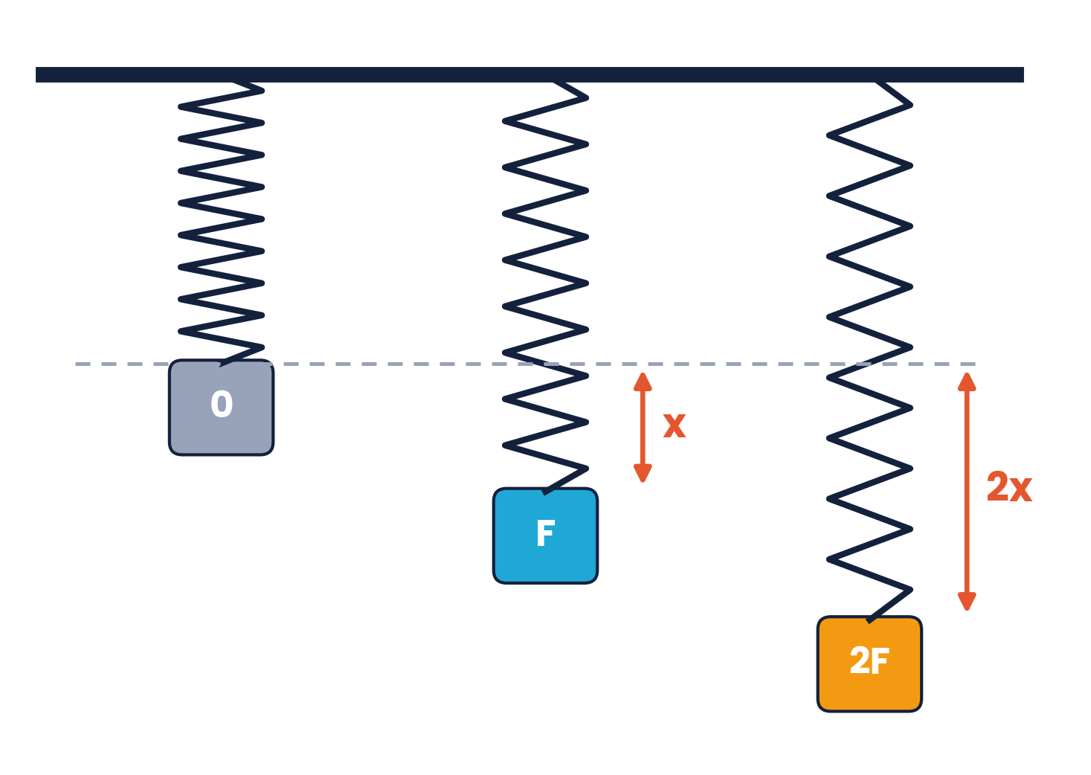
CAMBRIDGE AS & A LEVEL · PHYSICS 9702 · TOPIC 6
Deformation
of Solids
Hooke's law · stress, strain & Young modulus · strain energy
Syllabus 6.1 – 6.2 | Exams 2025 – 2027
WA
Waseem Ahmad
Head of Science & IB Physics Lead Teacher
Presidential School, Jizzakh · Cambridge Examiner
Author, Orange Publication · www.examspath.com

Slide 2
SYLLABUS 6.1 – 6.2 · DEFORMATION OF SOLIDS
What the syllabus asks you to do
1
LO 6.1.1
2
LO 6.1.2
3
LO 6.1.3
4
LO 6.1.4
5
LO 6.1.5
Deformation is caused by tensile or compressive forces (1D only)
Use load, extension, compression and limit of proportionality
Recall and use Hooke's law
Recall and use k = F / x
Define and use stress, strain and the Young modulus
6
LO 6.1.6
7
LO 6.2.1
8
LO 6.2.2
9
LO 6.2.3
10
LO 6.2.4
Describe an experiment to find the Young modulus of a wire
Elastic deformation, plastic deformation and elastic limit
Area under a force–extension graph = work done
Elastic PE from the area under the graph (within the limit of proportionality)
Recall and use E = ½Fx = ½kx²
Topic 6 · Deformation of solids | Cambridge International AS Level Physics 9702
2

Slide 3
TOPIC 6 · DEFORMATION OF SOLIDS
Lesson roadmap
01
02
03
04
Deformation & Hooke's law
Springs in combination
Stress, strain & Young modulus
Measuring E
Tension, compression, F = kx
Series and parallel
σ = F/A, ε = x/L, E = σ/ε
The wire experiment
05
06
07
08
Elastic & plastic
Strain energy
Past paper practice
Doubts & exam tips
Limits, brittle, ductile, polymers
Area under F–x graph, ½Fx = ½kx²
MCQs and structured questions
Misconceptions and technique
Topic 6 · Deformation of solids | Cambridge International AS Level Physics 9702
3

Slide 4
LEARNING OUTCOMES 6.1.1 – 6.1.4
01
Deformation and Hooke's law
Tensile and compressive forces · F = kx
Topic 6 · Deformation of solids | Cambridge International AS Level Physics 9702
4

Slide 5
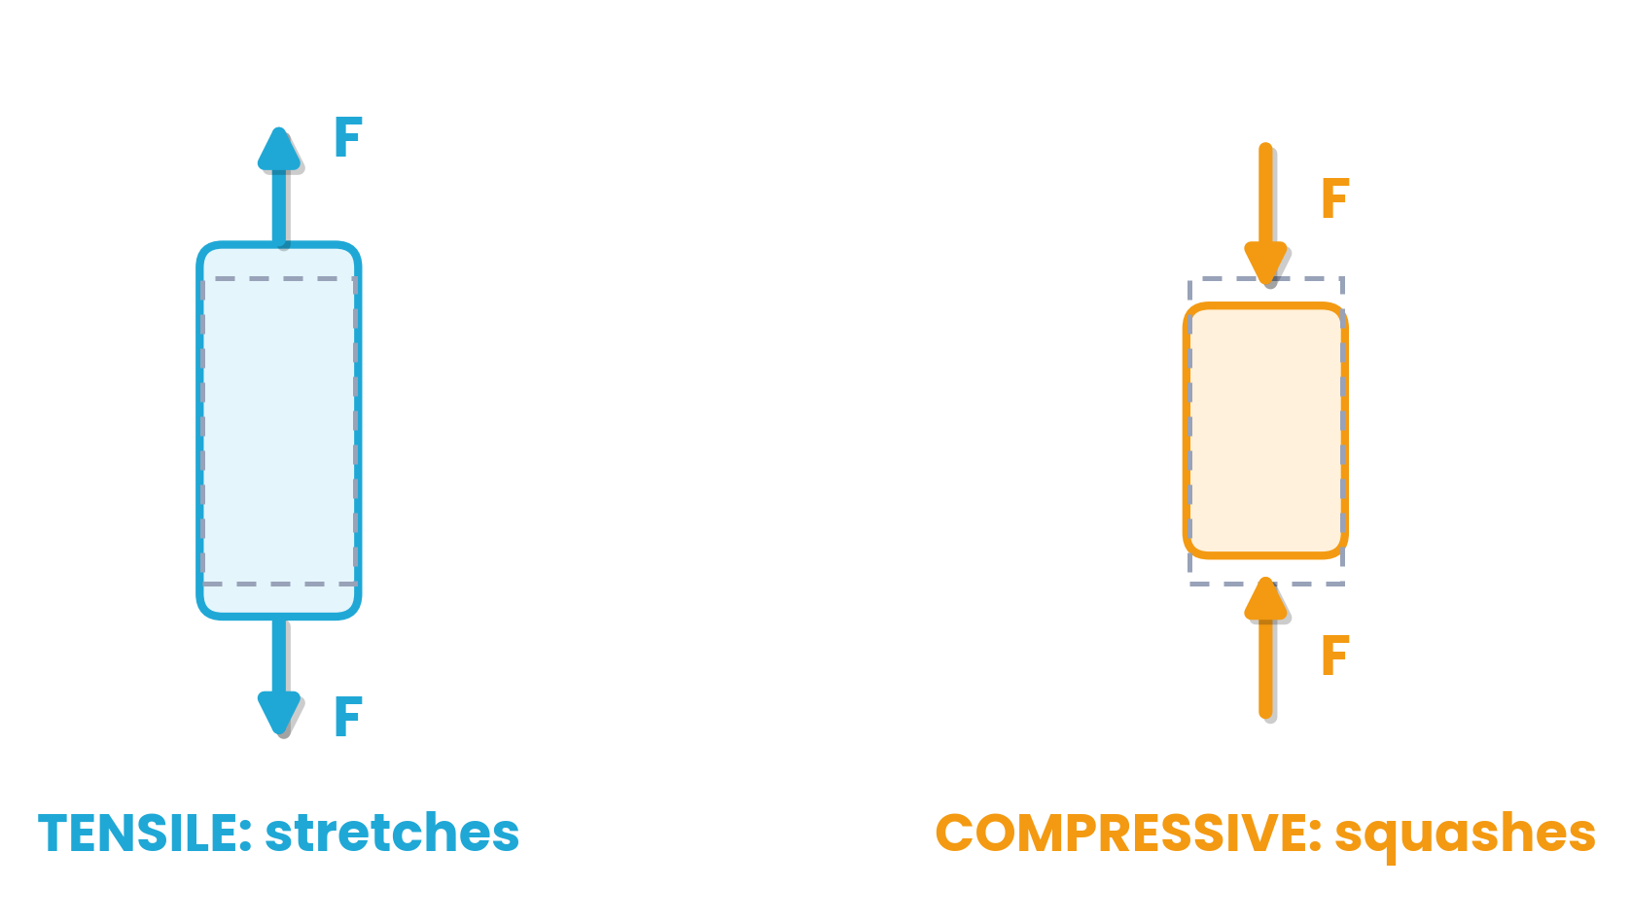
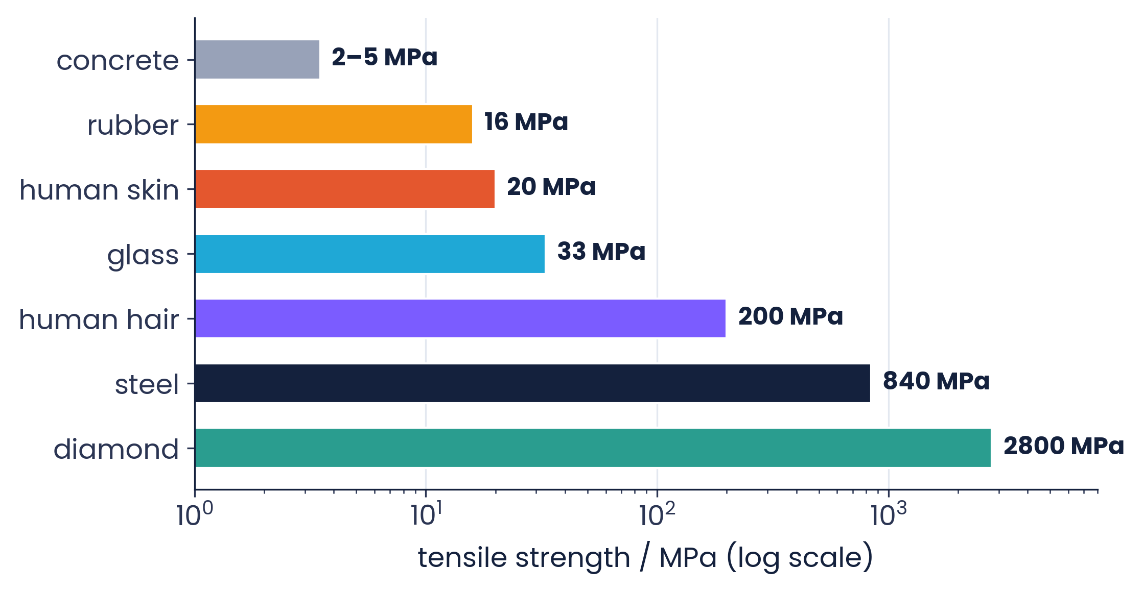
6.1.1 & 6.1.2 · FORCES CHANGE SHAPE AS WELL AS MOTION
Tensile and compressive forces
Deformation: a change in size or shape caused by forces
Tensile forces stretch → extension
Compressive forces squash → compression
Load: the force applied. Tensile strength: the stress a material can take before it breaks.
Topic 6 · Deformation of solids | Cambridge International AS Level Physics 9702
5

Slide 6
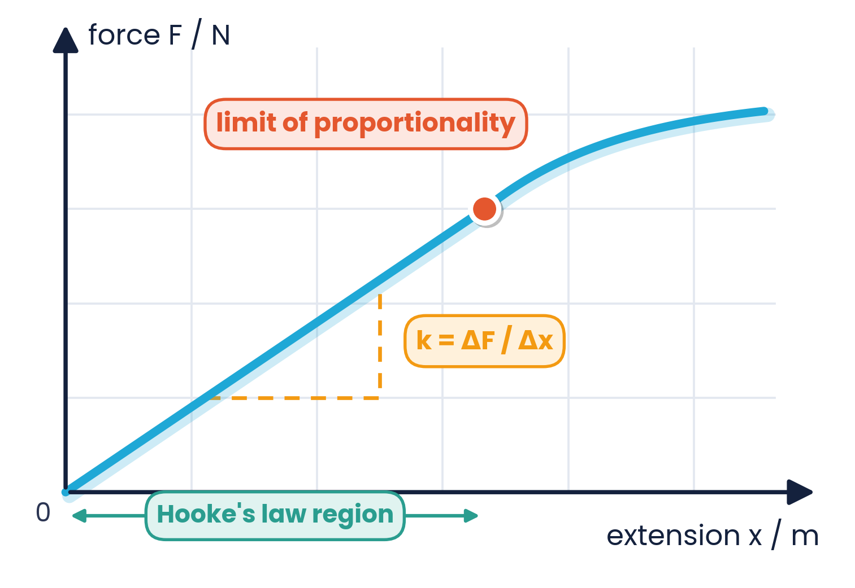
6.1.3 · EXTENSION IS PROPORTIONAL TO LOAD
Hooke's law
F = kx
k = spring constant (N m⁻¹)
Hooke's law:
the extension of a material is directly proportional to the applied force (load), up to the limit of proportionality. Beyond it the F–x graph curves. The law also applies to compression.
Topic 6 · Deformation of solids | Cambridge International AS Level Physics 9702
6

Slide 7
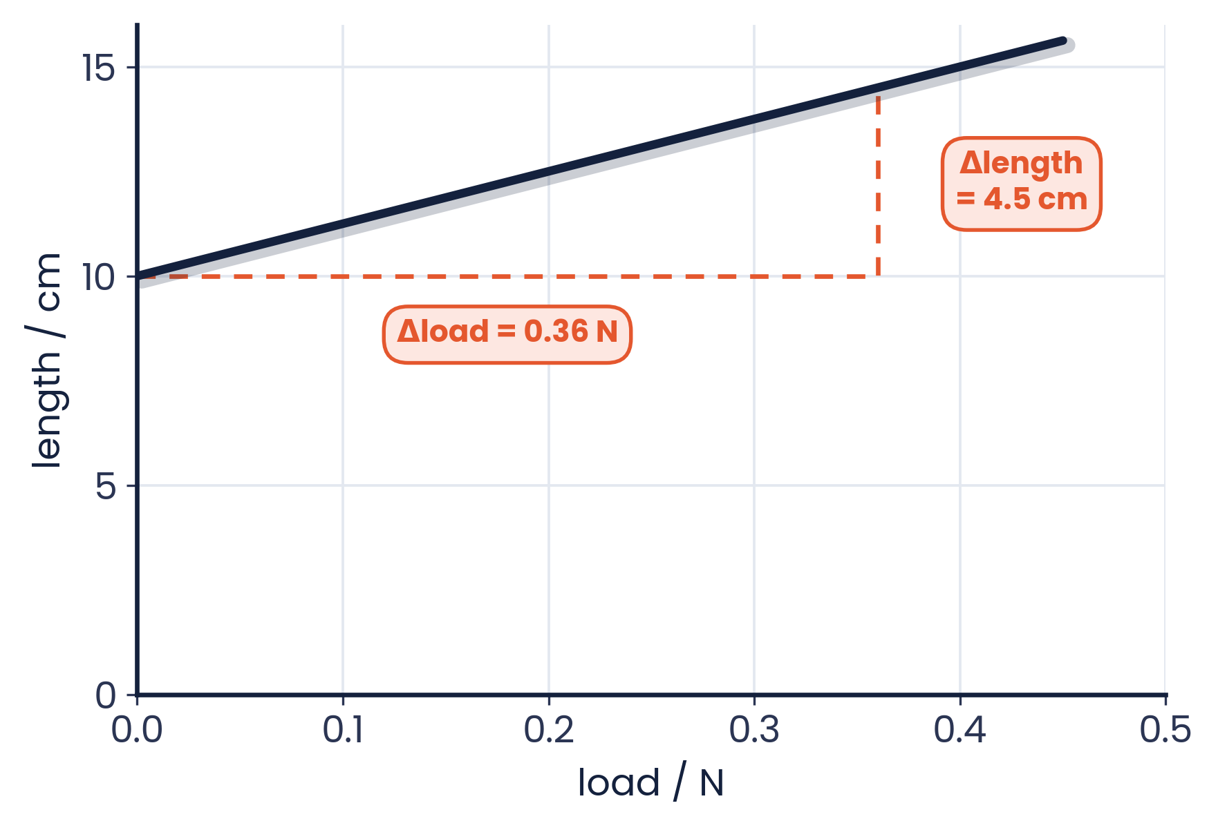
6.1.4 · K = F / X, A MEASURE OF STIFFNESS
The spring constant
k = F / x
Stiffer spring → larger k → smaller extension for the same force
k = gradient of the F–x graph in the straight-line region
Limit of proportionality: the point beyond which F is no longer proportional to x
force per unit extension (N m⁻¹)
Worked example
A spring is stretched with increasing load (graph of length against load).
Gradient = Δlength / Δload = 0.045 m / 0.36 N = 0.125 m N⁻¹
k = 1 / gradient = 8.0 N m⁻¹
Careful: this graph has F on the x-axis, so k is 1/gradient.
Topic 6 · Deformation of solids | Cambridge International AS Level Physics 9702
7

Slide 8
EXTENSION OF 6.1.3 – 6.1.4
02
Springs in combination
Series and parallel arrangements
Topic 6 · Deformation of solids | Cambridge International AS Level Physics 9702
8

Slide 9
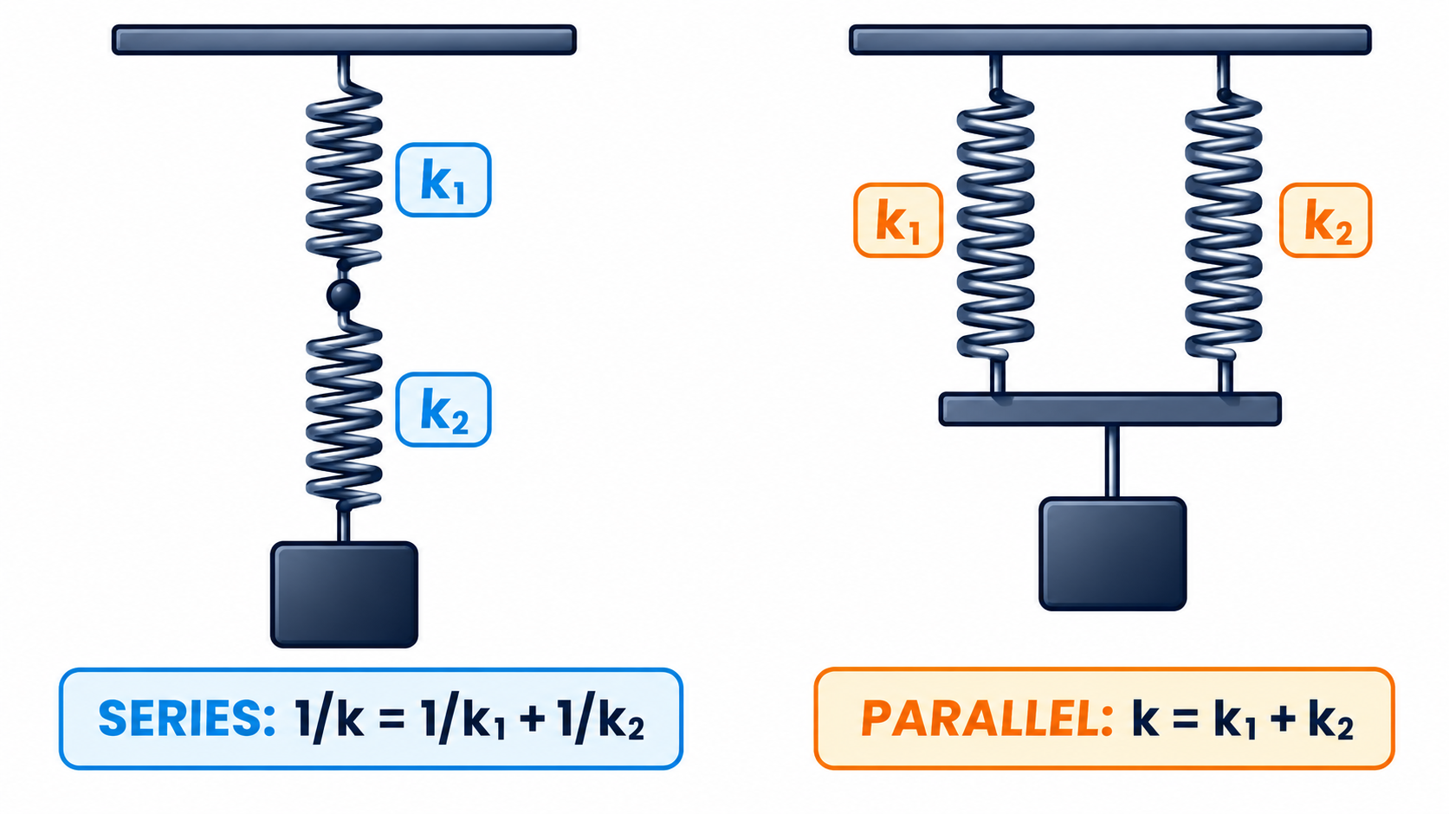
COMBINING SPRING CONSTANTS
Springs in series and parallel
Series (end to end)
Same force in each spring; extensions add. 1/k = 1/k₁ + 1/k₂ — the combination is LESS stiff.
Parallel (side by side)
Same extension; forces add. k = k₁ + k₂ — the combination is STIFFER.
Series: 10 N mm⁻¹ and 5 N mm⁻¹ → 1/k = 1/10 + 1/5 → k = 3.3 N mm⁻¹
Topic 6 · Deformation of solids | Cambridge International AS Level Physics 9702
9

Slide 10
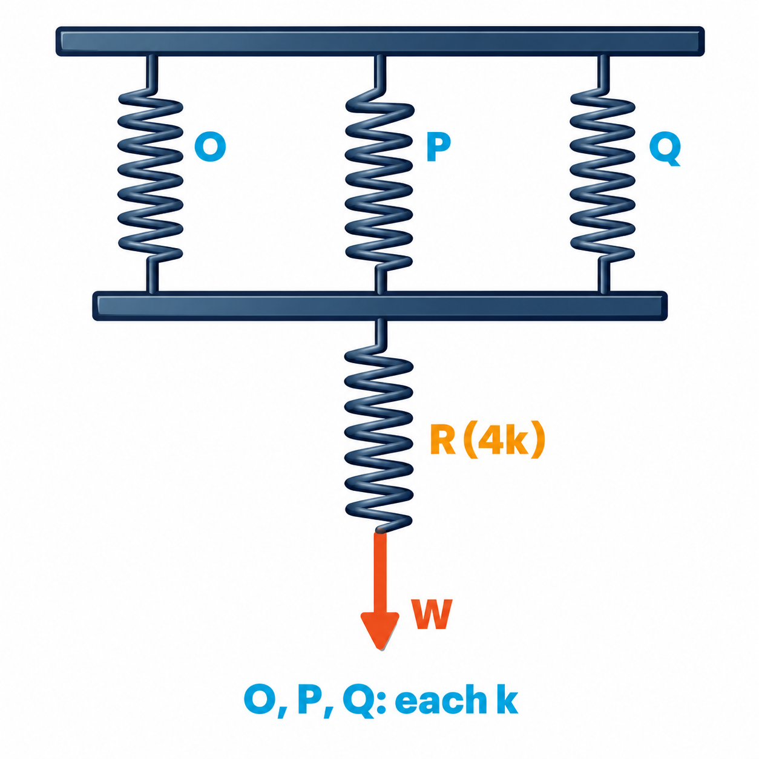
SERIES AND PARALLEL TOGETHER
Worked example · Mixed arrangement
Springs O, P and Q are identical with spring constant k. Spring R has spring constant 4k. What is the increase in overall length when a force W is applied?
1
O, P and Q in parallel: k(OPQ) = k + k + k = 3k
2
In series with R: 1/k(total) = 1/3k + 1/4k = 7/12k
3
k(total) = 12k / 7
4
x = W / k(total) = 7W / 12k
Topic 6 · Deformation of solids | Cambridge International AS Level Physics 9702
10

Slide 11
LEARNING OUTCOME 6.1.5
03
Stress, strain and the Young modulus
Properties of the material, not the sample
Topic 6 · Deformation of solids | Cambridge International AS Level Physics 9702
11

Slide 12
6.1.5 · DEFINE AND USE
Stress and strain
stress σ = F / A
strain ε = x / L
force per unit cross-sectional area · unit Pa (N m⁻²)
extension per unit original length · no unit
Ultimate tensile stress
Why use them?
The maximum force per original cross-sectional area that a wire can support before it breaks.
Extension depends on the size of the sample. Stress and strain remove the effect of A and L, so the results describe the MATERIAL.
Topic 6 · Deformation of solids | Cambridge International AS Level Physics 9702
12

Slide 13
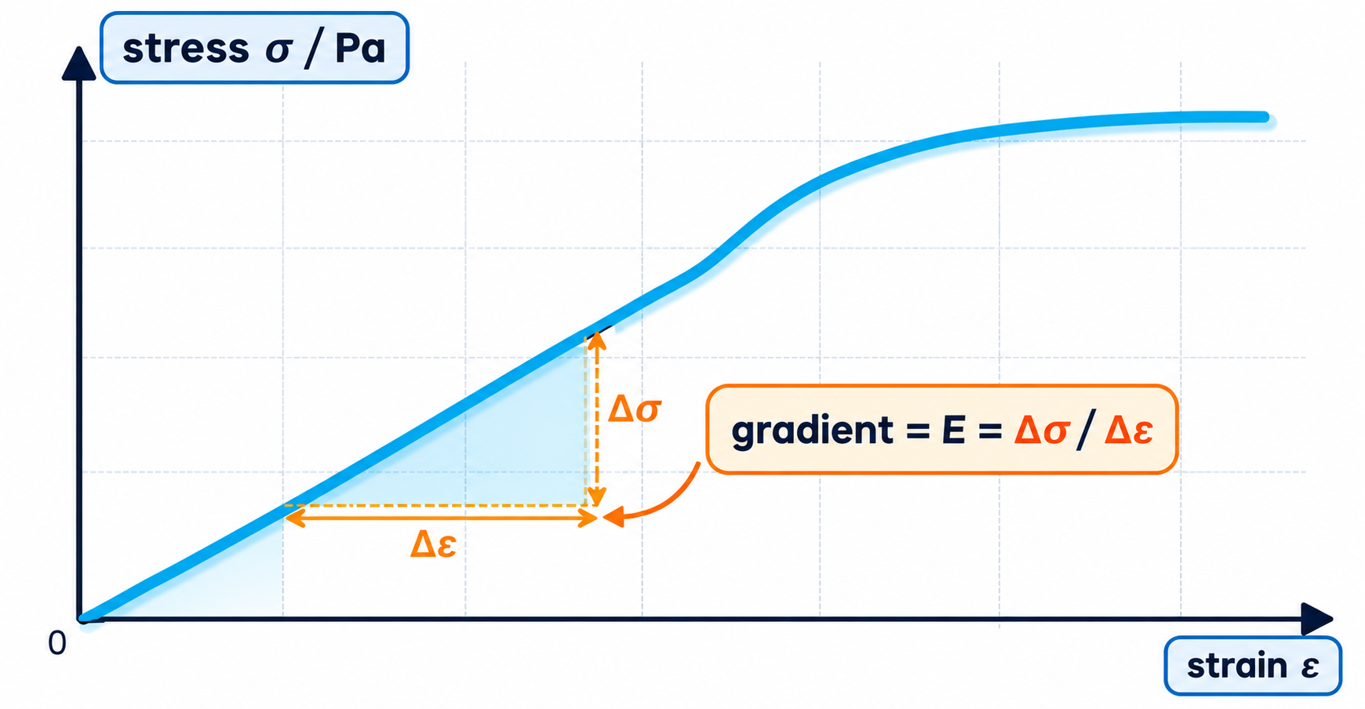
6.1.5 · STIFFNESS OF A MATERIAL
The Young modulus
E = σ / ε = FL / Ax
unit Pa · the gradient of the linear part of a stress–strain graph
Large E → stiff material (steel ≈ 2 × 10¹¹ Pa)
Small E → easily stretched (rubber ≈ 10⁷ Pa)
Valid only below the limit of proportionality
Strain has no unit, so E has the same unit as stress: pascal (Pa).
Topic 6 · Deformation of solids | Cambridge International AS Level Physics 9702
13

Slide 14
6.1.5 · CALCULATING E
Worked example · Metal wire
A metal wire hangs from a fixed point and supports a 92 N load. The cross-sectional area is 0.04 mm² and the wire obeys Hooke's law. Its length increases by 0.50%. What is the Young modulus?
1
Convert area: 0.04 mm² = 0.04 × 10⁻⁶ m² = 4 × 10⁻⁸ m²
Common traps
mm² → m²: multiply by 10⁻⁶, not 10⁻³
A percentage strain must be divided by 100
Area from diameter: A = πd² / 4
2
Stress σ = F / A = 92 / 4 × 10⁻⁸ = 2.3 × 10⁹ Pa
3
Strain ε = 0.50% = 0.0050
4
E = σ / ε = 2.3 × 10⁹ / 0.0050 = 4.6 × 10¹¹ Pa
Topic 6 · Deformation of solids | Cambridge International AS Level Physics 9702
14

Slide 15
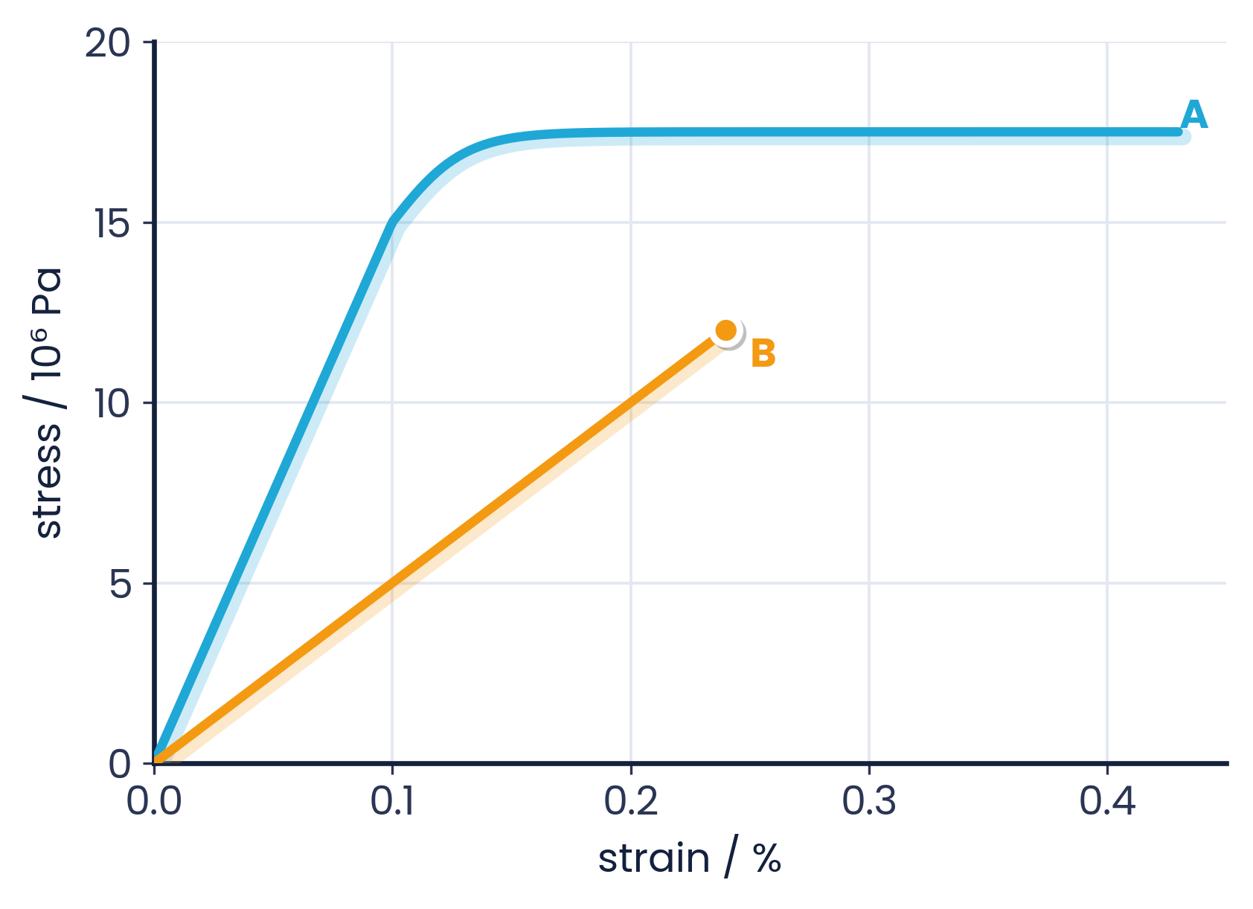
6.1.5 · GRADIENT OF THE STRAIGHT LINE
Worked example · Reading E from graphs
Material A
E = 15 × 10⁶ / 0.001 = 1.5 × 10¹⁰ Pa = 15 GPa (strain 0.1% = 0.001)
Material B
E = 12 × 10⁶ / 0.0024 = 5.0 × 10⁹ Pa = 5.0 GPa. A is stiffer; B breaks without plastic flow (brittle).
Convert % strain to a number before dividing.
Topic 6 · Deformation of solids | Cambridge International AS Level Physics 9702
15

Slide 16
LEARNING OUTCOME 6.1.6
04
Measuring the Young modulus
Experiment with a long metal wire
Topic 6 · Deformation of solids | Cambridge International AS Level Physics 9702
16

Slide 17
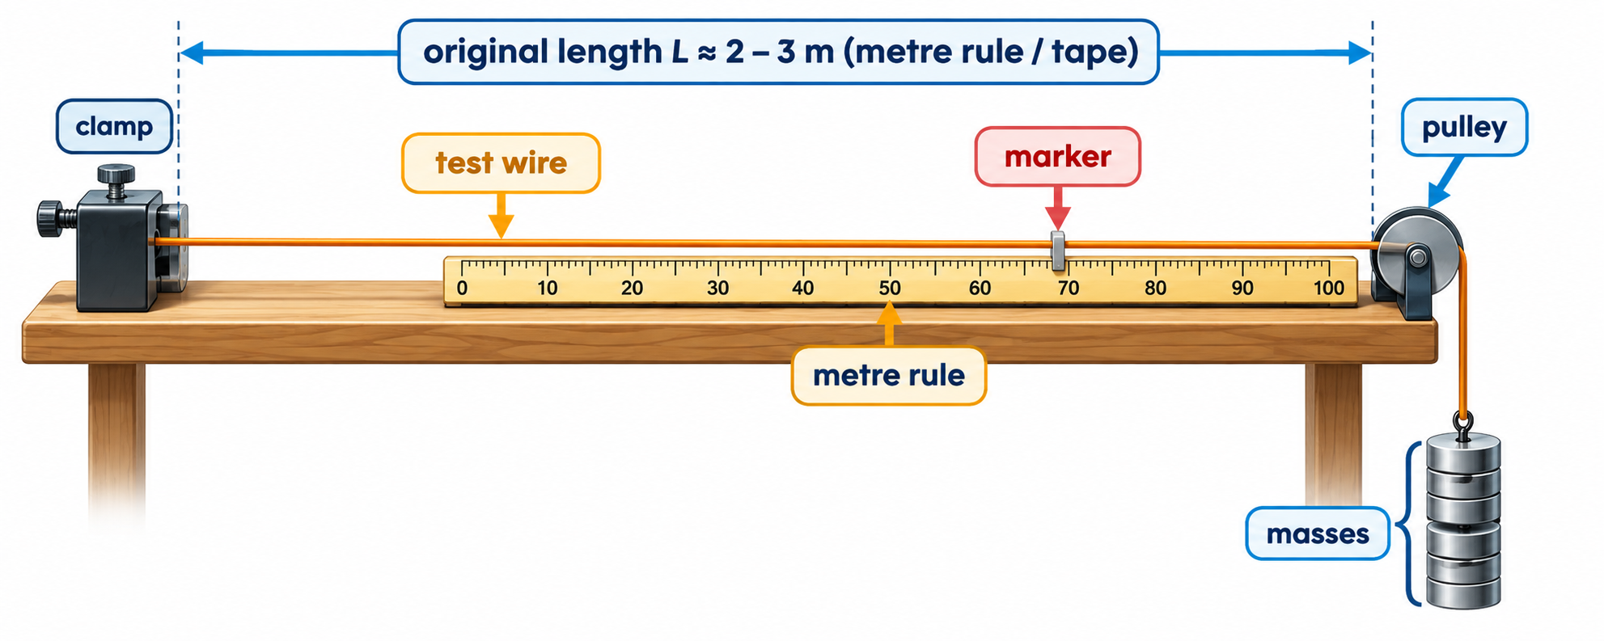
6.1.6 · DESCRIBE AN EXPERIMENT
Experiment: Young modulus of a wire
1
Measure L
2
Measure d
3
Add loads
4
Repeat on unloading
original length (≈ 2–3 m) from clamp to marker with a metre rule or tape
diameter with a micrometer at several points and orientations; A = πd² / 4
add masses in steps; read the marker's extension x each time with the metre rule (or a vernier)
check the wire returns to zero: still elastic
Topic 6 · Deformation of solids | Cambridge International AS Level Physics 9702
17

Slide 18
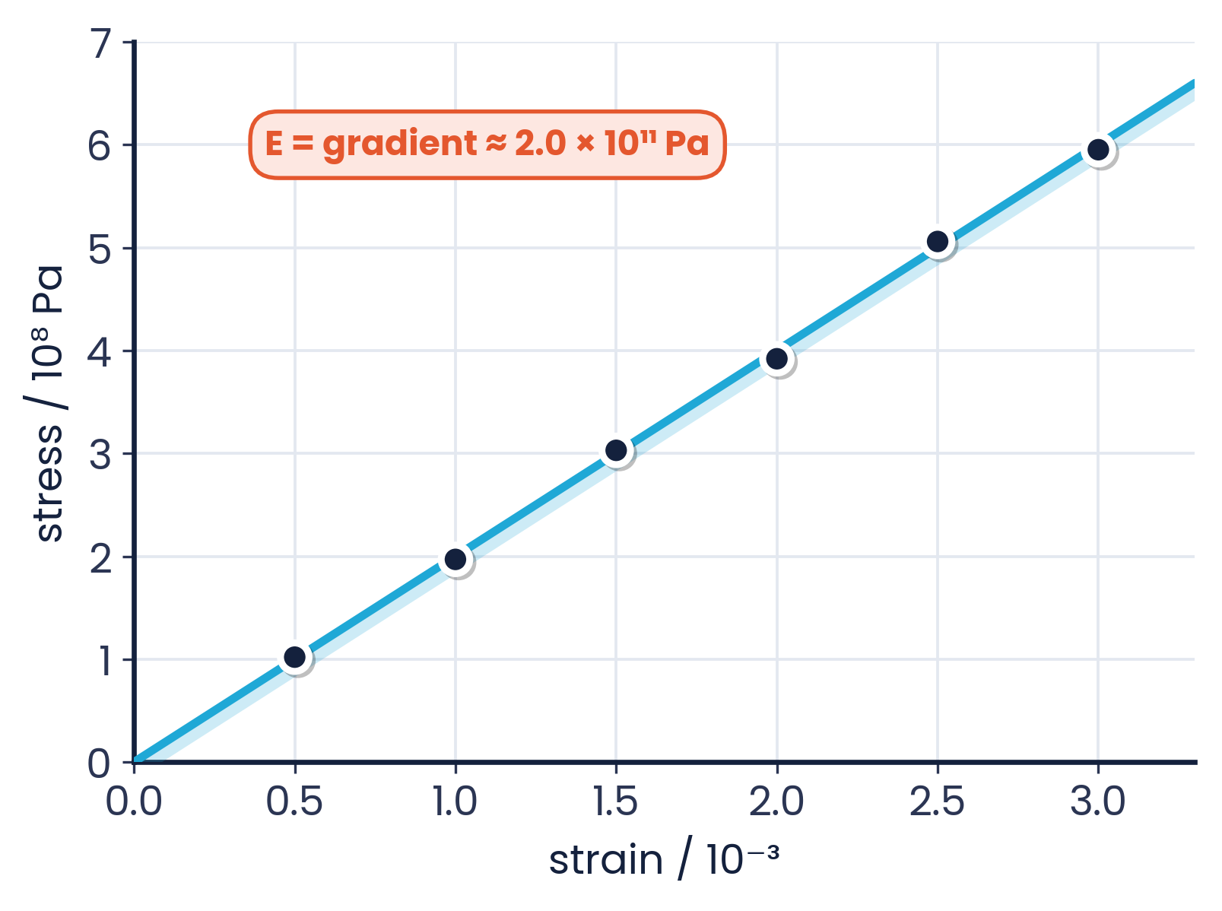
6.1.6 · FROM GRAPH TO E
Analysis and precautions
Analysis
Calculate σ = F/A and ε = x/L for each load
Plot σ against ε; E = gradient of the straight line
(or plot F against x: E = gradient × L / A)
Precautions
Long, thin wire → larger, more measurable extension
Straighten kinks with a small initial load first
Wear safety goggles — the wire may snap
A second, unloaded reference wire (Searle's method) cancels thermal expansion and sagging.
Topic 6 · Deformation of solids | Cambridge International AS Level Physics 9702
18

Slide 19
LEARNING OUTCOME 6.2.1
05
Elastic and plastic behaviour
Elastic limit, brittle, ductile and polymeric materials
Topic 6 · Deformation of solids | Cambridge International AS Level Physics 9702
19

Slide 20
6.2.1 · DOES IT RETURN TO ITS ORIGINAL SHAPE?
Elastic and plastic deformation
Elastic deformation
Plastic deformation
Elastic limit
When the load is removed, the object returns to its original shape and length.
When the load is removed, the object does NOT return to its original shape — a permanent extension remains.
The point beyond which the object does not return to its original length when the load is removed.
Exam tip
The limit of proportionality (end of Hooke's law) and the elastic limit are close but different. The elastic limit is slightly higher.
Topic 6 · Deformation of solids | Cambridge International AS Level Physics 9702
20

Slide 21
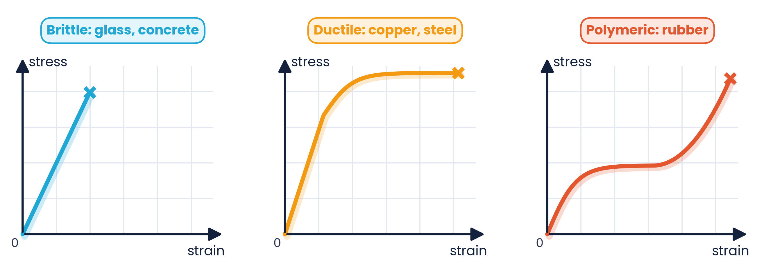
6.2.1 · SHAPES OF STRESS–STRAIN GRAPHS
Brittle, ductile and polymeric materials
Brittle
straight line to breaking; little or no plastic region — glass, concrete, cast iron
Ductile
straight line, then curves towards the x-axis; large plastic region — copper, steel
Polymeric
non-linear; large strain; rubber stiffens at high strain
Topic 6 · Deformation of solids | Cambridge International AS Level Physics 9702
21

Slide 22
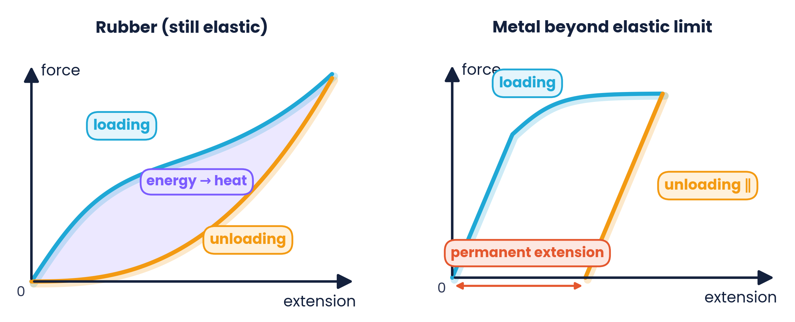
6.2.1 · WHAT THE UNLOADING CURVE TELLS YOU
Loading and unloading
Rubber: returns to zero (elastic) but by a different path; the area between the curves is energy converted to heat (hysteresis).
Metal past its elastic limit: unloads parallel to the loading line, leaving a permanent extension (plastic).
Topic 6 · Deformation of solids | Cambridge International AS Level Physics 9702
22

Slide 23
LEARNING OUTCOMES 6.2.2 – 6.2.4
06
Elastic potential energy
Work done = area under the force–extension graph
Topic 6 · Deformation of solids | Cambridge International AS Level Physics 9702
23

Slide 24
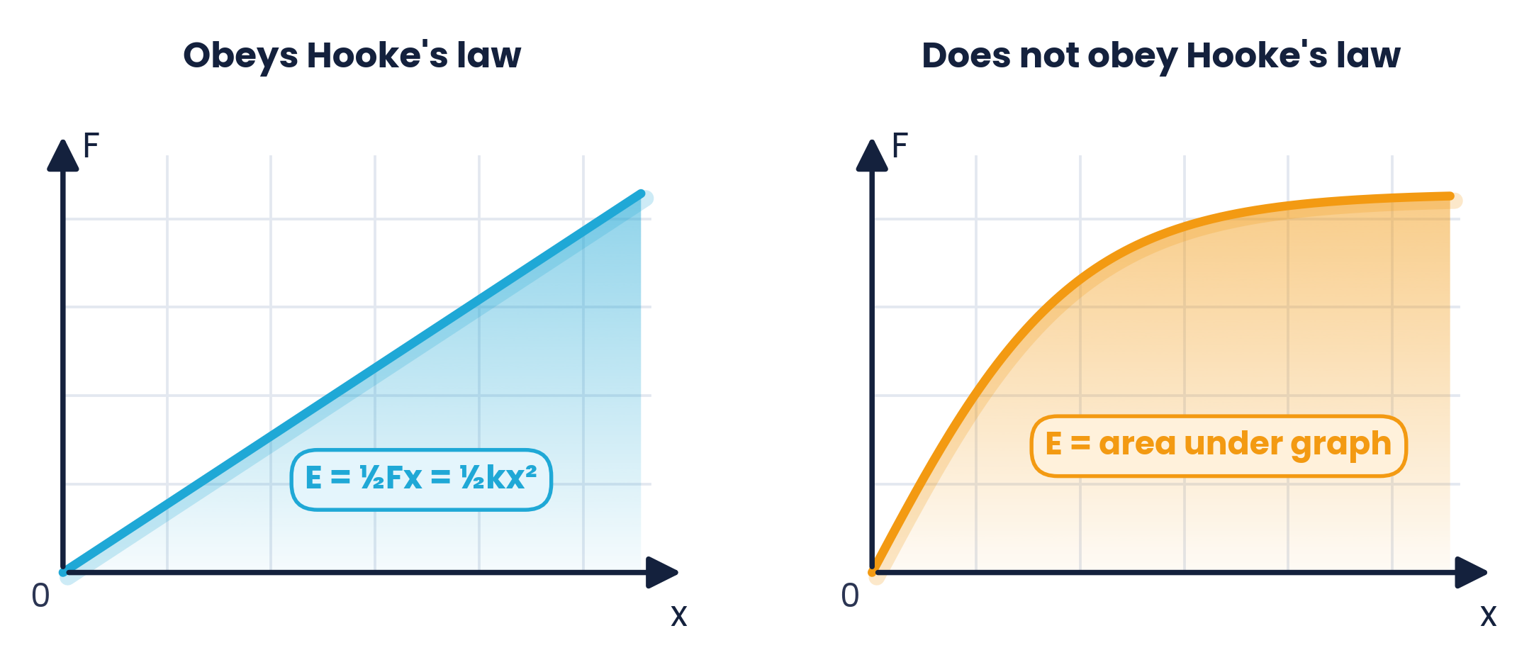
6.2.2 & 6.2.3 · WORK DONE IN STRETCHING
Strain energy = area under the F–x graph
Work done = force × distance moved
So the area under an F–x graph = work done in stretching
Stored as elastic potential (strain) energy if the deformation is elastic
E = ½Fx = ½kx²
Derivation:
area of triangle = ½ × base × height = ½ × x × F; with F = kx this gives ½kx².
within the limit of proportionality (triangle area)
Topic 6 · Deformation of solids | Cambridge International AS Level Physics 9702
24

Slide 25
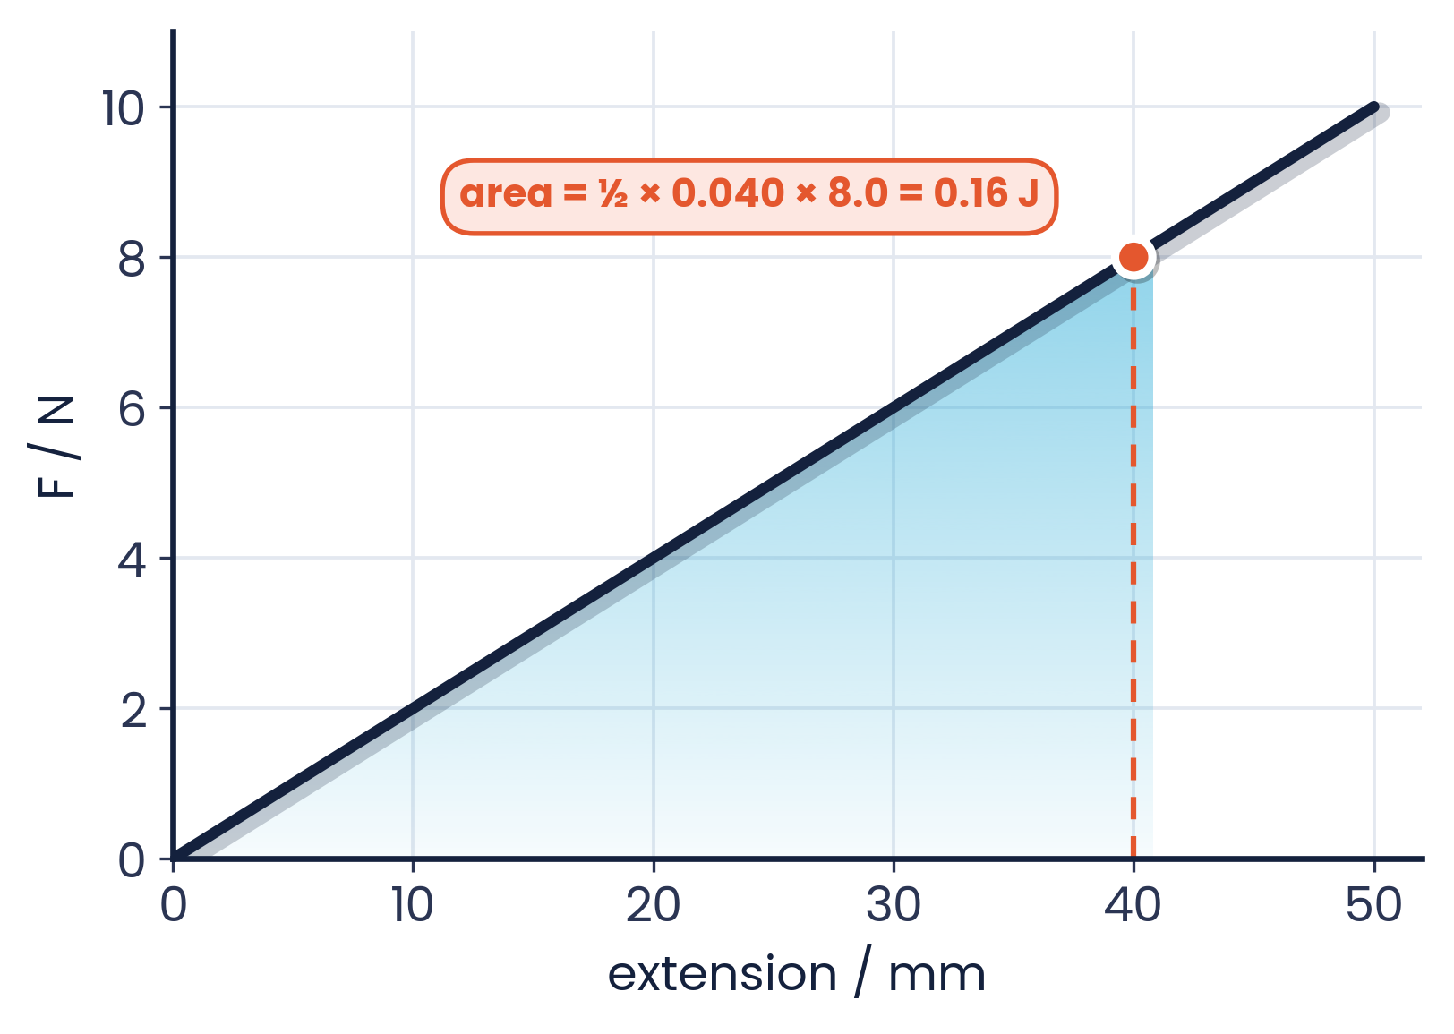
6.2.3 · AREA OF A TRIANGLE
Worked example · Energy stored in a spring
A spring is extended with varying forces (graph). What is the energy stored when the extension is 40 mm?
1
Read F at 40 mm: 8.0 N
2
Convert: 40 mm = 0.040 m
3
E = ½ × 0.040 × 8.0
4
E = 0.16 J
Alternatively: k = 200 N m⁻¹ and E = ½kx² = ½ × 200 × 0.040² = 0.16 J
Topic 6 · Deformation of solids | Cambridge International AS Level Physics 9702
25

Slide 26
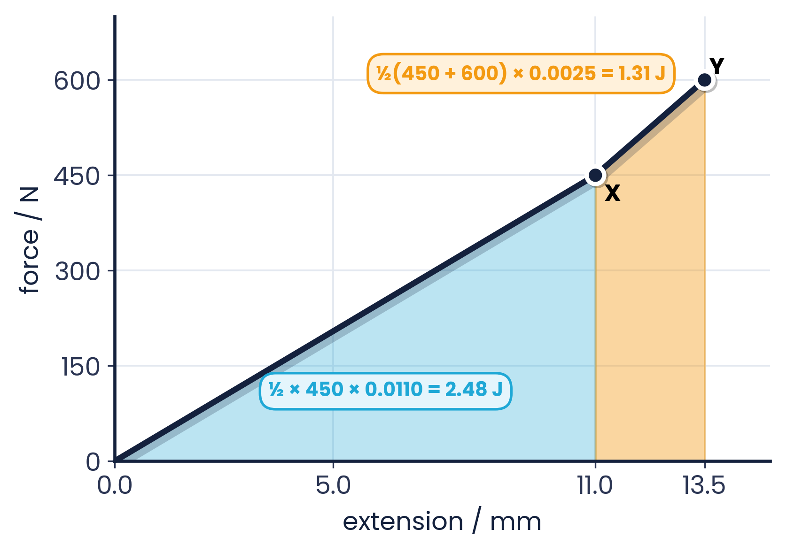
6.2.2 · SPLIT THE AREA INTO SHAPES
Worked example · Beyond the limit of proportionality
A metal sample is stretched until it starts to deform plastically. Find the total work done from 0 to 13.5 mm. Treat XY as a straight line.
1
Triangle 0 → X: ½ × 450 × 11.0 × 10⁻³ = 2.48 J
2
Trapezium X → Y: ½ × (450 + 600) × 2.5 × 10⁻³ = 1.31 J
3
Total work = 2.48 + 1.31 = 3.8 J
4
Only the elastic part is recoverable as strain energy
Topic 6 · Deformation of solids | Cambridge International AS Level Physics 9702
26

Slide 27
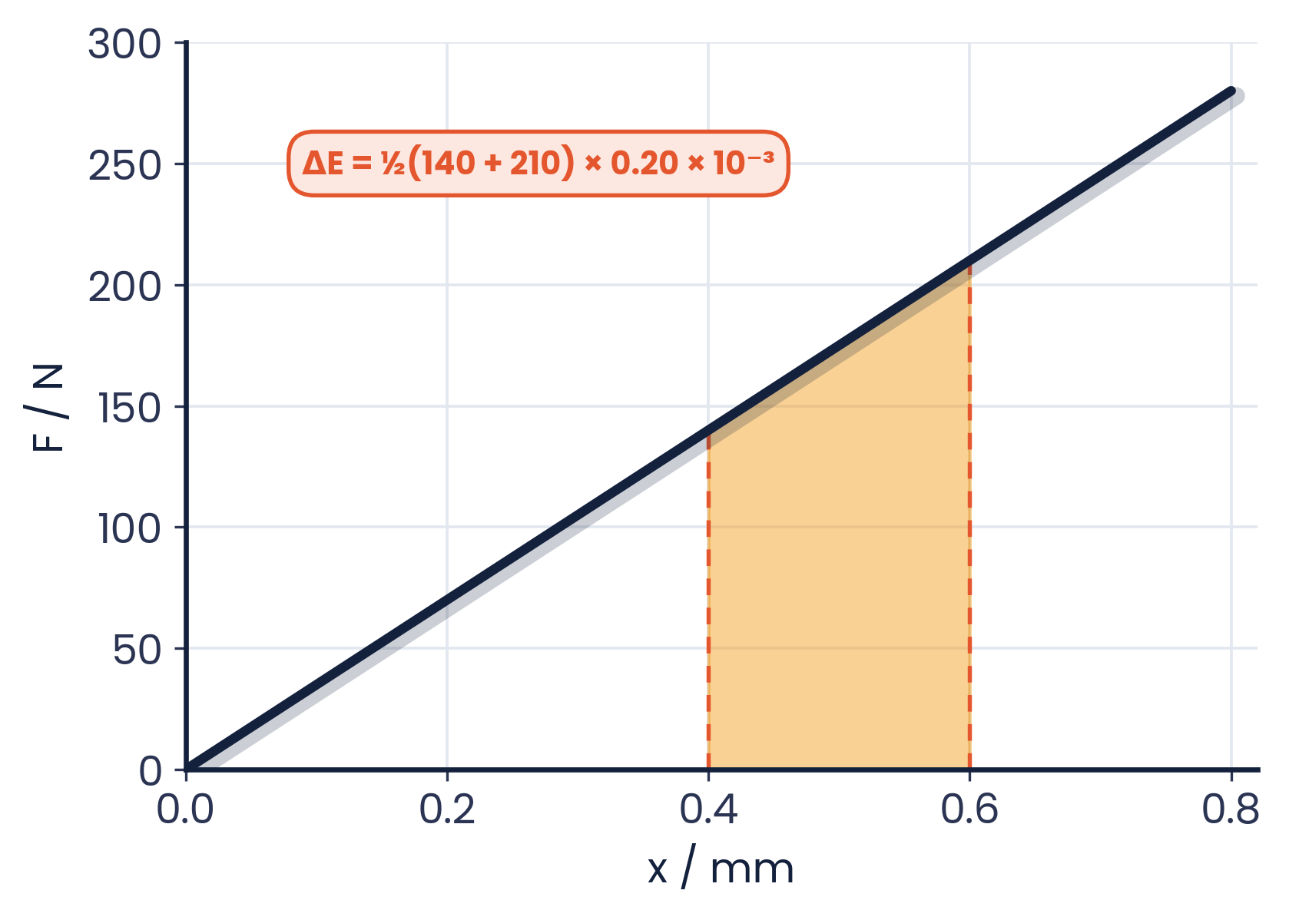
6.2.3 · AREA OF A TRAPEZIUM
Worked example · Change in strain energy
The F–x graph for a wire is shown. A gust of wind increases the tension from 140 N to 210 N. Calculate the change in strain energy.
1
From the graph: 140 N at 0.40 mm, 210 N at 0.60 mm
2
ΔE = area of the trapezium
3
ΔE = ½ × (140 + 210) × 0.20 × 10⁻³
4
ΔE = 0.035 J
Or: ½kx₂² − ½kx₁² with k = 3.5 × 10⁵ N m⁻¹ (9702/22 March 2020).
Topic 6 · Deformation of solids | Cambridge International AS Level Physics 9702
27

Slide 28
6.2.4 · RECALL AND USE ½FX AND ½KX²
Quick practice · Elastic potential energy
Rubber band
Stiff spring
A force of 12 N extends a rubber band by 18 cm. Estimate the energy stored.
A spring with k = 4800 N m⁻¹ is compressed by 2.0 mm. Calculate the energy stored.
E ≈ ½ × 12 × 0.18 = 1.1 J — only an estimate, because rubber does not obey Hooke's law.
E = ½ × 4800 × (0.0020)² = 9.6 × 10⁻³ J
Topic 6 · Deformation of solids | Cambridge International AS Level Physics 9702
28

Slide 29
CAMBRIDGE PAST PAPER QUESTIONS
07
Past paper practice
Paper 1 multiple choice · Paper 2 structured questions
Topic 6 · Deformation of solids | Cambridge International AS Level Physics 9702
29

Slide 30
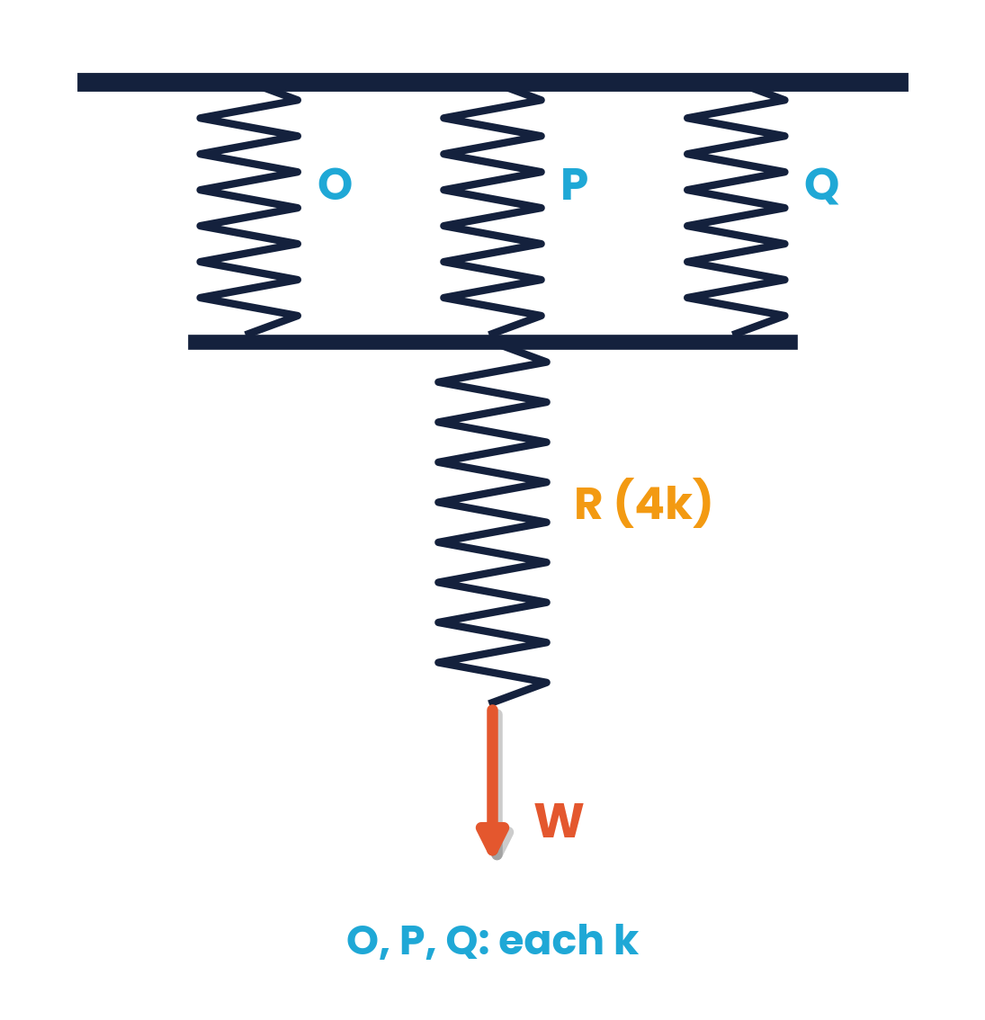
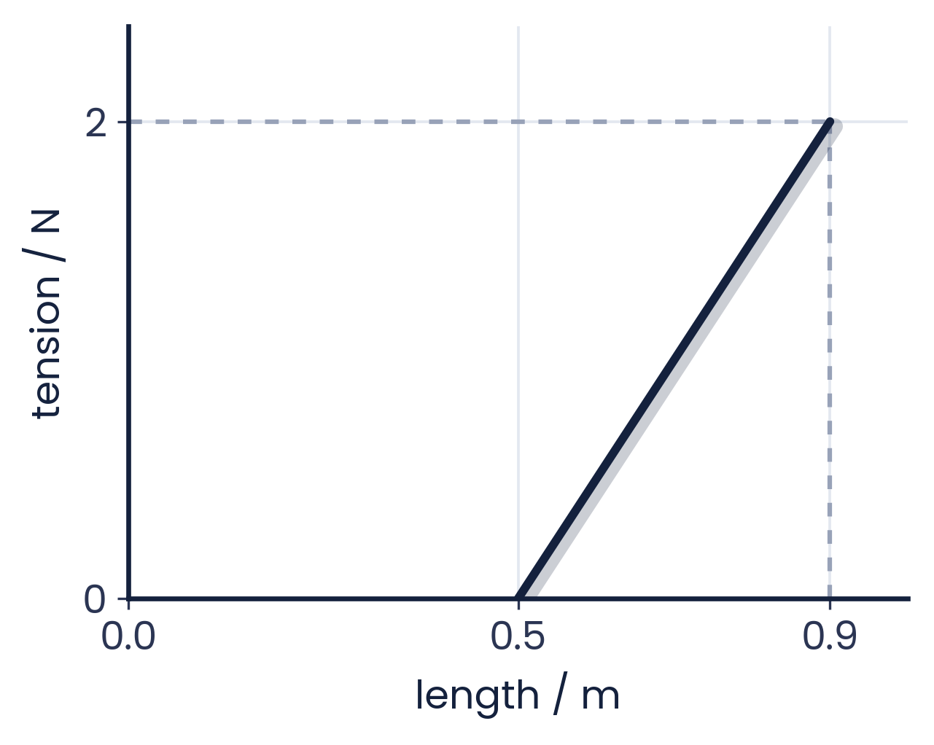
PAPER 1 STYLE · MULTIPLE CHOICE
Past paper set A · Springs
1
A mass hangs from two springs in series with stiffness 10 N mm⁻¹ and 5 N mm⁻¹. What is the equivalent stiffness?
2
Springs O, P and Q each have spring constant k; R has 4k. What is the increase in overall length when force W is applied?
A 0.3 N mm⁻¹
B 3.3 N mm⁻¹
C 5 N mm⁻¹
D 15 N mm⁻¹
A 12k / 7W
B 6W / 5k
C 7W / 12k
D 2W / 5
3
A 2.0 N force stretches a spring from 0.50 m to 0.90 m (graph). How much strain energy is stored?
A 1.8 J
B 0.90 J
C 0.40 J
D 0.80 J
Topic 6 · Deformation of solids | Cambridge International AS Level Physics 9702
30

Slide 31
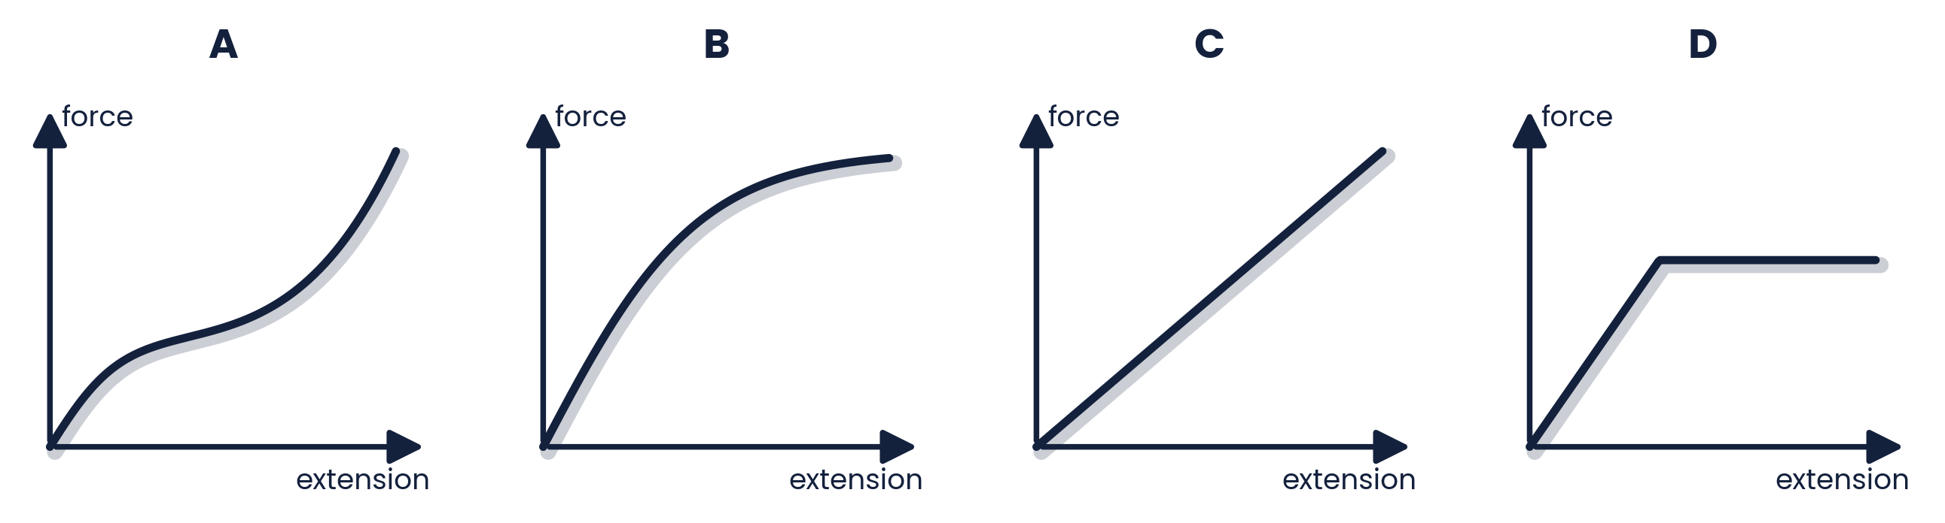
PAPER 1 STYLE · MULTIPLE CHOICE
Past paper · Rubber band
4
Which graph represents the force–extension relationship of a rubber band stretched almost to its breaking point?
Choose A, B, C or D
Topic 6 · Deformation of solids | Cambridge International AS Level Physics 9702
31

Slide 32
ANSWERS AND KEY WORKING
Answers · Questions 1 – 4
1
Answer B
2
Answer C
Series: 1/k = 1/10 + 1/5 = 3/10 → k = 3.3 N mm⁻¹ (less than either spring).
Parallel 3k in series with 4k: k(total) = 12k/7, so x = W / k(total) = 7W / 12k.
3
Answer C
4
Answer A
Extension = 0.40 m (not 0.90 m). E = ½ × 2.0 × 0.40 = 0.40 J.
Rubber stiffens as it approaches breaking — the gradient increases sharply at large extension.
Topic 6 · Deformation of solids | Cambridge International AS Level Physics 9702
32

Slide 33
PAPER 1 STYLE · MULTIPLE CHOICE
Past paper set B · Stress, strain, Young modulus
5
To measure the Young modulus of a wire, which measurement is NOT made directly with the listed apparatus?
6
Which is the definition of the ultimate tensile stress of a material?
A extension — vernier scale
B cross-sectional area — micrometer
C original length — metre rule
D mass of load — electronic balance
A max inter-atomic force before bonds break
B max force on a bar before it bends
C max tensile force in a wire before it breaks
D max stretching force per unit cross-sectional area before breaking
7
A glass rod is put under stress until it breaks; its stress–strain graph is a straight line to the end. Which statement is correct?
8
A material obeys Hooke's law, has Young modulus E and a tensile stress S. What is the elastic energy stored per unit volume?
A the glass shows plastic deformation
B doubling the area halves the UTS
C Hooke's law is obeyed up to breaking
D the glass is ductile
A E / 2S²
B S² / E
C S² / 2E
D 2E / S²
Topic 6 · Deformation of solids | Cambridge International AS Level Physics 9702
33

Slide 34
ANSWERS AND KEY WORKING
Answers · Questions 5 – 8
5
Answer B
6
Answer D
The micrometer measures the DIAMETER; area is then calculated with A = πd²/4.
UTS is a stress: maximum force per (original) cross-sectional area before breaking.
7
Answer C
8
Answer C
A straight line through the origin to the breaking point: proportional throughout, brittle, no plastic region.
Energy per unit volume = ½σε, and ε = σ/E, so ½S × S/E = S²/2E.
Topic 6 · Deformation of solids | Cambridge International AS Level Physics 9702
34

Slide 35
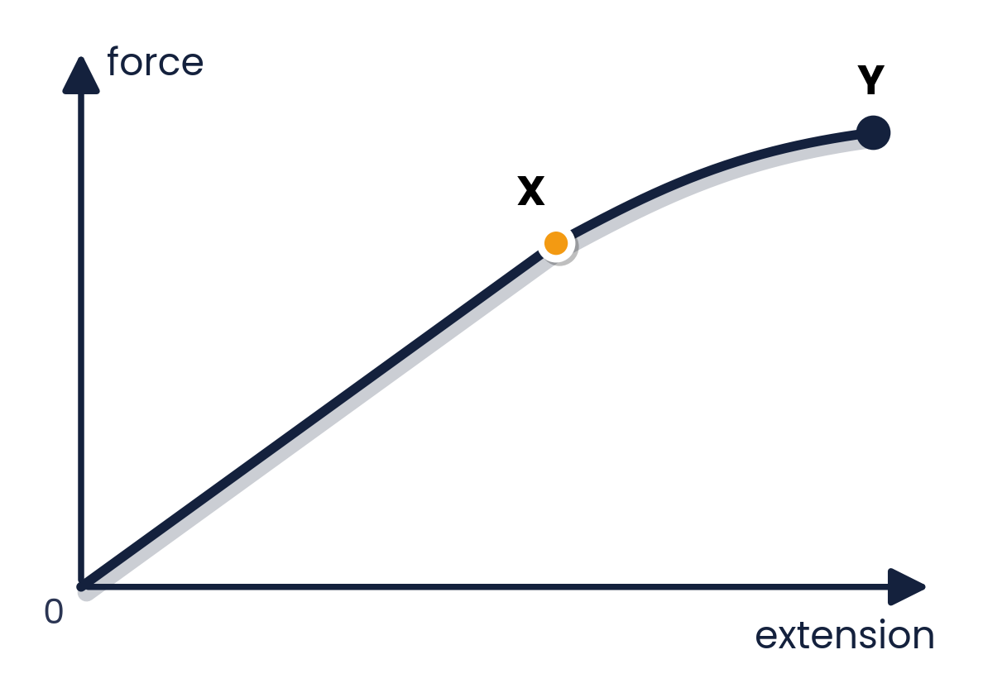
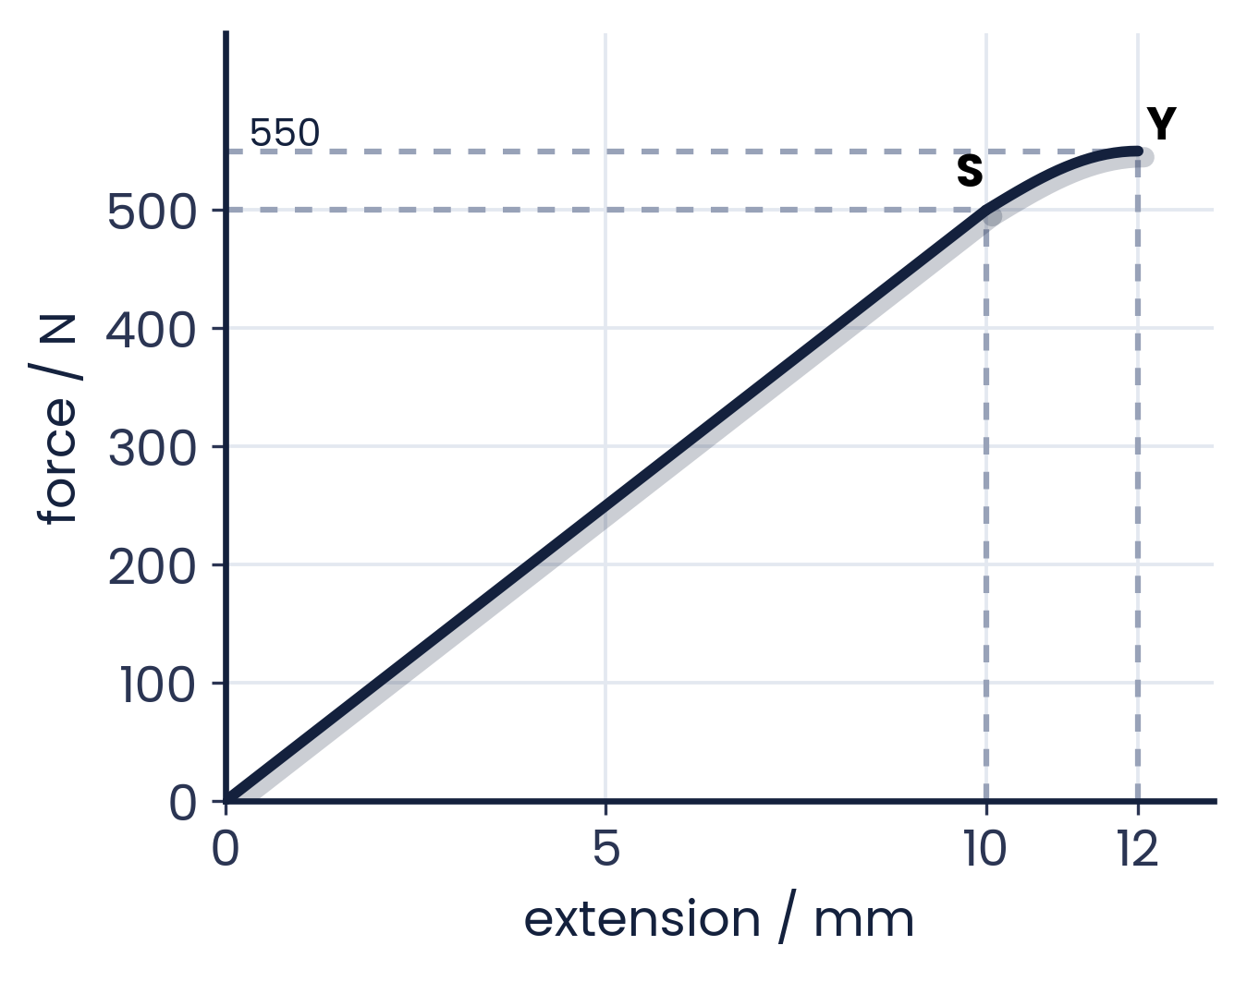
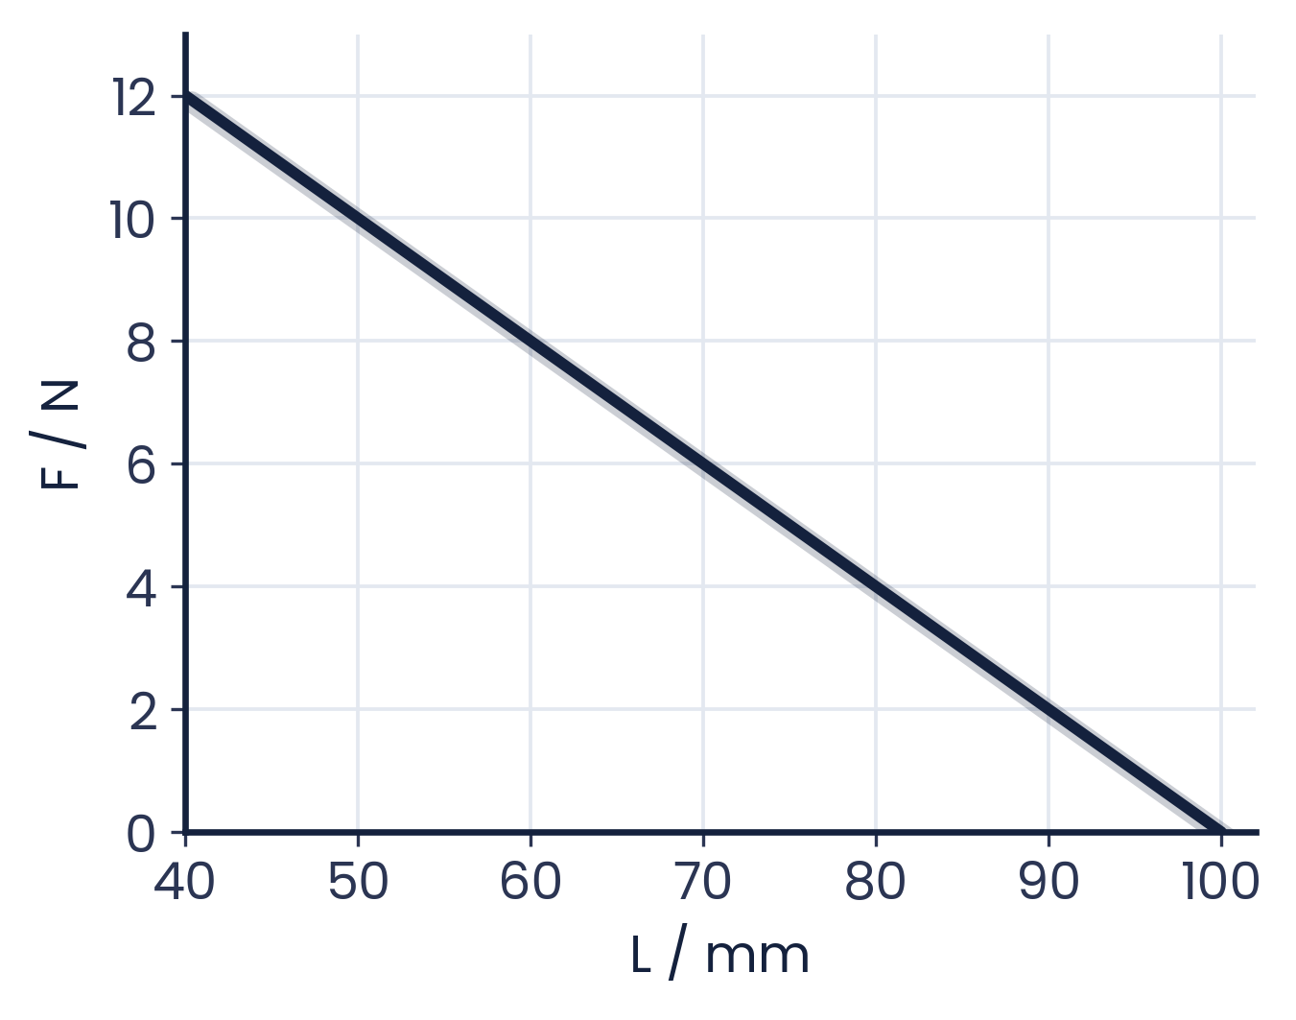
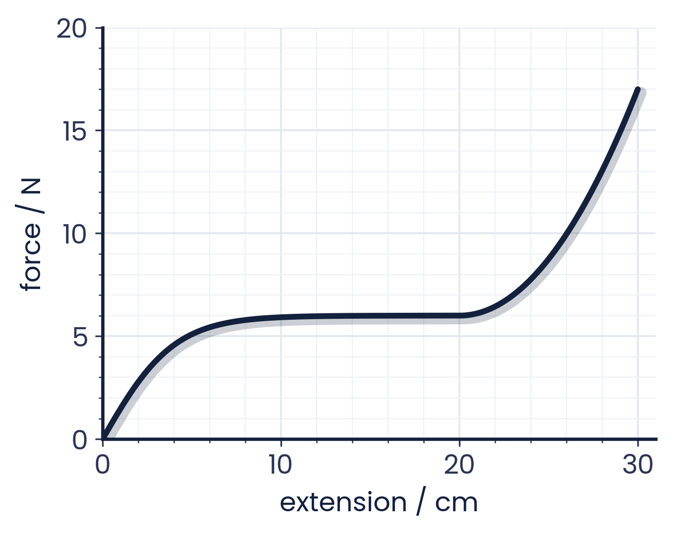
PAPER 1 STYLE · MULTIPLE CHOICE
Past paper set C · Graphs and energy
9
A metal sample is loaded until it fractures. What is the behaviour of the metal between X and Y?
10
A metal is stretched from 0 to 12.0 mm (graph). What is the work done? Treat SY as a straight line.
A both elastic and plastic
B not elastic and not plastic
C plastic but not elastic
D elastic but not plastic
A 6.60 J
B 3.60 J
C 3.55 J
D 3.30 J
11
A force compresses a mattress spring from 100 mm (graph of F against length L). What is the energy stored when L = 70 mm?
12
A graph shows the force applied to a rubber cord. What is the maximum strain energy in this deformed cord?
A 0.63 J
B 0.27 J
C 0.21 J
D 0.090 J
A 200 J
B 5.1 J
C 2.5 J
D 1.9 J
Topic 6 · Deformation of solids | Cambridge International AS Level Physics 9702
35

Slide 36
ANSWERS AND KEY WORKING
Answers · Questions 9 – 12
9
Answer C
10
Answer C
Straight to X (elastic); the curve from X to Y means the elastic limit is passed — plastic deformation until it fractures.
½ × 500 × 0.010 = 2.50 J plus ½ × (500 + 550) × 0.002 = 1.05 J → 3.55 J.
11
Answer D
12
Answer D
k = 12 N / 60 mm; at L = 70 mm, compression 30 mm and F = 6 N: E = ½ × 6 × 0.030 = 0.090 J.
Count squares: ≈ 0.45 + 0.6 + 0.9 ≈ 1.9 J (remember cm → m). 200 J forgets the conversion.
Topic 6 · Deformation of solids | Cambridge International AS Level Physics 9702
36

Slide 37
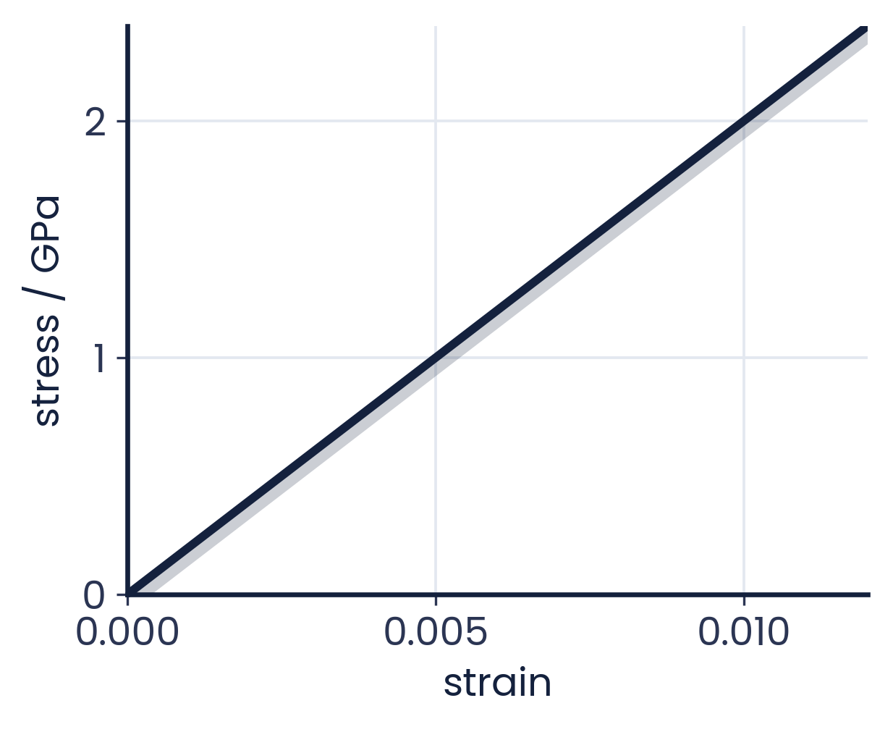
PAPER 1 STYLE · MULTIPLE CHOICE
Past paper set D · Strain energy and behaviour
13
The stress–strain graph for a metal is shown. When the strain is 0.010, what is the strain energy per unit volume?
14
A student shades the area under a graph for a metal wire; the area shows the total strain energy. How should the axes be labelled (Y, X)?
A 10 kJ m⁻³
B 10 MJ m⁻³
C 100 kJ m⁻³
D 1.0 MJ m⁻³
A mass, extension
B force, extension
C strain, energy
D stress, strain
15
A sample is loaded to a maximum force then unloaded. On contraction it follows the same curve (S to T) as when stretched. What is its behaviour between S and T?
A both elastic and plastic
B elastic but not plastic
C not elastic and not plastic
D plastic but not elastic
Topic 6 · Deformation of solids | Cambridge International AS Level Physics 9702
37

Slide 38
ANSWERS AND KEY WORKING
Answers · Questions 13 – 15
13
Answer B
14
Answer B
Energy per unit volume = ½σε = ½ × 2 × 10⁹ × 0.010 = 1.0 × 10⁷ J m⁻³ = 10 MJ m⁻³.
Area under a force–extension graph = work done = strain energy. (Stress–strain area gives energy per unit volume.)
15
Answer B
Returning along the same curve means no permanent change: elastic, even though the graph is curved (not Hooke's law).
Topic 6 · Deformation of solids | Cambridge International AS Level Physics 9702
38

Slide 39
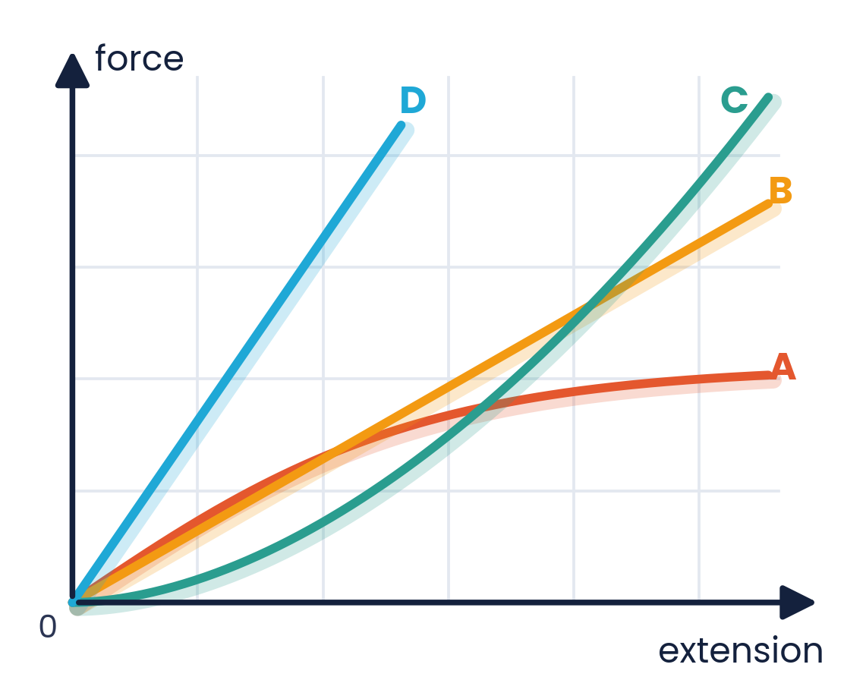
PAPER 2 STYLE · STRUCTURED QUESTION
Past paper 1 · Four springs
The figure shows the force–extension graphs for four springs, A, B, C and D.
(a) State which spring has the greatest value of force constant.
(b) State which spring is the least stiff.
(c) State which of the four springs does not obey Hooke's law.
Topic 6 · Deformation of solids | Cambridge International AS Level Physics 9702
39

Slide 40
MARK SCHEME STYLE SOLUTION
Past paper 1 · Solution
(a)
Spring D — the graph has the steepest gradient
(b)
Spring A — it extends the most for each unit of force applied (smallest gradient)
(c)
Spring C — no section of the graph forms a straight line through the origin
Topic 6 · Deformation of solids | Cambridge International AS Level Physics 9702
40

Slide 41
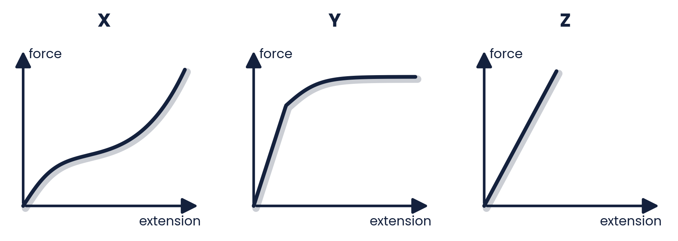
PAPER 2 STYLE · STRUCTURED QUESTION
Worked example · Identify the materials
Cylindrical samples of steel, glass and rubber are each subjected to a gradually increasing tensile force F. The extensions e are measured and graphs X, Y and Z are plotted.
Correctly label the graphs with the materials: steel, glass, rubber.
Explain your choice for each graph.
Topic 6 · Deformation of solids | Cambridge International AS Level Physics 9702
41

Slide 42
MARK SCHEME STYLE SOLUTION
Worked example · Solution
X = rubber
Non-linear throughout; extends considerably before breaking with little force; stiffens at large extension
Y = steel
Linear (elastic) region, then curves over into a large plastic region — ductile
Z = glass
Straight line up to breaking with no plastic region — brittle
Topic 6 · Deformation of solids | Cambridge International AS Level Physics 9702
42

Slide 43
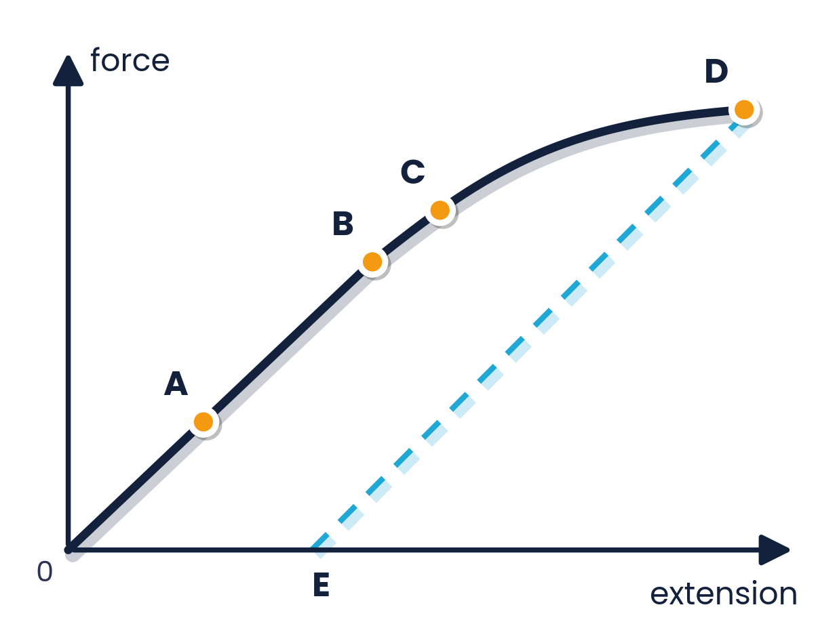
PAPER 2 STYLE · STRUCTURED QUESTION
Past paper 2 · Points on a force–extension graph
The figure shows the force–extension graph for a wire. The wire is loaded to D and then the load is removed; it returns along the dashed line to E.
(a) Which point shows the limit of proportionality?
(b) Which point shows the elastic limit?
(c) What does the length OE represent?
Topic 6 · Deformation of solids | Cambridge International AS Level Physics 9702
43

Slide 44
MARK SCHEME STYLE SOLUTION
Past paper 2 · Solution
(a)
B — the end of the straight-line section
(b)
C — beyond this the wire does not return to its original length
(c)
The permanent (plastic) extension; the unloading line is parallel to the original straight line
Topic 6 · Deformation of solids | Cambridge International AS Level Physics 9702
44

Slide 45
PAPER 2 STYLE · STRUCTURED QUESTION
Past paper 3 · Young modulus of steel
A piece of steel wire, 200.0 cm long and with cross-sectional area 0.50 mm², is stretched by a force of 50 N. Its new length is 200.1 cm.
(a) Calculate the stress in the wire.
(b) Calculate the strain.
(c) Calculate the Young modulus of steel.
Topic 6 · Deformation of solids | Cambridge International AS Level Physics 9702
45

Slide 46
MARK SCHEME STYLE SOLUTION
Past paper 3 · Solution
(a)
σ = F / A = 50 / (0.50 × 10⁻⁶) = 1.0 × 10⁸ Pa (0.5 mm² = 0.5 × 10⁻⁶ m²)
(b)
ε = x / L = 0.1 / 200.0 = 5.0 × 10⁻⁴ (0.05%)
(c)
E = σ / ε = 1.0 × 10⁸ / 5.0 × 10⁻⁴ = 2.0 × 10¹¹ Pa
Topic 6 · Deformation of solids | Cambridge International AS Level Physics 9702
46

Slide 47
PAPER 2 STYLE · STRUCTURED QUESTION
Past paper 4 · Extension of a copper wire
Calculate the extension of a copper wire of length 1.00 m and diameter 1.00 mm when a tensile force of 10 N is applied to the end of the wire. The Young modulus of copper is 130 GPa.
(a) Rearrange E = FL / Ax to make x the subject.
(b) Calculate the cross-sectional area.
(c) Calculate the extension.
Topic 6 · Deformation of solids | Cambridge International AS Level Physics 9702
47

Slide 48
MARK SCHEME STYLE SOLUTION
Past paper 4 · Solution
(a)
x = FL / AE
(b)
A = πd² / 4 = π × (1.00 × 10⁻³)² / 4 = 7.85 × 10⁻⁷ m²
(c)
x = 10 × 1.00 / (7.85 × 10⁻⁷ × 130 × 10⁹) = 9.8 × 10⁻⁵ m
Topic 6 · Deformation of solids | Cambridge International AS Level Physics 9702
48

Slide 49
PAPER 2 STYLE · STRUCTURED QUESTION
Past paper 5 · Glass fibre
In an experiment to measure the Young modulus of glass, a student draws out a glass rod into a fibre 0.800 m long. Using a travelling microscope she estimates its diameter to be 0.40 mm. The fibre snaps when a 1.00 N load is hung on the end; she judges it extended by no more than 1 mm before it snapped.
(a) Use these values to estimate the Young modulus of the glass.
(b) Explain how the actual or accepted value might differ from this estimate.
Topic 6 · Deformation of solids | Cambridge International AS Level Physics 9702
49

Slide 50
MARK SCHEME STYLE SOLUTION
Past paper 5 · Solution
(a)
σ = 4F / πd² = 4 × 1.00 / (π × (0.0004)²) = 8.0 × 10⁶ Pa; ε = 0.001 / 0.800 = 1.25 × 10⁻³ (at most); E ≈ 6.4 × 10⁹ Pa
(b)
The extension may have been LESS than 1 mm, so the strain is smaller and E could be larger. The diameter estimate is also uncertain (d is squared).
Topic 6 · Deformation of solids | Cambridge International AS Level Physics 9702
50

Slide 51
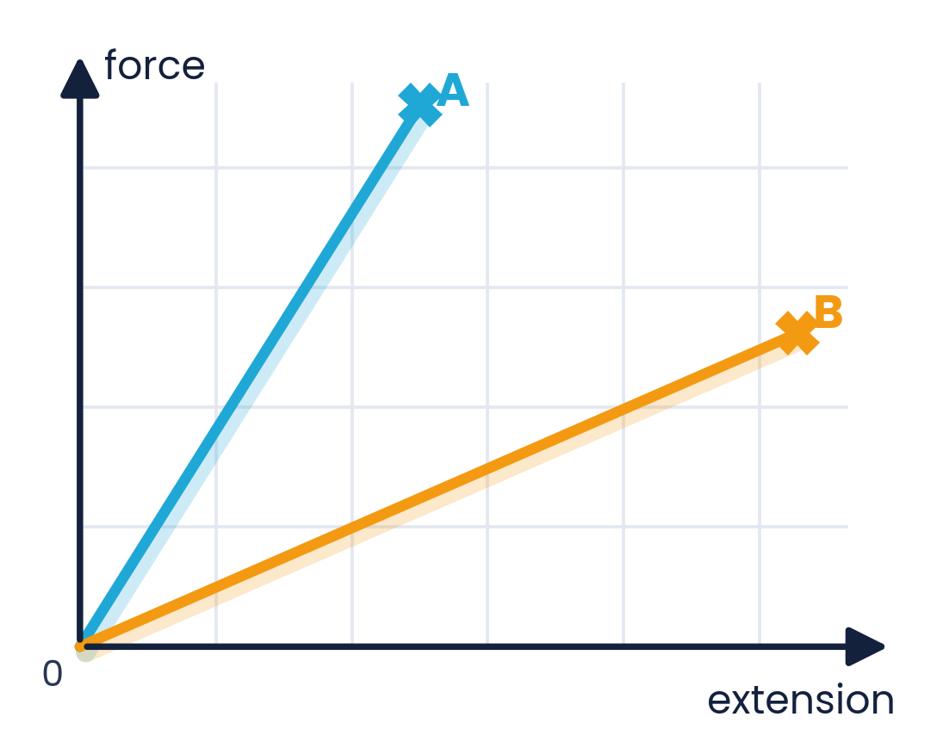
PAPER 2 STYLE · STRUCTURED QUESTION
Past paper 6 · Two polymers
The figure shows force–extension graphs for two polymers, A and B, up to the point where each breaks. For each statement, explain how you deduce your answer from the graphs.
(a) State which polymer has the greater stiffness.
(b) State which polymer requires the greater force to break it.
(c) State which polymer requires the greater amount of work to be done to break it.
Topic 6 · Deformation of solids | Cambridge International AS Level Physics 9702
51

Slide 52
MARK SCHEME STYLE SOLUTION
Past paper 6 · Solution
(a)
A — steeper gradient: less extension per unit force
(b)
A — its line continues to a higher force value
(c)
B — larger area under its graph
Topic 6 · Deformation of solids | Cambridge International AS Level Physics 9702
52

Slide 53
PAPER 2 STYLE · STRUCTURED QUESTION
Past paper 7 · Pre-stressed railway line
To allow for expansion in summer, a steel rail laid in cold weather is pre-stressed by a force of 2.6 × 10⁵ N. Its cross-sectional area is 5.0 × 10⁻³ m². A strain of 1.4 × 10⁻⁵ is caused by each °C rise in temperature. The Young modulus of the steel is 2.1 × 10¹¹ Pa.
(a) State and explain whether the force applied when the rail is laid should be tensile or compressive.
(b)(i) Calculate the strain produced when the rail is laid.
(b)(ii) Calculate the temperature rise when the rail becomes unstressed.
Topic 6 · Deformation of solids | Cambridge International AS Level Physics 9702
53

Slide 54
MARK SCHEME STYLE SOLUTION
Past paper 7 · Solution
(a)
Tensile — the rail expands on heating, which reduces the tensile stress; it becomes unstressed when the temperature is higher
(b)(i)
σ = 2.6 × 10⁵ / 5.0 × 10⁻³ = 5.2 × 10⁷ Pa; ε = σ / E = 5.2 × 10⁷ / 2.1 × 10¹¹ = 2.5 × 10⁻⁴
(b)(ii)
Temperature rise = 2.48 × 10⁻⁴ / 1.4 × 10⁻⁵ = 17.7 ≈ 18 °C
Topic 6 · Deformation of solids | Cambridge International AS Level Physics 9702
54

Slide 55
COMMON DOUBTS & MISCONCEPTIONS
Students often ask… (1)
?
“Is the limit of proportionality the same as the elastic limit?”
?
“Does a curved F–x graph mean plastic deformation?”
No. The LoP is where F stops being proportional to x; the elastic limit is where permanent deformation starts. They are close but different.
Not necessarily. Rubber has a curved graph but still returns to its original length — it is elastic, just not Hookean.
?
“Does a thicker wire have a larger Young modulus?”
?
“Why does my Young modulus come out 10³ times too big?”
No. E is a property of the material. A thicker wire has a larger spring constant k, but the same E.
Usually mm² was converted with 10⁻³ instead of 10⁻⁶, or a percentage strain was not divided by 100.
Topic 6 · Deformation of solids | Cambridge International AS Level Physics 9702
55

Slide 56
COMMON DOUBTS & MISCONCEPTIONS
Students often ask… (2)
?
“Can I always use E = ½kx²?”
?
“Are two springs in series stiffer?”
Only within the limit of proportionality. Otherwise use the area under the F–x graph.
No — less stiff. The same force acts on each, so the extensions add. Springs in parallel are stiffer.
?
“Is all the work done stored as strain energy?”
?
“Is a brittle material weak?”
Only for elastic deformation. In plastic deformation (and rubber hysteresis) some energy becomes internal (thermal) energy.
Not necessarily. Glass and diamond can have high tensile strength; brittle means little or no plastic deformation before breaking.
Topic 6 · Deformation of solids | Cambridge International AS Level Physics 9702
56

Slide 57
COMMAND WORDS AND MARK-SCHEME HABITS
Exam technique for deformation of solids
Define
Units
stress: force per unit cross-sectional area; strain: extension per unit original length; E = stress / strain
convert mm → m and mm² → m² (× 10⁻⁶); strain has no unit; E in Pa
Hooke's law
Energy
‘extension is proportional to force, up to the limit of proportionality’
½Fx only for straight-line graphs; otherwise count squares or split into shapes
Describe the experiment
Materials
long thin wire, micrometer for d, rule for L, marker for x, plot σ against ε
brittle = straight to breaking; ductile = large plastic region; polymer = curved
Topic 6 · Deformation of solids | Cambridge International AS Level Physics 9702
57

Slide 58
KEY IDEAS TO TAKE AWAY
Deformation in one slide
F = kx
σ = F / A
ε = x / L
E = FL / Ax
Limits
limit of proportionality → elastic limit → plastic → UTS → breaking
Energy
area under F–x = work done · E = ½Fx = ½kx² within the limit of proportionality
Springs
series: 1/k = 1/k₁ + 1/k₂ · parallel: k = k₁ + k₂
Topic 6 · Deformation of solids | Cambridge International AS Level Physics 9702
58

