Slide 1
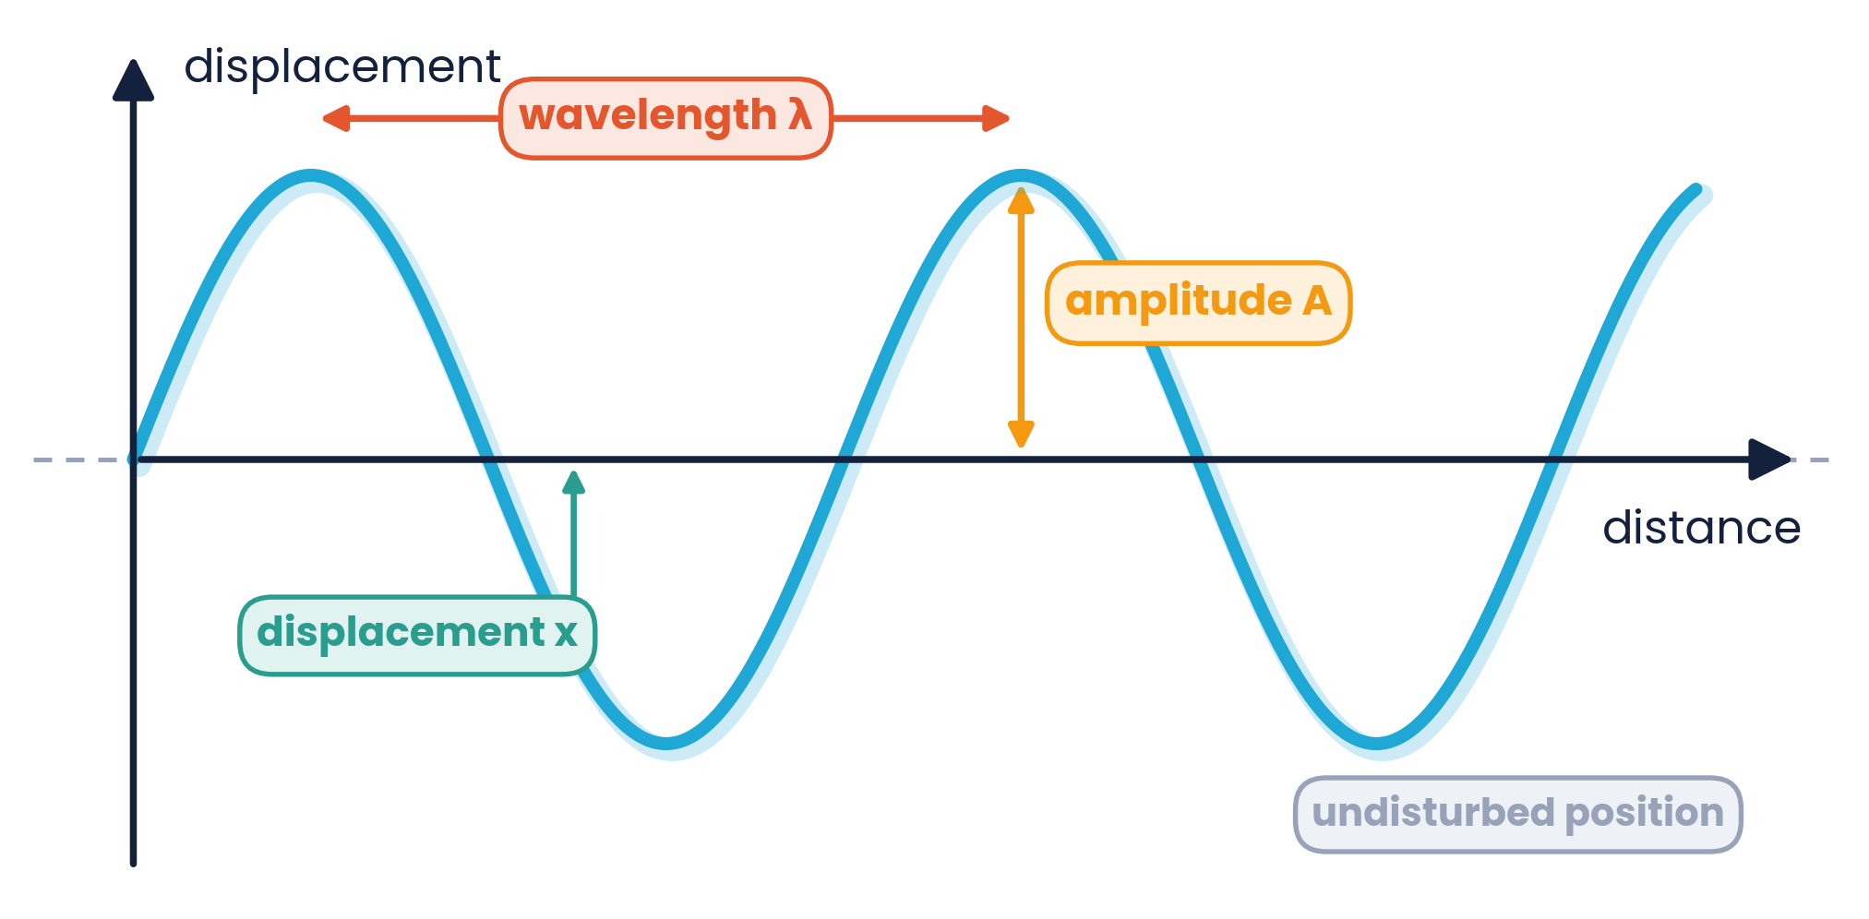

CAMBRIDGE AS & A LEVEL · PHYSICS 9702 · TOPIC 7
Waves
Energy on the Move
Progressive waves · Doppler effect · EM spectrum · polarisation
Syllabus 7.1 – 7.5 | Exams 2025 – 2027
WA
Waseem Ahmad
Head of Science & IB Physics Lead Teacher
Presidential School, Jizzakh · Cambridge Examiner
Author, Orange Publication · www.examspath.com

Slide 2
SYLLABUS 7.1 – 7.5 · WAVES
What the syllabus asks you to do
7.1.1
7.1.2
7.1.3
7.1.4
Wave motion in ropes, springs and ripple tanks
Displacement, amplitude, phase difference, period, frequency, wavelength, speed
Time-base and y-gain of a CRO
Derive v = fλ
7.1.5
7.1.6
7.1.7
7.2.1
Recall and use v = fλ
Progressive waves transfer energy
Intensity = power / area; I ∝ A²
Compare transverse and longitudinal waves
7.2.2
7.3.1
7.3.2
7.4.1
Interpret graphs of transverse and longitudinal waves
Doppler effect for a moving source
Use fₒ = fₛv / (v ± vₛ)
All EM waves are transverse with speed c in free space
7.4.2
7.4.3
7.5.1
7.5.2
Wavelength ranges from radio to γ-rays
Visible light: 400 – 700 nm
Polarisation is for transverse waves only
Malus's law I = I₀cos²θ
Topic 7 · Waves | Cambridge International AS Level Physics 9702
2

Slide 3
TOPIC 7 · WAVES
Lesson roadmap
01
02
03
04
Progressive waves
Phase & v = fλ
Energy & intensity
The oscilloscope
Terms and wave graphs
Phase difference, wave equation
I = P/A, I ∝ A², inverse square
Time-base and y-gain
05
06
07
08
Wave types
Doppler effect
EM spectrum
Polarisation
Transverse & longitudinal
fₒ = fₛv / (v ± vₛ)
Radio to γ-rays
Malus's law
Topic 7 · Waves | Cambridge International AS Level Physics 9702
3

Slide 4
LEARNING OUTCOMES 7.1.1 – 7.1.2
01
Progressive waves
Energy is transferred by oscillations — matter is not
Topic 7 · Waves | Cambridge International AS Level Physics 9702
4

Slide 5
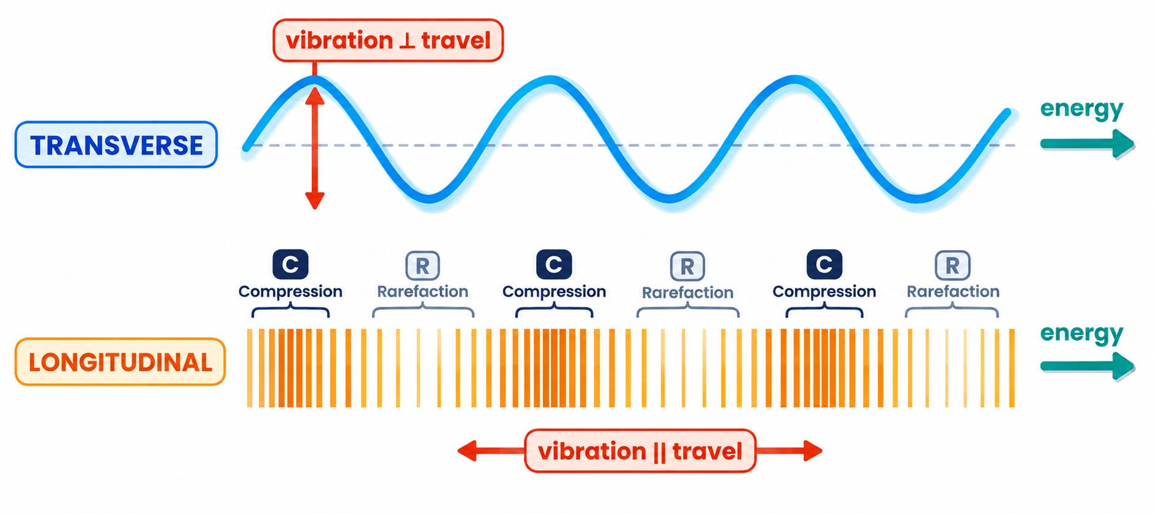
7.1.1 · VIBRATIONS IN ROPES, SPRINGS AND RIPPLE TANKS
Wave motion
A progressive wave transfers energy from one place to another without transferring matter
Each particle oscillates about a fixed equilibrium position
Rope: vibrations ⊥ to travel (transverse)
Spring (slinky): vibrations ∥ to travel (longitudinal)
Ripple tank: water surface waves seen from above as wavefronts
A plucked guitar string vibrates → the air vibrates → a sound wave. All vibrations produce waves of one kind or another.
Topic 7 · Waves | Cambridge International AS Level Physics 9702
5

Slide 6
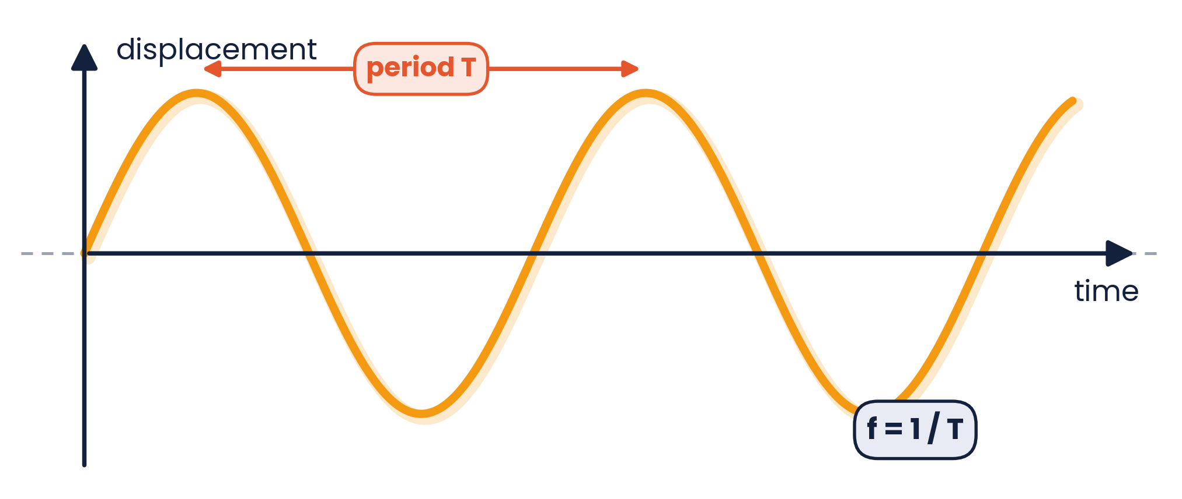
7.1.2 · THE KEY TERMS
Describing a wave
Displacement x: distance of a point from its equilibrium position (m)
Amplitude A: maximum displacement from equilibrium (m)
Wavelength λ: distance between successive points in phase, e.g. crest to crest (m)
Period T: time for one complete oscillation (s)
Frequency f: oscillations per second (Hz); f = 1/T
Speed v: distance travelled by the wave per unit time (m s⁻¹)
Topic 7 · Waves | Cambridge International AS Level Physics 9702
6

Slide 7
7.1.2 & 7.2.2 · READ THE X-AXIS FIRST!
Two kinds of wave graph
Displacement–distance
a ‘snapshot’ of the whole wave at one instant. Read wavelength λ and amplitude A.
Displacement–time
how ONE point moves over time. Read period T (then f = 1/T) and amplitude A — not λ.
Topic 7 · Waves | Cambridge International AS Level Physics 9702
7

Slide 8
LEARNING OUTCOMES 7.1.2, 7.1.4 – 7.1.5
02
Phase difference and the wave equation
How far ahead one wave is · v = fλ
Topic 7 · Waves | Cambridge International AS Level Physics 9702
8

Slide 9
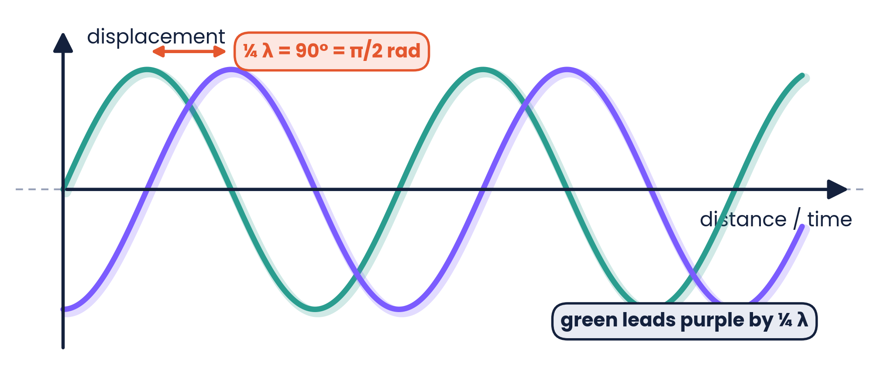
7.1.2 · IN FRONT OR BEHIND?
Phase difference
φ = (x / λ) × 360°
or × 2π rad, where x is the path (or time) difference as a fraction of λ (or T)
In phase
Antiphase
Quarter cycle
0°, 360° (2π): crests line up
180° (π): crest meets trough
90° (π/2): ¼ λ apart
Topic 7 · Waves | Cambridge International AS Level Physics 9702
9

Slide 10
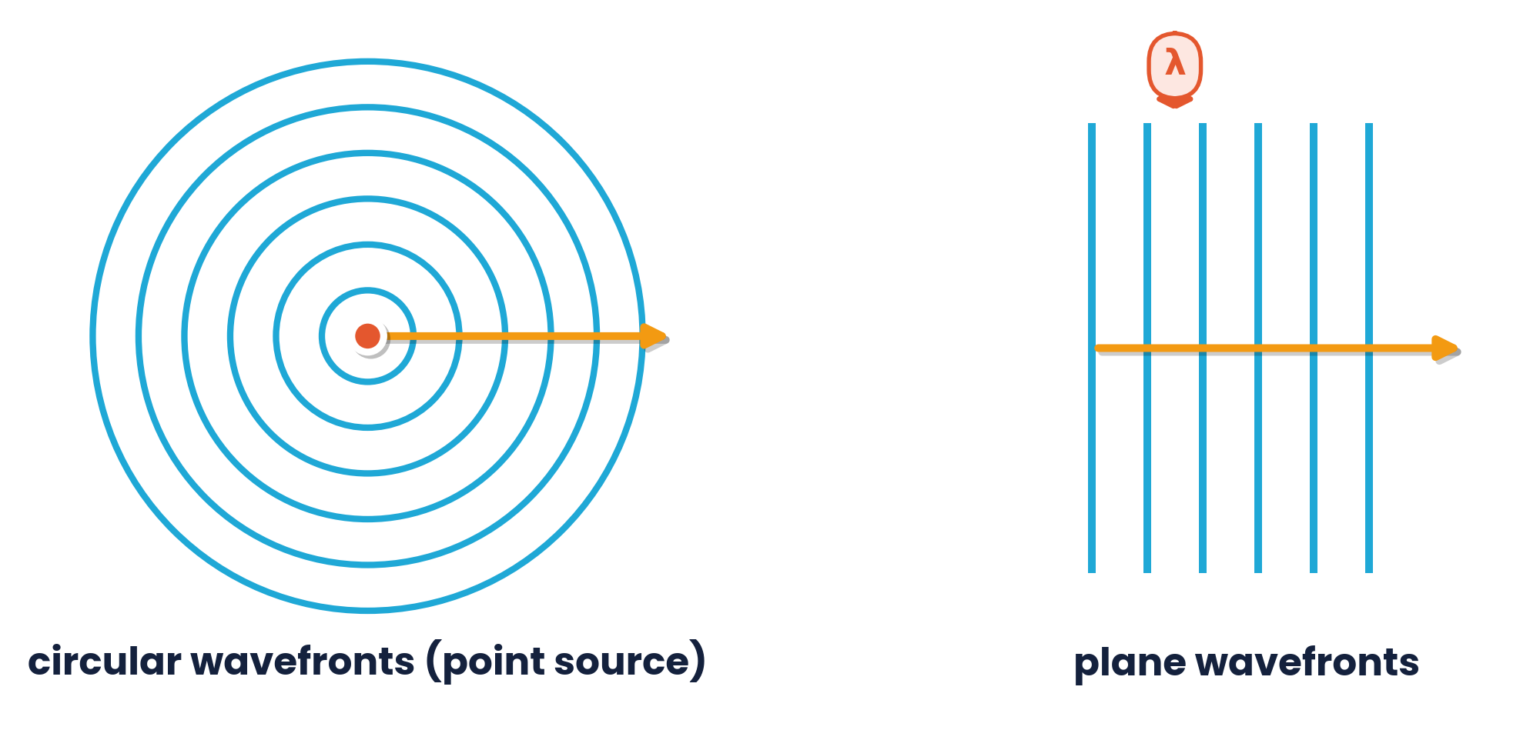
7.1.1 · SEEING WAVES FROM ABOVE
Wavefronts
A wavefront joins points on a wave that are in phase (e.g. all the crests)
Adjacent wavefronts are one wavelength apart
The wave travels at right angles to its wavefronts
Point source → circular; far from source → plane
Topic 7 · Waves | Cambridge International AS Level Physics 9702
10

Slide 11
7.1.4 & 7.1.5 · FROM THE DEFINITIONS
Deriving the wave equation v = fλ
Derivation
v = fλ
1
speed = distance / time
speed (m s⁻¹) = frequency (Hz) × wavelength (m)
2
In one period T the wave moves one wavelength λ
3
v = λ / T
For constant speed
Larger λ → smaller f
Smaller λ → larger f
The frequency is set by the source; the speed by the medium
4
Since f = 1 / T: v = fλ
Topic 7 · Waves | Cambridge International AS Level Physics 9702
11

Slide 12
7.1.5 · RECALL AND USE V = FΛ
Worked examples · The wave equation
Sound in steel
Cello string
v = 5060 m s⁻¹, λ = 0.25 m
f = 64 Hz, λ = 1.40 m
f = v / λ = 5060 / 0.25 = 2.0 × 10⁴ Hz (20 kHz)
v = fλ = 64 × 1.40 = 90 m s⁻¹
Rope oscillator
Orange light
f = 30 Hz, λ = 5.0 cm
λ = 600 nm, c = 3.0 × 10⁸ m s⁻¹
v = 30 × 0.050 = 1.5 m s⁻¹
f = c / λ = 5.0 × 10¹⁴ Hz (500 THz)
Topic 7 · Waves | Cambridge International AS Level Physics 9702
12

Slide 13
LEARNING OUTCOMES 7.1.6 – 7.1.7
03
Energy and intensity
Intensity = power per unit area
Topic 7 · Waves | Cambridge International AS Level Physics 9702
13

Slide 14
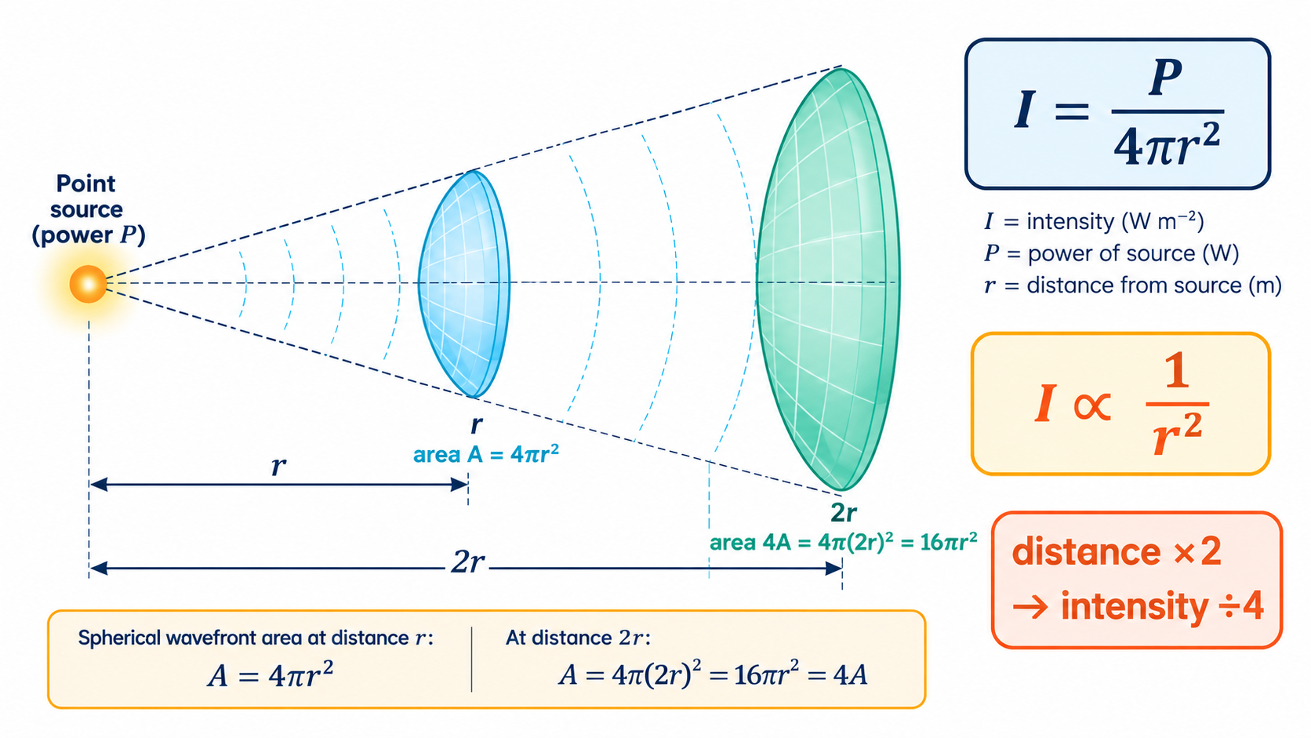
7.1.6 & 7.1.7 · POWER PER UNIT AREA
Intensity of a wave
I = P / A
I ∝ A²
I = P / 4πr²
intensity (W m⁻²) = power (W) ÷ area (m²)
double the amplitude → 4 × the intensity
point source: spreads over a sphere
Inverse square law: I ∝ 1/r²
Twice as far → one quarter of the intensity
Waves transfer energy; stationary waves do not
Topic 7 · Waves | Cambridge International AS Level Physics 9702
14

Slide 15
7.1.7 · I ∝ A² AND THE INVERSE SQUARE LAW
Worked examples · Intensity
Amplitude doubled
Intensity reduced
A wave has amplitude 5.0 cm and intensity 400 W m⁻². The amplitude increases to 10.0 cm.
The intensity falls from 400 W m⁻² to 100 W m⁻². Find the new amplitude.
A × 2 → I × 4 = 1600 W m⁻²
I ÷ 4 → A ÷ 2 = 2.5 cm
100 W lamp at 1.0 m
100 W lamp at 2.0 m
Radiation spreads equally in all directions.
Twice as far away.
I = 100 / (4π × 1.0²) = 8.0 W m⁻²
I = 100 / (4π × 2.0²) = 2.0 W m⁻² (¼ as much)
Topic 7 · Waves | Cambridge International AS Level Physics 9702
15

Slide 16
LEARNING OUTCOME 7.1.3
04
The cathode-ray oscilloscope
Measuring frequency and amplitude
Topic 7 · Waves | Cambridge International AS Level Physics 9702
16

Slide 17
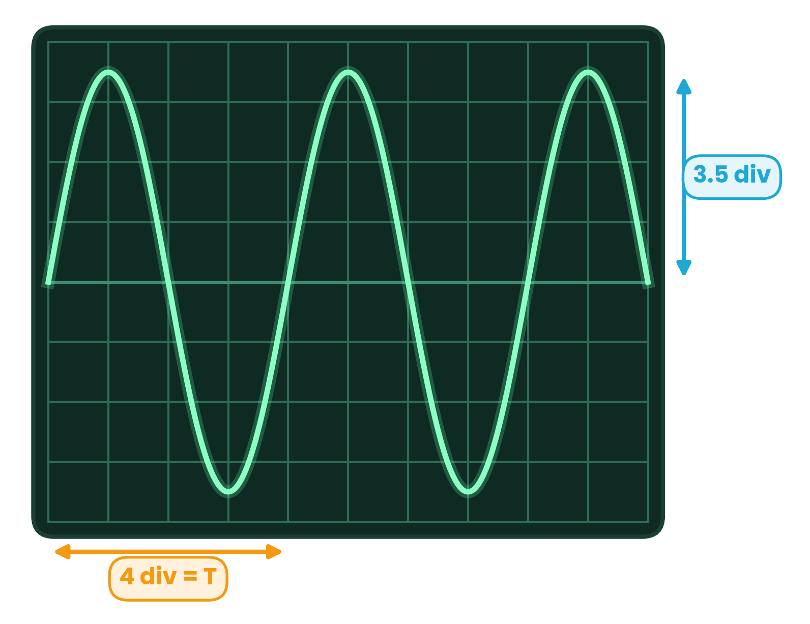
7.1.3 · TIME-BASE AND Y-GAIN
Using the CRO
Time-base (x-axis)
time per division (s div⁻¹ or ms cm⁻¹)
T = divisions per cycle × time-base; f = 1 / T
measure over several cycles to reduce uncertainty
Y-gain (y-axis)
volts per division (V div⁻¹)
amplitude = divisions from centre to peak × y-gain
example: 1 ms div⁻¹, 20 mV div⁻¹ → T = 4 ms, f = 250 Hz, A = 70 mV
The CRO trace is a graph of p.d. against TIME — it shows T, not λ.
Topic 7 · Waves | Cambridge International AS Level Physics 9702
17

Slide 18
LEARNING OUTCOMES 7.2.1 – 7.2.2
05
Transverse and longitudinal waves
Compare them and interpret their graphs
Topic 7 · Waves | Cambridge International AS Level Physics 9702
18

Slide 19
7.2.1 · DIRECTION OF VIBRATION
Transverse vs longitudinal
TRANSVERSE
LONGITUDINAL
Oscillations perpendicular to the direction of energy transfer
Have crests and troughs
Can be polarised
Examples: all EM waves, waves on a string, ripples on water, seismic S-waves
Oscillations parallel to the direction of energy transfer
Have compressions and rarefactions
Cannot be polarised
Examples: sound, ultrasound, seismic P-waves, a pushed slinky
Topic 7 · Waves | Cambridge International AS Level Physics 9702
19

Slide 20
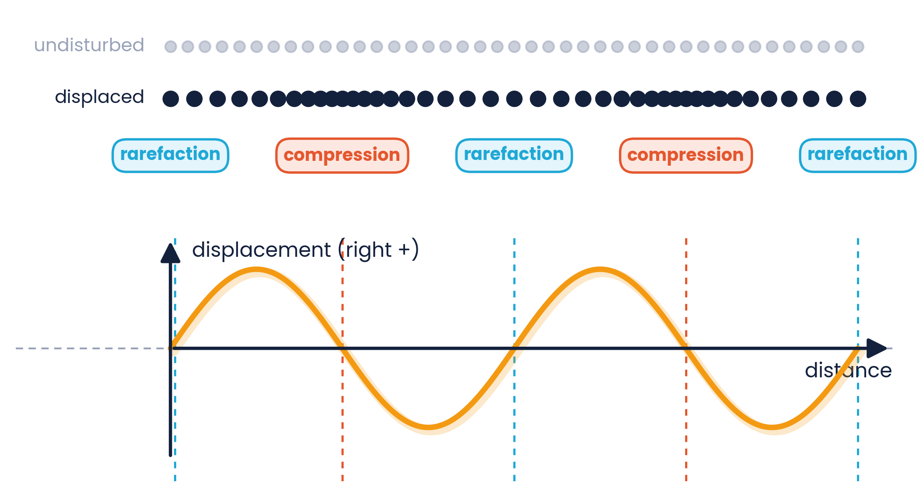
7.2.2 · COMPRESSIONS AND RAREFACTIONS
Graphs of a longitudinal wave
Plot displacement (right = +) against distance
Compression: particles on either side move towards it — displacement crosses zero going from + to −
Rarefaction: particles move apart — zero crossing from − to +
Pressure is highest at compressions, lowest at rarefactions
The displacement graph of a sound wave LOOKS transverse — it is only a graph.
Topic 7 · Waves | Cambridge International AS Level Physics 9702
20

Slide 21
LEARNING OUTCOMES 7.3.1 – 7.3.2
06
The Doppler effect
A moving source changes the observed frequency
Topic 7 · Waves | Cambridge International AS Level Physics 9702
21

Slide 22
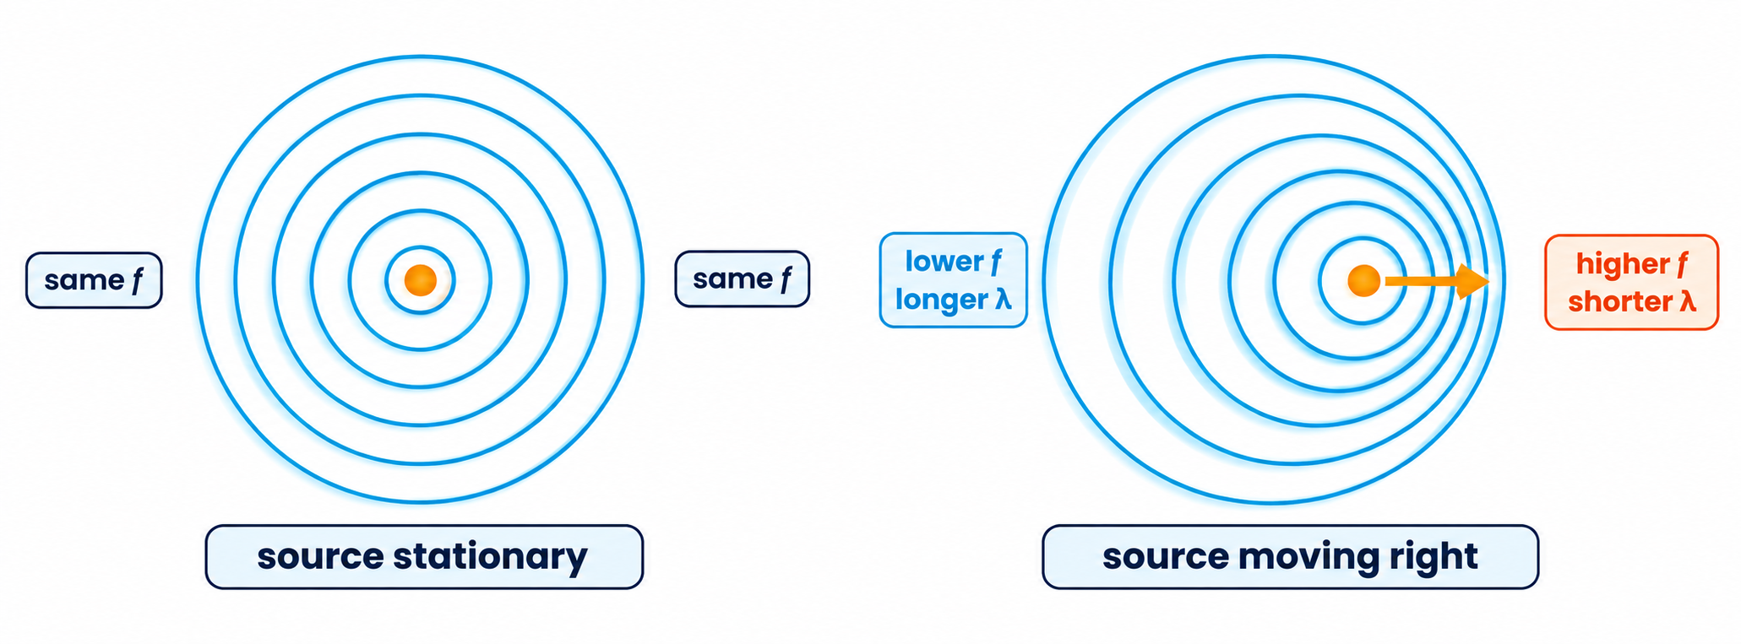
7.3.1 · SOURCE MOVING, OBSERVER STATIONARY
The Doppler effect for sound
Approaching:
wavefronts bunch up → shorter λ → higher observed frequency (higher pitch).
Receding:
wavefronts spread out → longer λ → lower observed frequency. An ambulance siren drops in pitch as it passes.
Topic 7 · Waves | Cambridge International AS Level Physics 9702
22

Slide 23
7.3.2 · Fₒ = FₛV / (V ± Vₛ)
Calculating the Doppler shift
fₒ = fₛ v / (v ± vₛ)
Towards the observer: v − vₛ (fₒ bigger)
Away from the observer: v + vₛ (fₒ smaller)
Only a moving SOURCE with a stationary observer is required
The equation is on the data sheet
fₒ observed, fₛ source frequency; v speed of sound; vₛ speed of source
Worked example
A train whistle of frequency 800 Hz approaches a stationary observer at 60 m s⁻¹ (speed of sound 330 m s⁻¹).
Approaching → minus sign: fₒ = 800 × 330 / (330 − 60) = 978 Hz ≈ 980 Hz — clearly higher, because 60 m s⁻¹ is a significant fraction of the speed of sound.
Topic 7 · Waves | Cambridge International AS Level Physics 9702
23

Slide 24
7.3.2 · WAVELENGTH AND FREQUENCY
Worked example · Aircraft flying away
An aircraft engine emits a note of constant frequency 120 Hz. It flies away from a stationary observer at 80 m s⁻¹ (speed of sound 330 m s⁻¹). Calculate (a) the observed wavelength (b) the observed frequency.
(a) Wavelength
(b) Frequency
Moving away stretches each wave by vₛT:
λₒ = (v + vₛ) / fₛ = (330 + 80) / 120
λₒ = 3.4 m
fₒ = v / λₒ = 330 / 3.4
or fₒ = fₛv / (v + vₛ) = 120 × 330 / 410
fₒ = 97 Hz
Topic 7 · Waves | Cambridge International AS Level Physics 9702
24

Slide 25
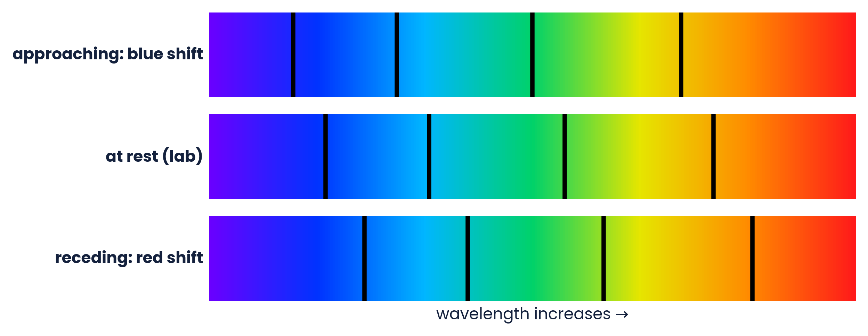
BEYOND SOUND · RED SHIFT AND BLUE SHIFT
Doppler effect for light
Star approaching: shorter λ → spectral lines shift towards blue
Star receding: longer λ → lines shift towards red
The pattern of lines is unchanged — only shifted
Used to measure speeds of stars and galaxies (A Level Topic 25)
The Sun rotates: one edge moves towards us and the other away, so light of one emitted wavelength is observed over a small range of wavelengths.
Topic 7 · Waves | Cambridge International AS Level Physics 9702
25

Slide 26
LEARNING OUTCOMES 7.4.1 – 7.4.3
07
The electromagnetic spectrum
Radio waves to gamma rays
Topic 7 · Waves | Cambridge International AS Level Physics 9702
26

Slide 27
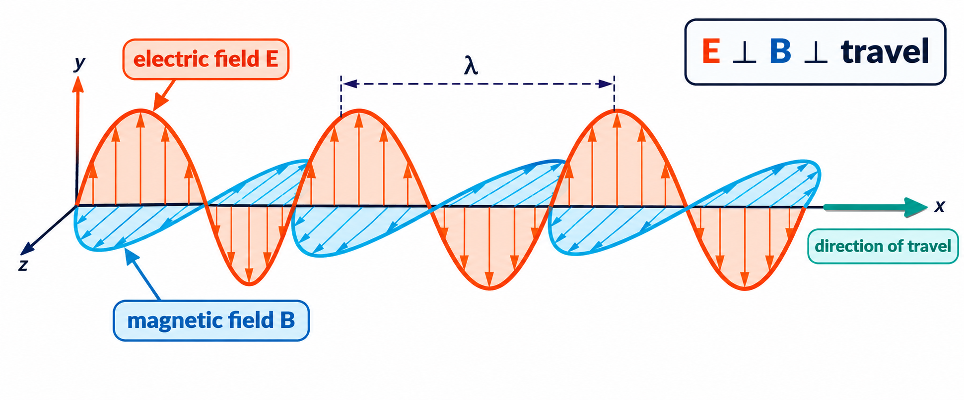
7.4.1 · COMMON PROPERTIES
Electromagnetic waves
Oscillating electric and magnetic fields at right angles to each other and to the direction of travel
All are transverse (so all can be polarised)
All travel through a vacuum
All travel at c = 3.00 × 10⁸ m s⁻¹ in free space
They differ only in wavelength and frequency.
Higher frequency → higher energy; UV, X-rays and γ-rays are ionising and can damage cells.
Topic 7 · Waves | Cambridge International AS Level Physics 9702
27

Slide 28
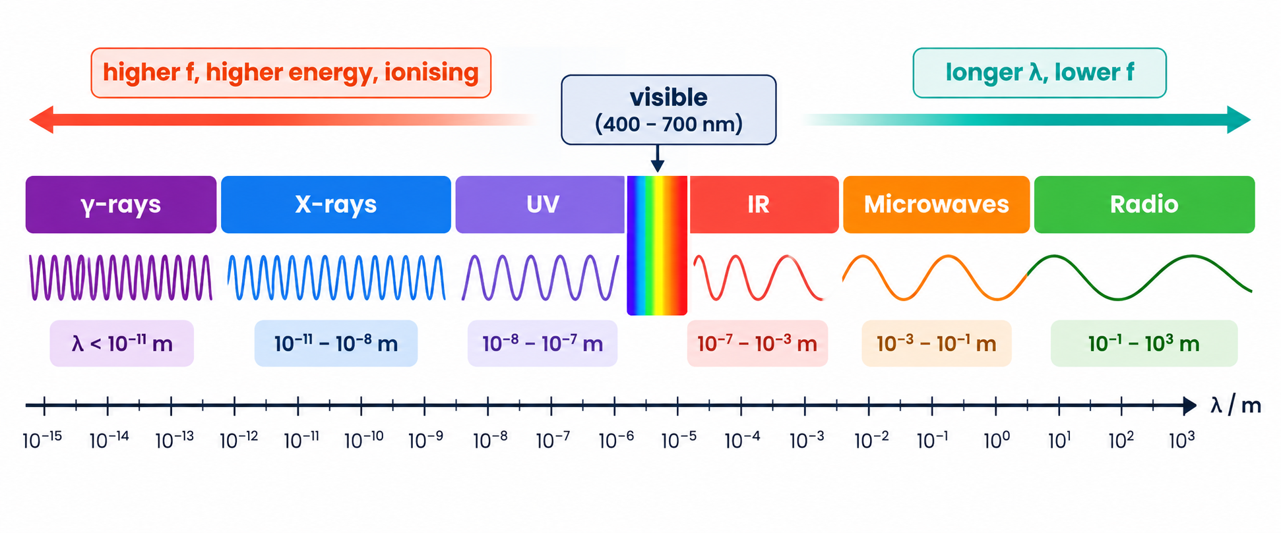
7.4.2 & 7.4.3 · APPROXIMATE VALUES IN FREE SPACE
Wavelength ranges to recall
γ-rays
X-rays
UV
visible
infrared
microwaves
radio
< 10⁻¹⁰ m
10⁻¹² – 10⁻⁸ m
10⁻⁸ – 4 × 10⁻⁷ m
4 – 7 × 10⁻⁷ m
7 × 10⁻⁷ – 10⁻³ m
10⁻³ – 10⁻¹ m
> 10⁻¹ m
Topic 7 · Waves | Cambridge International AS Level Physics 9702
28

Slide 29
7.4 · FROM RADIO WAVES TO GAMMA RAYS
Uses and dangers
Radio
Microwaves
Infrared
Visible
communication, radio and TV broadcasting
mobile phones, satellites, cooking, radar
remote controls, thermal imaging, optical fibres
sight, photography, lasers
Ultraviolet
X-rays
γ-rays
Visible light
security marking, sterilising, sun-tanning (can cause skin cancer)
medical imaging, airport security
cancer treatment, sterilising instruments
400 – 700 nm: only ~0.0035% of the spectrum; some animals see UV or IR
Topic 7 · Waves | Cambridge International AS Level Physics 9702
29

Slide 30
LEARNING OUTCOMES 7.5.1 – 7.5.2
08
Polarisation
Only transverse waves can be polarised
Topic 7 · Waves | Cambridge International AS Level Physics 9702
30

Slide 31
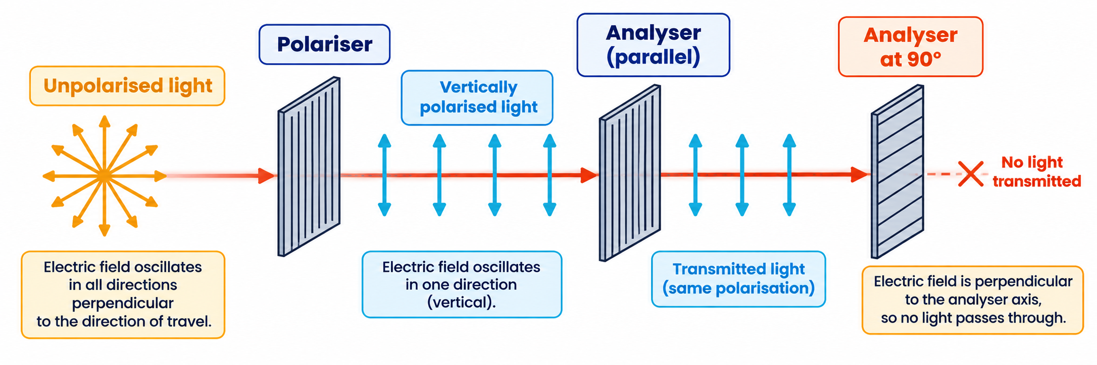
7.5.1 · OSCILLATIONS IN ONE PLANE
Polarised and unpolarised waves
Polarised:
oscillations are restricted to ONE plane, still perpendicular to the direction of travel.
Longitudinal waves (sound) cannot be polarised:
they already oscillate along the direction of travel.
Topic 7 · Waves | Cambridge International AS Level Physics 9702
31

Slide 32
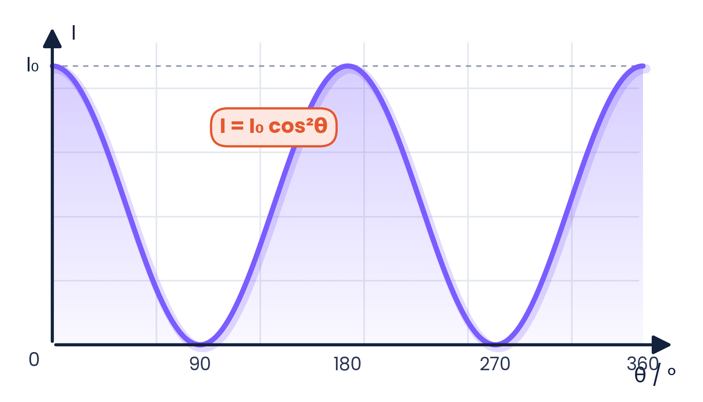
7.5.2 · INTENSITY THROUGH A POLARISING FILTER
Malus's law
I = I₀ cos²θ
θ = angle between the plane of polarisation and the transmission axis
θ = 0°: all light passes (I = I₀)
θ = 90°: none passes (crossed)
cos² because I ∝ A² and the amplitude component is A cos θ
Unpolarised light:
the first filter transmits I₀/2 (half the intensity). Calculations of this step are not required in the syllabus but make questions easier.
Topic 7 · Waves | Cambridge International AS Level Physics 9702
32

Slide 33
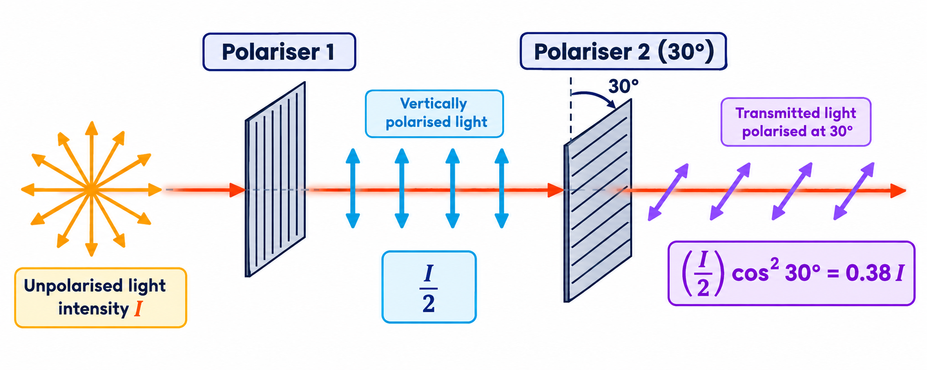
7.5.2 · RECALL AND USE I = I₀COS²Θ
Worked examples · Malus's law
θ = 45°
θ = 60°
Find θ
Plane-polarised light of 12 W m⁻² meets a Polaroid at 45°.
Same light, angle 60°.
Transmitted intensity is 30% of the incident intensity.
I = 12 × cos²45° = 12 × 0.50 = 6.0 W m⁻²
I = 12 × cos²60° = 12 × 0.25 = 3.0 W m⁻²
cos²θ = 0.30 → cos θ = √0.30 → θ = 57°
Two filters at 30°:
I → I/2 → (I/2)cos²30° = 0.375 I ≈ 0.38 I
Topic 7 · Waves | Cambridge International AS Level Physics 9702
33

Slide 34
7.5 · WHERE IT IS USED
Applications of polarisation
Sunglasses
LCD screens
Stress analysis
Polaroid lenses block horizontally polarised glare reflected from water and roads
liquid crystals rotate the plane of polarisation between crossed filters
strained plastic between polarisers shows coloured stress patterns
3D cinema
Aerials
Transverse test
each eye receives light of a different polarisation
TV and radio aerials are aligned with the plane of polarisation of the signal
if a wave can be polarised it must be transverse
Topic 7 · Waves | Cambridge International AS Level Physics 9702
34

Slide 35
CAMBRIDGE PAST PAPER QUESTIONS
09
Past paper practice
Paper 1 multiple choice · Paper 2 structured questions
Topic 7 · Waves | Cambridge International AS Level Physics 9702
35

Slide 36
PAPER 1 STYLE · MULTIPLE CHOICE
Past paper set A · Wave basics
1
A wave has a frequency of 4 GHz. What is the period of the wave?
2
Light of wavelength 600 nm has an orange colour. What is the frequency of this light?
A 25 000 μs
B 250 ps
C 25 ns
D 2.5 ns
A 500 kHz
B 500 THz
C 180 GHz
D 180 Hz
3
Sound (330 m s⁻¹): a displacement–time graph shows period 4.0 ms, amplitude 0.2 mm. Which is correct?
4
Which are INCORRECT? (1) longitudinal waves can be polarised (2) amplitude ∝ energy (3) all EM waves have equal speed in vacuum (4) IR has higher f than UV
A the wavelength is 1.32 m
B the graph shows sound is transverse
C the frequency is 500 Hz
D doubling the amplitude doubles the intensity
A 1, 3 and 4
B 1, 2 and 4
C 1, 2 and 3
D 2, 3 and 4
Topic 7 · Waves | Cambridge International AS Level Physics 9702
36

Slide 37
ANSWERS AND KEY WORKING
Answers · Questions 1 – 4
1
Answer B
2
Answer B
T = 1/f = 1 / (4 × 10⁹) = 2.5 × 10⁻¹⁰ s = 250 ps.
f = c/λ = 3.0 × 10⁸ / 600 × 10⁻⁹ = 5.0 × 10¹⁴ Hz = 500 THz.
3
Answer A
4
Answer B
f = 1/T = 250 Hz; λ = v/f = 330/250 = 1.32 m. A graph does not show whether a wave is transverse; I ∝ A² (×4).
1 false (only transverse), 2 false (energy ∝ A²), 4 false (IR has lower f). 3 is true.
Topic 7 · Waves | Cambridge International AS Level Physics 9702
37

Slide 38
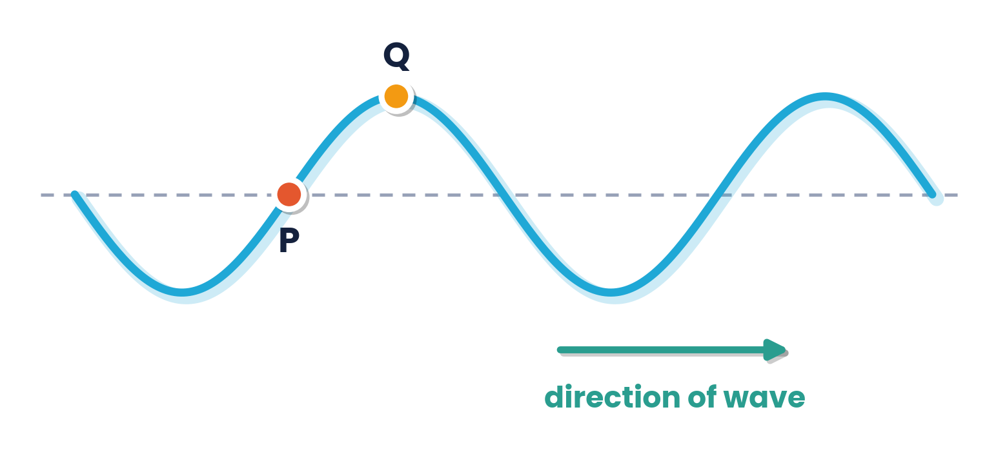
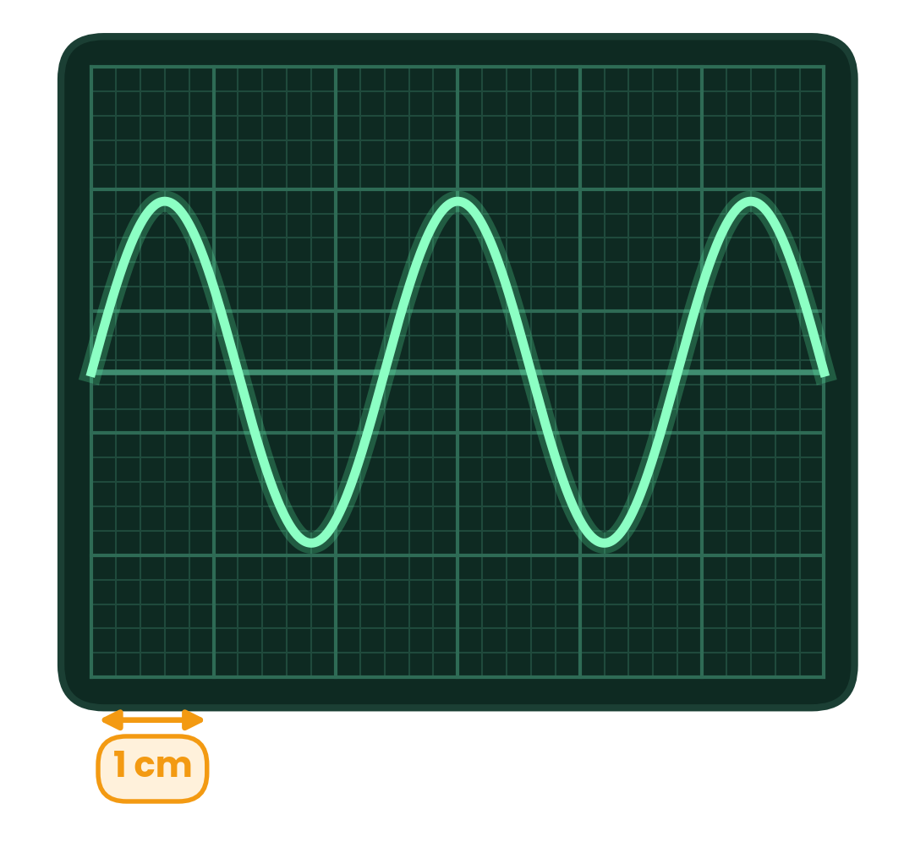
PAPER 1 STYLE · MULTIPLE CHOICE
Past paper set B · Graphs and the CRO
5
A wave moves left to right on a rope. P has zero displacement, Q maximum. Which describes their motion now?
6
The speed of deep-water waves is given by v² = gλ / 2π. Which graph should give a straight line through the origin?
A P downwards, Q stationary
B P stationary, Q downwards
C P stationary, Q upwards
D P upwards, Q stationary
A f against λ²
B f² against λ
C f against 1/λ
D f² against 1/λ
7
A sound wave is displayed on a c.r.o. with time-base 5 μs mm⁻¹ (large squares are 1 cm). What is the frequency of the sound wave?
8
Statements: 1 travel through free space; 2 can be polarised; 3 frequency inversely proportional to wavelength; 4 intensity proportional to amplitude. Which apply to BOTH sound and light?
A 83 Hz
B 8.3 Hz
C 83 kHz
D 8.3 kHz
A 3 only
B 4 only
C 1 and 4
D 1 and 2
Topic 7 · Waves | Cambridge International AS Level Physics 9702
38

Slide 39
ANSWERS AND KEY WORKING
Answers · Questions 5 – 8
5
Answer A
6
Answer D
The wave moves right, so P takes the displacement of the trough to its left: moving down. Q is at maximum displacement: momentarily stationary.
v = fλ → f²λ² = gλ/2π → f² = g / (2πλ). So f² ∝ 1/λ.
7
Answer D
8
Answer A
One cycle = 2.4 cm = 24 mm; T = 24 × 5 μs = 120 μs; f = 1/T = 8.3 kHz.
Sound cannot travel through a vacuum or be polarised; intensity ∝ amplitude² for both. Only v = fλ (3) applies to both.
Topic 7 · Waves | Cambridge International AS Level Physics 9702
39

Slide 40
PAPER 1 STYLE · MULTIPLE CHOICE
Past paper set C · Doppler effect
9
A police car siren emits 450 Hz. The car travels away from an observer at 45 m s⁻¹. The speed of sound is 340 m s⁻¹. What frequency does the observer hear?
10
A police car siren emits 440 Hz and travels away from an observer at 30 m s⁻¹. The speed of sound is 340 m s⁻¹. What frequency does the observer hear?
A 519 Hz
B 403 Hz
C 397 Hz
D 358 Hz
A 478 Hz
B 460 Hz
C 440 Hz
D 404 Hz
11
A cyclist rides past a stationary observer ringing a bell. Which describes the sound heard after the cyclist has passed (wavelength, frequency, pitch)?
12
The Sun emits light of wavelength λ₀, but at any instant a range of wavelengths from less than λ₀ to more than λ₀ is observed on Earth due to the Doppler effect. Which explains this?
A shorter, higher, lower
B longer, lower, higher
C shorter, lower, higher
D longer, lower, lower
A the Sun is rotating
B the Sun is moving towards the Earth
C the Sun is moving away from the Earth
D the Sun moves at right angles to the Sun–Earth line
Topic 7 · Waves | Cambridge International AS Level Physics 9702
40

Slide 41
ANSWERS AND KEY WORKING
Answers · Questions 9 – 12
9
Answer C
10
Answer D
Away → v + vₛ: fₒ = 450 × 340 / (340 + 45) = 397 Hz.
fₒ = 440 × 340 / (340 + 30) = 404 Hz. A uses the minus sign (approaching).
11
Answer D
12
Answer A
Moving away: waves stretched → longer λ → lower f → lower pitch.
One edge of the Sun moves towards us (blue shift), the other away (red shift), so both shorter and longer wavelengths arrive.
Topic 7 · Waves | Cambridge International AS Level Physics 9702
41

Slide 42
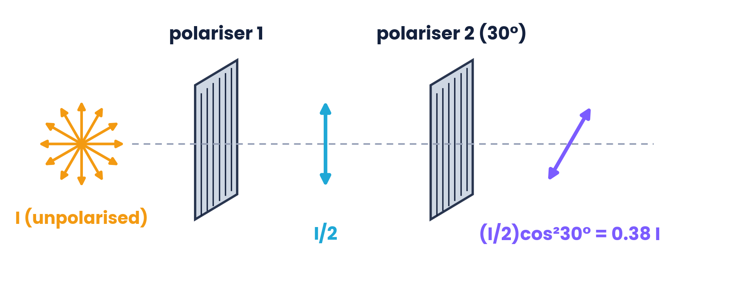
PAPER 1 STYLE · MULTIPLE CHOICE
Past paper set D · Polarisation
13
Unpolarised light (intensity I) passes two polarisers with axes at 30°. What intensity emerges?
14
Which statement describes a situation in which polarisation happens?
A 0.75 I
B 0.38 I
C 0.87 I
D 0.43 I
A radio waves pass through a metal grid
B surface water waves are diffracted
C sound waves are reflected
D ultrasound waves pass through a metal grid
15
Unpolarised light meets two parallel polarisers. The first is rotated through an angle smaller than 90°. How do the intensity and polarisation of the transmitted light change?
16
Unpolarised light of intensity I₀ meets two polarising sheets that are initially crossed. Which sheet must be rotated, and by what angle, so that I₀/4 emerges?
A intensity no change, polarisation no change
B intensity no change, polarisation different
C intensity different, polarisation different
D intensity different, polarisation no change
A 1 or 2, cos⁻¹(½)
B 1 or 2, cos⁻¹(√2 / 2)
C 2 only, cos²(½)
D 1 only, cos⁻¹(√2 / 2)
Topic 7 · Waves | Cambridge International AS Level Physics 9702
42

Slide 43
ANSWERS AND KEY WORKING
Answers · Questions 13 – 16
13
Answer B
14
Answer A
First filter: I/2. Malus: (I/2) cos²30° = (I/2)(0.75) = 0.375 I.
Only transverse waves (radio) are polarised by a grid; sound and ultrasound are longitudinal; diffraction is not polarisation.
15
Answer D
16
Answer B
The angle between the filters changes, so cos²θ changes the intensity; the second filter still sets the plane, so the polarisation is unchanged.
After sheet 1: I₀/2. Need cos²θ = ½, so the angle between the axes must become 45°: rotate either sheet by cos⁻¹(√2/2) = 45°.
Topic 7 · Waves | Cambridge International AS Level Physics 9702
43

Slide 44
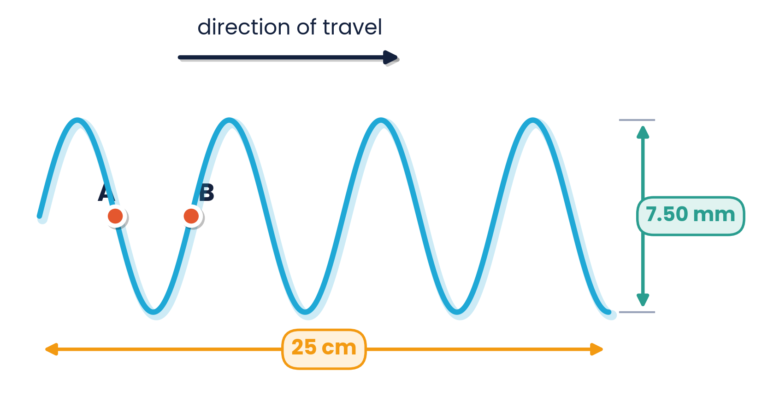
PAPER 2 STYLE · STRUCTURED QUESTION
Worked example · Water waves
Plane waves on the surface of water are shown at one instant. The distance marked is 25 cm and the peak-to-trough height is 7.50 mm. The waves have a frequency of 2.5 Hz.
(a) Determine the amplitude.
(b) Determine the wavelength.
(c) Determine the phase difference between points A and B.
(d) Calculate the speed of the waves.
Topic 7 · Waves | Cambridge International AS Level Physics 9702
44

Slide 45
MARK SCHEME STYLE SOLUTION
Worked example · Solution
(a)
Amplitude = 7.50 mm ÷ 2 = 3.75 mm (maximum displacement from equilibrium)
(b)
25 cm contains 3¾ wavelengths → λ = 25 ÷ 3.75 = 6.67 cm
(c)
A and B are ½ λ apart → phase difference = ½ × 360° = 180° (antiphase)
(d)
v = fλ = 2.5 × 0.0667 = 0.17 m s⁻¹
Topic 7 · Waves | Cambridge International AS Level Physics 9702
45

Slide 46
PAPER 2 STYLE · STRUCTURED QUESTION
Practice · Radio stations
Radio waves travel at 3.00 × 10⁸ m s⁻¹. Copy and complete the table of wavelengths and frequencies. Radio A (FM): 97.6 MHz; Radio B (FM): 94.6 MHz; Radio B (LW): 1515 m; Radio C (MW): 693 m.
(a) Calculate the wavelength for Radio A and Radio B (FM).
(b) Calculate the frequency for Radio B (LW) and Radio C (MW).
(c) Which region of the EM spectrum are all these in?
Topic 7 · Waves | Cambridge International AS Level Physics 9702
46

Slide 47
MARK SCHEME STYLE SOLUTION
Practice · Solution
(a)
λ = c / f: Radio A = 3.00 × 10⁸ / 97.6 × 10⁶ = 3.07 m; Radio B (FM) = 3.17 m
(b)
f = c / λ: Radio B (LW) = 3.00 × 10⁸ / 1515 = 0.198 MHz; Radio C (MW) = 0.433 MHz
(c)
All are radio waves (wavelength > 0.1 m)
Topic 7 · Waves | Cambridge International AS Level Physics 9702
47

Slide 48
PAPER 2 STYLE · STRUCTURED QUESTION
Practice · CRO trace of a sound
A microphone connected to a c.r.o. detects a sound. The time-base is 1 ms div⁻¹ and the y-gain is 20 mV div⁻¹.
(a) Determine the period of the trace.
(b) Calculate the frequency of the sound.
(c) Determine the amplitude of the trace in volts.
Topic 7 · Waves | Cambridge International AS Level Physics 9702
48

Slide 49
MARK SCHEME STYLE SOLUTION
Practice · Solution
(a)
One cycle spans 4.0 divisions → T = 4.0 × 1 ms = 4.0 × 10⁻³ s
(b)
f = 1 / T = 1 / 4.0 × 10⁻³ = 250 Hz
(c)
Amplitude = 3.5 div × 20 mV div⁻¹ = 70 mV
Topic 7 · Waves | Cambridge International AS Level Physics 9702
49

Slide 50
PAPER 2 STYLE · STRUCTURED QUESTION
Past paper · Power boat and the Doppler effect
A student sits on a beach, observing a power boat moving at speed on the sea. The boat has a siren emitting a constant sound of frequency 420 Hz. The boat moves around in a circular path at 25 m s⁻¹. The student notices that the pitch of the siren changes with a regular pattern. (Speed of sound in air = 330 m s⁻¹.)
(a) Explain why the pitch of the siren changes, as observed by the student.
(b) Determine the maximum and minimum frequencies that the student will hear.
(c) At which point in the boat's motion will the student hear the most high-pitched note?
Topic 7 · Waves | Cambridge International AS Level Physics 9702
50

Slide 51
MARK SCHEME STYLE SOLUTION
Past paper · Solution
(a)
Doppler effect: the source moves towards / away from the observer, which shortens / lengthens the observed wavelength and so raises / lowers the frequency
(b)
Max = 420 × 330 / (330 − 25) = 454 Hz; Min = 420 × 330 / (330 + 25) = 390 Hz
(c)
When the boat's velocity is directed straight towards the student
Topic 7 · Waves | Cambridge International AS Level Physics 9702
51

Slide 52
PAPER 2 STYLE · STRUCTURED QUESTION
Practice · Speed of sound with uncertainty
In an experiment, a student determines the speed of sound using v = fλ. The values are f = 1000 ± 10 Hz and λ = 33 ± 2 cm.
Determine the speed v, including its absolute uncertainty.
Topic 7 · Waves | Cambridge International AS Level Physics 9702
52

Slide 53
MARK SCHEME STYLE SOLUTION
Practice · Solution
Value
v = fλ = 1000 × 0.33 = 330 m s⁻¹
% unc.
%f = 10/1000 = 1.0%; %λ = 2/33 = 6.06%; %v = 1.0 + 6.06 = 7.06%
Answer
Δv = 0.0706 × 330 = 23 m s⁻¹ → v = 330 ± 23 m s⁻¹
Topic 7 · Waves | Cambridge International AS Level Physics 9702
53

Slide 54
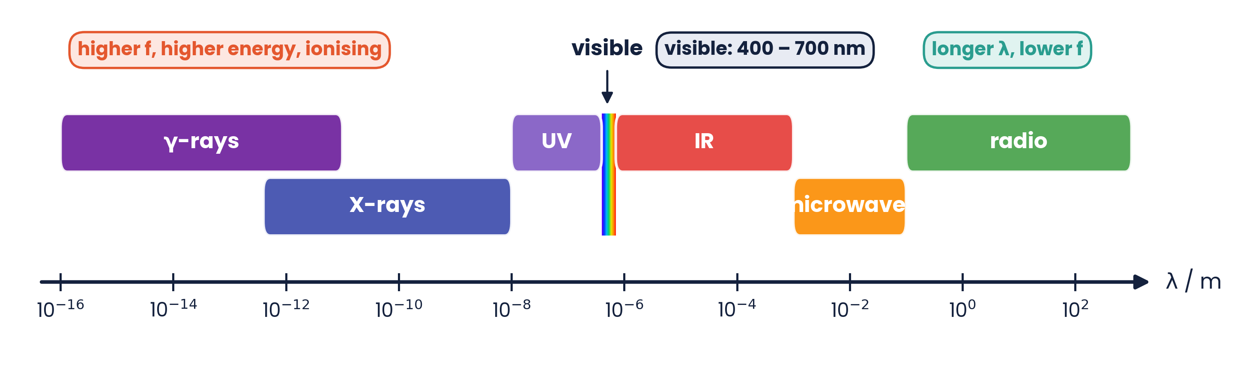
PAPER 2 STYLE · STRUCTURED QUESTION
Practice · Identify the radiation
For each of the following, state the type of electromagnetic radiation to which it corresponds (all values in a vacuum).
(a) wavelengths: 1 km, 3 cm, 5000 nm, 500 nm, 50 nm, 10⁻¹² m
(b) frequencies: 200 kHz, 100 MHz, 5 × 10¹⁴ Hz, 10¹⁸ Hz
Topic 7 · Waves | Cambridge International AS Level Physics 9702
54

Slide 55
MARK SCHEME STYLE SOLUTION
Practice · Solution
(a)
1 km radio; 3 cm microwaves; 5000 nm infrared; 500 nm visible; 50 nm ultraviolet; 10⁻¹² m X-rays or γ-rays
(b)
Convert with λ = c/f: 200 kHz → 1500 m radio; 100 MHz → 3 m radio; 5 × 10¹⁴ Hz → 600 nm visible; 10¹⁸ Hz → 3 × 10⁻¹⁰ m X-rays or γ-rays
Topic 7 · Waves | Cambridge International AS Level Physics 9702
55

Slide 56
COMMON DOUBTS & MISCONCEPTIONS
Students often ask… (1)
?
“Does the wave carry the water (or air) along with it?”
?
“Can I read the wavelength from a displacement–time graph?”
No. Particles oscillate about fixed positions; only energy is transferred by a progressive wave.
No — that gives the period. Wavelength needs a displacement–distance graph (or v = fλ).
?
“If I double the amplitude, does the intensity double?”
?
“Does a louder note travel faster?”
No. I ∝ A², so it becomes four times as large.
No. The speed depends on the medium. Loudness depends on amplitude; pitch on frequency.
Topic 7 · Waves | Cambridge International AS Level Physics 9702
56

Slide 57
COMMON DOUBTS & MISCONCEPTIONS
Students often ask… (2)
?
“In the Doppler equation, when do I use v − vₛ?”
?
“Does the source frequency change in the Doppler effect?”
When the source moves TOWARDS the observer: the denominator is smaller, so fₒ is larger.
No. The source emits the same frequency; the observed wavelength and frequency change because the source moves.
?
“Can sound be polarised?”
?
“Why cos²θ and not cos θ in Malus's law?”
No. Sound is longitudinal. Only transverse waves (e.g. light, radio, waves on a string) can be polarised.
The amplitude transmitted is A cos θ; intensity ∝ amplitude², so I = I₀cos²θ.
Topic 7 · Waves | Cambridge International AS Level Physics 9702
57

Slide 58
COMMAND WORDS AND MARK-SCHEME HABITS
Exam technique for waves
Definitions
Graphs
wavelength: distance between adjacent points in phase; intensity: power per unit area
check the x-axis: distance gives λ, time gives T
CRO
Doppler
divisions × time-base = T; divisions × y-gain = amplitude; convert ms and μs
decide towards (−) or away (+) BEFORE substituting; fₛ is unchanged
EM spectrum
Polarisation
learn orders of magnitude of λ; visible 400–700 nm; all travel at c
say ‘oscillations in one plane’, ‘perpendicular to the direction of travel’
Topic 7 · Waves | Cambridge International AS Level Physics 9702
58

Slide 59
KEY IDEAS TO TAKE AWAY
Waves in one slide
v = fλ
I = P / A, I ∝ A²
fₒ = fₛv / (v ± vₛ)
I = I₀cos²θ
Types
transverse: ⊥ vibrations, can be polarised · longitudinal: ∥ vibrations, compressions and rarefactions
EM waves
all transverse, speed c in a vacuum · γ < X < UV < visible (400–700 nm) < IR < microwaves < radio
Doppler
source towards → higher f, shorter λ · source away → lower f, longer λ
Topic 7 · Waves | Cambridge International AS Level Physics 9702
59

