Slide 1
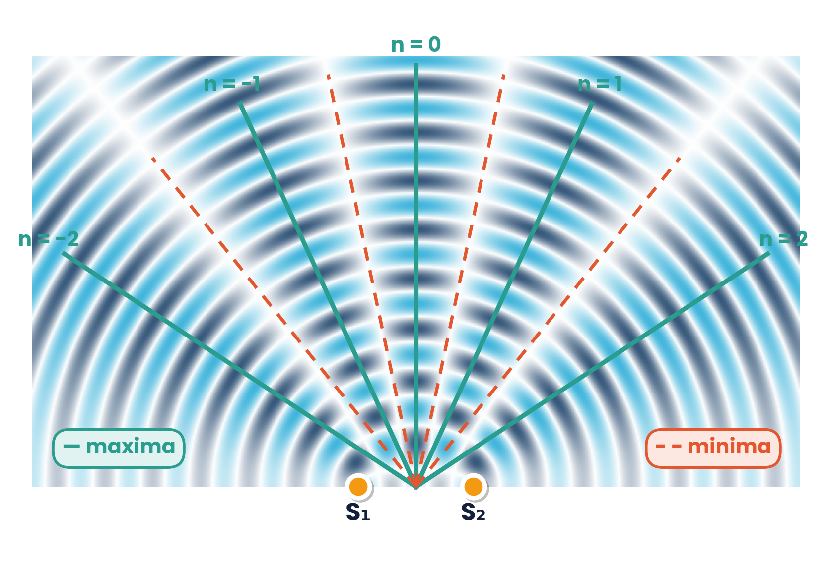
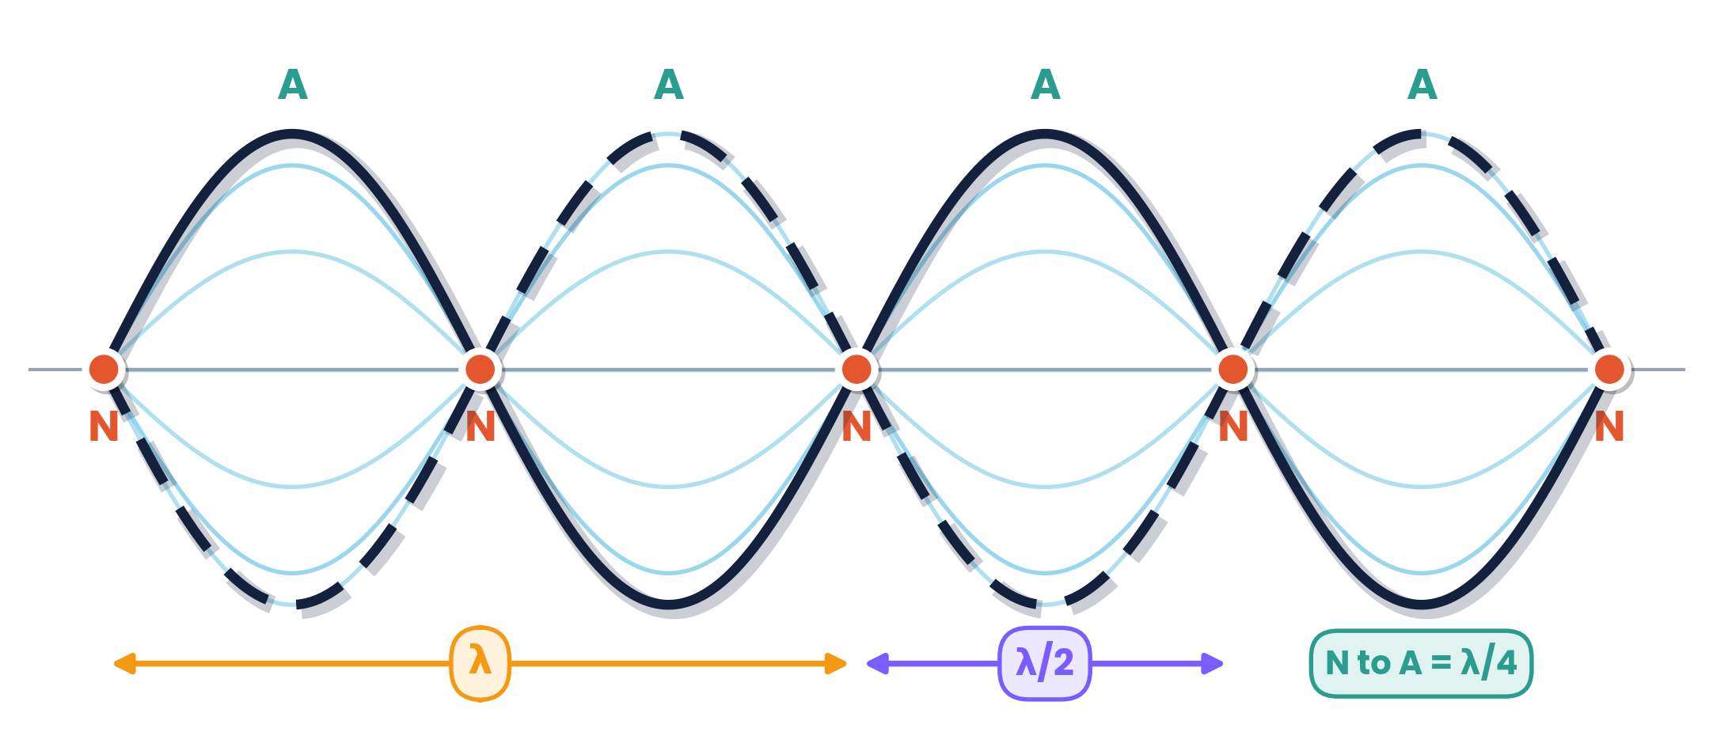
CAMBRIDGE AS & A LEVEL · PHYSICS 9702 · TOPIC 8
Superposition
When Waves Meet
Stationary waves · diffraction · interference · diffraction grating
Syllabus 8.1 – 8.4 | Exams 2025 – 2027
WA
Waseem Ahmad
Head of Science & IB Physics Lead Teacher
Presidential School, Jizzakh · Cambridge Examiner
Author, Orange Publication · www.examspath.com

Slide 2
SYLLABUS 8.1 – 8.4 · SUPERPOSITION
What the syllabus asks you to do
1
LO 8.1.1
2
LO 8.1.2
3
LO 8.1.3
4
LO 8.1.4
Explain and use the principle of superposition
Experiments: stationary waves with microwaves, strings, air columns
Formation of a stationary wave; nodes and antinodes
Find wavelength from node or antinode positions
5
LO 8.2.1
6
LO 8.2.2
7
LO 8.3.1
8
LO 8.3.2
Explain the meaning of diffraction
Effect of gap width relative to wavelength (ripple tank)
Understand interference and coherence
Two-source interference: water, sound, light, microwaves
9
LO 8.3.3
10
LO 8.3.4
11
LO 8.4.1
12
LO 8.4.2
Conditions for observable interference fringes
Recall and use λ = ax / D
Recall and use d sin θ = nλ
Use a grating to find the wavelength of light
Topic 8 · Superposition | Cambridge International AS Level Physics 9702
2

Slide 3
TOPIC 8 · SUPERPOSITION
Lesson roadmap
01
02
03
04
Superposition
Stationary waves
Strings & air columns
Measuring λ
Adding displacements
Nodes and antinodes
Harmonics
Microwaves and resonance
05
06
07
08
Diffraction
Interference
Young's double slit
Diffraction grating
Gap width vs wavelength
Coherence, path difference
λ = ax / D
d sin θ = nλ
Topic 8 · Superposition | Cambridge International AS Level Physics 9702
3

Slide 4
LEARNING OUTCOME 8.1.1
01
The principle of superposition
When waves overlap, their displacements add
Topic 8 · Superposition | Cambridge International AS Level Physics 9702
4

Slide 5
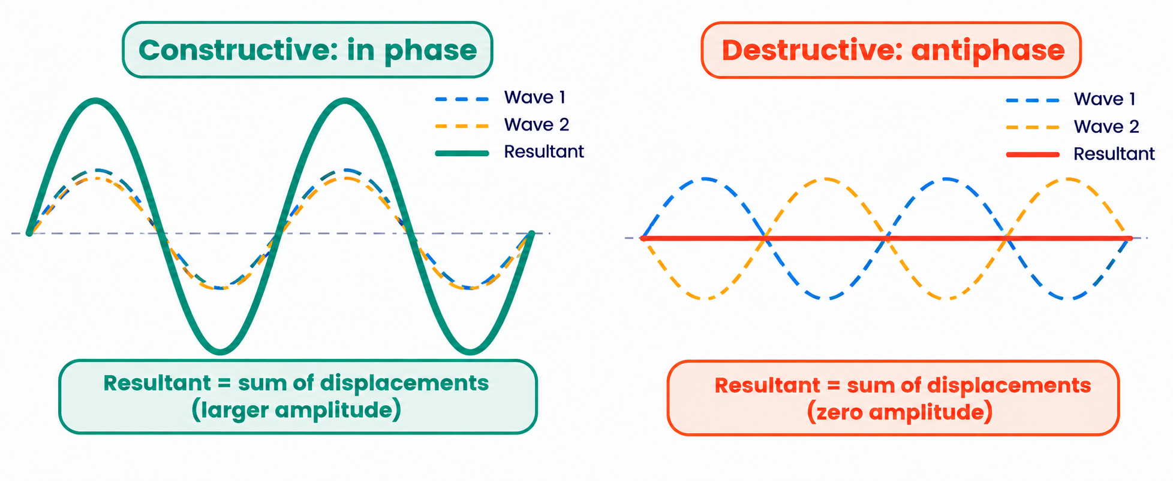
8.1.1 · EXPLAIN AND USE
The principle of superposition
When two or more waves of the same type overlap at a point, the resultant displacement is the sum of the individual displacements.
In phase → constructive:
amplitudes add (double for equal waves)
Antiphase → destructive:
equal waves cancel to zero
Topic 8 · Superposition | Cambridge International AS Level Physics 9702
5

Slide 6
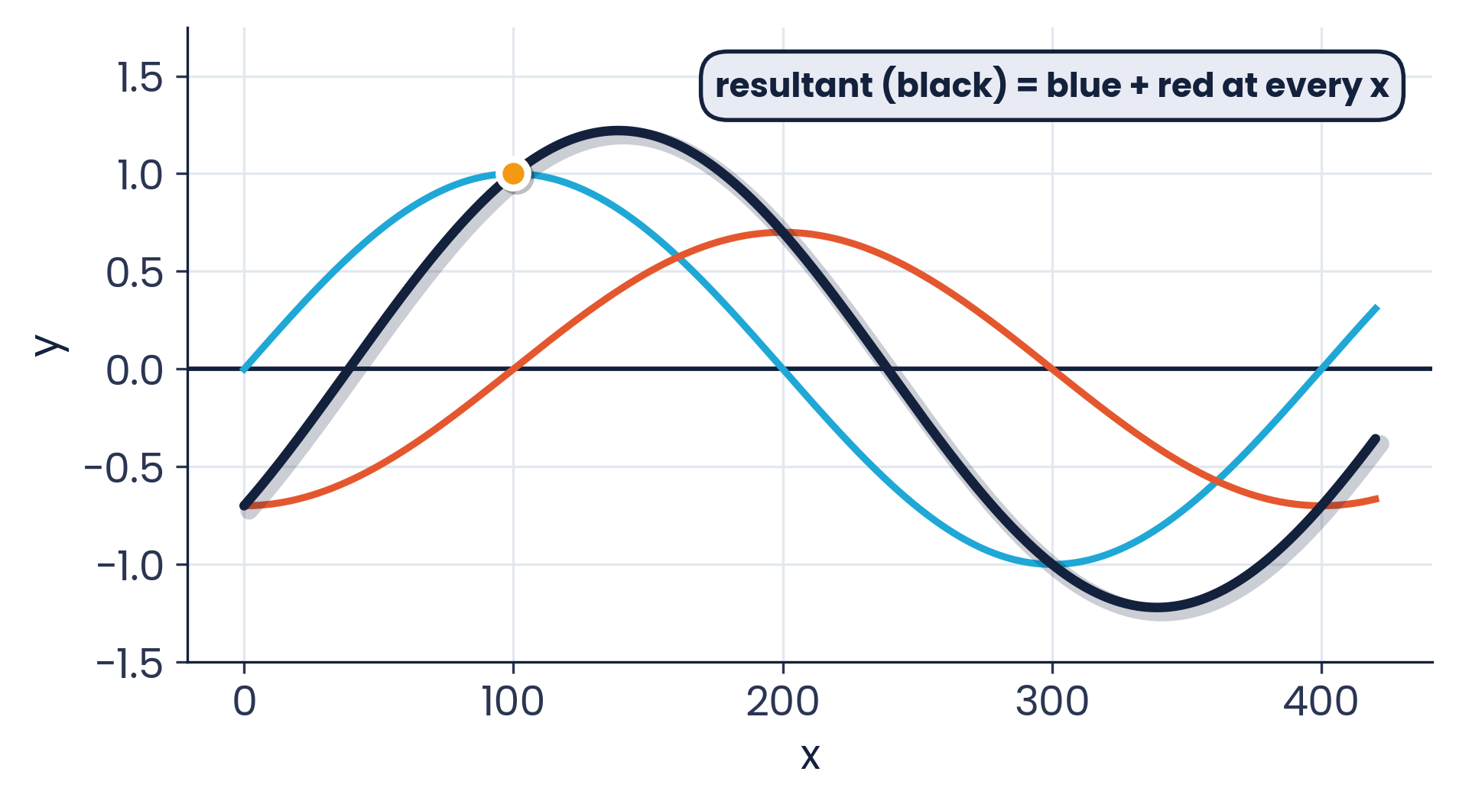
8.1.1 · ADD POINT BY POINT
Sketching a resultant wave
Method
1
At each x, read both displacements (with sign)
2
Add them: e.g. at x = 100, 1.0 + 0 = 1.0
3
Repeat at crests, troughs and zero points
4
Join with a smooth curve of the same wavelength
Mark scheme: ‘when two waves meet, the resultant displacement is the sum of the individual displacements’ (B1 + B1).
Topic 8 · Superposition | Cambridge International AS Level Physics 9702
6

Slide 7
LEARNING OUTCOMES 8.1.2 – 8.1.3
02
Stationary waves
Two waves travelling in opposite directions
Topic 8 · Superposition | Cambridge International AS Level Physics 9702
7

Slide 8
8.1.3 · NODES AND ANTINODES
Formation of a stationary wave
A stationary wave forms when two progressive waves of the same frequency (and similar amplitude) travel in opposite directions and superpose — usually a wave and its reflection.
Node (N): zero amplitude — destructive interference
Antinode (A): maximum amplitude
N to N = λ/2
N to A = λ/4
Topic 8 · Superposition | Cambridge International AS Level Physics 9702
8

Slide 9
8.1.3 · MARK-SCHEME DIFFERENCES
Stationary vs progressive waves
Property | Stationary wave | Progressive wave
Energy | not transferred | transferred
Amplitude | varies with position (0 at nodes) | same for all points
Phase | points between adjacent nodes are in phase | phase changes continuously along the wave
Wave profile | does not move along | moves along at speed v
Nodes / antinodes | yes | no
Conditions for formation:
two waves of the same type, same frequency (wavelength) and speed, travelling in opposite directions, overlap.
Topic 8 · Superposition | Cambridge International AS Level Physics 9702
9

Slide 10
LEARNING OUTCOMES 8.1.2 – 8.1.4
03
Strings and air columns
Harmonics of stationary waves
Topic 8 · Superposition | Cambridge International AS Level Physics 9702
10

Slide 11
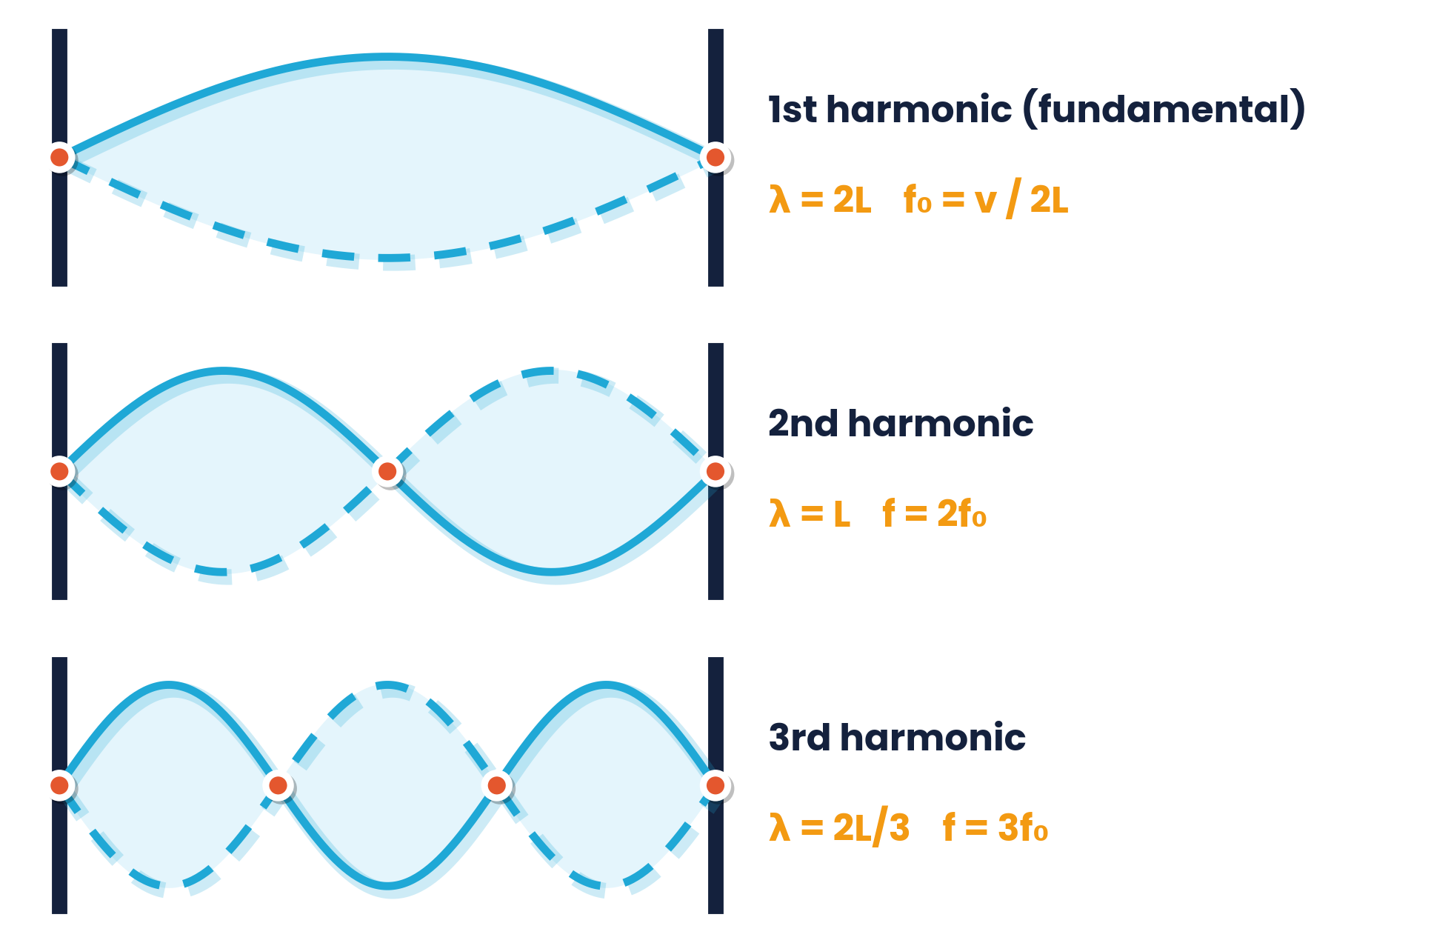
8.1.2 · BOTH ENDS ARE NODES
Stationary waves on a stretched string
Fundamental: one loop, λ = 2L, f₀ = v / 2L
Higher harmonics: f = nf₀ (n = 1, 2, 3, …)
Set up with an oscillator (vibration generator), pulley and hanging mass to keep the string taut
Adjust the frequency until a clear pattern forms
Topic 8 · Superposition | Cambridge International AS Level Physics 9702
11

Slide 12
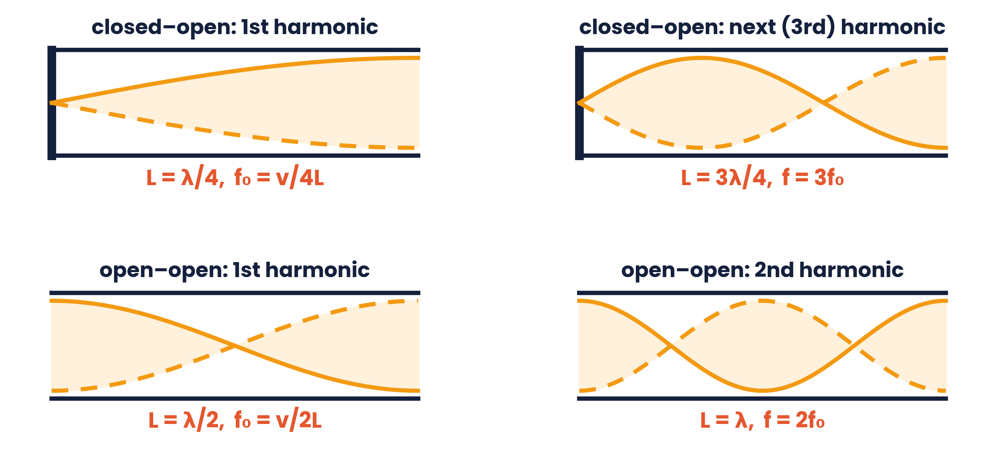
8.1.2 · CLOSED END = NODE, OPEN END = ANTINODE
Stationary waves in air columns
closed–open
L = λ/4, 3λ/4, 5λ/4 …
f = nv / 4L, n odd
open–open
L = λ/2, λ, 3λ/2 …
f = nv / 2L, n = 1, 2, 3
string (fixed–fixed)
L = λ/2, λ, 3λ/2 …
f = nv / 2L
Kundt's tube: fine powder in a tube collects in heaps at the nodes — the heaps are λ/2 apart. End corrections are ignored in this syllabus.
Topic 8 · Superposition | Cambridge International AS Level Physics 9702
12

Slide 13
8.1.4 · NODE-TO-NODE = Λ/2
Worked examples · Wavelength from nodes
Vibrating spring
Sound, 2500 Hz
Adjacent nodes are 25 cm apart.
Two nodes are 20 cm apart with three antinodes between them.
λ = 2 × 25 = 50 cm; node → antinode = 50/4 = 12.5 cm
3 × λ/2 = 20 cm → λ = 13.3 cm; v = fλ = 2500 × 0.133 = 330 m s⁻¹
String, 60 cm
Closed tube, 400 Hz
One complete wavelength is shown on the 60 cm string.
The 63.8 cm tube holds ¾ of a wavelength.
λ = 60 cm; antinodes 30 cm apart. With three antinodes: 3λ/2 = 60 → λ = 40 cm
λ = 4/3 × 0.638 = 0.851 m; v = 400 × 0.851 = 340 m s⁻¹
Topic 8 · Superposition | Cambridge International AS Level Physics 9702
13

Slide 14
LEARNING OUTCOMES 8.1.2 & 8.1.4
04
Measuring wavelength
Microwaves and a movable detector
Topic 8 · Superposition | Cambridge International AS Level Physics 9702
14

Slide 15
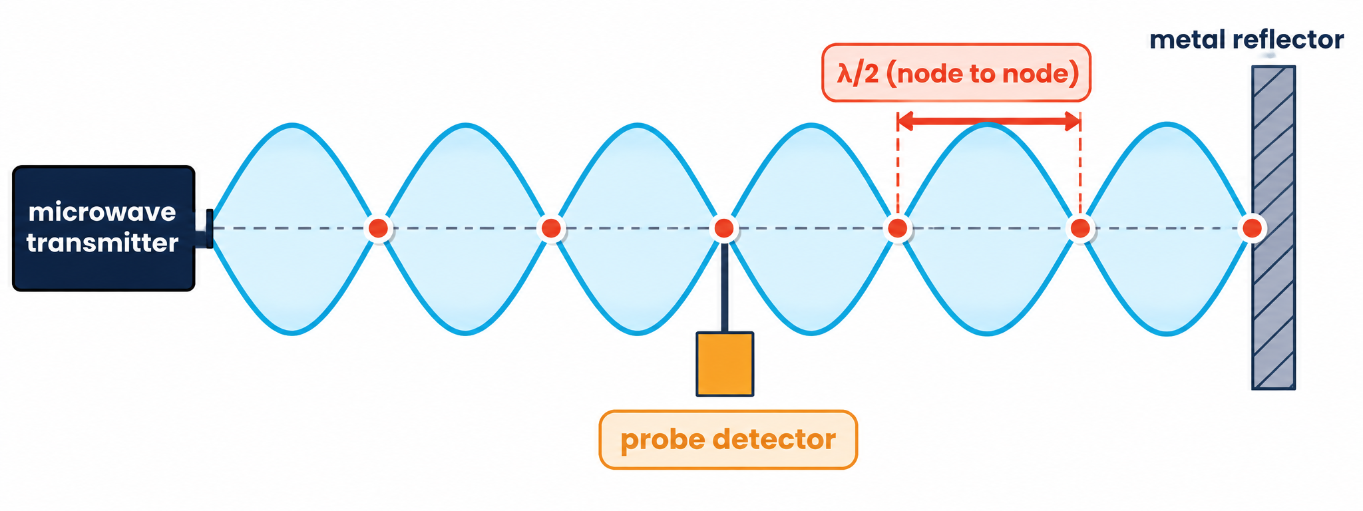
8.1.2 & 8.1.4 · TRANSMITTER, REFLECTOR AND PROBE
Stationary microwaves
1
Aim the transmitter at a metal plate; the reflected wave overlaps the incident wave
2
Move the probe detector along the line: readings rise and fall between maxima (antinodes) and minima (nodes)
3
Measure the distance across several nodes; divide to find node spacing = λ/2
4
e.g. 10 node spacings in 14.0 cm → λ/2 = 1.40 cm → λ = 2.8 cm
Topic 8 · Superposition | Cambridge International AS Level Physics 9702
15

Slide 16
LEARNING OUTCOMES 8.2.1 – 8.2.2
05
Diffraction
Spreading at gaps and edges
Topic 8 · Superposition | Cambridge International AS Level Physics 9702
16

Slide 17
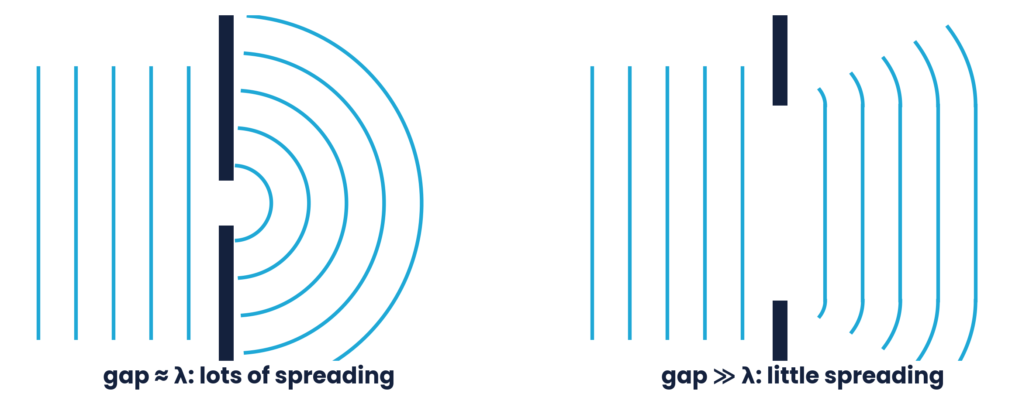
8.2.1 & 8.2.2 · GAP WIDTH COMPARED WITH WAVELENGTH
Diffraction
Diffraction is the spreading of a wave as it passes through a gap or around an edge.
Greatest when gap ≈ wavelength
Much wider gap → very little spreading
Wavelength and frequency are unchanged; the amplitude falls as energy spreads
Ripple tank: vary the gap with barriers
Topic 8 · Superposition | Cambridge International AS Level Physics 9702
17

Slide 18
8.2.2 · WHY THE GAP SIZE MATTERS
Diffraction in everyday life
Radio waves
Sound
λ up to kilometres: diffract around hills and buildings, so long-wave radio is received in valleys
λ ≈ 1 m: diffracts through doorways — you hear round corners but cannot see round them
Light
X-rays
λ ≈ 500 nm: needs very narrow slits (μm) for noticeable diffraction
λ ≈ 10⁻¹⁰ m: diffracted by the atoms in a crystal, whose spacing is similar
Topic 8 · Superposition | Cambridge International AS Level Physics 9702
18

Slide 19
LEARNING OUTCOMES 8.3.1 – 8.3.3
06
Interference and coherence
Two-source interference patterns
Topic 8 · Superposition | Cambridge International AS Level Physics 9702
19

Slide 20
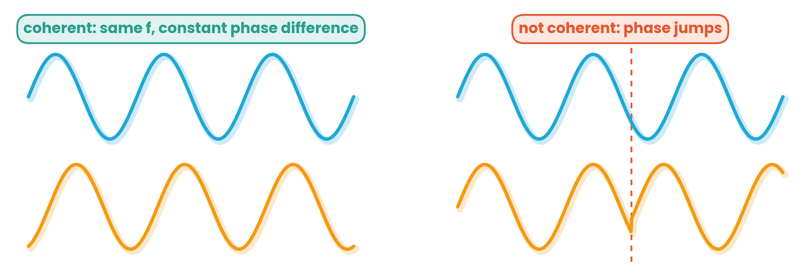
8.3.1 · NEEDED FOR A STEADY PATTERN
Coherence
Coherent sources
have the same frequency and a constant phase difference. A laser is coherent; a filament lamp is not.
Interference
is the superposition of waves from coherent sources, giving a stable pattern of maxima and minima.
Topic 8 · Superposition | Cambridge International AS Level Physics 9702
20

Slide 21
8.3.2 · RIPPLE TANK, SOUND, LIGHT, MICROWAVES
Two-source interference
Ripple tank: two dippers on one vibrator give lines of calm (minima) and large ripples (maxima)
Sound: two loudspeakers on one signal generator — walk across and hear loud and quiet regions
Microwaves: a double slit in metal plates; the detector records maxima and minima
Light: Young's double slit (next section)
Noise-cancelling headphones use destructive interference of sound.
Topic 8 · Superposition | Cambridge International AS Level Physics 9702
21

Slide 22
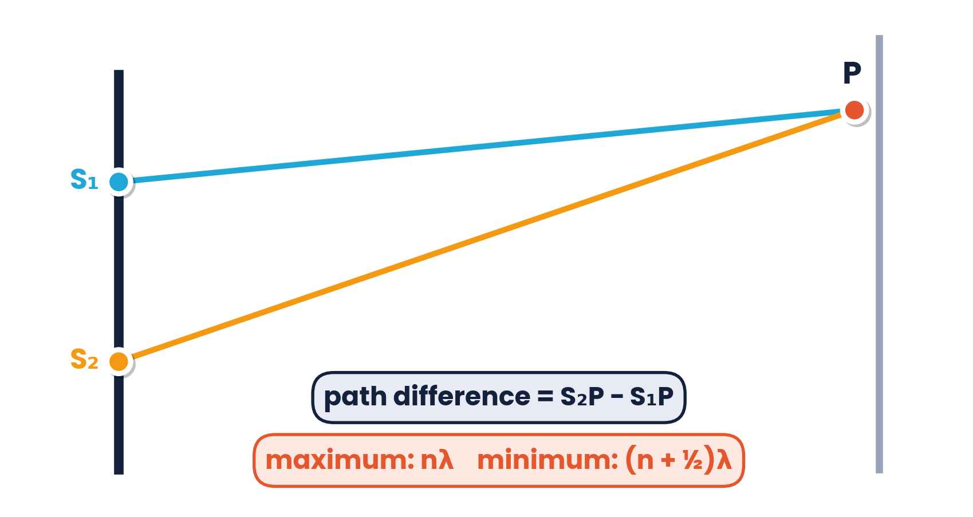
8.3.2 · WHERE DO MAXIMA AND MINIMA OCCUR?
Path difference and phase difference
Maximum (constructive)
path difference = nλ (phase difference 0, 2π …)
Minimum (destructive)
path difference = (n + ½)λ (phase difference π …)
Conditions for observable fringes (8.3.3)
Coherent sources · same type of wave · similar amplitudes (for dark minima) · monochromatic light · slit separation small enough for fringes to be visible
Topic 8 · Superposition | Cambridge International AS Level Physics 9702
22

Slide 23
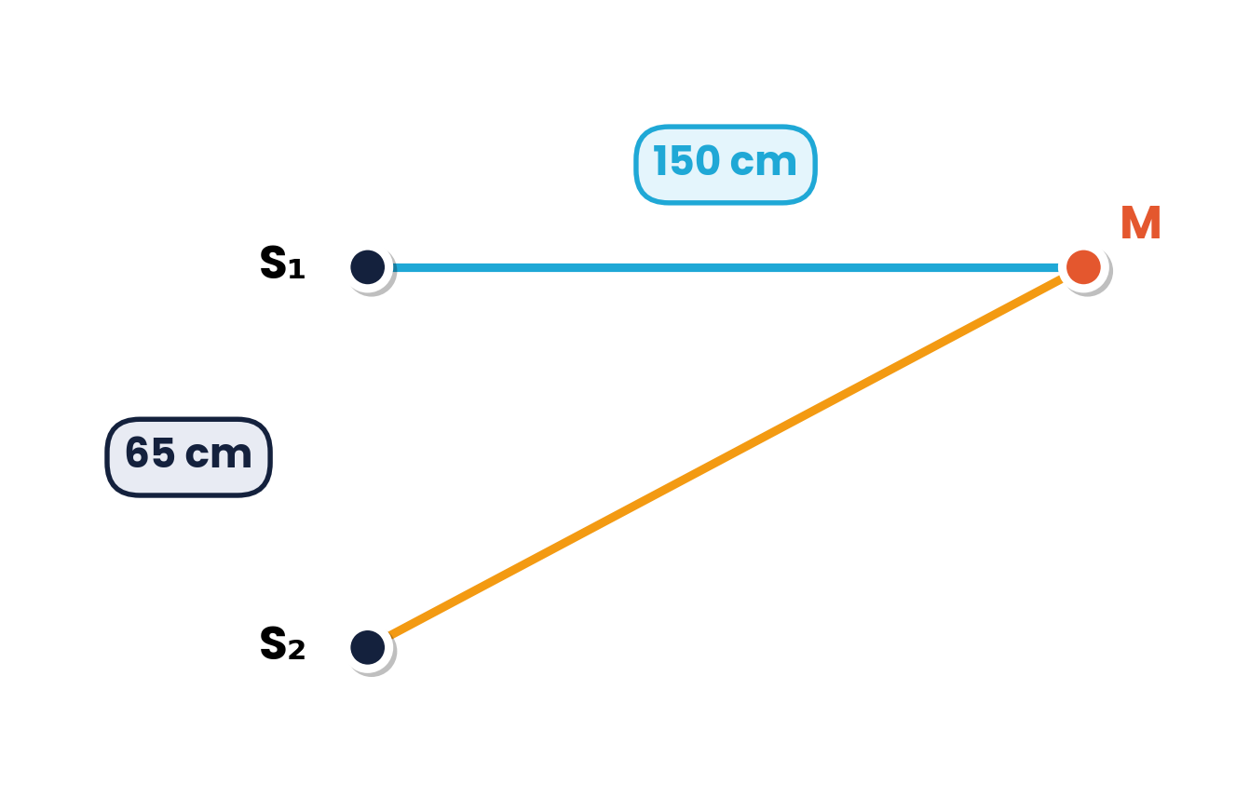
8.3.2 · PATH DIFFERENCE WITH PYTHAGORAS
Worked example · Interference of sound
Coherent sound sources S₁ and S₂ are 65 cm apart and vibrate in phase. A microphone M is 150 cm from S₁ along the normal to S₁S₂. Which orders of maxima are detected as λ increases from 3.5 cm to 12.5 cm?
1
S₂M = √(150² + 65²) = 163.5 cm
2
Path difference = 163.5 − 150 = 13.5 cm
Minima (quiet) occur between them when 13.5 = (n + ½)λ.
3
Maxima when 13.5 = nλ: n = 2 gives 6.7 cm; n = 3 gives 4.5 cm
4
n = 1 (13.5 cm) and n = 4 (3.4 cm) are outside the range → orders 2 and 3
Topic 8 · Superposition | Cambridge International AS Level Physics 9702
23

Slide 24
LEARNING OUTCOME 8.3.4
07
Young's double-slit experiment
Measuring the wavelength of light
Topic 8 · Superposition | Cambridge International AS Level Physics 9702
24

Slide 25
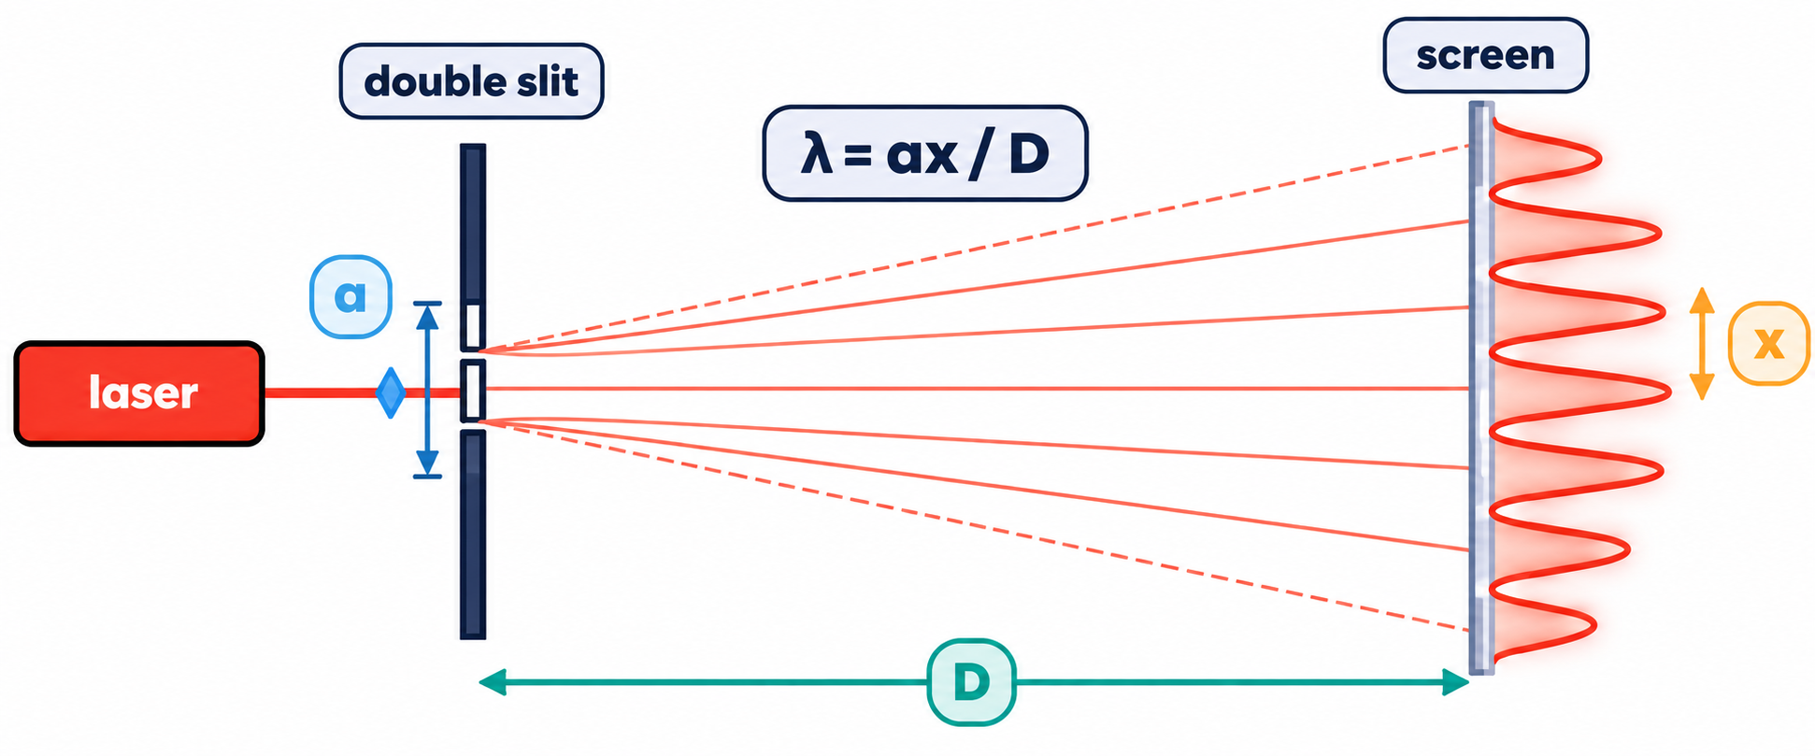
8.3.4 · Λ = AX / D
Young's double-slit experiment
a
slit separation (m) — very small, ≈ 0.1–1 mm
x
fringe separation: centre of one bright fringe to the next (m)
D
slit-to-screen distance (m) — large, ≈ 1–3 m
Topic 8 · Superposition | Cambridge International AS Level Physics 9702
25

Slide 26
8.3.4 · MEASURE ACROSS MANY FRINGES
Worked example · Helium–neon laser
In a double-slit experiment using a He–Ne laser, the width of 10 fringes is 1.5 cm, the slit separation is 1.0 mm and the slit-to-screen distance is 2.40 m. Calculate the wavelength in nm.
1
Fringe separation x = 1.5 × 10⁻² / 10 = 1.5 × 10⁻³ m
Why 10 fringes?
Measuring across many fringes and dividing reduces the percentage uncertainty in x. A large D also gives larger, easier-to-measure fringes.
2
λ = ax / D = (1.0 × 10⁻³ × 1.5 × 10⁻³) / 2.40
3
λ = 6.25 × 10⁻⁷ m ≈ 630 nm (red)
Topic 8 · Superposition | Cambridge International AS Level Physics 9702
26

Slide 27
8.3.4 · X = ΛD / A
How the fringe pattern changes
Slits closer (a ↓)
Blue light (λ ↓)
Screen further (D ↑)
x ∝ 1/a → fringes further apart
x ∝ λ → fringes closer together than for red
x ∝ D → wider fringes, smaller % uncertainty
Sodium light
Change filter
Laser 750 THz
λ = 589 nm, a = 0.20 mm, D = 1.20 m → x = 589 × 10⁻⁹ × 1.20 / 0.0002 = 3.5 mm
red 600 nm gives x = 2.4 mm; blue 450 nm → x = 2.4 × 450/600 = 1.8 mm
λ = c/f = 400 nm; 9 fringe spacings in 15 mm, D = 4.5 m → a = λD/x = 1.1 mm
Topic 8 · Superposition | Cambridge International AS Level Physics 9702
27

Slide 28
LEARNING OUTCOMES 8.4.1 – 8.4.2
08
The diffraction grating
Many slits give sharp, bright maxima
Topic 8 · Superposition | Cambridge International AS Level Physics 9702
28

Slide 29
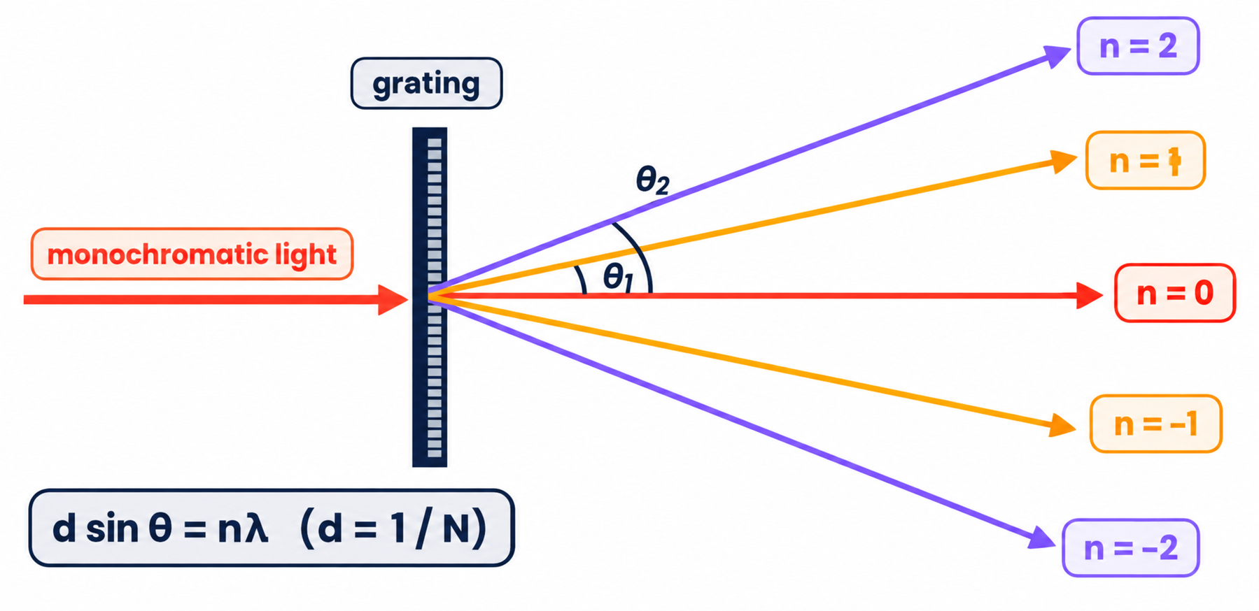
8.4.1 · D SIN Θ = NΛ
The diffraction grating
d sin θ = nλ
d = slit spacing = 1/N (N = lines per metre)
n = order of the maximum (0, 1, 2 …)
θ is measured from the straight-through (zero-order) beam
Highest order: n ≤ d / λ (sin θ ≤ 1)
Convert lines per mm to d in metres: 300 lines mm⁻¹ → d = 1 / (300 × 10³) = 3.33 × 10⁻⁶ m.
Topic 8 · Superposition | Cambridge International AS Level Physics 9702
29

Slide 30
8.4.1 & 8.4.2 · WAVELENGTH AND ORDERS
Worked example · Grating calculations
(a) Find the wavelength
(b) How many maxima?
300 lines mm⁻¹; first-order maximum at 10.0°.
sin θ = nλ / d = 0.174n
n = 2: 20.4° n = 3: 31.5°
n = 4: 44.2° n = 5: 60.6°
n = 6 would need sin θ > 1 — impossible
Total: 5 each side + the zero order = 11 maxima
1
d = 1 / 300 000 = 3.33 × 10⁻⁶ m
2
λ = d sin θ / n = 3.33 × 10⁻⁶ × sin 10.0°
3
λ = 5.8 × 10⁻⁷ m = 580 nm
Topic 8 · Superposition | Cambridge International AS Level Physics 9702
30

Slide 31
8.4.2 · ACCURACY AND OVERLAPPING SPECTRA
Grating vs double slit · White light
Why a grating is more accurate
White light (400 – 700 nm), d = 2.00 μm
Maxima are very sharp and bright (light from many slits)
Maxima are widely spaced, so θ can be measured precisely
Example (546 nm): double slit gives 10 fringes = 8.7 mm (± 1 mm on a ruler); a 3000 lines cm⁻¹ grating gives a second-order angle of 19.1°, measurable to ± 0.1°
First order: red sin θ = 0.350 → 20.5°; violet 0.200 → 11.5°
Angular width of the first-order spectrum = 9.0°
Second-order red: 44.4°; third-order violet: 36.9°
The 2nd and 3rd order spectra overlap
Topic 8 · Superposition | Cambridge International AS Level Physics 9702
31

Slide 32
CAMBRIDGE PAST PAPER QUESTIONS
09
Past paper practice
Paper 1 multiple choice · Paper 2 structured questions
Topic 8 · Superposition | Cambridge International AS Level Physics 9702
32

Slide 33
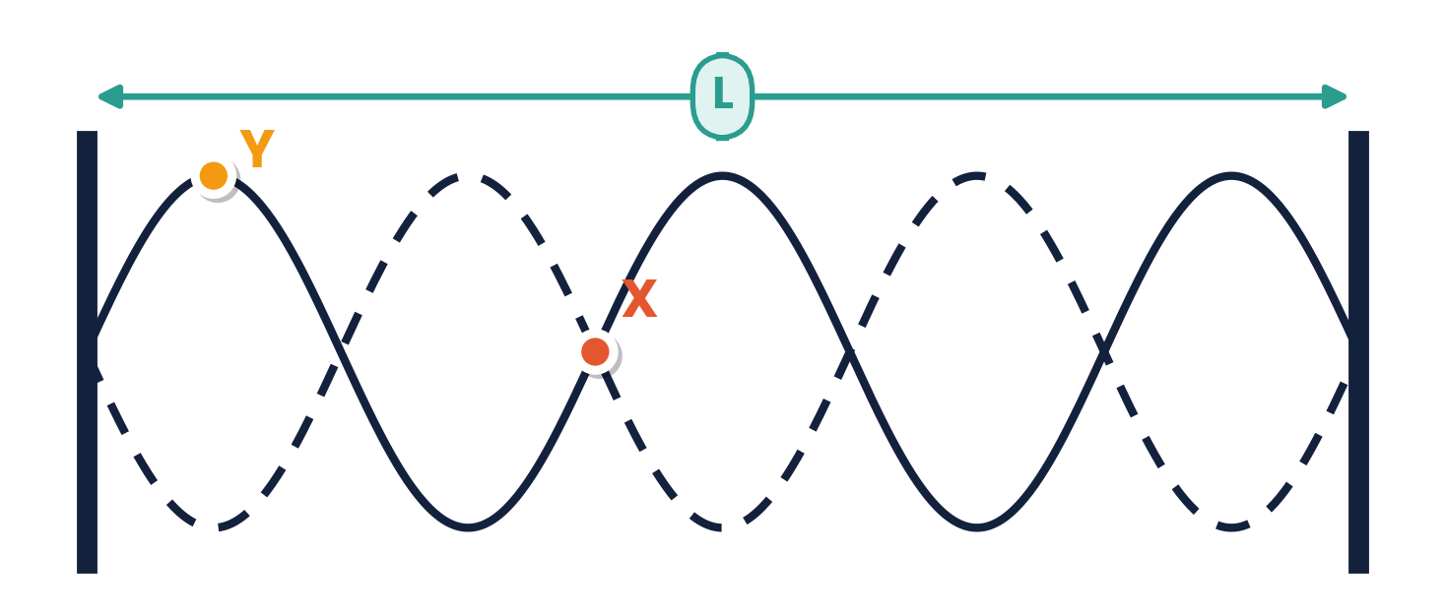
PAPER 1 STYLE · MULTIPLE CHOICE
Past paper set A · Stationary waves
1
A stretched string shows the stationary wave pattern (5 loops). Which describes the length L and the names of points X and Y?
2
Adjacent nodes of a stationary sound wave are 12 cm apart. The frequency is 1.4 kHz. What is the speed of sound?
A 168 m s⁻¹
B 336 m s⁻¹
C 17 m s⁻¹
D 672 m s⁻¹
A 5 λ, X node, Y antinode
B 2½ λ, X antinode, Y node
C 2½ λ, X node, Y antinode
D 5 λ, X antinode, Y node
3
A pipe of length 0.85 m is closed at one end. The speed of sound is 340 m s⁻¹. What is the fundamental frequency?
4
Which statement about a stationary wave is correct?
A 50 Hz
B 100 Hz
C 200 Hz
D 400 Hz
A it transfers energy along the wave
B all points have the same amplitude
C points between adjacent nodes are in phase
D adjacent nodes are one wavelength apart
Topic 8 · Superposition | Cambridge International AS Level Physics 9702
33

Slide 34
ANSWERS AND KEY WORKING
Answers · Questions 1 – 4
1
Answer C
2
Answer B
Five loops = 5 × λ/2 = 2½ λ. X has zero displacement (node); Y has maximum amplitude (antinode).
λ = 2 × 12 = 24 cm; v = fλ = 1400 × 0.24 = 336 m s⁻¹. A forgets to double the node spacing.
3
Answer B
4
Answer C
Closed pipe: L = λ/4 → λ = 3.4 m; f = v/λ = 340/3.4 = 100 Hz.
No energy transfer; amplitude varies; nodes are λ/2 apart; all points between two nodes oscillate in phase.
Topic 8 · Superposition | Cambridge International AS Level Physics 9702
34

Slide 35
PAPER 1 STYLE · MULTIPLE CHOICE
Past paper set B · Diffraction and interference
5
When a wave travels through air, which scenario best demonstrates diffraction?
6
Two sources are coherent. What must be true?
A UV radiation through a gate post
B sound waves passing a steel rod
C radio waves passing human hair
D X-rays passing atoms in a crystalline solid
A same amplitude
B same frequency, constant phase difference
C same wave speed
D always in phase with equal intensity
7
In a double-slit experiment the slit separation is halved and the slit-to-screen distance is doubled. What happens to the fringe separation?
8
Light of wavelength 600 nm is incident normally on a grating with 500 lines per mm. What is the highest order of maximum observed?
A it is quartered
B it is unchanged
C it is doubled
D it is four times as large
A 1
B 2
C 3
D 4
Topic 8 · Superposition | Cambridge International AS Level Physics 9702
35

Slide 36
ANSWERS AND KEY WORKING
Answers · Questions 5 – 8
5
Answer D
6
Answer B
Diffraction is greatest when λ ≈ gap: X-ray wavelengths (~10⁻¹⁰ m) match atomic spacing.
Coherent: same frequency and constant phase difference. Equal amplitudes help, but are not required.
7
Answer D
8
Answer C
x = λD / a: D × 2 and a ÷ 2 → x × 4.
d = 1 / 500 000 = 2.0 × 10⁻⁶ m; n ≤ d/λ = 3.3 → highest order 3.
Topic 8 · Superposition | Cambridge International AS Level Physics 9702
36

Slide 37
PAPER 2 STYLE · STRUCTURED QUESTION
Past paper 1 · Stationary and progressive waves
A stationary wave is set up on a string.
(a) State the principle of superposition. [2]
(b) State two ways in which a stationary wave differs from a progressive wave. [2]
(c) State the conditions required for the formation of a stationary wave. [2]
Topic 8 · Superposition | Cambridge International AS Level Physics 9702
37

Slide 38
MARK SCHEME STYLE SOLUTION
Past paper 1 · Solution
(a)
When two (or more) waves meet at a point (B1), the resultant displacement is the sum of the individual displacements (B1)
(b)
Any two: a stationary wave has nodes and antinodes; does not transfer energy; amplitude varies with position; points between adjacent nodes are in phase
(c)
Two waves travelling (at the same speed) in opposite directions overlap (B1); waves of the same type with the same frequency / wavelength (B1)
Topic 8 · Superposition | Cambridge International AS Level Physics 9702
38

Slide 39
PAPER 2 STYLE · STRUCTURED QUESTION
Book question · Stationary wave on a string
A stationary wave is set up on a string of vibrating length 60 cm. One complete wavelength fits on the string.
(a) Determine the wavelength of the progressive wave and the separation of two neighbouring antinodes.
(b) The frequency is increased until a pattern with three antinodes appears. Sketch it.
(c) Calculate the new wavelength.
Topic 8 · Superposition | Cambridge International AS Level Physics 9702
39

Slide 40
MARK SCHEME STYLE SOLUTION
Book question · Solution
(a)
One complete wavelength → λ = 60 cm; separation of two antinodes = λ/2 = 30 cm
(b)
Three loops between the fixed ends, with four nodes (including the two ends)
(c)
3λ/2 = 60 cm → λ = 40 cm
Topic 8 · Superposition | Cambridge International AS Level Physics 9702
40

Slide 41
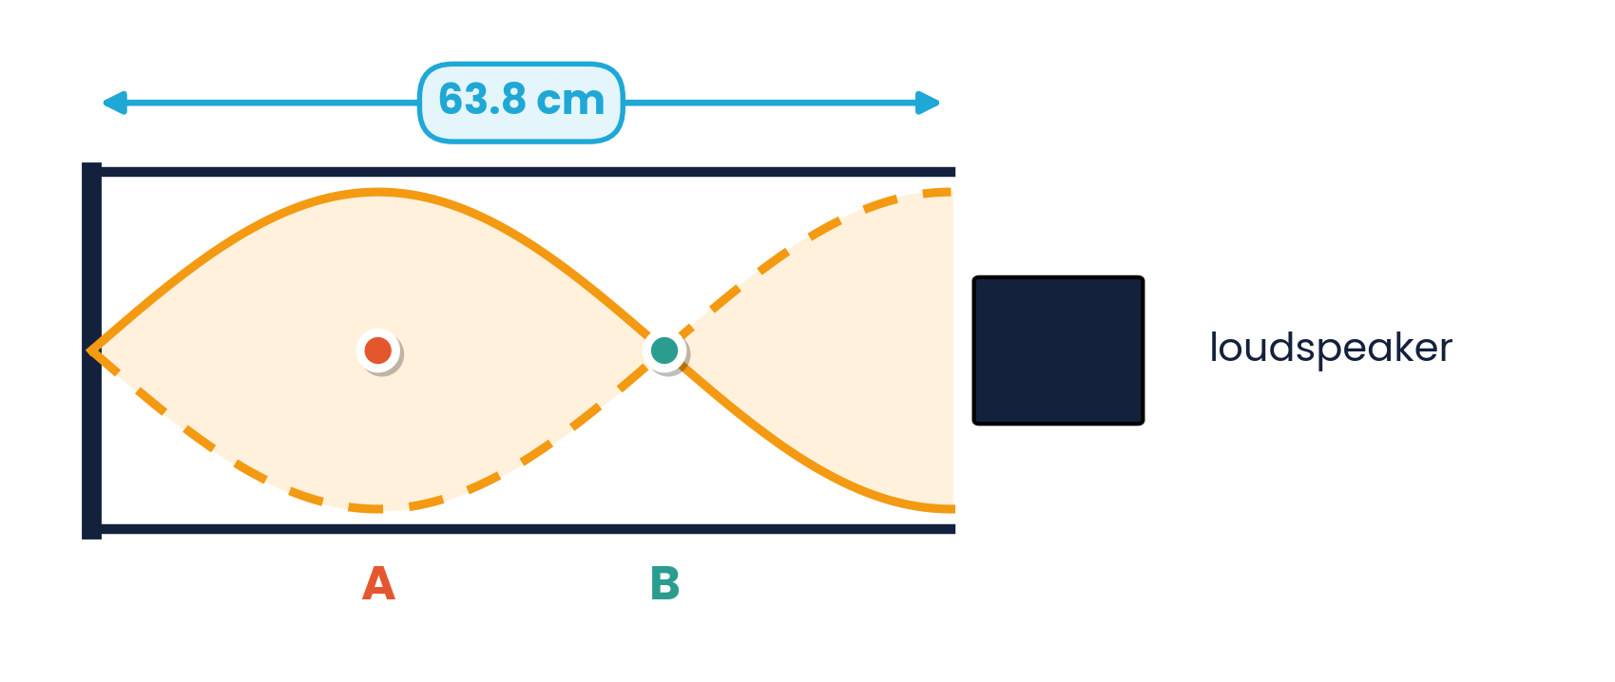
PAPER 2 STYLE · STRUCTURED QUESTION
Past paper 2 · Sound in a closed tube
A stationary wave of frequency 400 Hz is produced by a loudspeaker in a tube closed at one end. The tube is 63.8 cm long and contains ¾ of a wavelength, as shown.
(a) Describe the movement of the air particles at (i) A (ii) B.
(b) Calculate the speed of the sound.
Topic 8 · Superposition | Cambridge International AS Level Physics 9702
41

Slide 42
MARK SCHEME STYLE SOLUTION
Past paper 2 · Solution
(a)(i)
A is an antinode: the particles vibrate back and forth parallel to the tube with maximum amplitude
(a)(ii)
B is a node: the particles are stationary
(b)
¾λ = 63.8 cm → λ = 0.851 m; v = fλ = 400 × 4/3 × 0.638 = 340 m s⁻¹
Topic 8 · Superposition | Cambridge International AS Level Physics 9702
42

Slide 43
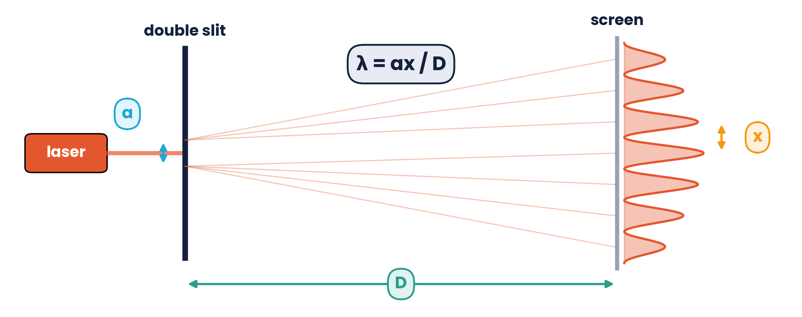
PAPER 2 STYLE · STRUCTURED QUESTION
Book question · Young's double slit
Yellow light from a sodium lamp (λ = 589 nm) is used in a double-slit experiment. The slit separation is 0.20 mm and the screen is 1.20 m from the slits.
(a) Calculate the separation between adjacent bright fringes.
(b) Use λ = ax/D to explain why (i) the fringes are further apart when the slits are closer (ii) blue fringes are closer than red (iii) a large D is desirable.
Topic 8 · Superposition | Cambridge International AS Level Physics 9702
43

Slide 44
MARK SCHEME STYLE SOLUTION
Book question · Solution
(a)
x = λD / a = 589 × 10⁻⁹ × 1.20 / 0.20 × 10⁻³ = 3.5 × 10⁻³ m (3.5 mm)
(b)
(i) x ∝ 1/a, so smaller a gives larger x; (ii) blue light has a shorter λ and x ∝ λ; (iii) x ∝ D, so a larger D gives larger fringes and a smaller percentage uncertainty
Topic 8 · Superposition | Cambridge International AS Level Physics 9702
44

Slide 45
PAPER 2 STYLE · STRUCTURED QUESTION
Book question · Double slit or grating?
A student measures the wavelength (546 nm) of green light from a mercury lamp. Method 1: a double slit (separation 0.50 mm) and a screen 0.80 m away; she measures across 10 fringes with a ruler (± 1 mm). Method 2: a grating with 3000 lines cm⁻¹; she measures the angle of the second-order maximum (± 0.1°).
(a) Determine the width of the 10 fringes in method 1.
(b) Determine the angle of the second-order maximum in method 2.
(c) Suggest which method gives the more accurate value of λ.
Topic 8 · Superposition | Cambridge International AS Level Physics 9702
45

Slide 46
MARK SCHEME STYLE SOLUTION
Book question · Solution
(a)
x = λD / a = 546 × 10⁻⁹ × 0.80 / 0.50 × 10⁻³ = 0.87 mm → 10 fringes = 8.7 mm (so ±1 mm is about ±11%)
(b)
d = 1 / 3000 cm = 3.33 × 10⁻⁶ m; sin θ = 2 × 546 × 10⁻⁹ / 3.33 × 10⁻⁶ = 0.328 → θ = 19.1°
(c)
The grating: its maxima are sharp and bright, and ±0.1° in 19° is only about 0.5% uncertainty
Topic 8 · Superposition | Cambridge International AS Level Physics 9702
46

Slide 47
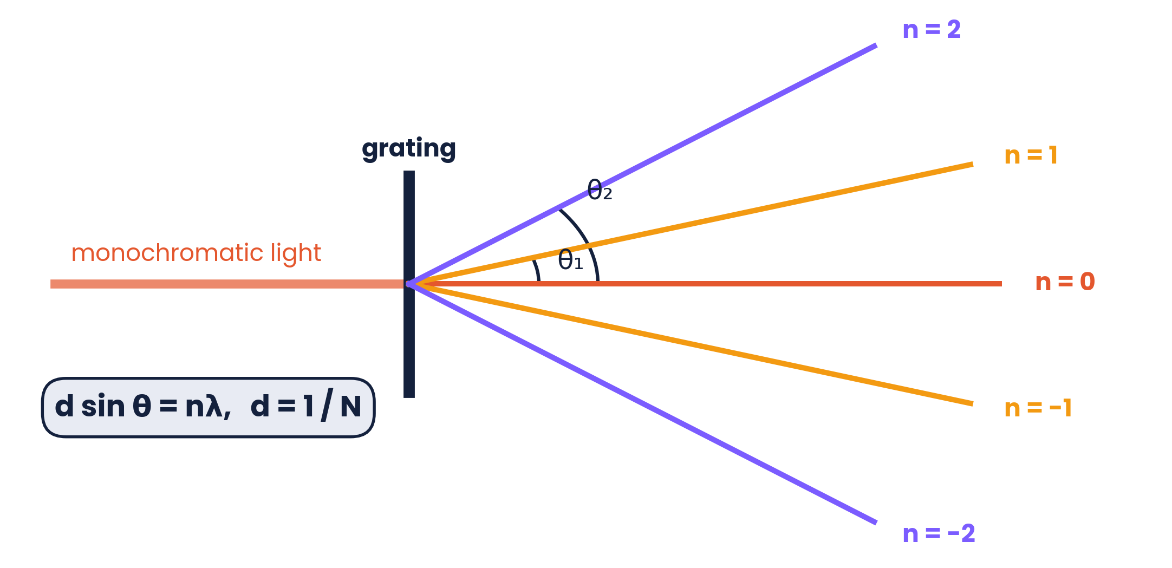
PAPER 2 STYLE · STRUCTURED QUESTION
Practice · Angle between second orders
Light of wavelength 550 nm passes through a diffraction grating with slit spacing 1.7 μm. Second-order lines appear either side of the central maximum.
(a) Calculate the angle θ of the second-order maximum from the central maximum.
(b) Calculate the angle between the two second-order lines.
(c) State the highest order visible.
Topic 8 · Superposition | Cambridge International AS Level Physics 9702
47

Slide 48
MARK SCHEME STYLE SOLUTION
Practice · Solution
(a)
sin θ = nλ / d = 2 × 550 × 10⁻⁹ / 1.7 × 10⁻⁶ = 0.647 → θ = 40.3°
(b)
Angle between the two second-order lines = 2θ = 81°
(c)
n ≤ d / λ = 1.7 × 10⁻⁶ / 550 × 10⁻⁹ = 3.1 → highest order is 3
Topic 8 · Superposition | Cambridge International AS Level Physics 9702
48

Slide 49
COMMON DOUBTS & MISCONCEPTIONS
Students often ask… (1)
?
“Does a stationary wave carry energy along the string?”
?
“Are nodes one wavelength apart?”
No. Energy is stored in the oscillation but is not transferred along the wave, unlike a progressive wave.
No — adjacent nodes (or antinodes) are λ/2 apart. Node to antinode is λ/4.
?
“Is the closed end of a pipe an antinode?”
?
“Does diffraction change the wavelength?”
No. Air cannot move at a closed end, so it is a node. An open end is an antinode.
No. Wavelength, frequency and speed are unchanged; only the direction (spreading) and amplitude change.
Topic 8 · Superposition | Cambridge International AS Level Physics 9702
49

Slide 50
COMMON DOUBTS & MISCONCEPTIONS
Students often ask… (2)
?
“Why can't two light bulbs make fringes?”
?
“In λ = ax/D, what is x?”
They are not coherent: the phase difference changes randomly, so the pattern shifts too fast to see.
The distance between the centres of adjacent bright (or dark) fringes, not the distance to the first fringe from the slits.
?
“Is d the number of lines?”
?
“Can the angle θ be 90° in d sin θ = nλ?”
No. d is the slit spacing = 1/N. For 500 lines mm⁻¹, d = 1 / (500 × 10³) m = 2 × 10⁻⁶ m.
sin θ cannot exceed 1. The highest order is the largest whole number ≤ d/λ.
Topic 8 · Superposition | Cambridge International AS Level Physics 9702
50

Slide 51
COMMAND WORDS AND MARK-SCHEME HABITS
Exam technique for superposition
Definitions
Stationary waves
superposition, coherence, diffraction, node, antinode — learn the mark-scheme wording
node spacing = λ/2; always check ends: fixed/closed = node, open = antinode
Double slit
Grating
measure across several fringes; convert mm → m; x ∝ λD/a
find d = 1/N first; highest order = whole number ≤ d/λ
Path difference
Diagrams
use Pythagoras for geometry; maxima nλ, minima (n + ½)λ
draw diffracted wavefronts with the SAME wavelength as the incident waves
Topic 8 · Superposition | Cambridge International AS Level Physics 9702
51

Slide 52
KEY IDEAS TO TAKE AWAY
Superposition in one slide
N–N = λ/2
f₀ = v / 2L
λ = ax / D
d sin θ = nλ
Stationary
two waves, opposite directions · nodes and antinodes · no energy transfer
Diffraction
spreading at gaps and edges · greatest when gap ≈ λ
Interference
coherent sources · maxima at nλ, minima at (n + ½)λ path difference
Topic 8 · Superposition | Cambridge International AS Level Physics 9702
52

