Slide 1
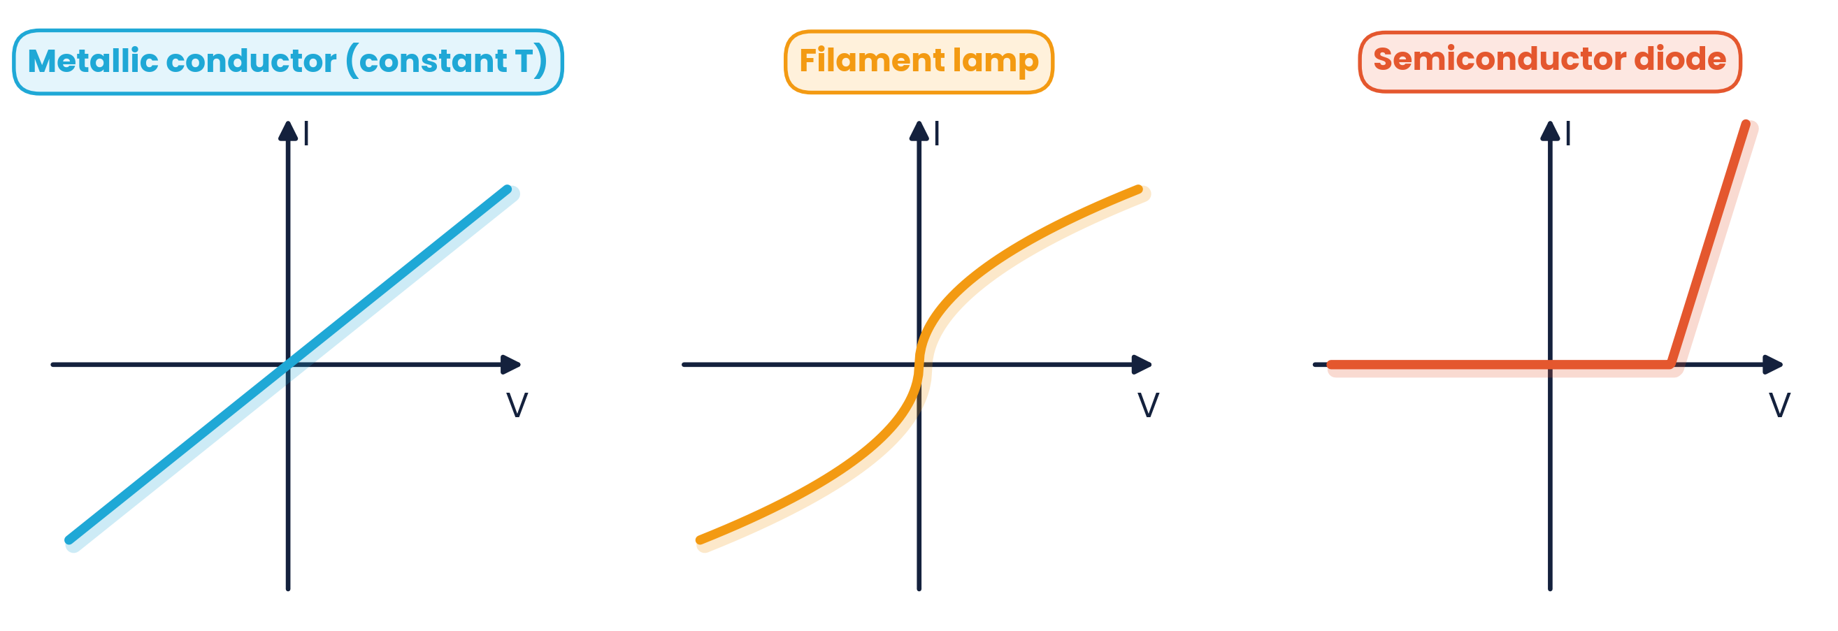
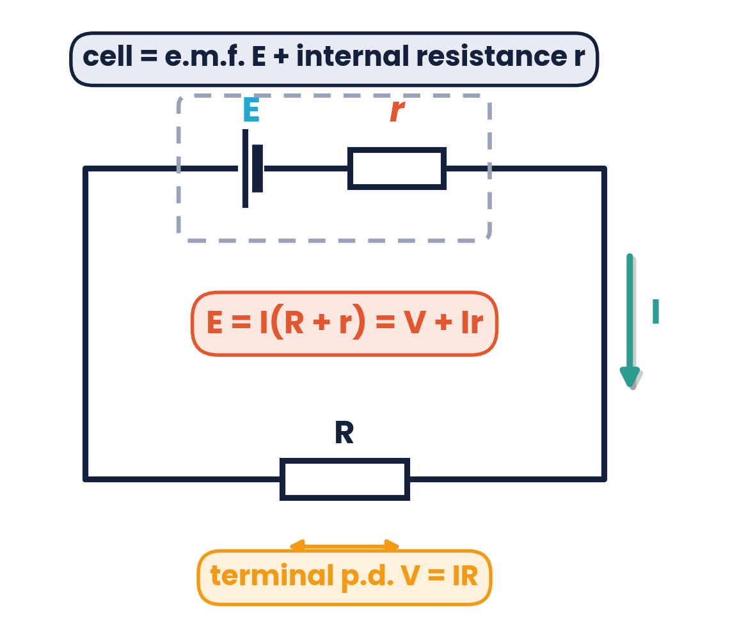
CAMBRIDGE AS & A LEVEL · PHYSICS 9702 · TOPICS 9 & 10
Electricity
& D.C. Circuits
Current · power · resistivity · e.m.f. · Kirchhoff · dividers
Syllabus 9.1 – 10.3 | Exams 2025 – 2027
WA
Waseem Ahmad
Head of Science & IB Physics Lead Teacher
Presidential School, Jizzakh · Cambridge Examiner
Author, Orange Publication · www.examspath.com

Slide 2
SYLLABUS 9.1 – 10.3 · ELECTRICITY AND D.C. CIRCUITS
What the syllabus asks you to do
9.1 Electric current
9.2 P.d. and power
9.3 Resistance & resistivity
current is a flow of charge carriers · charge is quantised · Q = It · I = Anvq
p.d. = energy per unit charge · V = W/Q · P = VI = I²R = V²/R
R = V/I · I–V graphs (metal, diode, lamp) · Ohm's law · R = ρL/A · LDR and thermistor
10.1 Practical circuits
10.2 Kirchhoff's laws
10.3 Potential dividers
circuit symbols · e.m.f. vs p.d. · internal resistance and terminal p.d.
first law (charge) · second law (energy) · derive series and parallel formulae · solve circuits
principle · potentiometer comparing p.d.s · galvanometer null methods · thermistor and LDR sensors
Topics 9 & 10 · Electricity and D.C. circuits | Cambridge International AS Level Physics 9702
2

Slide 3
TOPICS 9 & 10 · ELECTRICITY AND D.C. CIRCUITS
Lesson roadmap
01
02
03
04
Current & charge
P.d. & power
Resistance & I–V
Resistivity & sensors
Q = It, I = Anvq
V = W/Q, P = VI
Ohm's law, lamp, diode
R = ρL/A, LDR, thermistor
05
06
07
08
E.m.f. & internal r
Kirchhoff's laws
Potential dividers
Practice & doubts
E = I(R + r)
Junctions and loops
Sensors, potentiometer
Past papers, misconceptions
Topics 9 & 10 · Electricity and D.C. circuits | Cambridge International AS Level Physics 9702
3

Slide 4
LEARNING OUTCOMES 9.1.1 – 9.1.4
01
Electric current and charge
Current is a flow of charge carriers
Topics 9 & 10 · Electricity and D.C. circuits | Cambridge International AS Level Physics 9702
4

Slide 5
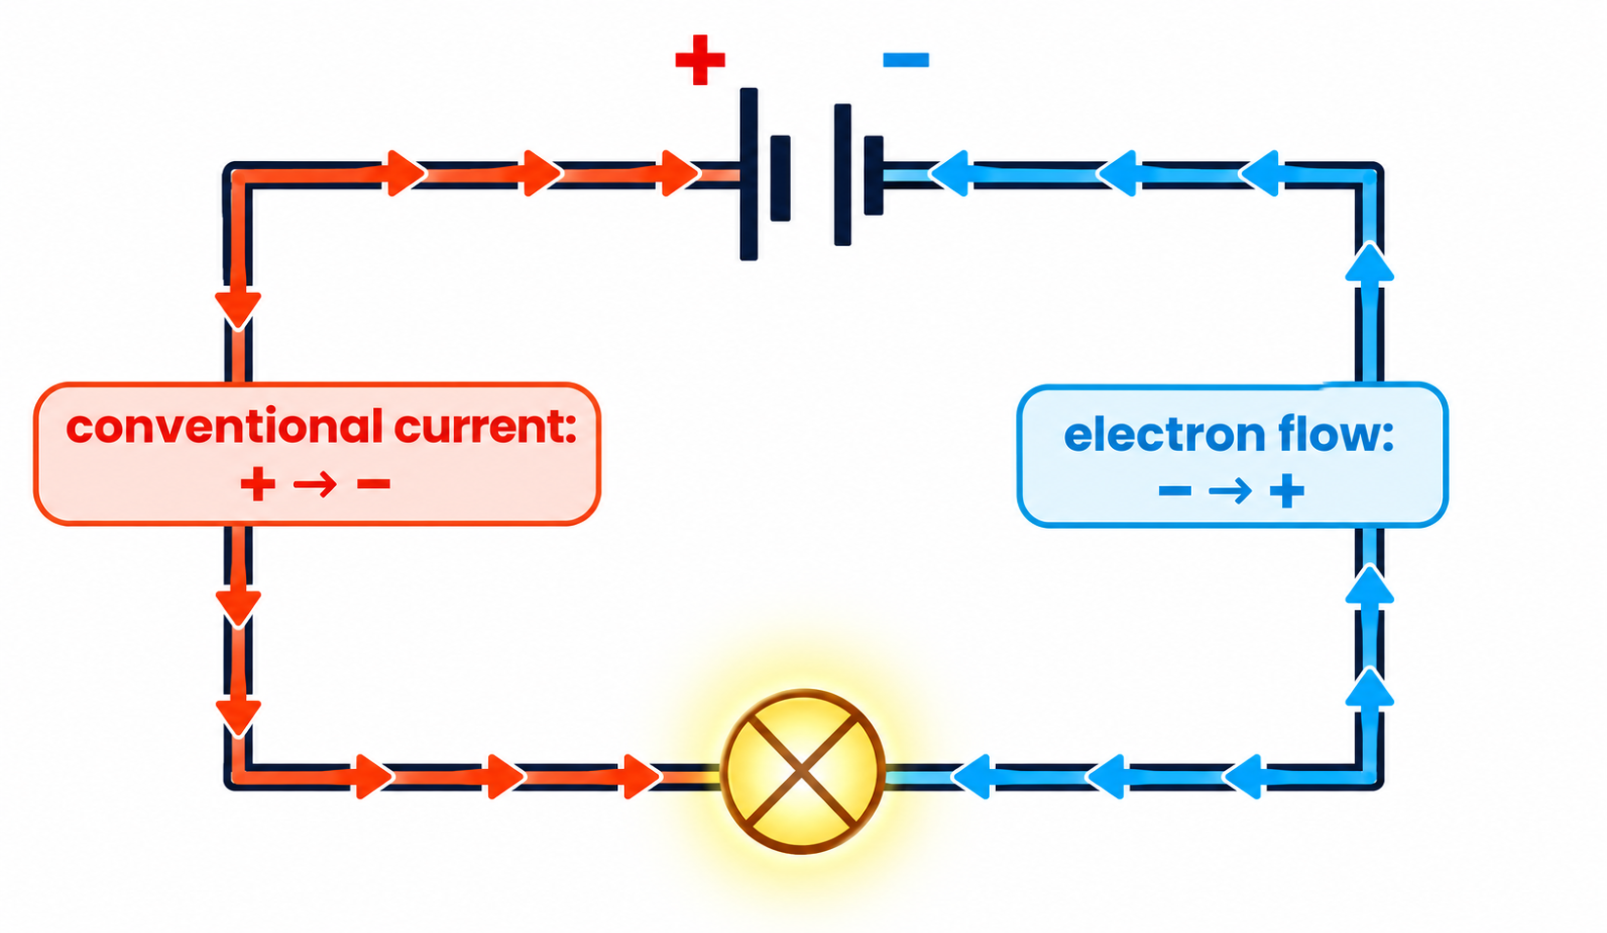
9.1.1 & 9.1.3 · RATE OF FLOW OF CHARGE
Electric current
Q = It
charge (C) = current (A) × time (s); 1 C = 1 A s
Current: the rate of flow of charge carriers
In metals the carriers are free electrons; in electrolytes, ions
Conventional current flows from + to −, opposite to electron flow
Ammeter: connected in series; ideally zero resistance
Quick check:
0.40 A for 15 s → Q = 6.0 C; 150 C in 30 s → I = 5.0 A; 50 C in 20 s → I = 2.5 A
Topics 9 & 10 · Electricity and D.C. circuits | Cambridge International AS Level Physics 9702
5

Slide 6
9.1.2 · Q = NE
Charge is quantised
Q = ne
Charge comes in whole-number multiples of the elementary charge e. A proton carries +e and an electron −e — no smaller free charge exists.
n = whole number; e = 1.60 × 10⁻¹⁹ C
Protons in 1 C
Which is possible?
Car battery 50 A h
n = 1 / 1.60 × 10⁻¹⁹ = 6.3 × 10¹⁸
6.0 × 10⁻¹⁹ C = 3.75e ✗; 8.0 × 10⁻¹⁹ C = 5e ✓; 10.0 × 10⁻¹⁹ C = 6.25e ✗ — only exact multiples of e
at 200 A lasts ¼ h = 15 min; charge = 200 × 900 = 1.8 × 10⁵ C
Topics 9 & 10 · Electricity and D.C. circuits | Cambridge International AS Level Physics 9702
6

Slide 7
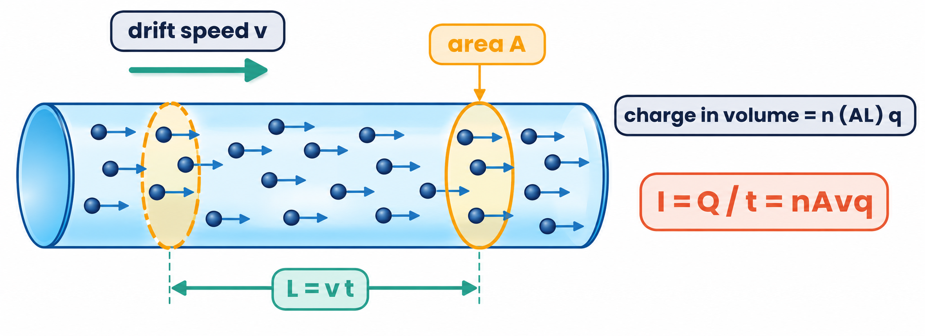
9.1.4 · NUMBER DENSITY AND DRIFT SPEED
Current in a conductor: I = Anvq
n: number density (carriers per m³)
A: cross-sectional area (m²)
v: mean drift speed (m s⁻¹)
q: charge of each carrier (C)
Worked example:
a copper wire (n = 8.2 × 10²⁸ m⁻³, A = 1.5 mm²) carries 3.5 A. v = I / nAq = 3.5 / (8.2 × 10²⁸ × 1.5 × 10⁻⁶ × 1.60 × 10⁻¹⁹) = 1.8 × 10⁻⁴ m s⁻¹ — only about 0.18 mm per second! The current is set up almost instantly because n is enormous.
Topics 9 & 10 · Electricity and D.C. circuits | Cambridge International AS Level Physics 9702
7

Slide 8
9.1.4 · USING I = ANVQ
Worked examples · Drift speed
Gold wire
Copper wire
A = 2.0 mm², v = 0.10 mm s⁻¹, n = 5.9 × 10²⁸ m⁻³
diameter 1.0 mm, I = 5.0 A, n = 8.5 × 10²⁸ m⁻³
I = 5.9 × 10²⁸ × 2.0 × 10⁻⁶ × 1.0 × 10⁻⁴ × 1.6 × 10⁻¹⁹ = 1.9 A
v = 5.0 / (8.5 × 10²⁸ × π(0.50 × 10⁻³)² × 1.6 × 10⁻¹⁹) = 4.7 × 10⁻⁴ m s⁻¹
Copper → silver
Thin vs thick
same current and size; silver n = 5.9 × 10²⁸ m⁻³
same current in wires of different area
v ∝ 1/n, so the drift speed increases in silver (fewer carriers must move faster)
v ∝ 1/A: the electrons drift faster in the thinner wire
Topics 9 & 10 · Electricity and D.C. circuits | Cambridge International AS Level Physics 9702
8

Slide 9
LEARNING OUTCOMES 9.2.1 – 9.2.3
02
Potential difference and power
Energy transferred per unit charge
Topics 9 & 10 · Electricity and D.C. circuits | Cambridge International AS Level Physics 9702
9

Slide 10
9.2.1 & 9.2.2 · V = W / Q
Potential difference
V = W / Q
Definition:
the potential difference across a component is the energy transferred (from electrical to other forms) per unit charge passing through it. A voltmeter is connected in parallel and ideally has infinite resistance.
1 V = 1 J C⁻¹
Which lamp is brighter?
Worked example
A 240 V mains lamp and a 12 V car lamp carry the same current. Each coulomb transfers 240 J in the mains lamp but only 12 J in the car lamp — 20 times more energy per second, so the 240 V lamp is far brighter.
A lamp carries 10 A for 20 s and transfers 400 J. Charge = 10 × 20 = 200 C; energy per coulomb = 400 / 200 = 2.0 J; so the p.d. = 2.0 V.
Topics 9 & 10 · Electricity and D.C. circuits | Cambridge International AS Level Physics 9702
10

Slide 11
9.2.3 · P = VI = I²R = V²/R
Electrical power
P = VI
P = I²R
P = V² / R
power = rate of transfer of energy
using V = IR
using I = V/R
Calculator
230 V, 15 W bulb
100 W bulb, 0.43 A
Power station
3.0 V across 20 kΩ: P = V²/R = 9 / 20 000 = 0.45 mW
I = P/V = 0.065 A; R = V/I = 3500 Ω
R = P/I² = 100 / 0.43² = 540 Ω
25 kV, 40 kA: P = VI = 1.0 × 10⁹ W (1 GW)
Topics 9 & 10 · Electricity and D.C. circuits | Cambridge International AS Level Physics 9702
11

Slide 12
9.2 · ENERGY, CHARGE AND POWER
Worked example · Car battery
A battery has negligible internal resistance, an e.m.f. of 12.0 V and a capacity of 100 A h (ampere-hours). Calculate (i) the total charge it can supply (ii) the total energy it can transfer. It is connected to a 27 W lamp — calculate the lamp's resistance.
Charge
Energy
Resistance
Q = It = 100 A × 3600 s = 3.6 × 10⁵ C
W = QV = 3.6 × 10⁵ × 12 = 4.3 × 10⁶ J
R = V² / P = 12² / 27 = 5.3 Ω
Also:
a 12 V battery supplying 10 A for 5.0 hours transfers W = IVt = 10 × 12 × 18 000 = 2.2 MJ. E.m.f. is the work done per coulomb in the whole circuit; terminal p.d. is the work done per coulomb in the external circuit.
Topics 9 & 10 · Electricity and D.C. circuits | Cambridge International AS Level Physics 9702
12

Slide 13
LEARNING OUTCOMES 9.3.1 – 9.3.5
03
Resistance and I–V characteristics
R = V / I and Ohm's law
Topics 9 & 10 · Electricity and D.C. circuits | Cambridge International AS Level Physics 9702
13

Slide 14
9.3.1, 9.3.2 & 9.3.5 · DEFINE AND STATE
Resistance and Ohm's law
R = V / I
Resistance:
the ratio of the p.d. across a component to the current through it.
Ohm's law:
for a metallic conductor at constant temperature, the current is directly proportional to the p.d.
1 Ω = 1 V A⁻¹
Worked example
Measuring R
5.0 C passes through a resistor in 30 s with 2.0 V across it. I = Q/t = 5.0/30 = 0.17 A; R = V/I = 2.0 / 0.167 = 12 Ω
Ammeter in series, voltmeter in parallel
Use a low supply p.d. (1–2 V) so the component does not heat up
Vary with a variable resistor; plot I against V
Topics 9 & 10 · Electricity and D.C. circuits | Cambridge International AS Level Physics 9702
14

Slide 15
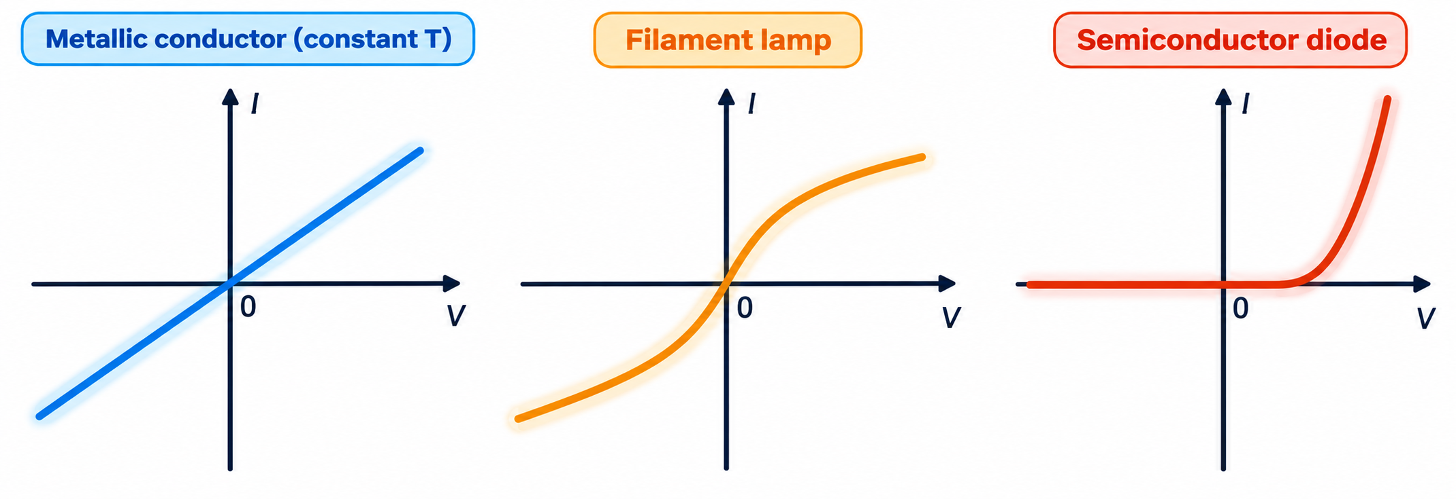
9.3.3 · SKETCH AND EXPLAIN THE SHAPES
I–V characteristics
Metallic conductor
straight line through the origin: constant R (obeys Ohm's law)
Filament lamp
gradient decreases: R increases as I increases because the filament gets hotter
Semiconductor diode
conducts only in forward bias above ≈ 0.6 V; almost zero current in reverse
Topics 9 & 10 · Electricity and D.C. circuits | Cambridge International AS Level Physics 9702
15

Slide 16
9.3.4 · RESISTANCE AND TEMPERATURE
Why a filament's resistance rises
Explanation chain
Reading the graph
R = V/I at a point (NOT 1/gradient of the tangent). On an I–V graph a decreasing gradient means increasing resistance.
1
Larger current → more energy dissipated → filament temperature rises
2
Lattice ions vibrate with larger amplitude
3
Free electrons collide with the ions more often
Semiconductors are different
heating releases many more charge carriers, so the number density n rises and resistance FALLS (thermistor).
4
Mean drift speed falls for a given p.d. → resistance increases
Topics 9 & 10 · Electricity and D.C. circuits | Cambridge International AS Level Physics 9702
16

Slide 17
LEARNING OUTCOMES 9.3.6 – 9.3.8
04
Resistivity, LDRs and thermistors
R = ρL / A
Topics 9 & 10 · Electricity and D.C. circuits | Cambridge International AS Level Physics 9702
17

Slide 18
9.3.6 · R = ΡL / A
Resistivity
R = ρL / A
Double the length → double the resistance
Double the diameter → area × 4 → resistance ÷ 4
Resistivity depends on the material and its temperature
ρ = resistivity (Ω m): a property of the material
copper
aluminium
silicon
glass
1.7 × 10⁻⁸ Ω m
2.8 × 10⁻⁸ Ω m
2.3 × 10³ Ω m
10¹² Ω m
Stretched wire:
a 10 Ω wire stretched to twice its length (same volume) has half the area, so R = 10 × 2 × 2 = 40 Ω.
Topics 9 & 10 · Electricity and D.C. circuits | Cambridge International AS Level Physics 9702
18

Slide 19
9.3.6 · RECALL AND USE R = ΡL/A
Worked examples · Resistivity
Cylinders
1.0 cm³ of copper
Cu: d = 5 mm, L = 8 mm; Al: d = 10 mm, L = 16 mm
drawn into a wire of area 4.0 × 10⁻⁷ m²
R(Cu) = 1.7 × 10⁻⁸ × 0.008 / π(0.0025)² = 6.9 μΩ; R(Al) = 5.7 μΩ → aluminium conducts better here
L = V/A = 2.5 m; R = ρL/A = 1.69 × 10⁻⁸ × 2.5 / 4.0 × 10⁻⁷ = 0.11 Ω
Same wire, 5 m
Heater element
a 1.0 m length has R = 0.50 Ω
ρ = 1.30 × 10⁻⁸ Ω m, A = 0.0080 mm²
R ∝ L → 5.0 m has 2.5 Ω; halving the diameter instead → R × 4 = 2.0 Ω
1.5 m has R = 1.30 × 10⁻⁸ × 1.5 / 8.0 × 10⁻⁹ = 2.4 Ω; for 30 Ω, L = RA/ρ = 18 m
Topics 9 & 10 · Electricity and D.C. circuits | Cambridge International AS Level Physics 9702
19

Slide 20
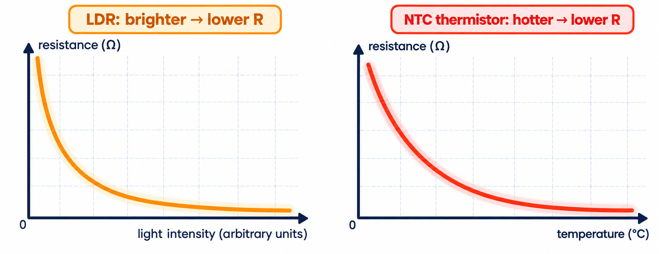
9.3.7 & 9.3.8 · SENSORS
LDRs and thermistors
LDR:
resistance decreases as light intensity increases — used in automatic street lights and light meters.
Thermistor (NTC):
resistance decreases as temperature increases — used in thermostats, fire alarms and thermometers.
Topics 9 & 10 · Electricity and D.C. circuits | Cambridge International AS Level Physics 9702
20

Slide 21
LEARNING OUTCOMES 10.1.1 – 10.1.5
05
E.m.f. and internal resistance
Practical circuits
Topics 9 & 10 · Electricity and D.C. circuits | Cambridge International AS Level Physics 9702
21

Slide 22
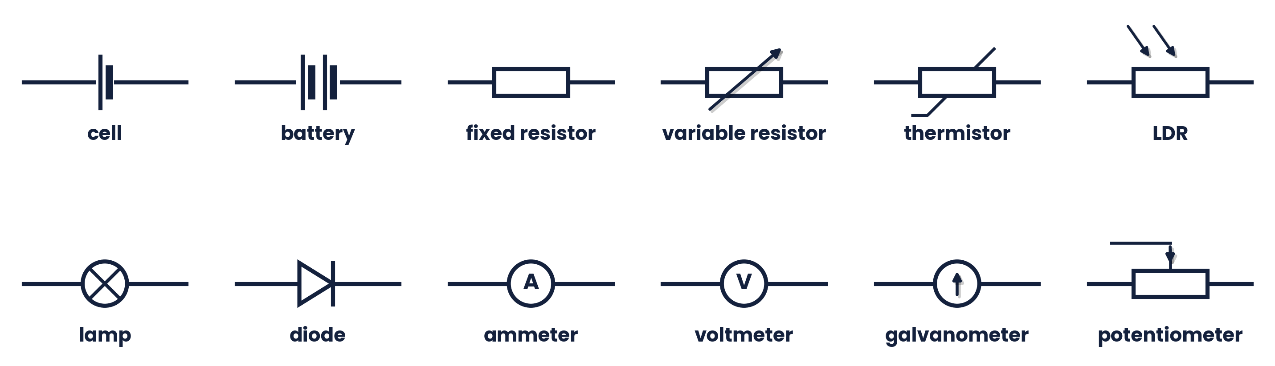
10.1.1 & 10.1.2 · RECALL, DRAW AND INTERPRET
Circuit symbols
Ammeters go in series (ideal: zero resistance); voltmeters go in parallel (ideal: infinite resistance). A diode's arrow shows the direction of conventional current when it conducts.
Topics 9 & 10 · Electricity and D.C. circuits | Cambridge International AS Level Physics 9702
22

Slide 23
10.1.3 & 10.1.4 · TWO KINDS OF ENERGY TRANSFER
E.m.f. and potential difference
E.m.f. E
P.d. V
The energy transferred per unit charge from other forms (e.g. chemical) to ELECTRICAL energy in driving charge around a complete circuit.
The energy transferred per unit charge from ELECTRICAL energy to other forms (heat, light) in a component.
Measuring e.m.f.:
connect a high-resistance voltmeter across the cell with no other current flowing (open circuit). Example: a voltmeter reads 3.0 V; when a 10 Ω resistor is connected it drops to 2.8 V → I = 0.28 A, lost volts 0.2 V, r = 0.2 / 0.28 = 0.71 Ω.
Topics 9 & 10 · Electricity and D.C. circuits | Cambridge International AS Level Physics 9702
23

Slide 24
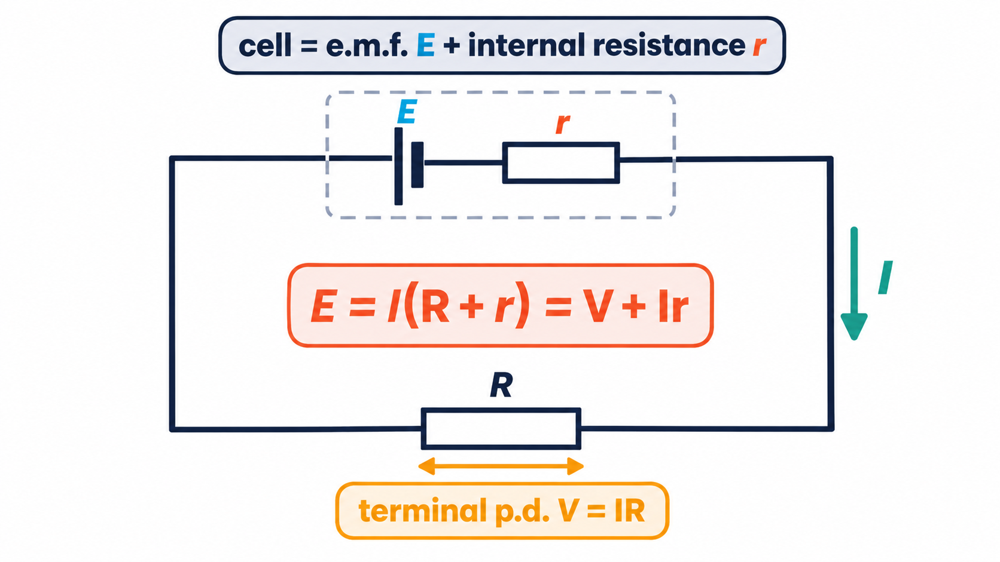
10.1.5 · TERMINAL P.D. AND LOST VOLTS
Internal resistance
E = I(R + r) = V + Ir
Terminal p.d. V = IR (available to the circuit)
Lost volts = Ir (energy dissipated inside the cell, which warms up)
Worked example
E = 7.3 V, r = 0.30 Ω, R = 9.5 Ω. I = 7.3 / 9.8 = 0.74 A; lost volts = 0.74 × 0.30 = 0.22 V; terminal p.d. = 7.1 V
Larger current → more lost volts → lower terminal p.d.
Topics 9 & 10 · Electricity and D.C. circuits | Cambridge International AS Level Physics 9702
24

Slide 25
10.1.5 · INTERNAL RESISTANCE PROBLEMS
Worked examples · E = I(R + r)
Single resistor
Two 10 Ω in series
E = 5.0 V, r = 2.0 Ω, R = 8.0 Ω
E = 3.0 V, r = 4.0 Ω
I = 5.0 / 10 = 0.50 A
I = 3.0 / 24 = 0.125 A; lost volts 0.50 V; terminal p.d. 2.5 V
Two 10 Ω in parallel
Four cells in series
E = 3.0 V, r = 4.0 Ω; R = 5.0 Ω
each 1.5 V, 0.10 Ω; lamp 2.0 Ω
I = 3.0 / 9.0 = 0.33 A; lost volts 1.33 V; terminal p.d. 1.67 V
I = 6.0 / (2.0 + 0.40) = 2.5 A
Topics 9 & 10 · Electricity and D.C. circuits | Cambridge International AS Level Physics 9702
25

Slide 26
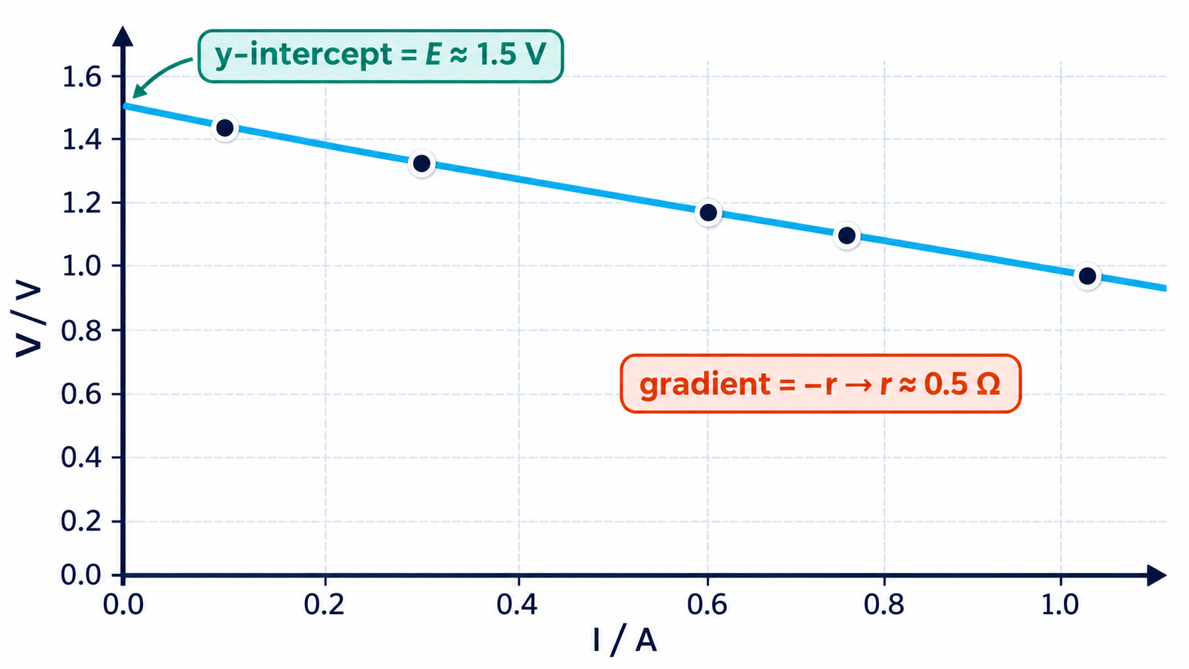
10.1.5 · V = −RI + E
Finding E and r from a graph
Method
Connect a variable resistor across the cell; measure V and I for several settings
Plot V (y-axis) against I
Compare with y = mx + c
Results from the table
y-intercept = E ≈ 1.5 V
gradient = −r → r ≈ 0.5 Ω
Topics 9 & 10 · Electricity and D.C. circuits | Cambridge International AS Level Physics 9702
26

Slide 27
LEARNING OUTCOMES 10.2.1 – 10.2.7
06
Kirchhoff's laws
Conservation of charge and energy
Topics 9 & 10 · Electricity and D.C. circuits | Cambridge International AS Level Physics 9702
27

Slide 28
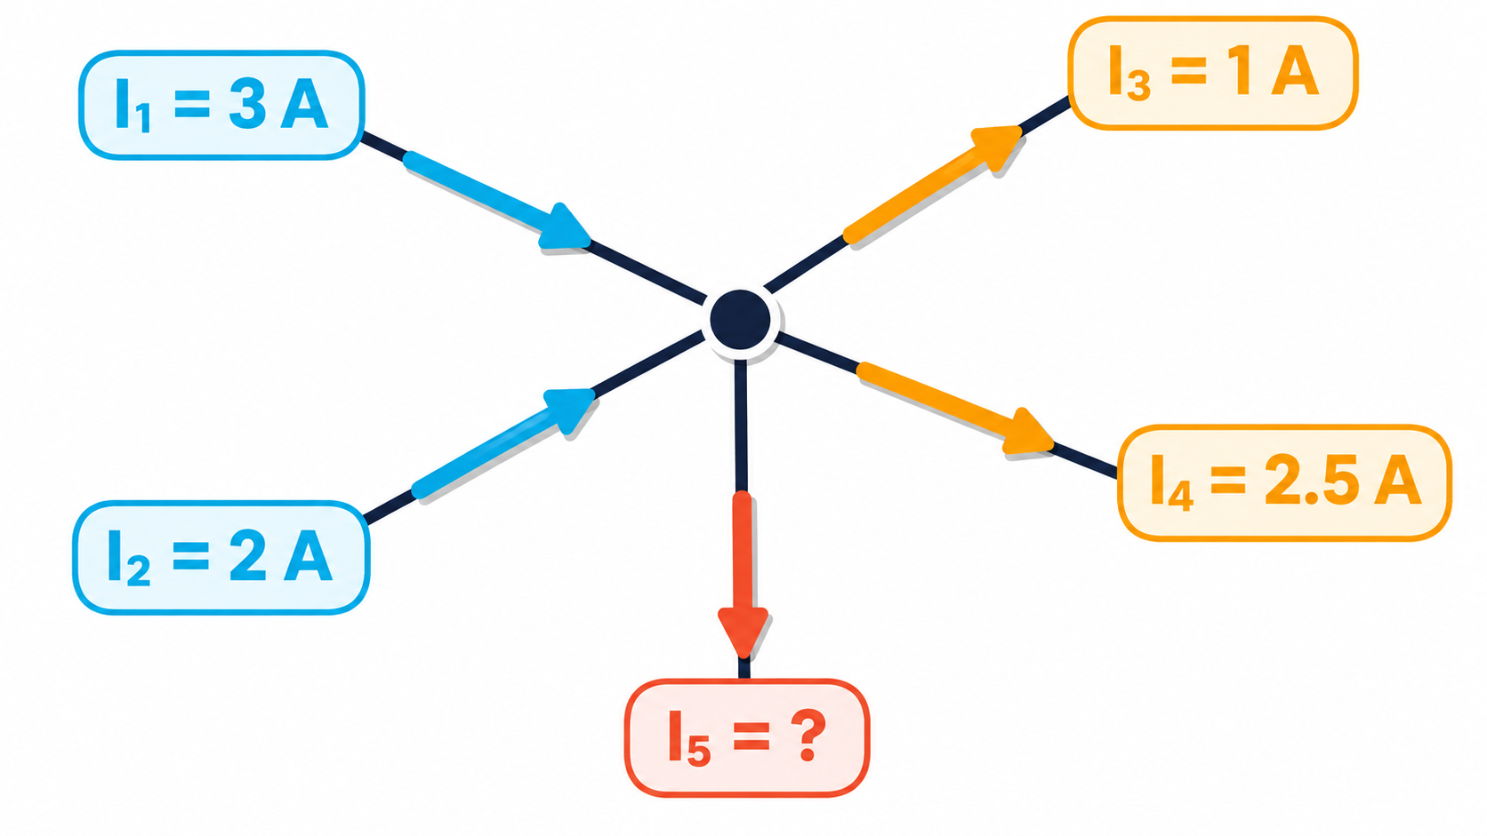
10.2.1 · CONSEQUENCE OF CONSERVATION OF CHARGE
Kirchhoff's first law
The sum of the currents entering a junction equals the sum of the currents leaving it.
Example
In: 3 A + 2 A = 5 A. Out: 1 A + 2.5 A + I₅
→ I₅ = 1.5 A (out of the junction)
Charge cannot be created or destroyed at a junction, so the rate of flow in must equal the rate of flow out. In a series circuit the current is the same everywhere.
Topics 9 & 10 · Electricity and D.C. circuits | Cambridge International AS Level Physics 9702
28

Slide 29
10.2.2 · CONSEQUENCE OF CONSERVATION OF ENERGY
Kirchhoff's second law
Around any closed loop, the sum of the e.m.f.s equals the sum of the p.d.s.
Sign rules
Worked example
Choose a direction round the loop
e.m.f. positive if it pushes current that way
IR positive if the current flows that way through the resistor
A negative answer means the current flows the opposite way
A 10 V battery (negligible r) drives 0.1 A through 20 Ω and R in series. p.d. across 20 Ω = 0.1 × 20 = 2.0 V; so p.d. across R = 10 − 2.0 = 8.0 V; R = 8.0 / 0.1 = 80 Ω
Topics 9 & 10 · Electricity and D.C. circuits | Cambridge International AS Level Physics 9702
29

Slide 30
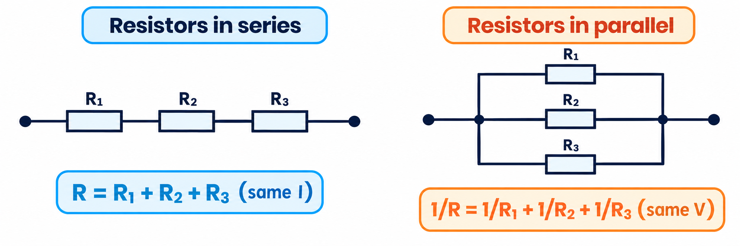
10.2.3 – 10.2.6 · USING KIRCHHOFF'S LAWS
Deriving series and parallel formulae
Series
Same current I (first law). Second law: V = V₁ + V₂ + V₃ → IR = IR₁ + IR₂ + IR₃ → R = R₁ + R₂ + R₃
Parallel
Same p.d. V (second law). First law: I = I₁ + I₂ + I₃ → V/R = V/R₁ + V/R₂ + V/R₃ → 1/R = 1/R₁ + 1/R₂ + 1/R₃
Topics 9 & 10 · Electricity and D.C. circuits | Cambridge International AS Level Physics 9702
30

Slide 31
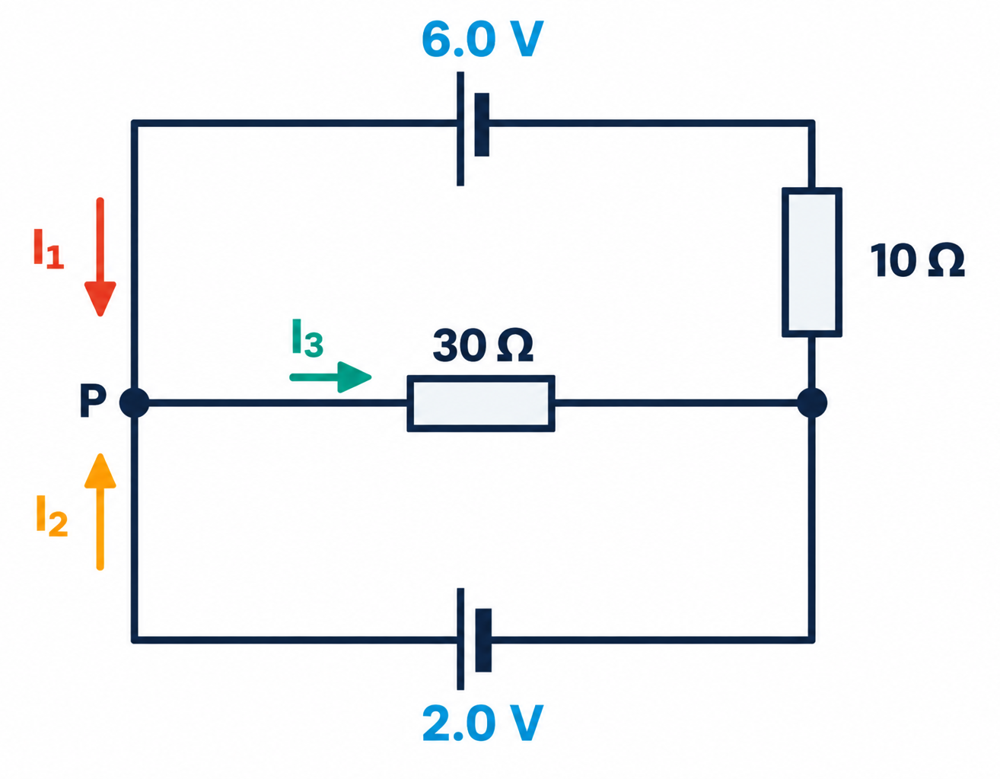
10.2.7 · SOLVE WITH BOTH LAWS
Worked example · Two e.m.f.s
Find the currents I₁, I₂ and I₃ in the circuit (both cells have negligible internal resistance).
1
First law at P: I₁ + I₂ = I₃
2
Upper loop (6.0 V, 10 Ω, 30 Ω): 6.0 = 10I₁ + 30I₃
3
Lower loop (2.0 V, 30 Ω): 2.0 = 30I₃ → I₃ = 0.067 A
4
Then 10I₁ = 6.0 − 2.0 → I₁ = 0.40 A; I₂ = 0.067 − 0.40 = −0.33 A (it flows the other way)
Topics 9 & 10 · Electricity and D.C. circuits | Cambridge International AS Level Physics 9702
31

Slide 32
LEARNING OUTCOMES 10.3.1 – 10.3.4
07
Potential dividers
Sharing the supply p.d. between resistors
Topics 9 & 10 · Electricity and D.C. circuits | Cambridge International AS Level Physics 9702
32

Slide 33
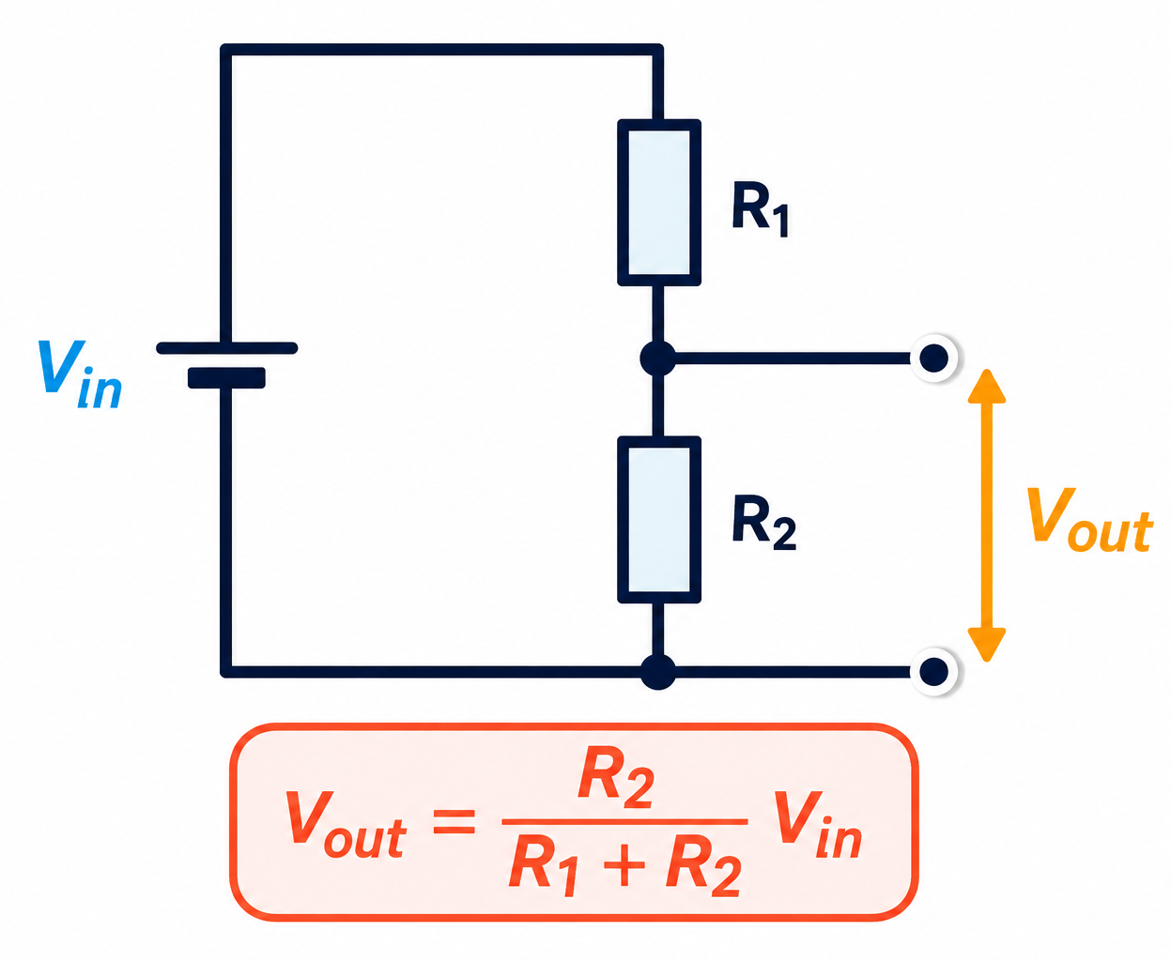
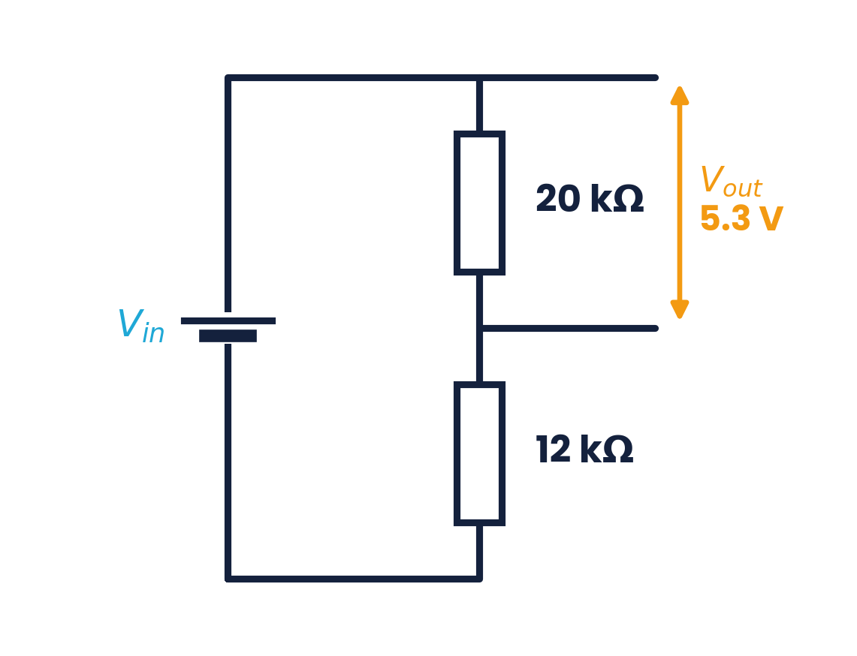
10.3.1 · PRINCIPLE
The potential divider
The p.d. is shared in proportion to the resistances
V₁ / V₂ = R₁ / R₂ (same current)
Vary R₁ or R₂ (or use a sliding contact) to get any output from 0 to the supply p.d.
Worked example
Vout = 5.3 V across 20 kΩ (with 12 kΩ).
Vin = 5.3 × (20 + 12) / 20 = 8.5 V
Topics 9 & 10 · Electricity and D.C. circuits | Cambridge International AS Level Physics 9702
33

Slide 34
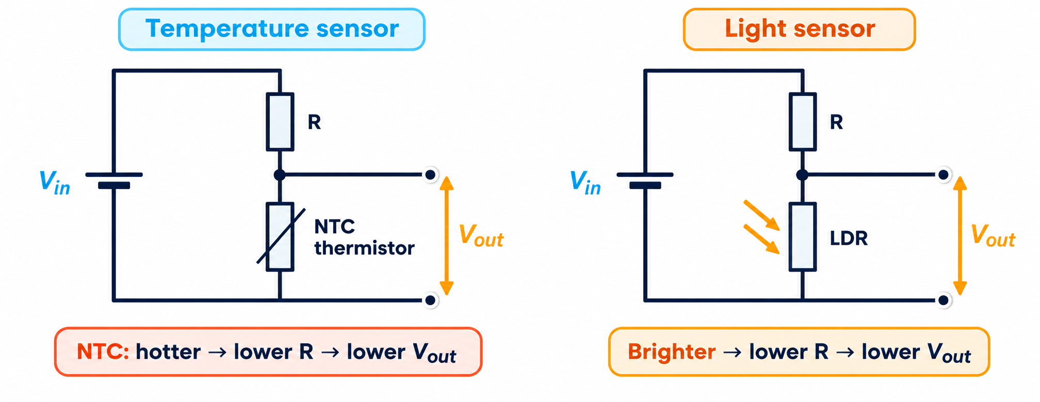
10.3.4 · THERMISTORS AND LDRS IN POTENTIAL DIVIDERS
Sensing circuits
Temperature rises → thermistor R falls → its share of p.d. falls
Light increases → LDR R falls → its share of p.d. falls
Vout across the fixed R rises in both cases
Design tip:
swap the sensor and the fixed resistor to reverse the behaviour — e.g. put the LDR at the top so Vout across the fixed resistor RISES as it gets DARK to switch on a street light.
Topics 9 & 10 · Electricity and D.C. circuits | Cambridge International AS Level Physics 9702
34

Slide 35
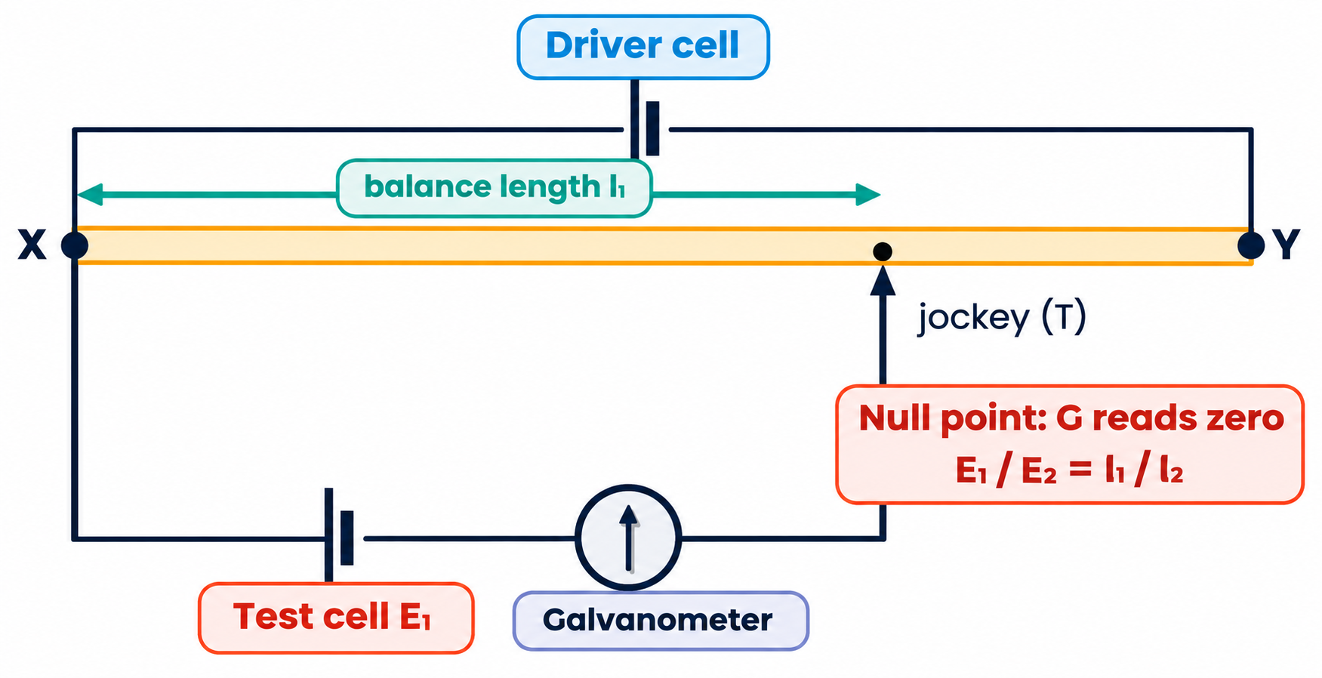
10.3.2 & 10.3.3 · COMPARING POTENTIAL DIFFERENCES
The potentiometer and null methods
A uniform wire XY carries a steady current from the driver cell, so p.d. ∝ length
Move the jockey until the galvanometer reads zero: the null (balance) point
At balance no current flows through the test cell, so its terminal p.d. = its e.m.f.
Comparing cells: E₁ / E₂ = l₁ / l₂
A galvanometer is a sensitive meter used to detect a zero current (null reading).
Topics 9 & 10 · Electricity and D.C. circuits | Cambridge International AS Level Physics 9702
35

Slide 36
CAMBRIDGE PAST PAPER QUESTIONS
08
Past paper practice
Paper 1 multiple choice · Paper 2 structured questions
Topics 9 & 10 · Electricity and D.C. circuits | Cambridge International AS Level Physics 9702
36

Slide 37
PAPER 1 STYLE · MULTIPLE CHOICE
Past paper set A · Current and units
1
When will 8 mA of current pass through an electrical circuit?
2
What is the unit of resistance when expressed in SI base units?
A when 1 J of energy is used by 1 C of charge
B when a charge of 4 C passes in 500 s
C when a charge of 8 C passes in 100 s
D when a charge of 1 C passes in 8 s
A kg m² s⁻² A⁻¹
B kg m² s⁻³ A⁻²
C kg m s⁻² A⁻¹
D kg m² s⁻³ A⁻¹
3
The unit of resistivity in SI base units is kg x³ y⁻³ z⁻². Which base units are x, y and z?
A ampere, metre, second
B metre, ampere, second
C metre, second, ampere
D second, ampere, metre
Topics 9 & 10 · Electricity and D.C. circuits | Cambridge International AS Level Physics 9702
37

Slide 38
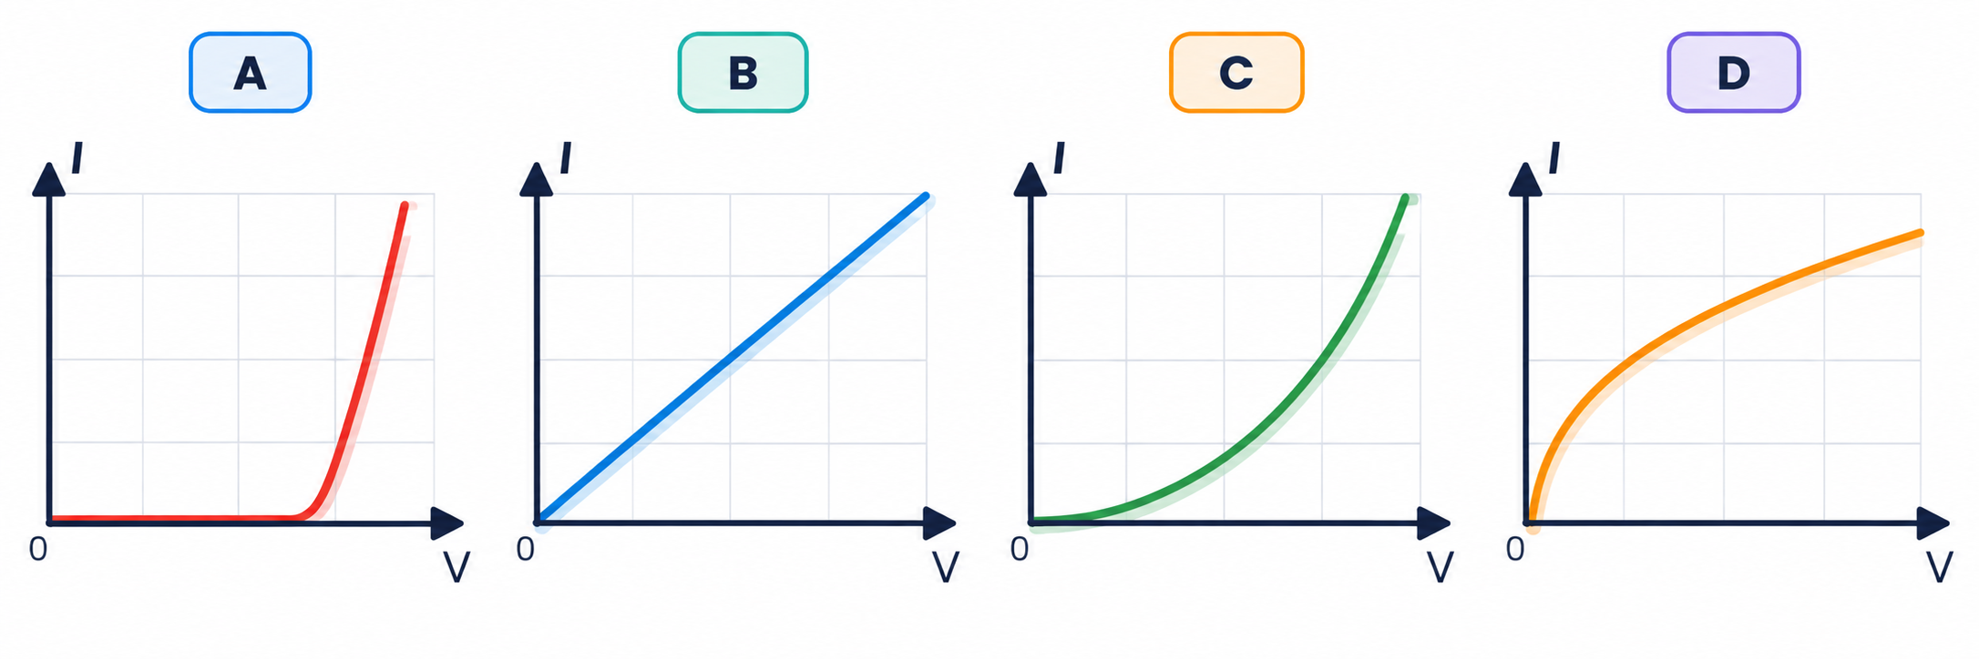
PAPER 1 STYLE · MULTIPLE CHOICE
Past paper · Filament lamp
4
Which graph shows the I–V characteristic of a filament lamp?
Choose A, B, C or D
Topics 9 & 10 · Electricity and D.C. circuits | Cambridge International AS Level Physics 9702
38

Slide 39
ANSWERS AND KEY WORKING
Answers · Questions 1 – 4
1
Answer B
2
Answer B
I = Q/t = 4 / 500 = 8 × 10⁻³ A = 8 mA. C gives 80 mA; D gives 125 mA; A is a p.d., not a current.
R = V/I; V = kg m² s⁻³ A⁻¹, so R = kg m² s⁻³ A⁻². (D is the volt.)
3
Answer C
4
Answer D
ρ = RA/L → kg m² s⁻³ A⁻² × m² ÷ m = kg m³ s⁻³ A⁻², so x = metre, y = second, z = ampere.
Current rises steeply at first, then the gradient falls as the filament heats up and its resistance increases.
Topics 9 & 10 · Electricity and D.C. circuits | Cambridge International AS Level Physics 9702
39

Slide 40
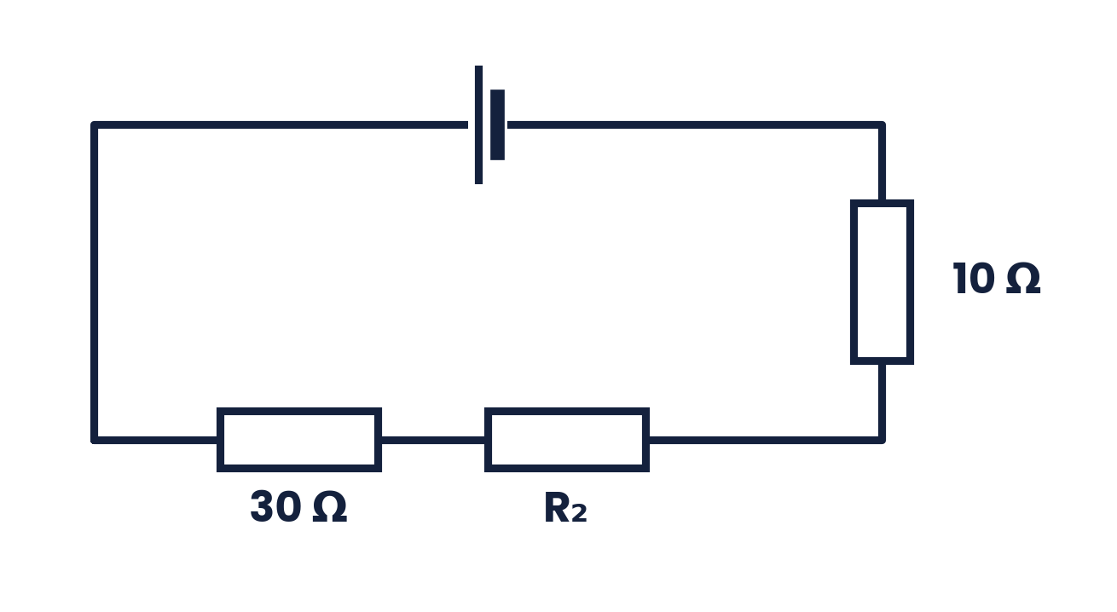
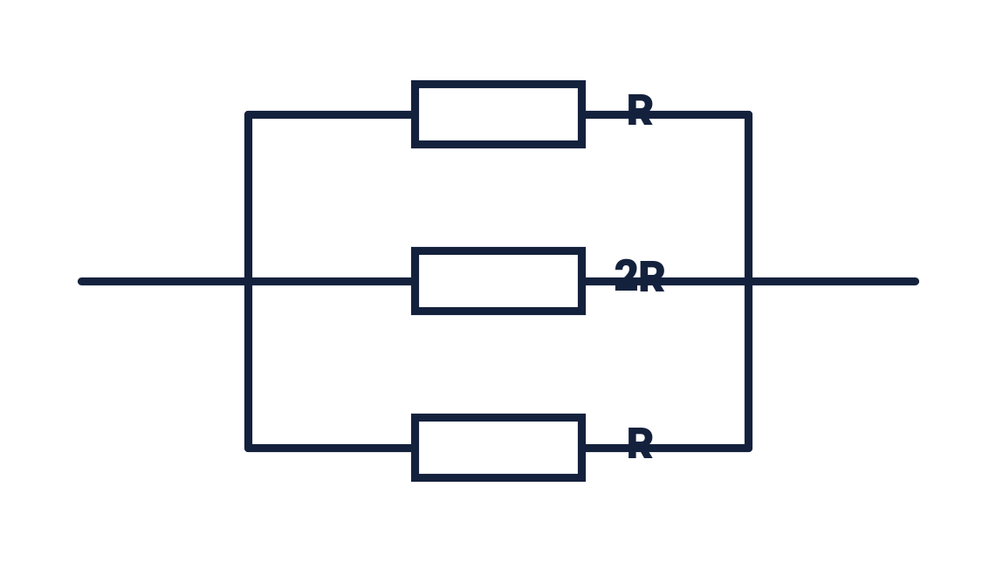
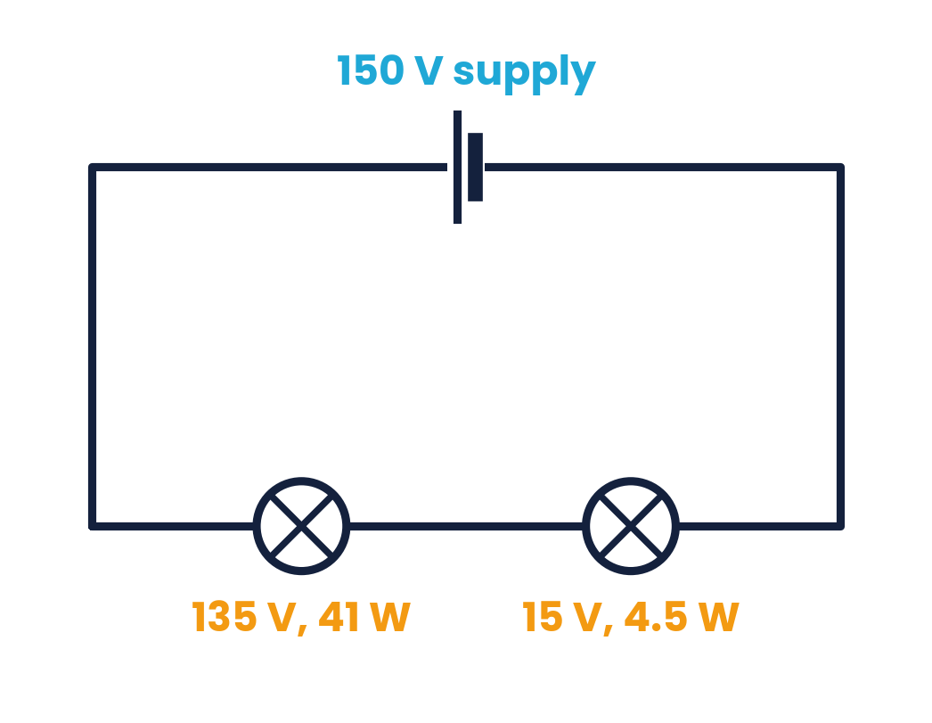
PAPER 1 STYLE · MULTIPLE CHOICE
Past paper set B · Circuits
5
The combined resistance of the series circuit is 60 Ω. What is the resistance of R₂?
6
Three resistors R, 2R and R are connected in parallel. What is their combined resistance?
A 100 Ω
B 30 Ω
C 20 Ω
D 40 Ω
A 5R / 2
B 2 / 5R
C 5 / 2R
D 2R / 5
7
Two lamps are connected in series to a 150 V supply: one is rated 135 V, 41 W and the other 15 V, 4.5 W. What happens?
8
The resistance of R₁ changes with temperature; the resistance of R₂ changes with illumination. What are these devices?
A both lamps light normally
B the 15 V lamp blows
C only the 41 W lamp lights
D both light at less than normal brightness
A thermistor, light-dependent resistor
B thermistor, potential divider
C diode, light-dependent resistor
D diode, potential divider
Topics 9 & 10 · Electricity and D.C. circuits | Cambridge International AS Level Physics 9702
40

Slide 41
ANSWERS AND KEY WORKING
Answers · Questions 5 – 8
5
Answer C
6
Answer D
Series: 60 = 30 + R₂ + 10 → R₂ = 20 Ω.
1/R_T = 1/R + 1/2R + 1/R = 5/2R → R_T = 2R/5.
7
Answer A
8
Answer A
Normal currents: 41/135 = 0.30 A and 4.5/15 = 0.30 A — equal, and 135 + 15 = 150 V, so both work normally in series.
Temperature → thermistor; illumination → LDR. A potential divider is a circuit, not a device.
Topics 9 & 10 · Electricity and D.C. circuits | Cambridge International AS Level Physics 9702
41

Slide 42
PAPER 1 STYLE · MULTIPLE CHOICE
Set C · Sensors and internal resistance
9
A thermistor is in series with a resistor R and a battery. At room temperature their resistances are equal. The temperature of the thermistor DECREASES. Which is correct?
10
An LDR is in series with a resistor R. With no light the LDR's resistance equals R. Light now falls on the LDR. Which is correct?
A the p.d. across the thermistor increases
B the current in R increases
C the current through the thermistor decreases
D the p.d. across R increases
A the current in R decreases
B the current through the LDR decreases
C the p.d. across R decreases
D the p.d. across the LDR decreases
11
A potential divider consists of a fixed resistor R above a thermistor. The temperature increases. What happens to the p.d.s across the thermistor and across R?
12
A car battery of e.m.f. 12 V delivers 100 A to the starter motor; the terminal p.d. falls to 9.0 V. What is the internal resistance?
A thermistor increases, R increases
B thermistor decreases, R increases
C thermistor decreases, R decreases
D thermistor increases, R decreases
A 0.03 Ω
B 0.09 Ω
C 0.12 Ω
D 3.0 Ω
Topics 9 & 10 · Electricity and D.C. circuits | Cambridge International AS Level Physics 9702
42

Slide 43
ANSWERS AND KEY WORKING
Answers · Questions 9 – 12
9
Answer A
10
Answer D
Colder → thermistor R rises → it takes a larger share of the p.d. (total current falls; R's p.d. falls).
Light → LDR resistance falls → current rises → p.d. across R rises, so p.d. across the LDR falls.
11
Answer B
12
Answer A
Hotter → thermistor R falls → its p.d. falls and the fixed resistor's p.d. rises.
Lost volts = 12 − 9.0 = 3.0 V = Ir → r = 3.0 / 100 = 0.03 Ω.
Topics 9 & 10 · Electricity and D.C. circuits | Cambridge International AS Level Physics 9702
43

Slide 44
PAPER 2 STYLE · STRUCTURED QUESTION
Past paper 1 · Drift speed (9702/23 M/J 2020)
The current I in a metal wire is given by I = Anve, where v is the average drift speed of the free electrons and e is the elementary charge. Two lamps P and Q are connected in series. The radius of the filament wire of P is twice that of Q; the filaments are made of metals with the same value of n.
(a) State what is meant by the symbols A and n. [2]
(b) Use the expression to determine the SI base units of e. [2]
(c) Calculate the ratio: average drift speed in P / average drift speed in Q. [2]
Topics 9 & 10 · Electricity and D.C. circuits | Cambridge International AS Level Physics 9702
44

Slide 45
MARK SCHEME STYLE SOLUTION
Past paper 1 · Solution
(a)
A: cross-sectional area (of the wire); n: number density of free electrons (number per unit volume)
(b)
e = I / Anv → A ÷ (m² × m⁻³ × m s⁻¹) = A s
(c)
Same current in series; v ∝ 1/A = 1/r²; radius of P = 2 × radius of Q → ratio = 1/4 = 0.25
Topics 9 & 10 · Electricity and D.C. circuits | Cambridge International AS Level Physics 9702
45

Slide 46
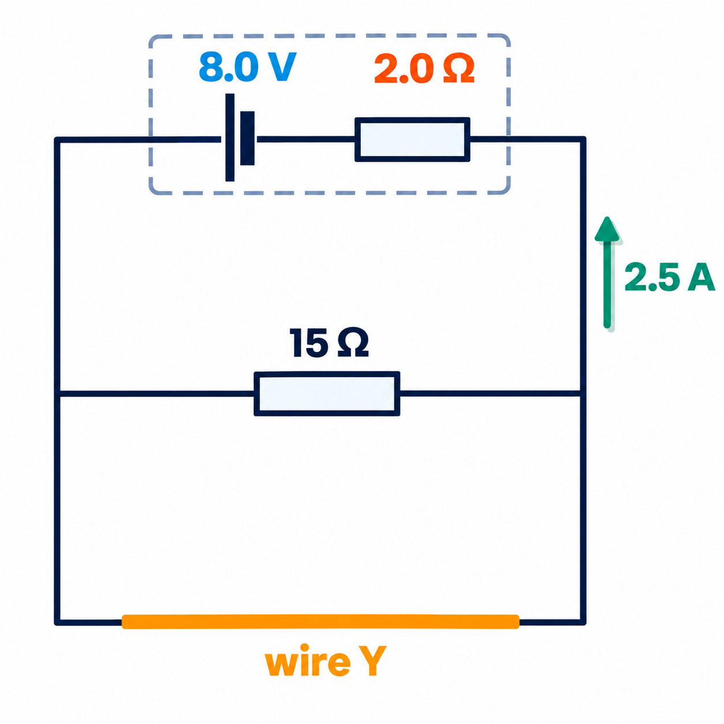
PAPER 2 STYLE · STRUCTURED QUESTION
Past paper 2 · Battery, X and wire Y (9702/22)
A battery of e.m.f. 8.0 V and internal resistance 2.0 Ω is connected to resistor X (15 Ω) in parallel with a wire Y. The current in the battery is 2.5 A.
(a) State Kirchhoff's first law and the quantity it conserves. [2]
(b)(i) Calculate the thermal energy dissipated in the battery in 5.0 minutes. [2]
(b)(ii) Calculate the terminal p.d. of the battery and the resistance of Y. [4]
(c) A new wire Z of the same length has less resistance than Y. State two possible differences and the effect on the total power produced by the battery. [3]
Topics 9 & 10 · Electricity and D.C. circuits | Cambridge International AS Level Physics 9702
46

Slide 47
MARK SCHEME STYLE SOLUTION
Past paper 2 · Solution
(a)
The sum of currents into a junction = sum of currents out of it; charge is conserved
(b)(i)
E = I²rt = 2.5² × 2.0 × 300 = 3750 J (3.8 kJ)
(b)(ii)
V = 8.0 − 2.5 × 2.0 = 3.0 V; I(X) = 3.0 / 15 = 0.20 A; I(Y) = 2.3 A; R(Y) = 3.0 / 2.3 = 1.3 Ω
(c)
Z has a larger diameter (area) or a material of smaller resistivity; total resistance falls, current rises, so the power produced (P = EI) increases
Topics 9 & 10 · Electricity and D.C. circuits | Cambridge International AS Level Physics 9702
47

Slide 48
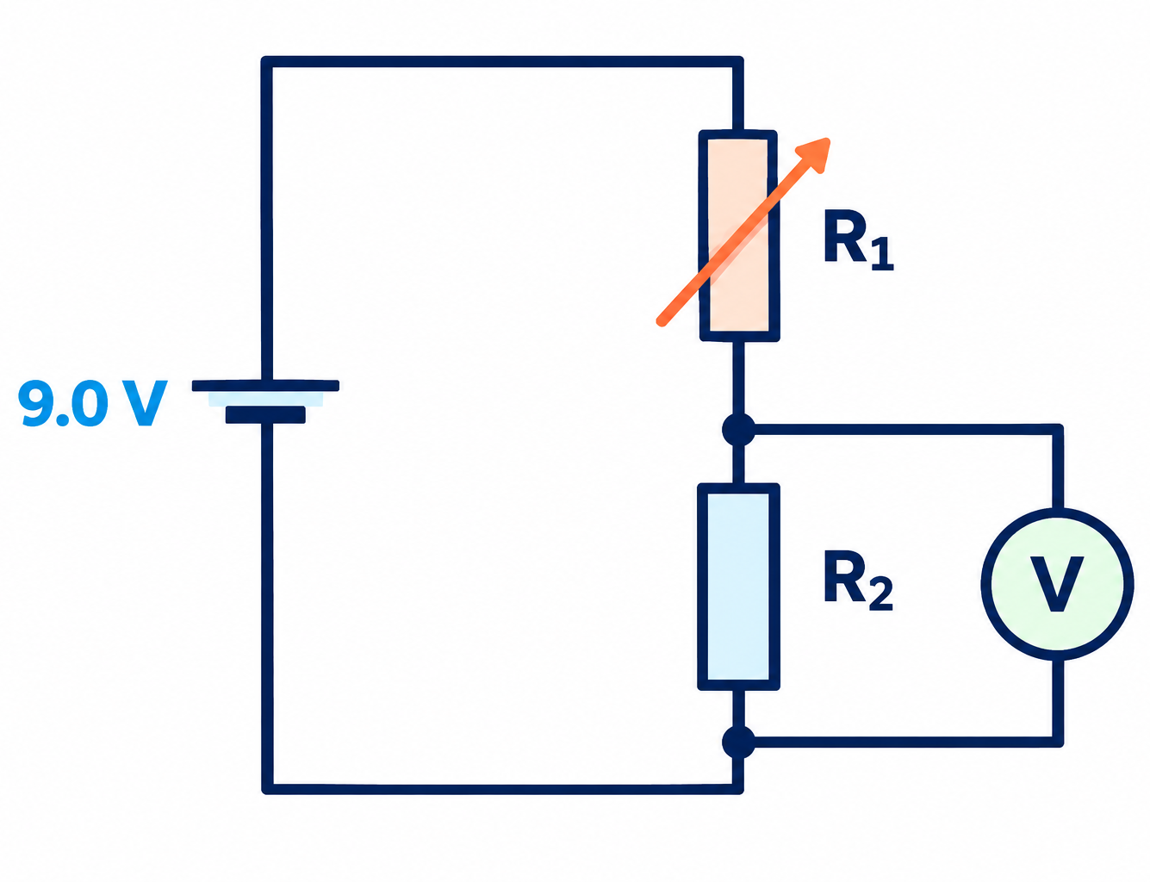
PAPER 2 STYLE · STRUCTURED QUESTION
Book question · Potential divider
This circuit shows a potential divider. The battery has negligible internal resistance (9.0 V) and the voltmeter has infinite resistance. R₁ is a variable resistor and R₂ = 470 Ω.
(a) State and explain how the voltmeter reading changes when the resistance of R₁ is increased. [2]
(b) Calculate R₁ when the voltmeter reads 2.0 V. [2]
(c) The voltmeter is replaced with one of resistance 2 kΩ. Calculate its new reading. [3]
Topics 9 & 10 · Electricity and D.C. circuits | Cambridge International AS Level Physics 9702
48

Slide 49
MARK SCHEME STYLE SOLUTION
Book question · Solution
(a)
The reading decreases: R₁ takes a larger share of the 9.0 V (the current falls, so the p.d. across R₂ falls)
(b)
2.0 / 9.0 = 470 / (470 + R₁) → R₁ = 1645 Ω ≈ 1.6 kΩ
(c)
R₂ ∥ 2 kΩ = 381 Ω; V = 9.0 × 381 / (381 + 1645) = 1.7 V (the voltmeter draws current and lowers the reading)
Topics 9 & 10 · Electricity and D.C. circuits | Cambridge International AS Level Physics 9702
49

Slide 50
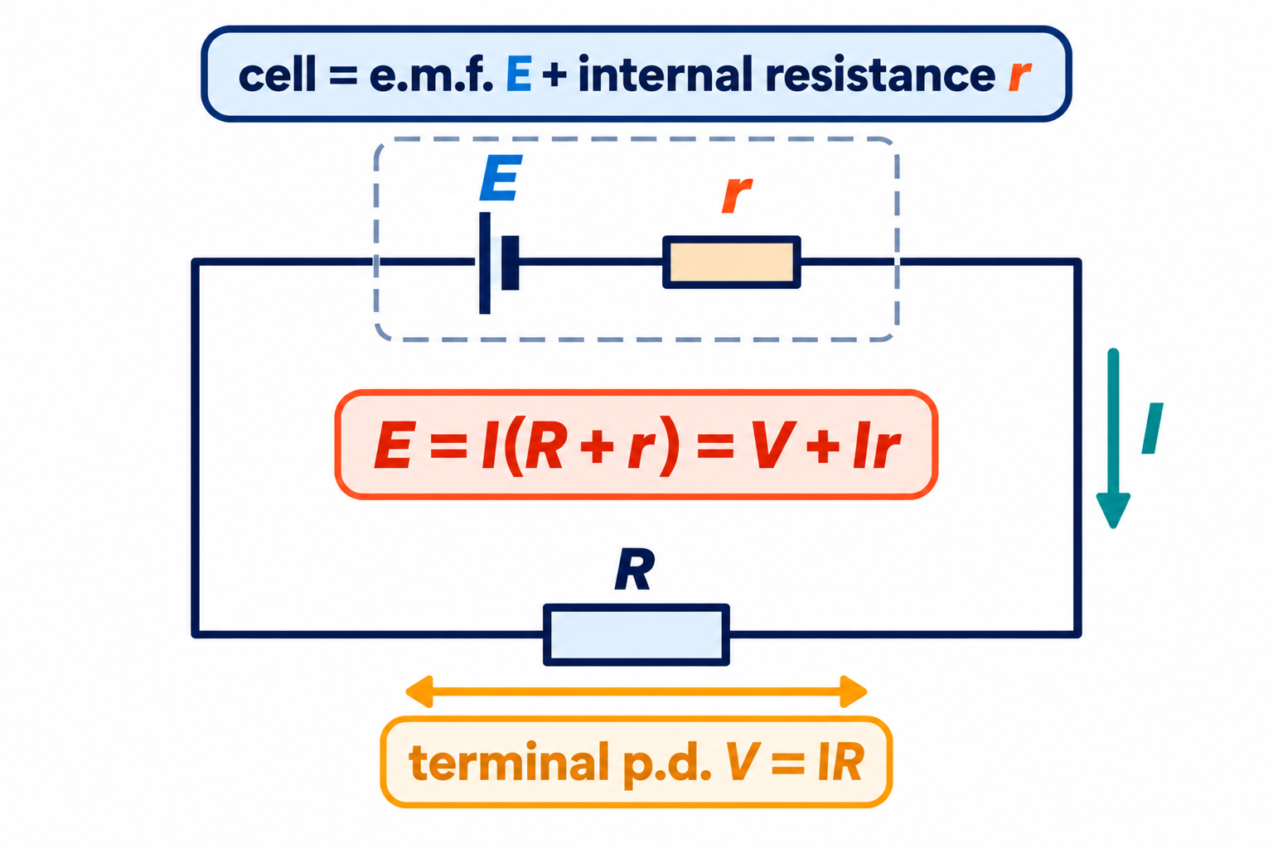
PAPER 2 STYLE · STRUCTURED QUESTION
Book question · Internal resistance
A high-resistance voltmeter placed across an isolated battery reads 3.0 V. When a 10 Ω resistor is connected across the battery, the voltmeter reading drops to 2.8 V.
(a) State the e.m.f. of the battery.
(b) Calculate the current in the circuit.
(c) Determine the internal resistance of the battery.
Topics 9 & 10 · Electricity and D.C. circuits | Cambridge International AS Level Physics 9702
50

Slide 51
MARK SCHEME STYLE SOLUTION
Book question · Solution
(a)
E = 3.0 V (open-circuit reading of a high-resistance voltmeter)
(b)
I = V / R = 2.8 / 10 = 0.28 A
(c)
lost volts = 3.0 − 2.8 = 0.2 V; r = 0.2 / 0.28 = 0.71 Ω
Topics 9 & 10 · Electricity and D.C. circuits | Cambridge International AS Level Physics 9702
51

Slide 52
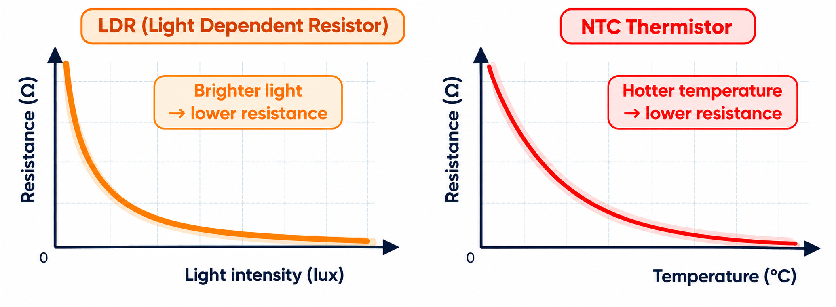
PAPER 2 STYLE · STRUCTURED QUESTION
Book question · Thermometers
The resistance of a metal wire changes with temperature, so a wire could be used to sense changes in temperature, in the same way that a thermistor is used.
(a) Suggest one advantage a thermistor has over a metal wire for this purpose.
(b) Suggest one advantage a metal wire has over a thermistor.
(c) Explain why the resistance of a metal increases with temperature while that of a semiconductor decreases.
Topics 9 & 10 · Electricity and D.C. circuits | Cambridge International AS Level Physics 9702
52

Slide 53
MARK SCHEME STYLE SOLUTION
Book question · Solution
(a)
A thermistor's resistance changes much more per degree, so it is more sensitive
(b)
A metal wire works over a much wider temperature range, and its resistance changes almost linearly (easier calibration)
(c)
Metal: ions vibrate more, more collisions, lower drift speed. Semiconductor: more electrons gain enough energy to become free, so n increases greatly
Topics 9 & 10 · Electricity and D.C. circuits | Cambridge International AS Level Physics 9702
53

Slide 54
COMMON DOUBTS & MISCONCEPTIONS
Students often ask… (1)
?
“Is current used up in a lamp?”
?
“Is e.m.f. a force?”
No. Charge is conserved: the same current flows in and out. It is ENERGY that is transferred to heat and light.
No. E.m.f. is energy transferred per unit charge (in volts), despite its name.
?
“Does a filament lamp obey Ohm's law?”
?
“Is resistance the gradient of an I–V graph?”
No. Its temperature rises with current, so its resistance increases and the I–V graph curves.
No. R = V/I at that point. Only for a straight line through the origin does this equal 1/gradient.
Topics 9 & 10 · Electricity and D.C. circuits | Cambridge International AS Level Physics 9702
54

Slide 55
COMMON DOUBTS & MISCONCEPTIONS
Students often ask… (2)
?
“Why does the terminal p.d. drop when I draw more current?”
?
“Does a thicker wire have higher resistivity?”
Lost volts Ir increase with I, so V = E − Ir decreases.
No. Resistivity is a property of the material. A thicker wire has LOWER resistance, same resistivity.
?
“In a potential divider, why does my voltmeter read low?”
?
“Does the galvanometer measure the e.m.f. at balance?”
A voltmeter with finite resistance in parallel lowers the combined resistance of that part, reducing its share of the p.d.
It shows zero current; at the null point the p.d. along the wire equals the cell's e.m.f.
Topics 9 & 10 · Electricity and D.C. circuits | Cambridge International AS Level Physics 9702
55

Slide 56
COMMAND WORDS AND MARK-SCHEME HABITS
Exam technique for electricity
Definitions
Units
p.d.: energy per unit charge (electrical → other forms); e.m.f.: other forms → electrical
convert mm² → m² (× 10⁻⁶); A h × 3600 = coulombs; kW h is energy
Kirchhoff
Graphs
state conservation of charge (1st law) and energy (2nd law); mark current directions
R = V/I at a point; V–I graph for a cell: intercept E, gradient −r
Sensors
Filament lamp
explain step by step: T ↑ → R(thermistor) ↓ → share of p.d. ↓ → Vout …
temperature ↑ → lattice vibrations ↑ → more collisions → R ↑
Topics 9 & 10 · Electricity and D.C. circuits | Cambridge International AS Level Physics 9702
56

Slide 57
KEY IDEAS TO TAKE AWAY
Electricity in one slide
Q = It, I = Anvq
P = VI = I²R
R = ρL / A
E = I(R + r)
I–V
metal: straight line · lamp: gradient falls (R rises) · diode: conducts forward only
Kirchhoff
1st: Σ I in = Σ I out (charge) · 2nd: Σ e.m.f. = Σ IR round a loop (energy)
Dividers
Vout = R₂ / (R₁ + R₂) × Vin · thermistor and LDR sensors · potentiometer null method
Topics 9 & 10 · Electricity and D.C. circuits | Cambridge International AS Level Physics 9702
57

